Slide 1



Leveraging Trinity for de novo transcriptome assembly and analysis
Cambridge, Massachusetts, USA.
CSHL Workshop
Brian Haas
Broad Institute
Notes:
Abstract:
Trinity as a Framework for De novo Transcriptome Assembly and Analysis
B. Haas*
Broad Institute (, US)
Transcriptome sequencing via RNA-Seq provides a powerful method for transcript discovery and gene expression analysis in both model and non-model organisms. De novo transcriptome assembly, as performed by our Trinity software, enables transcript discovery and analysis for organisms where reference genome assemblies are lacking or are sufficiently different from the transcriptome under study.
Since the initial development of Trinity, we have concentrated effort on integrating tools to facilitate analysis efforts beyond transcript reconstruction, including analysis of differential expression, identification and functional annotation of likely protein-coding sequences, transcript-based polymorphism discovery, and fusion gene detection such as in cancer.
Here, we describe the composition of the Trinity software and provide examples of downstream applications, in the context of reference genomes and for genome-free studies, tackling research problems across diverse eukaryotes.

Slide 2
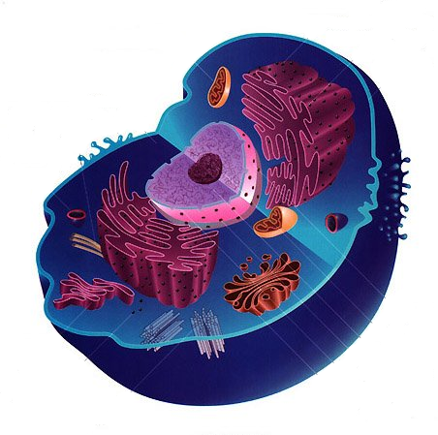
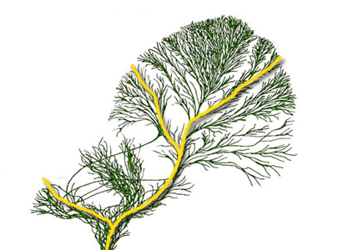
Next-gen Sequencing Transforming Modern Science
Molecular Biology of the Cell
Sequencing Methods
Chromatin structure
Histone occupancy
Transcription factor binding
DNA 3D topology
Genes and transcripts
gene content
alternative splicing
expression
RNA-editing
DNA-Seq
ChIP-Seq
RNA-Seq
Methyl-Seq
Algorithms and Software Tools
Sequence assembly
Polymorphism calling
Gene finding and
transcript reconstruction
Differential Expression analysis
Evolution
Population Genetics
Notes:
Next generation sequencing technologies are rapidly changing the way we do science.
We now have various sequencing methods and algorithms and software tools that are enabling unprecedented insights into the molecular biology of the cell, evolution, and population genetics.
To best make the most use of these technologies, it’s helpful or even necessary to have a reference genome sequence.

Slide 3
RNA-Seq as a Driving Technology
Molecular Biology of the Cell
Sequencing Methods
Chromatin structure
Histone occupancy
Transcription factor binding
DNA 3D topology
Genes and transcripts
gene content
alternative splicing
expression
RNA-editing
DNA-Seq
ChIP-Seq
RNA-Seq
Methyl-Seq
Algorithms and Software Tools
Sequence assembly
Polymorphism calling
Gene finding and
transcript reconstruction
Differential Expression analysis
Evolution
Population Genetics
Notes:
RNA-Seq has become one of the most popular applications of next generation sequencing technology, and it has the advantage that with or without a reference genome, it can provide a cost-effective method to generate significant insights into several research areas.
This is in part due to developments of software to support analyses.

Slide 4
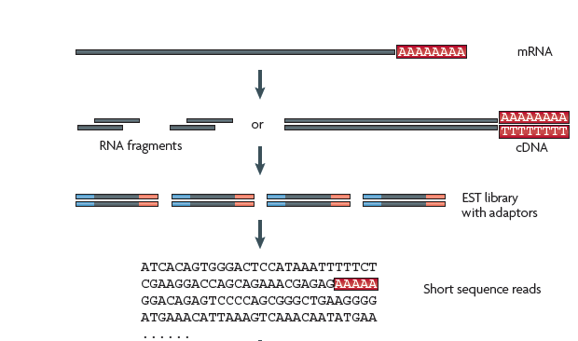
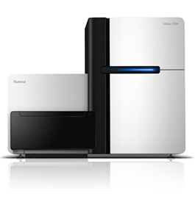
RNA-Sequencing Methodology
Computational
Reconstruction
*At Broad Institute, typically Illumina 76 or 101 base reads as paired ends
*Adapted from Wang, Gerstein, and Snyder, Nature Reviews Genetics, 2009
Notes:
The RNA-Seq method involves fragmenting full-length transcripts to generate a sequencing library, and then many short reads are sequenced, each typically representing a much smaller region of the original transcript molecule. At the Broad Institute, we usually generate 76 or 101 base illumina reads as paired fragment reads.
A primary challenge towards making use of the RNA-Seq data is to first reconstruct the original transcript from which the fragments were derived.

Slide 5
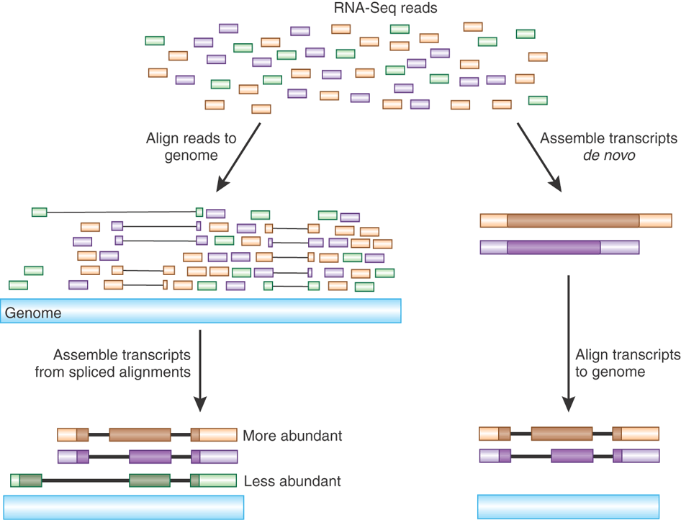
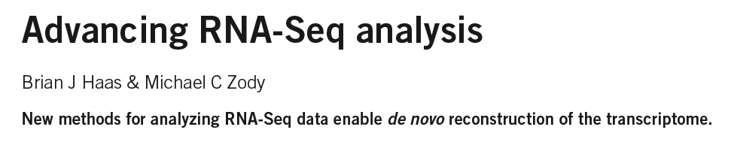
Transcript Reconstruction from RNA-Seq Reads
Nature Biotech, 2010
Notes:
Two general strategies have been explored for reconstructing transcripts from RNA-Seq reads.

Slide 6
Transcript Reconstruction from RNA-Seq Reads
Notes:
One strategy requires having a reference genome and involves first aligning reads to the genome using a spliced aligner.

Slide 7
Transcript Reconstruction from RNA-Seq Reads
Notes:
Then, the alignments, instead of the original reads, are assembled into transcript structures.

Slide 8
Transcript Reconstruction from RNA-Seq Reads
Notes:
An alternative strategy doesn’t require a reference genome and involves assembling the read sequences directly.

Slide 9
Transcript Reconstruction from RNA-Seq Reads
Notes:
Then, if a genome sequence is available, the assembled transcripts can be aligned to the genome to reveal individual introns and exons.

Slide 10
Transcript Reconstruction from RNA-Seq Reads
Trinity
Scripture
Notes:
There are several bioinformatics tools that implement these strategies. Examples of tools developed at the Broad Institute include Scripture for reconstrucing transcripts based on the genome alignments, and Trinity for de novo RNA-Seq assembly.

Slide 11
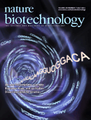

Transcript Reconstruction from RNA-Seq Reads
Trinity
Grabherr, Haas, & Yassour et al., Nature Biotechnology, 2011
How it works.
Applications of interest.
Notes:
Trinity is a software tool that I helped develop, and which we published last year in Nature Biotechnology.
In this talk, I’ll describe how Trinity works, and describe some of the applications that we aim to support.

Slide 12
Short Read Assembly Using de Bruijn Graphs
Target
….GATCAGCAGGTCCAGACGT……
….GATCAGCA
Reads
AGCAGGTCCAG
CCAGACGT……
…-GATC-ATCA-TCAG-CAGC-AGCA
De Bruijn
Graph Construction
(K=4)
Notes:
Trinity, like most all short-read assembly tools, uses a de Bruijn graph-based method to assemble sequences.
The assembly process begins by decomposing the sequencing reads into sets of overlapping kmers, and assigning each kmer as a node in the graph. In this example, we set k = 4. Each 4-mer is made a node in the graph, and the immediately overlapping k-mers are linked together by an edge.

Slide 13
Short Read Assembly Using de Bruijn Graphs
Target
….GATCAGCAGGTCCAGACGT……
….GATCAGCA
Reads
AGCAGGTCCAG
CCAGACGT……
…-GATC-ATCA-TCAG-CAGC-AGCA
De Bruijn
Graph Construction
(K=4)
AGCA-GCAG-CAGG-AGGT
-GGTC-GTCC-TCCA-CCAG
Notes:
Each read is deconstructed this way, and identical kmers are assigned to the same node in the graph.

Slide 14
Short Read Assembly Using de Bruijn Graphs
Target
….GATCAGCAGGTCCAGACGT……
….GATCAGCA
Reads
AGCAGGTCCAG
CCAGACGT……
…-GATC-ATCA-TCAG-CAGC-AGCA
De Bruijn
Graph Construction
(K=4)
AGCA-GCAG-CAGG-AGGT
-GGTC-GTCC-TCCA-CCAG
CCAG-CAGA-AGAC-GACG-ACGT-….
Notes:
Once all reads have been processed this way and the graph is complete, the original target molecule, be it a genome or a transcript, is reconstructed…

Slide 15
Short Read Assembly Using de Bruijn Graphs
Target
….GATCAGCAGGTCCAGACGT……
….GATCAGCA
Reads
AGCAGGTCCAG
CCAGACGT……
…-GATC-ATCA-TCAG-CAGC-AGCA
De Bruijn
Graph Construction
(K=4)
AGCA-GCAG-CAGG-AGGT
-GGTC-GTCC-TCCA-CCAG
CCAG-CAGA-AGAC-GACG-ACGT-….
Sequence Reconstruction
By Path Traversal
….GATCAGCAGGTCCAGACGT……
Notes:
…by traversing paths of connected nodes in the graph.

Slide 16
Contrasting Genome and Transcriptome Assembly
Genome Assembly
Transcriptome Assembly
Uniform coverage
Single contig per locus
Double-stranded
Exponentially distributed coverage levels
Multiple contigs per locus (alt splicing)
Strand-specific
Notes:
Although the underlying data structure for assembly is quite similar for genome and transcriptome assembly, there are some critical differences between the expectations of the two and that explain why tools developed for genome assembly are mostly unfit for transcriptome assembly.
Genome assemblers expect that read coverage is going to be uniform and will often discard sequences that occur at high coverage as repetitive sequences. Transcriptome assembly needs to consider a wide range of coverage levels since sequences with high coverage are more likely to represent highly expressed transcripts instead of repeats.
Genome assemblers aim to generate a single contig per locus, possibly two if tuned to separate haplotypes in a polymorphic genome assembly. There’s no such expectation in transcriptome assembly since it’s understood that single genes can generate many alternatively spliced transcripts.
Finally, in genome assembly, reads are assumed to be derived from either strand of the double-stranded DNA molecule. Given strand-specific RNA-Seq reads, Transcriptome assemblers should aim to assemble sense and antisense transcripts separately.
Trinity, of course, was developed to take all of these properties into account.

Slide 17
Trinity Aggregates Isolated Transcript Graphs
Genome Assembly
Single Massive Graph
Trinity Transcriptome Assembly
Many Thousands of Small Graphs
Entire chromosomes represented.
Ideally, one graph per expressed gene.
Notes:
A significant difference between Trinity as compared to all other genome and transcriptome assemblers is how it goes about building the graphs.
Genome assemblers (and other transcriptome assemblers that are built on top of genome assemblers) build single large graphs.
Trinity instead tries to partition the data into many thousands of small graphs, ideally one graph per expressed gene. This is possible because most expressed transcripts are expected to be non-overlapping.
Having many small graphs lends itself to massive parallel processing, which is an added computational benefit.

Slide 18
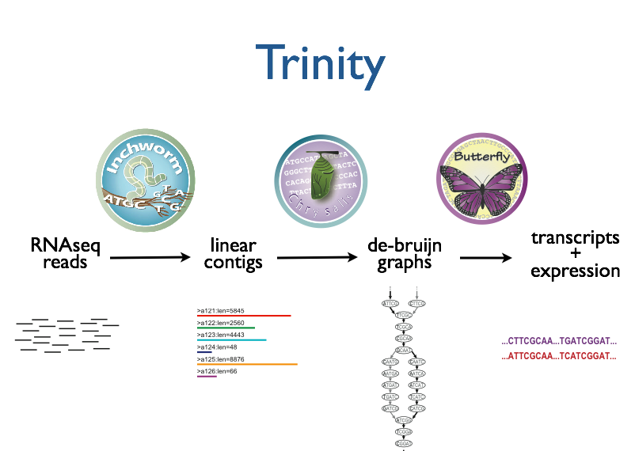



Trinity – How it works:
RNA-Seq reads
Linear
contigs
de-Bruijn
graphs
Transcripts
+
Isoforms
Thousands of disjoint graphs
Notes:
Here’s a high-level overview of the whole Trinity assembly algorithm.
We call it Trinity because it involves three major steps that we’ve built into three separate software modules.
It starts with Inchworm, which first assembles the RNA-Seq data into linear contigs.
Then, Chrysalis groups contigs that are related due to alternative splicing or gene duplication and constructs de bruijn graphs.
Finally, Butterfly examines reads in the context of the de bruijn graphs, and reports the final full-length transcripts and isoforms of transcripts.

Slide 19
Inchworm Algorithm
Decompose all reads into overlapping Kmers (25-mers)
Identify seed kmer as most abundant Kmer, ignoring low-complexity kmers.
Extend kmer at 3’ end, guided by coverage.
G
A
GATTACA
9
T
C
Notes:
The inchworm algorithm works as follows:
It first decomposes reads into a catalog of overlapping Kmers. By default we use overlapping 25-mers.
The single most abundant kmer with reasonable sequence complexity is identified as a seed kmer.
This seed kmer is then extended at the 3’ end guided by the coverage of overlapping kmers.
For each extension, there are four possible kmers, each ending with one of the four possible nucleotides.

Slide 20
Inchworm Algorithm
G
4
A
GATTACA
9
T
C
Notes:
Each of the possible overlapping kmers is looked up in the kmer catalog to determine their frequency within the reads.
In this toy example, the kmer ending with ‘G’ is found 4 times.

Slide 21
Inchworm Algorithm
G
4
A
GATTACA
1
9
T
C
Notes:
‘A’ is found once.

Slide 22
Inchworm Algorithm
G
4
A
GATTACA
1
9
T
0
C
Notes:
The kmer ending with ‘T’ doesn’t exist in the reads, so it has a count of zero.

Slide 23
Inchworm Algorithm
G
4
A
GATTACA
1
9
T
0
C
4
Notes:
And the kmer ending with ‘C’ is found 4 times.

Slide 24
Inchworm Algorithm
G
4
A
GATTACA
1
9
T
0
C
4
Notes:
In this case we have a tie.

Slide 25
Inchworm Algorithm
G
A
0
5
T
1
G
4
C
A
0
GATTACA
1
9
T
0
G
C
1
4
A
1
C
T
1
1
Notes:
When we encounter a tie, we explore the tied paths recursively to find the extension providing the highest cumulative coverage.

Slide 26
Inchworm Algorithm
G
A
0
5
T
1
G
4
C
A
0
GATTACA
1
9
T
0
G
C
1
4
A
1
C
T
1
1
Notes:
In this case, the extension of two overlapping kmers ending with an ‘A’ provides the highest scoring path, and so the other paths are ignored.

Slide 27
Inchworm Algorithm
A
5
G
4
GATTACA
9
Notes:
Extensions continue to occur in this way until there are no more kmers that provide for an extension.

Slide 28
Inchworm Algorithm
A
5
C
G
0
4
T
0
GATTACA
A
9
6
G
1
Notes:
Then, we extend from right to left in the same manner, following the path of greatest coverage.

Slide 29
Inchworm Algorithm
A
5
G
4
GATTACA
A
9
6
A
7
Report contig: ….AAGATTACAGA….
Remove assembled kmers from catalog, then repeat the entire process.
Notes:
Once the extension completes, the assembled contig is reported.
--transition—
The kmers found in the contig are removed from the kmer catalog, and the entire process is repeated starting from a new seed.

Slide 30

Inchworm Contigs from Alt-Spliced Transcripts
Notes:
Inchworm performs very well at reconstructing full-length transcripts, but in the case of alternative splicing, inchworm alone is unable to reconstruct full-length transcripts for each of the isoforms.
This is because it assembles contigs from unique kmers and the sequences shared between isoforms can be reported in only one contig.

Slide 31
Inchworm Contigs from Alt-Spliced Transcripts
Notes:
Inchworm will often report a more highly expressed isoform as a single full-length contig.

Slide 32
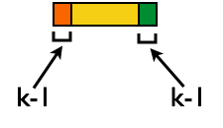
Inchworm Contigs from Alt-Spliced Transcripts
+
Notes:
And the unique regions of alternatively spliced isoforms are reported as separate contigs.

Slide 33
Inchworm Contigs from Alt-Spliced Transcripts
+
Notes:
Although these inchworm contigs lack complete kmers in common, they maintain partial kmer overlap at points where the isoforms diverge.
The smaller contig can still be associated with the larger contig based on these partial kmers of length k-1, and we can find reads to support the junction.
The Chrysalis tool, in the next step, exploits these partial kmers to regroup related contigs.

Slide 34
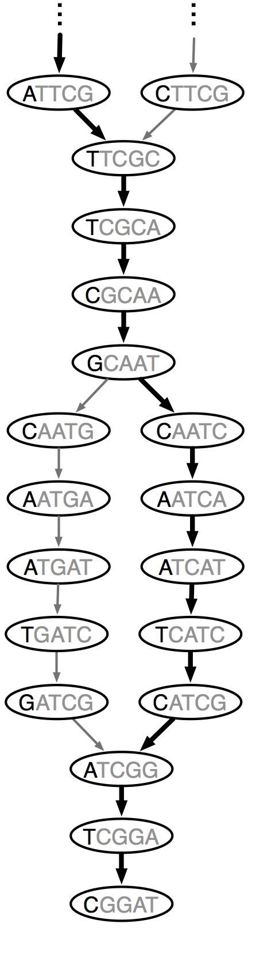

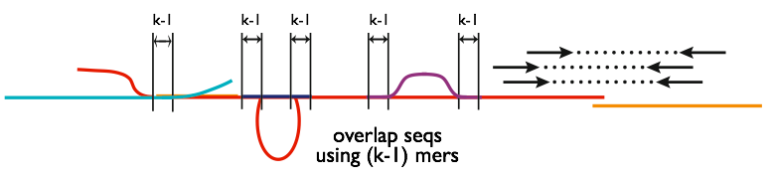
Chrysalis
Integrate isoforms
via k-1 overlaps
Build de Bruijn Graphs
(ideally, one per gene)
Notes:
In the next step, Chrysalis clusters related contigs based on these k-1mer overlaps.
Chyrsalis also leverages read pairing information to join minimally overlapping contigs.
After identifying the connected inchworm contigs, it constructs a separate de Bruijn graph for each group.
(The de Bruijn graph represents the overlaps between adjacent kmers in the sequences with branches at sequencing variations.)
In many cases, we end up with one graph per gene, with each graph representing the transcriptional complexity at that locus.
These graphs can then be processed in a parallel fashion by the next step involving Butterfly.

Slide 35
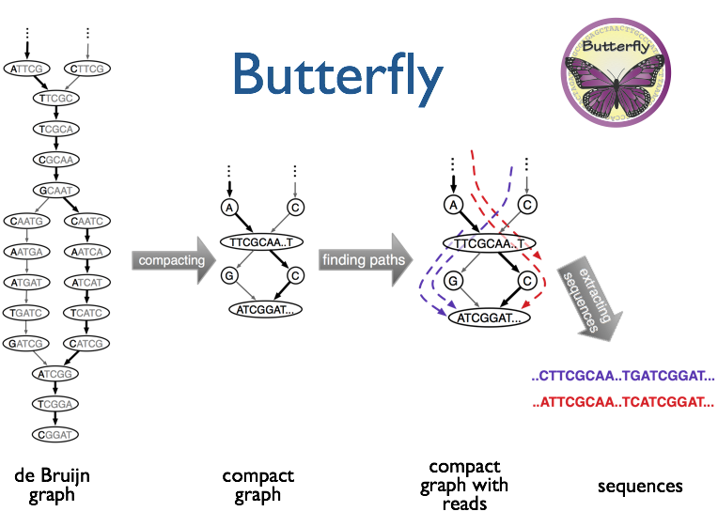
(isoforms and paralogs)
Notes:
Butterfly operates on each of these graphs independently.
It first compacts the de Bruijn graph by collapsing the unbranched streteches.
It then threads the original sequencing reads into the graph, tracking the paths occupied by the reads and the pairings.
Butterfly then reports the most probable paths through the graph supported by the reads and read pairings, emitting full-length transcripts for isoforms and paralogs.

Slide 36
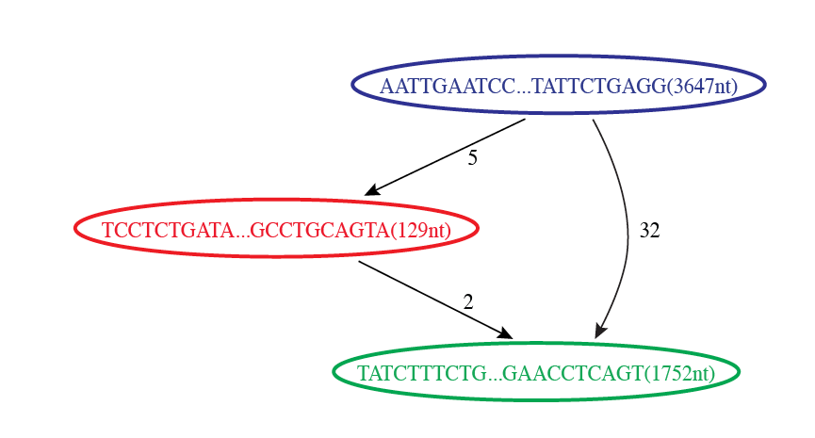

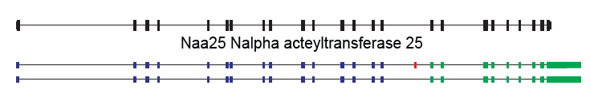
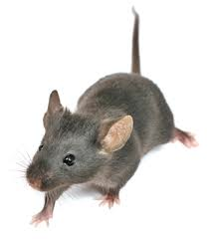
Reconstruction of Alternatively Spliced Transcripts
Butterfly’s Compacted Sequence Graph
Reconstructed Transcripts
Aligned to Mouse Genome
Notes:
Branching patterns and bulges in the graph result from variations that are found among related sequences, such as due to alternative splicing.
For example, in this simple case, Butterfly compacted the de Bruijn graph into three nodes, and transcripts can be reconstructed by following either of two paths.

Slide 37
Reconstruction of Alternatively Spliced Transcripts
Butterfly’s Compacted Sequence Graph
Reconstructed Transcripts
Aligned to Mouse Genome
Notes:
By traversing the path from the top blue node to the bottom green node, we generate a single transcript sequence.

Slide 38
Reconstruction of Alternatively Spliced Transcripts
Butterfly’s Compacted Sequence Graph
Reconstructed Transcripts
Aligned to Mouse Genome
Notes:
By traversing the alternative path through the red node, we generate another transcript sequence. This second transcript shares the blue and green segments, but contains an additional internal red segment.

Slide 39
Reconstruction of Alternatively Spliced Transcripts
Butterfly’s Compacted Sequence Graph
Reconstructed Transcripts
Aligned to Mouse Genome
(Reference structure)
Notes:
From mapping the transcripts to the reference genome sequence we can see that the inserted sequence actually corresponds to a cassette exon that is alternatively spliced, and novel given that it wasn’t found in the reference transcript structure.

Slide 40
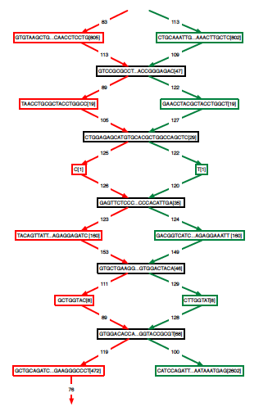
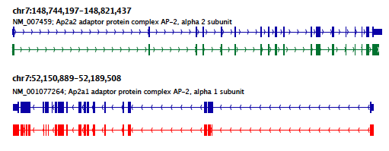
Teasing Apart Transcripts of Paralogous Genes
Ap2a1
Ap2a2
Notes:
Some transcript graphs are far more complex.
Here we have an example of two such transcripts derived from paralogous genes that became intertwined in the compacted graph due to stretches of sequence identity among segments of the transcripts.
Shared sequences are represented by the central sequence nodes and paralog-specific sequences are represented by branched nodes.
By tracing consistent paths of reads through the graph, Butterfly is able to tease apart the paralogous gene sequences and report the individual transcripts. In this case, the green path yields one of the transcripts and the red path yields the other.

Slide 41
Teasing Apart Transcripts of Paralogous Genes
Ap2a1
Ap2a2
Notes:
These transcripts, when mapped to the mouse genome match perfectly with the reference gene structures.

Slide 42

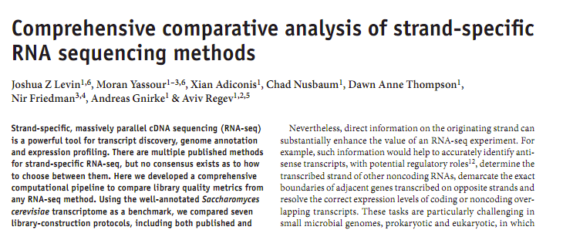
Strand-specific RNA-Seq is Preferred
Computationally: fewer confounding graph structures:
ex. Forward != reverse complement
(GGAA != TTCC)
Biologically: separate sense vs. antisense transcription
‘dUTP second strand marking’ identified as the leading protocol
Notes:
Strand specific rna-seq is the preferred substrate for transcriptome assembly.
Computationally, there are fewer confounding graph structures since forward kmers and the reverse complement kmers are treated as distinct.
Biologically, it’s important because it allows the separation of sense and antisense transcription.
Our group at the Broad performed a study of the various methods for generating strand-specific RNA-Seq, and we found the ‘dUTP second strand marking’ method to be the leading protocol.
We routinely generate strand-specific RNA-Seq as our default protocol at the Broad, and there are now kits available that make the approach readily accessible.

Slide 43
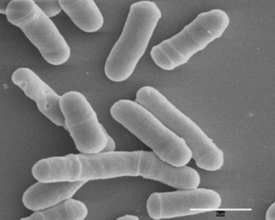
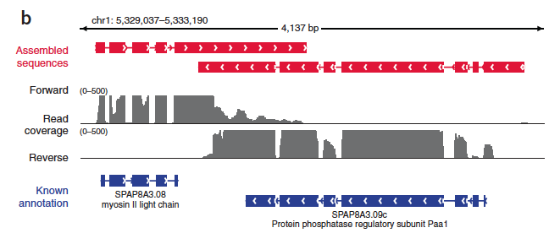
Overlapping UTRs from Opposite Strands
Schizosacharomyces pombe
(fission yeast)
Notes:
Strand-specific RNA-Seq is tremendously useful when applied to organisms that have compact genomes.
Here’s an example from Schizosaccharomyces pombe (fission yeast) where we have two known genes that are transcribed on opposite strands and point toward each other.
We have strand specific rna-seq and the coverage plots for each strand are shown above. From the coverage plots, you can see that there’s overlap in the coverage in their UTR regions, and if we didn’t have strand-specific data, then we’d reconstruct a single transcript that covers both genes. Because we have the strand-specific data, though, Trinity is able to separately reconstruct these transcripts, allowing for overlap among their UTRs.

Slide 44
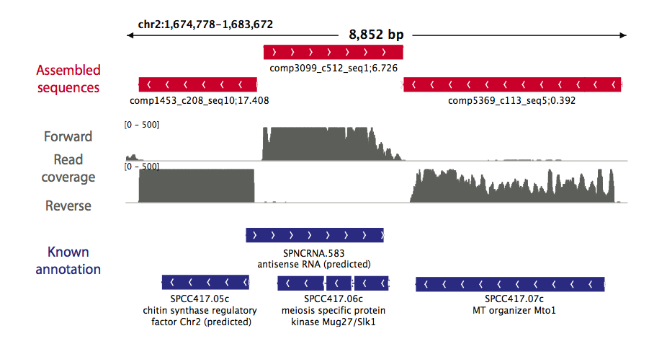
Antisense-dominated Transcription
Notes:
Here’s another example in fission yeast that highlights the importance of strand-specific rna-seq.
This region of the genome encodes three genes that are all encoded on the same strand. From the rna-seq coverage plots, we can see that the two genes on the end are transcribed on their coding strand, but the central gene encoding a meiosis specific protein kinase is dominated by transcription on the opposite strand, and antisense transcription is thought to play an important role in the regulation of meiotic genes in fission yeast. This would have gone unnoticed if we hadn’t used strand-specific rna-seq.

Slide 45
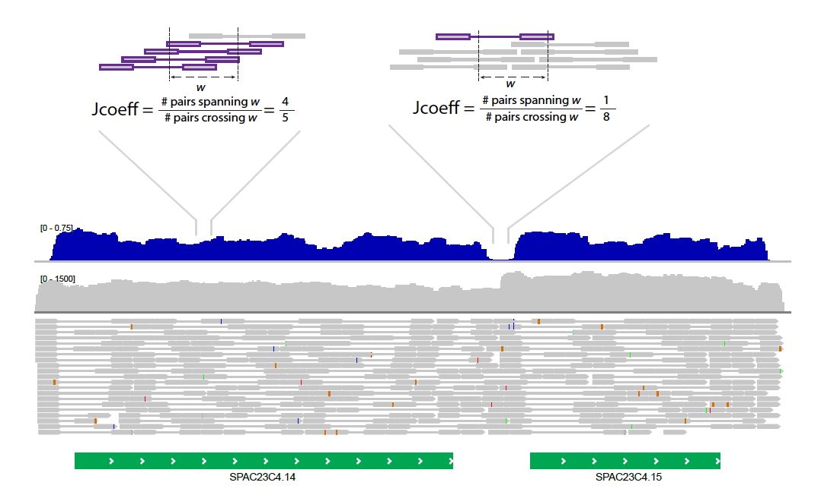
* Use the Jaccard Clip Option *
Compact genomes and Not using strand-specific data = fusion transcripts
Jaccard coeff
Read coverage
Read alignments
genes

Slide 46
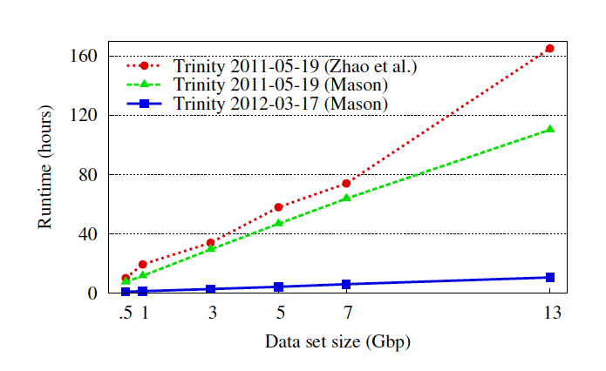
Post-publication of Trinity
Since May, 2011:
Approx. 750 software downloads per month
More than 100 literature citations
Open Source software development contributions from developers world-wide.
Trinity is now 10x faster!
Notes:
Since our publication of Trinity last May, it has been successfully used by large numbers of researchers worldwide.
We’ve had ~750 software downloads each month, there are over 100 literature citations to it, and continued software maintenance and development as an open source software project has attracted a number of other contributors to the codebase, and this has led to great increases in runtime performance.
Shown here is a plot that compares the runtime of the original version of Trinity as a function of data size, and as run on a couple of different systems, to the current version, which we find is about 10x faster that the original.
http://dl.acm.org/citation.cfm?id=2335755.2335842&coll=DL&dl=GUIDE

Slide 47

Trinity as a foundation for transcriptomics in diverse organisms
Differential Expression
Alternative Splicing
SNPs & Alleles
RNA-Seq
Coding annotations
Comparative Transcriptomics
Fusion transcripts (Cancer)
Support proteomic studies
Notes:
Transcript reconstruction really represents the ‘end of the beginning’
in that there are a number of different downstream studies that one might want to pursue.
In addition to further improving the Trinity software so that it works better and faster, we aim to facilitate or enable the full range of downstream applications.
We have built-in support for differential expression analysis and have verified that we can obtain results that are on par with using reference genome annotations.
I’ve already shown how we’re resolving alternative splice variants.
It’s possible to call SNPs with high sensitivity, and we’ve identified cases of allele-specific expression.
We recently incorporated a tool to extract likely coding regions from Trinity transcripts, which further enables comparative transcriptome analyses such as ortholog identification.
These last two areas are new developments that I’ll describe in more detail, starting with Fusion transcripts in cancer.

Slide 48
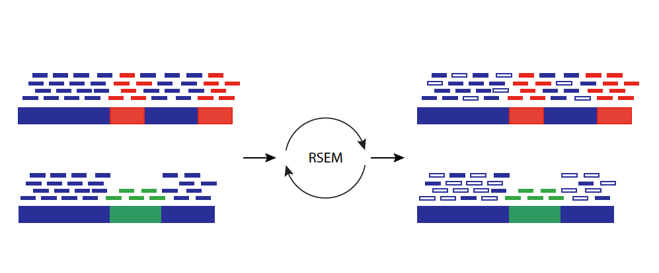
Abundance Estimation Using Expectation Maximization
RSEM fractionally allocates multi-mapped reads according to maximum likelihood
RSEM: accurate transcript quantification from RNA-Seq data with or without a reference genome.
Bo Li and Colin N Dewey.
BMC Bioinformatics. 2011; 12: 323.

Slide 49
Normalized Expression Values
Normalized for both length of the transcript and total depth of sequencing.
Number of RNA-Seq Fragments Per Kilobase of transcript per total Million fragments mapped
FPKM
Note, RPKM : Reads per … instead of Fragments is often used with single-end reads.

Slide 50
RSEM Abundance Estimates
0 transcript_id
1 gene_id
2 length
3 effective_length
4 expected_count
5 TPM
6 FPKM
7 IsoPct
comp100_c0_seq1
comp100_c0
727
534.74
14.00
328.11
532.77
100.00

Slide 51
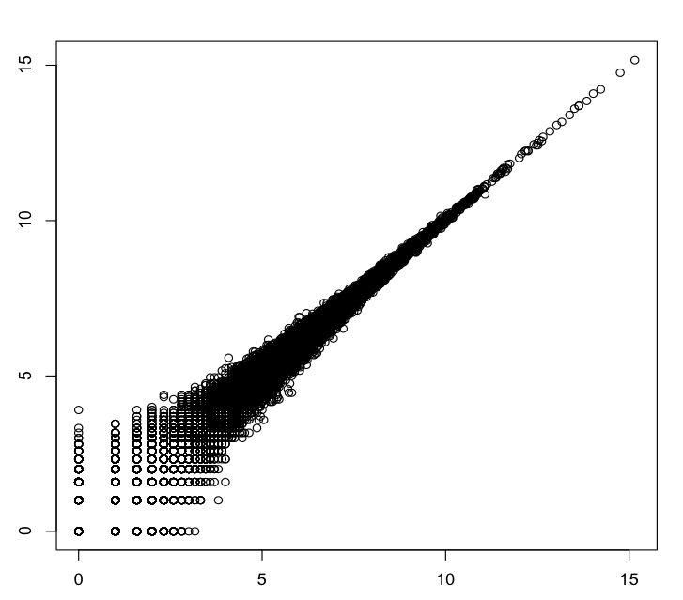
Technical Replicates
R^2=0.999
Log2(rep2_counts+1)
Kidney rna-seq samples
Log2(rep1_counts+1)
Data from Marioni et al. [2008]

Slide 52
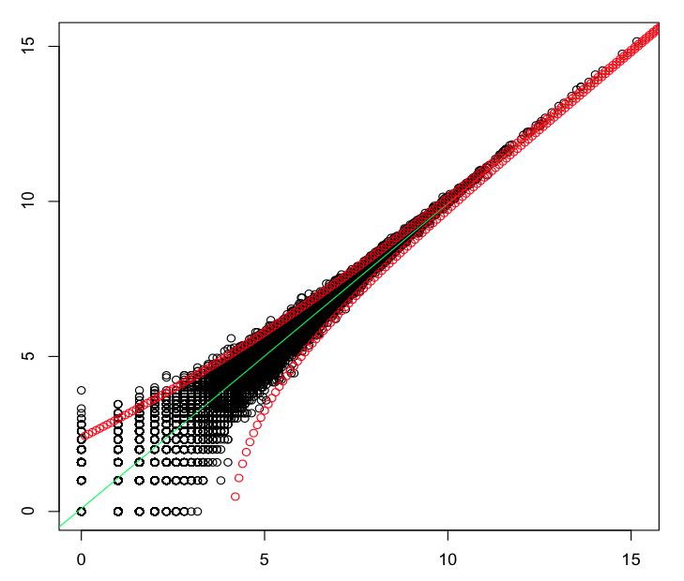
Technical Replicates
Variation observed matches expectations due to random sampling (Poisson distribution)
R^2=0.999
Log2(rep2_counts+1)
Poisson, 4-fold stdev pts shown
Kidney rna-seq samples
Log2(rep1_counts+1)
Data from Marioni et al. [2008]

Slide 53
Identifying Differentially Expressed Transcripts
Statistical tests performed on fragment counts (not FPKM values).
Given observed read counts for a transcript in each of two samples, what’s the probability they were derived from the same distribution (null hypothesis)? (ex. Fishers exact test)
If (P <= 0.05), significantly different
Don’t forget to adjust P-values due to false discovery rate (FDR) resulting from running many (thousands of) statistical tests. (ex. use Q-values)

Slide 54
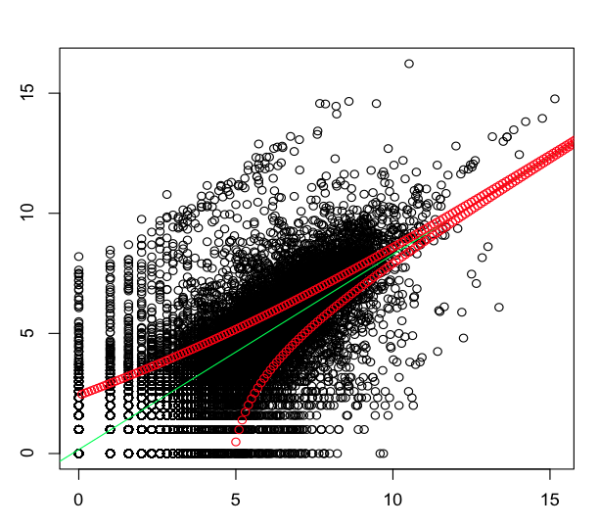
Kidney vs. Liver
Log2(liver+1)
Log2(kidney+1)

Slide 55
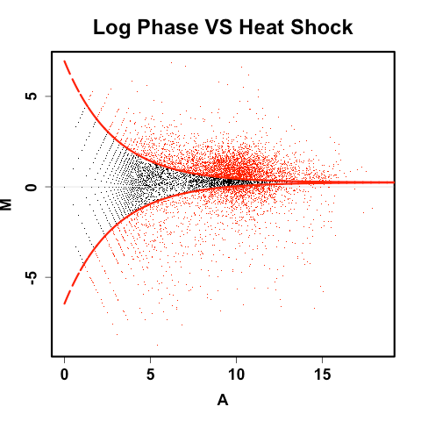
Increased Power for Identifying Differentially Expressed Transcripts With Deeper Sequencing
MA plot: log(Counts) vs. log(Fold change)
Log2(fold change)
* 2-fold is NOT stat significant here.
* 2-fold is stat significant here.
Average log2(counts)

Slide 56
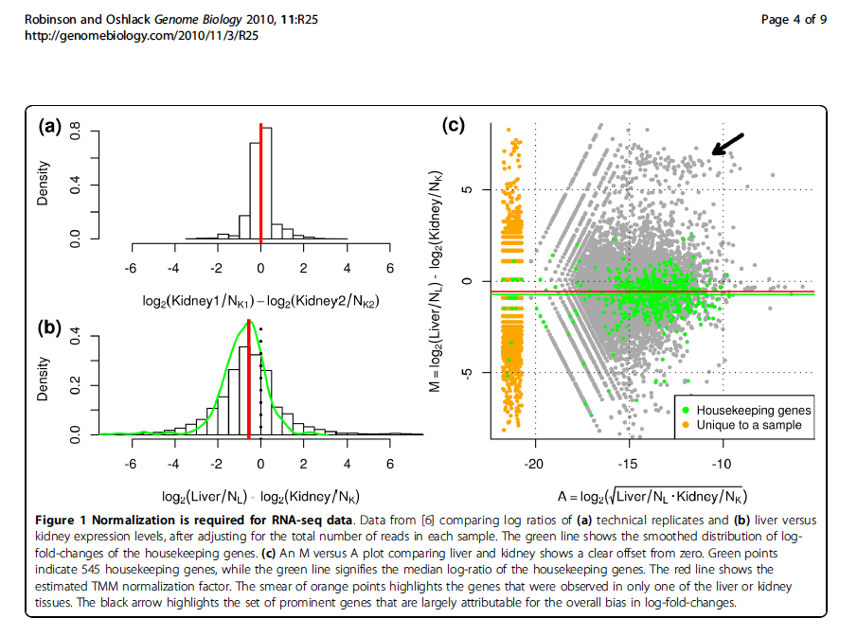
Normalization Required Otherwise, housekeeping genes look diff expressed due to sample composition differences
Subset of genes highly expressed in liver
Technical replicates
Liver - kidney
Robinson and Oshlack, Genome Biology, 2010
Notes:
Pushes relative concentration of the other liver transcripts down.

Slide 57
Differential Expression Pipeline
Sample_A
Sample_B
Sample_C
Combined samples
Align reads to Trinity transcripts using Bowtie
Trinity Assembly
Estimate transcript abundance using RSEM
Statistical analysis to identify significantly differently expressed transcripts using Bioconductor

Slide 58
Statistical Analysis Software for Identifying Differentially Expressed Transcripts
Bioconductor
EdgeR
DEGseq
DESeq
And others…

Slide 59
Examples of Results (example edgeR)
comp217_c0_seq1
6.69056684523186
16.1146897543805
2.06844466442231e-15
9.01969581996253e-13
0 logFC
1 logCPM
2 PValue
3 FDR
(expression level)

Slide 60
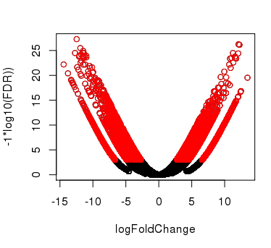
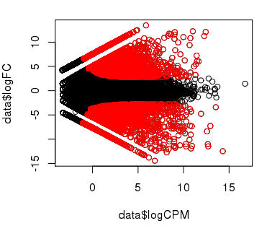
Plotting Pairwise Differential Expression Data
Volcano plot
( fold change vs. significance)
MA plot
(abundance vs. fold change)
(expression level)
Significantly differently expressed transcripts have FDR <= 0.001
(shown in red)
No replicates available, so modeled by edgeR using the Negative Binomial with dispersion manually set to 0.1
Notes:
data= read.table("CNS_vs_Mus.results.txt")
signif = data$FDR<= 0.001
plot(data$logFC, -1*log(data$FDR,10), xlab="logFoldChange", ylab="-1*log10(FDR))")
points(data$logFC[signif], -1*log(data$FDR[signif],10), col='red')
plot(data$logCPM, data$logFC)
points(data$logCPM[signif], data$logFC[signif], col='red')

Slide 61
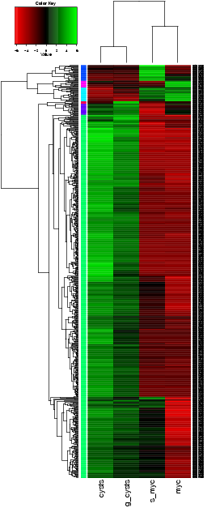
Comparing Multiple Samples
Heatmaps provide an effective tool for navigating differential expression across multiple samples.
Clustering can be performed across both axes:
-cluster transcripts with similar expression patters.
-cluster samples according to similar expression values among transcripts.

Slide 62
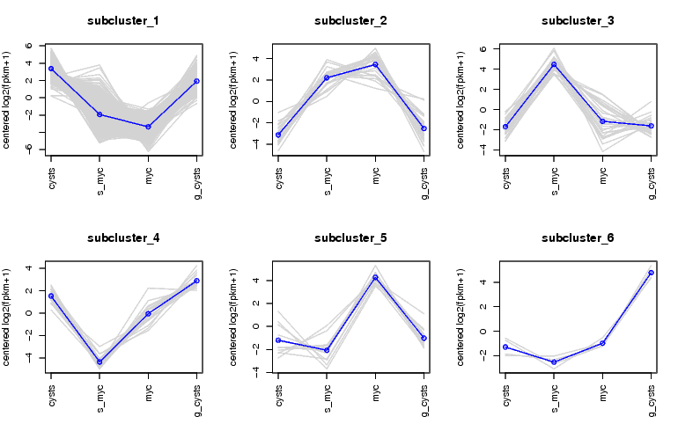
Examining Patterns of Expression Across Samples
Can extract clusters of transcripts and examine them separately.

Slide 63
Hands-on Tutorial
Trinity
De novo assembly using Trinity
Bowtie and RSEM for abundance estimation
edgeR for differential expression analysis

