Slide 1
RNA-Seq Workshop Using Tuxedo and Trinity for Transcript Reconstruction and Analysis
Software and Data Installation Using VirtualBox

Slide 2
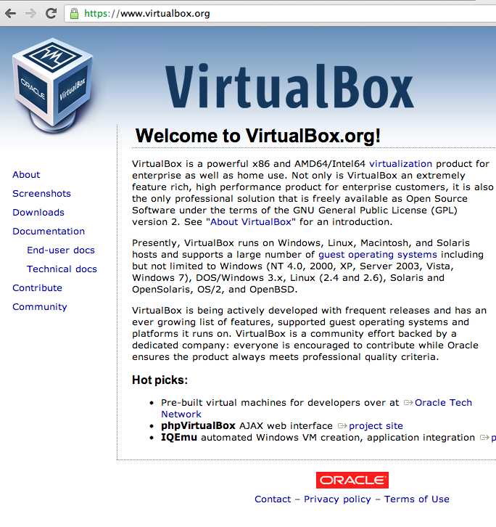
Download and Install VirtualBox http://virtualbox.org

Slide 3
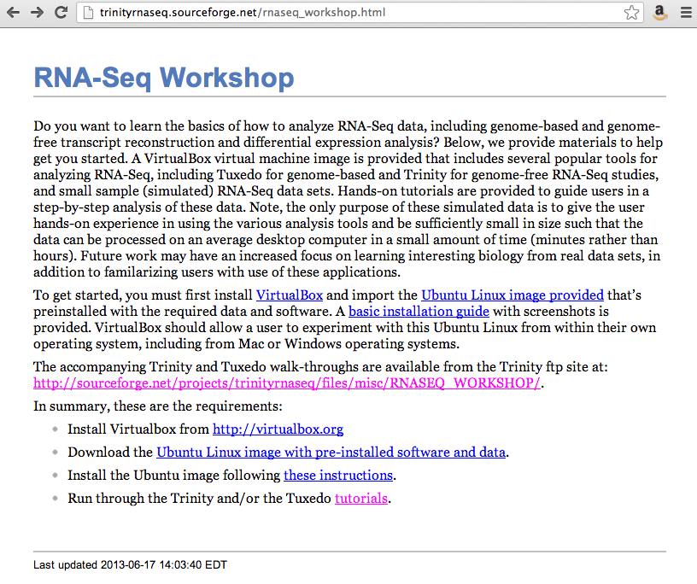
Download the RNA-Seq Workshop Virtual Machine (VM) Image and Related Materials
http://trinityrnaseq.sourceforge.net/rnaseq_workshop.html
Download
Materials
(Ubuntu_RNASeqWorkshop.ova)
Note: This is the installation guide mentioned above.

Slide 4
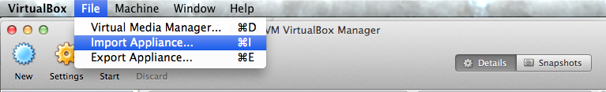
Run VirtualBox and Import Appliance

Slide 5
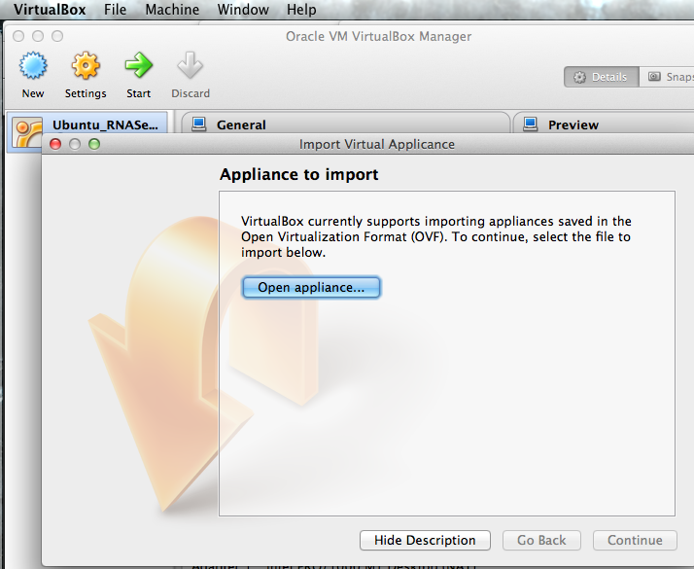
Next, click the ‘Open appliance…’ button

Slide 6
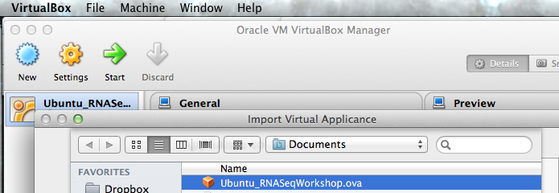
Select the Ubuntu_RNASeqWorkshop.ova file you downloaded earlier.
(note, the .ova file may be named differently depending on workshop VM release)

Slide 7
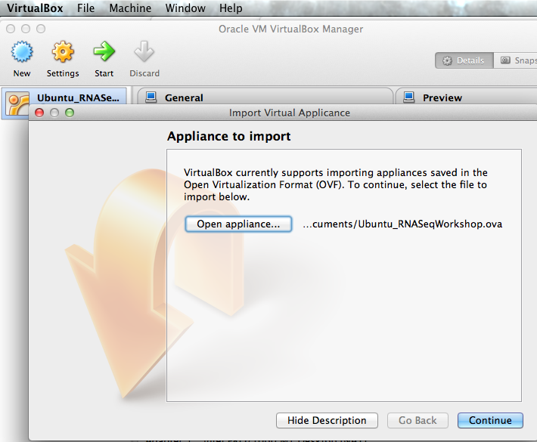
Click ‘Continue’

Slide 8
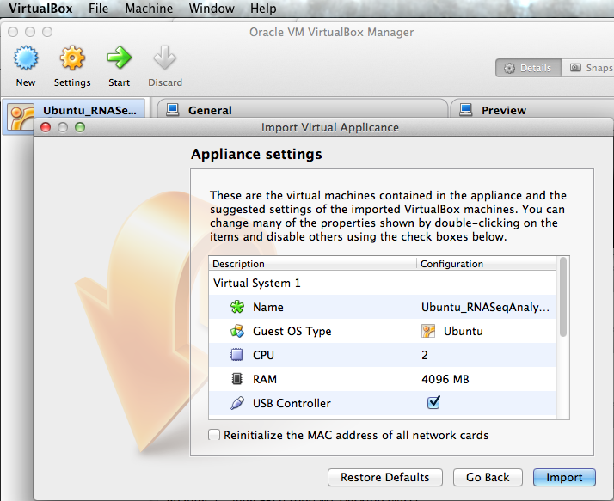
Click ‘Import’

Slide 9
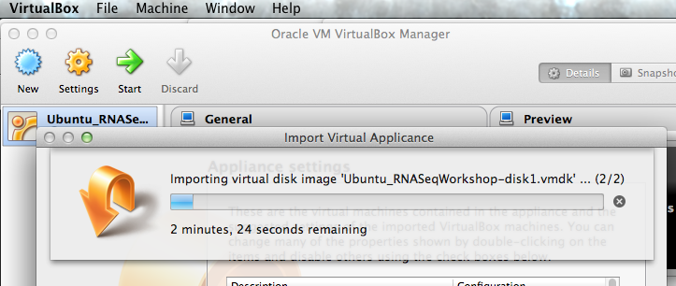
This import step can take a few minutes.

Slide 10
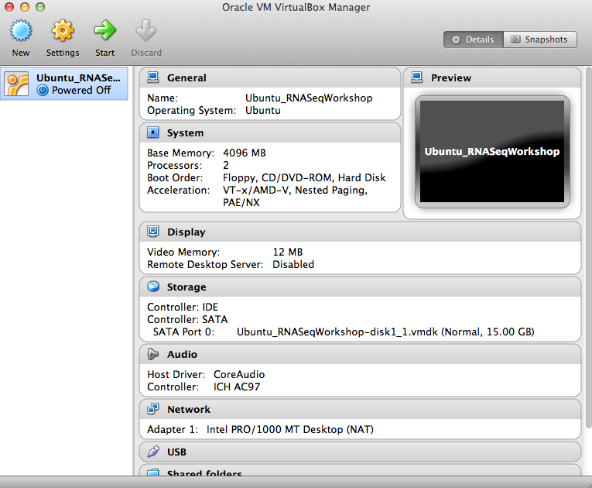
Select the Ubuntu_RNASeqWorkshop entry on the left, and click the Start button at top.

Slide 11
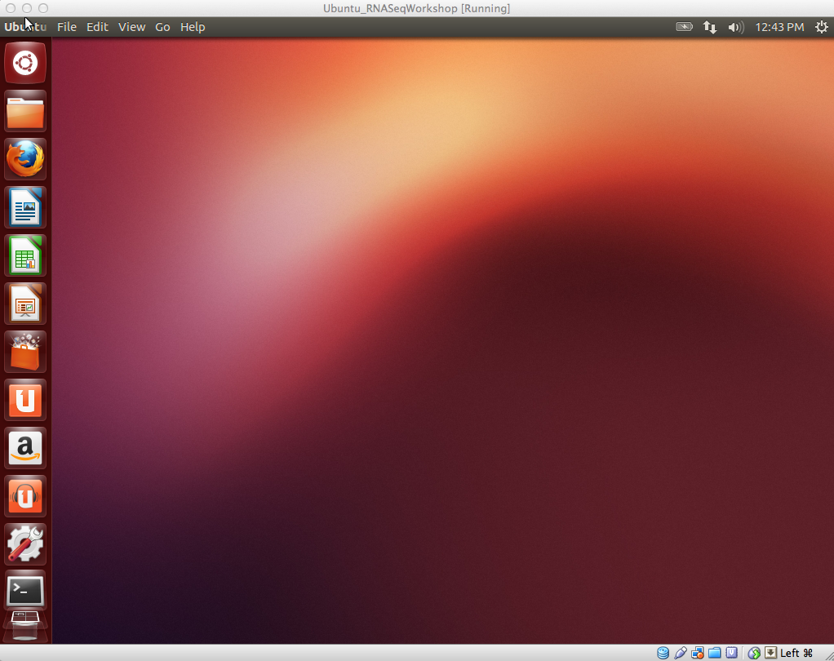
Ubuntu Linux should load. Click the ‘terminal’ icon on the left to open a terminal window.

Slide 12
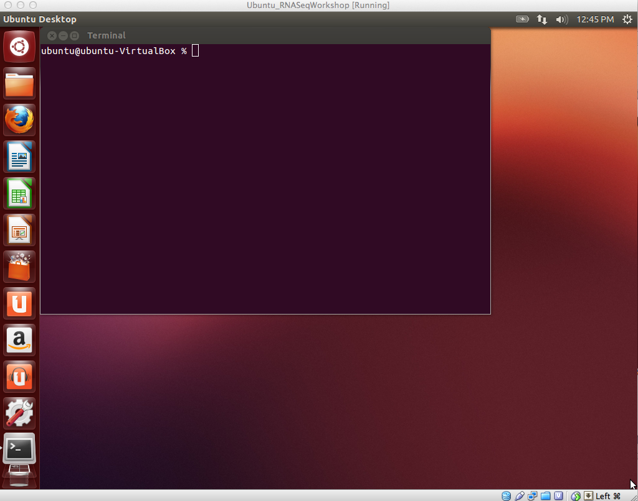
Terminal window should appear.

Slide 13
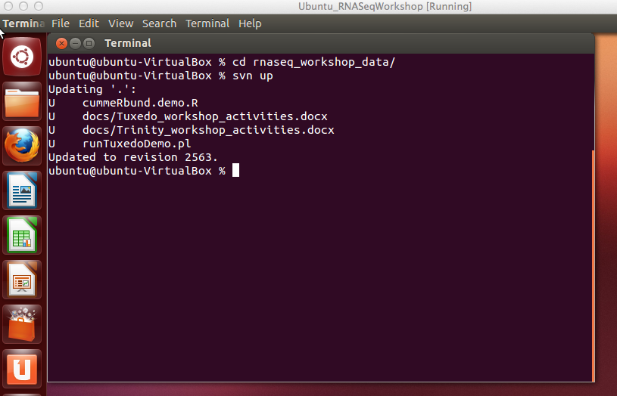
Enter the rnaseq_workshop_data/ directory, and update the contents:
(note, may be rnaseq_workshop_{year}/ in newer versions )

Slide 14
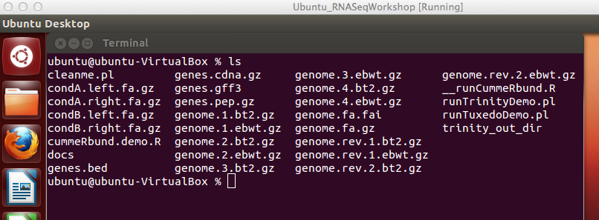
Data and demo scripts provided:
Lots of files, but the most important data files used here are:
Paired-end RNA-Seq reads for two conditions (A, B):
condA.left.fa and condA.right.fa
condB.left.fa and condB.right.fa
Genome sequence:
genome.fa

Slide 15
Notes on the VM configuration
All required software tools come pre-installed
Transcript reconstruction:
Trinity and Tuxedo (bowtie, tophat, cufflinks, cuffdiff, cummeRbund)
Visualization
IGV
Utilities leveraged during RNA-Seq processing and analysis:
samtools, GMAP, R/Bioconductor, etc.

Slide 16
Notes on the VM Environment
All required software tools are available via the PATH setting. (so just type ‘tophat’ or ‘cufflinks’ at the command prompt).
Additional environmental variables are set to facilitate access to Trinity and IGV
$TRINITY_HOME = /path/to/Trinity/installation/directory
$IGV = /path/to/IGV/installation/directory
These environmental variables are used throughout the hands-on tutorials.

Slide 17
Automating Tutorial Execution
*See documents for hands-on activities for Trinity and Tuxedo
Automating Trinity Activities:
% runTrinityDemo.pl
Automating Tuxedo Activities:
% runTuxedoDemo.pl

