Slide 1
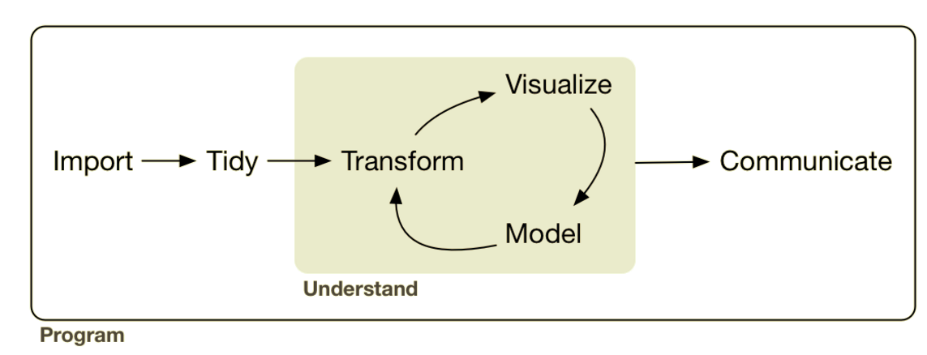
Analysis: Data Transformation cont…
Lesson Objective: Be able to mutate and summarize within groups.

Slide 2

“5 verbs + one other tool can do 90% of all your data manipulation.”
select | Pick columns by name
filter | Grab rows matching a condition
arrange | Reorder rows
mutate | Add new columns/variables
summarize | Reduce variables to values
group_by | Split-Apply-Combine

Slide 3
“5 verbs + one other tool can do 90% of all your data manipulation.”
Last Session
select | Pick columns by name
filter | Grab rows matching a condition
arrange | Reorder rows
mutate | Add new columns/variables
summarize | Reduce variables to values
group_by | Split-Apply-Combine

Slide 4
“5 verbs + one other tool can do 90% of all your data manipulation.”
This Session
select | Pick columns by name
filter | Grab rows matching a condition
arrange | Reorder rows
mutate | Add new columns/variables
summarize | Reduce variables to values
group_by | Split-Apply-Combine

Slide 5
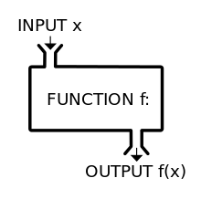


Review: What’s a Function?
Functions take inputs, apply a rule, and return outputs
Used in Mutation
Used in Summarization typically
One to one
Many to one
Takes a column(s) & returns a column
Takes a column(s) & returns a value
square root
squares
+, –, x, ÷
….
mean
median
minimum
….
Notes:
Mutation tells how to apply the function

Slide 6
“5 verbs + one other tool can do 90% of all your data manipulation.”
This Session
select | Pick columns by name
filter | Grab rows matching a condition
arrange | Reorder rows
mutate | Add new columns/variables
summarize | Reduce variables to values
group_by | Split-Apply-Combine

Slide 7
Group By: Split-Apply-Combine
Used w/ row verbs
select
filter
arrange
mutate
summarize

Slide 8
Group By: Split-Apply-Combine
Used w/ row verbs
select
filter
arrange
mutate
summarize
✔
✔
✔
✔

Slide 9
Group By: Split-Apply-Combine
Used w/ row verbs
select
filter
arrange
mutate
summarize
✔
✔
✔
✔

Slide 10


Group By: Split-Apply-Combine
Usually used with summarization!!

Slide 11
Group By: Split-Apply-Combine
X
Y

Slide 12
Group By: Split-Apply-Combine
X
Y

Slide 13
Group By: Split-Apply-Combine
Mean
X
Y

Slide 14
Group By: Split-Apply-Combine
X
Y
mean(y)
mean(y)
mean(y)

Slide 15
Group By: Split-Apply-Combine
X
Y
mean(y)
mean(y)
mean(y)

Slide 16
Group By: Split-Apply-Combine
Usually used with summarization!!

Slide 17
Group By: Split-Apply-Combine
Usually used with summarization!!
BUT……………………………………………!!

Slide 18
Group By: Split-Apply-Combine
X
Y

Slide 19

Group By: Split-Apply-Combine
X
Y
mutation
function
mutation
function
mutation
function

Slide 20
Group By: Split-Apply-Combine
X
Y
mutate
mutate
mutate

Slide 21
Group By: Split-Apply-Combine
X
Y
mean(y)
mean(y)
mean(y)

Slide 22
Group By: Split-Apply-Combine
X
Y
X
Y
mean(Y)
mean(y)
mean(y)
mean(y)

Slide 23
Group By: Split-Apply-Combine
X
Y
X
Y
mean(Y)
mean(y)
mean(y)
mean(y)

Slide 24
“5 verbs + one other tool can do 90% of all your data manipulation.”
This Session
select | Pick columns by name
filter | Grab rows matching a condition
arrange | Reorder rows
mutate | Add new columns/variables
summarize | Reduce variables to values
group_by | Split-Apply-Combine

