Slide 1

Data Visualization Module
Viz Grammar & Theory
Viz Design [Relationships]
How do I make?
How do I make __ to show __?
What patterns am I looking for?

Slide 2
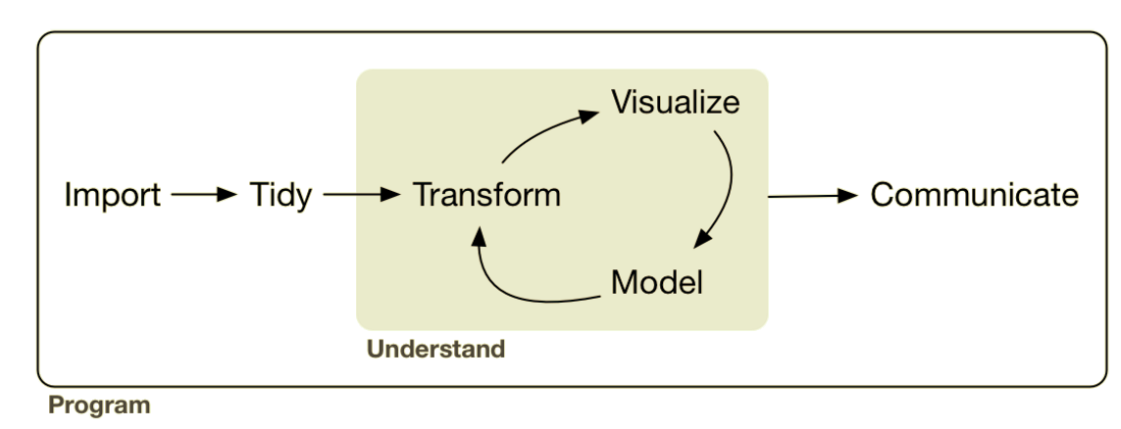
Analysis: Visualization Theory & Grammar
Lesson Objective: Select theory based geoms & aesthetics to represent data.
Notes:
We can use the tansforms to add summary representations to the visual. Adding this makes our visualizations more powerful because we can add more layers.

Slide 3





Analysis: Visualization Theory & Grammar
sql ops

Slide 4
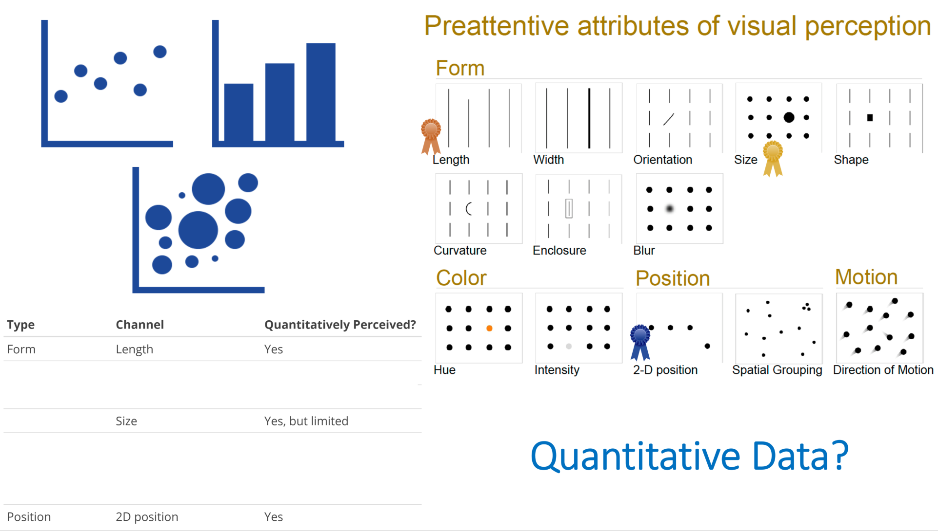
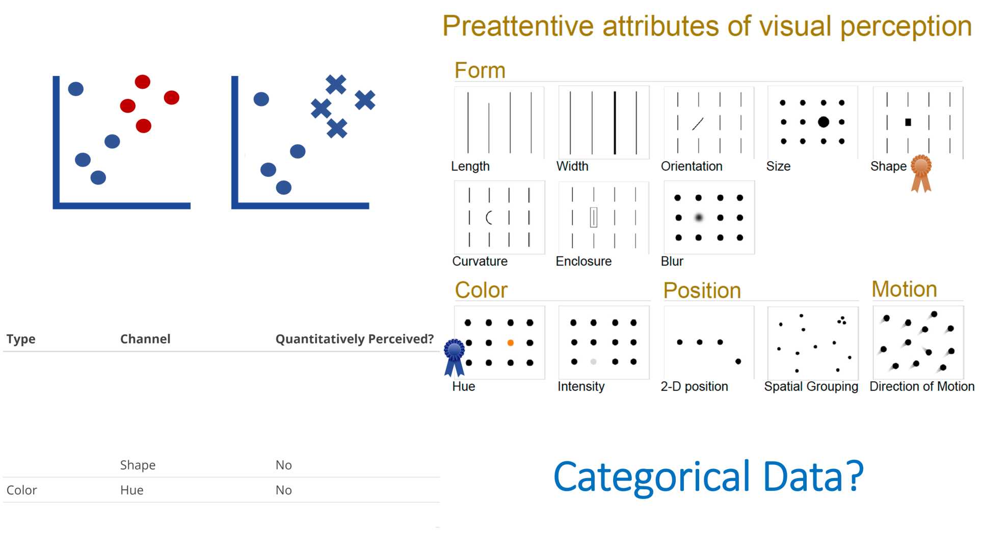
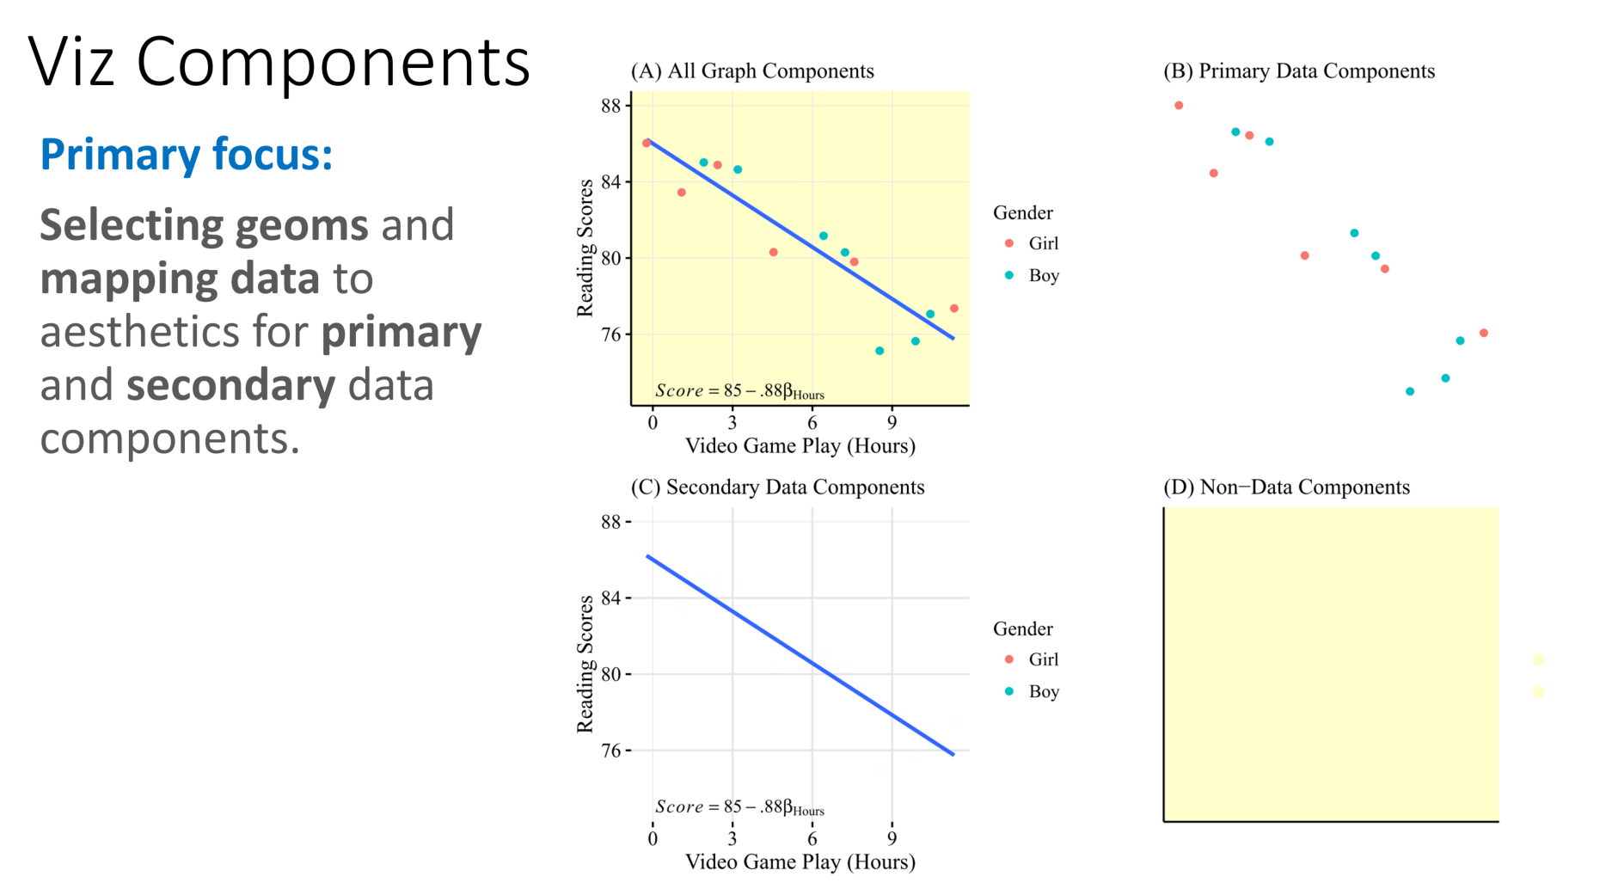
Recap
Let’s apply it.......

Slide 5
How do I make __ to show __?
What relationship(s) do I want to explore?

Slide 6
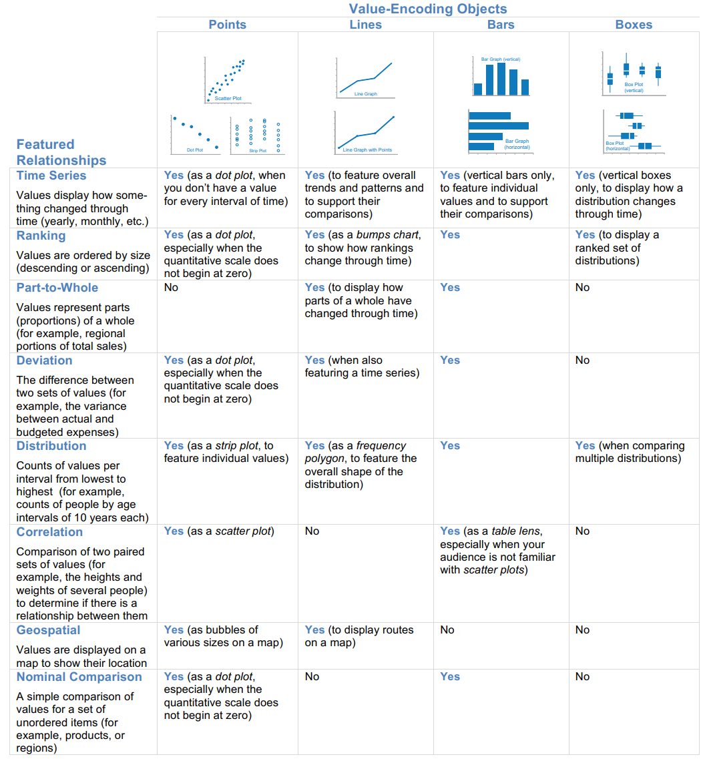
Few’s Graph Selection Matrix
What is the relationship you want to examine?
How do I make __ to show __?

Slide 7
Few’s Graph Selection Matrix
What is the relationship you want to examine?

Slide 8
Few’s Graph Selection Matrix
What is the relationship you want to examine?

Slide 9
Few’s Graph Selection Matrix
What is the relationship you want to examine?

Slide 10
Few’s Graph Selection Matrix
What is the relationship you want to examine?

Slide 11
Few’s Graph Selection Matrix
What is the relationship you want to examine?

Slide 12
Few’s Graph Selection Matrix
What is the relationship you want to examine?

Slide 13

Few’s Graph Selection Matrix
What is the relationship you want to examine?

Slide 14
Few’s Graph Selection Matrix
What is the relationship you want to examine?

Slide 15
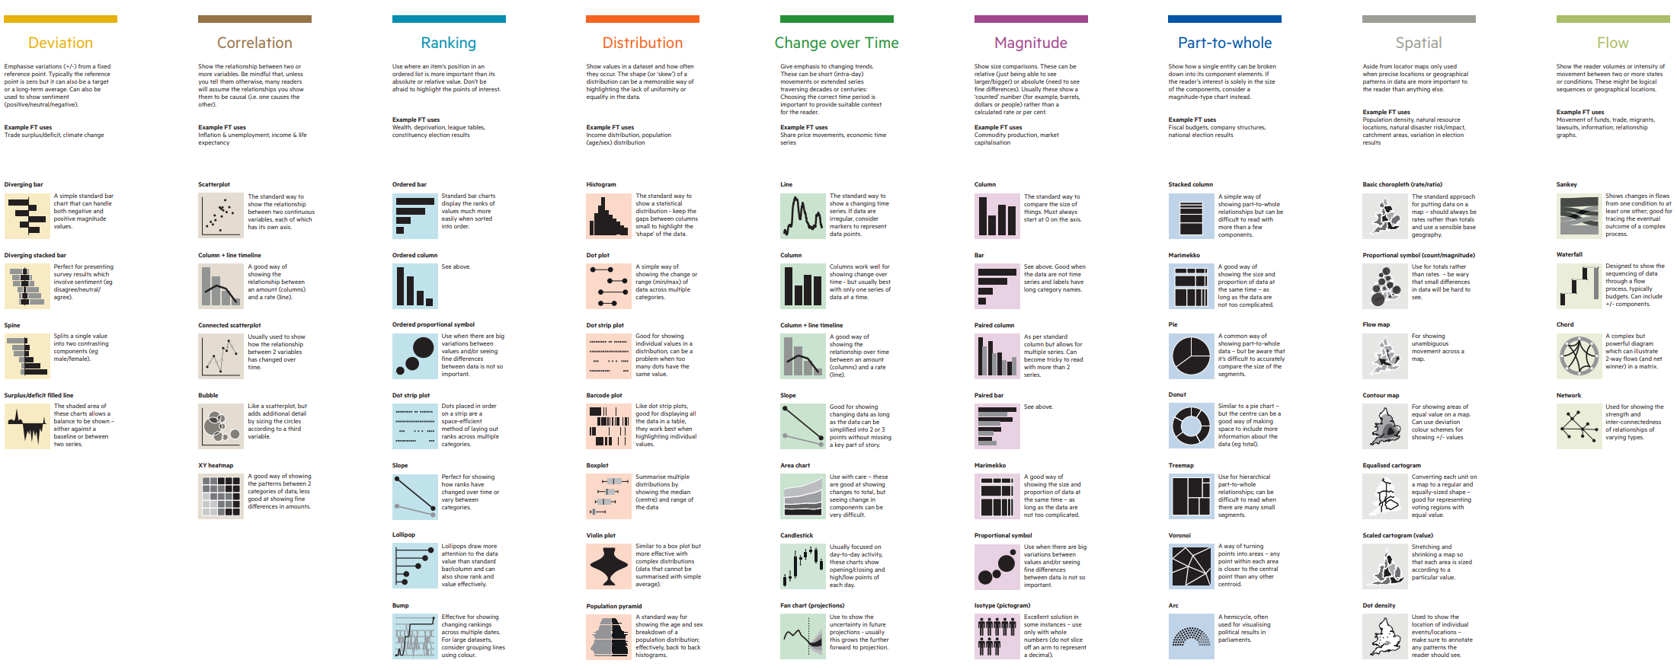
Financial Times Visual Vocabulary
What is the relationship you want to examine?

Slide 16
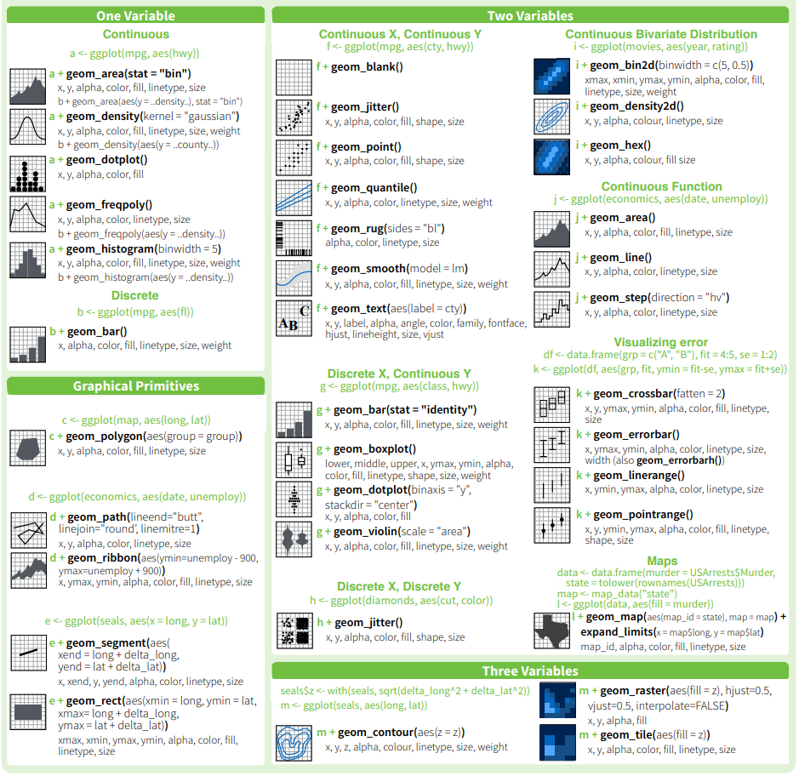
Ggplot2 Cheatsheet
What geoms for investigating 1, 2, & 3 variables?

Slide 17
Resource: Cookbook
http://r-statistics.co/Top50-Ggplot2-Visualizations-MasterList-R-Code.html
50 ggplot2 visuals
By relationship
w/ code

Slide 18
What patterns am I looking for?

Slide 19
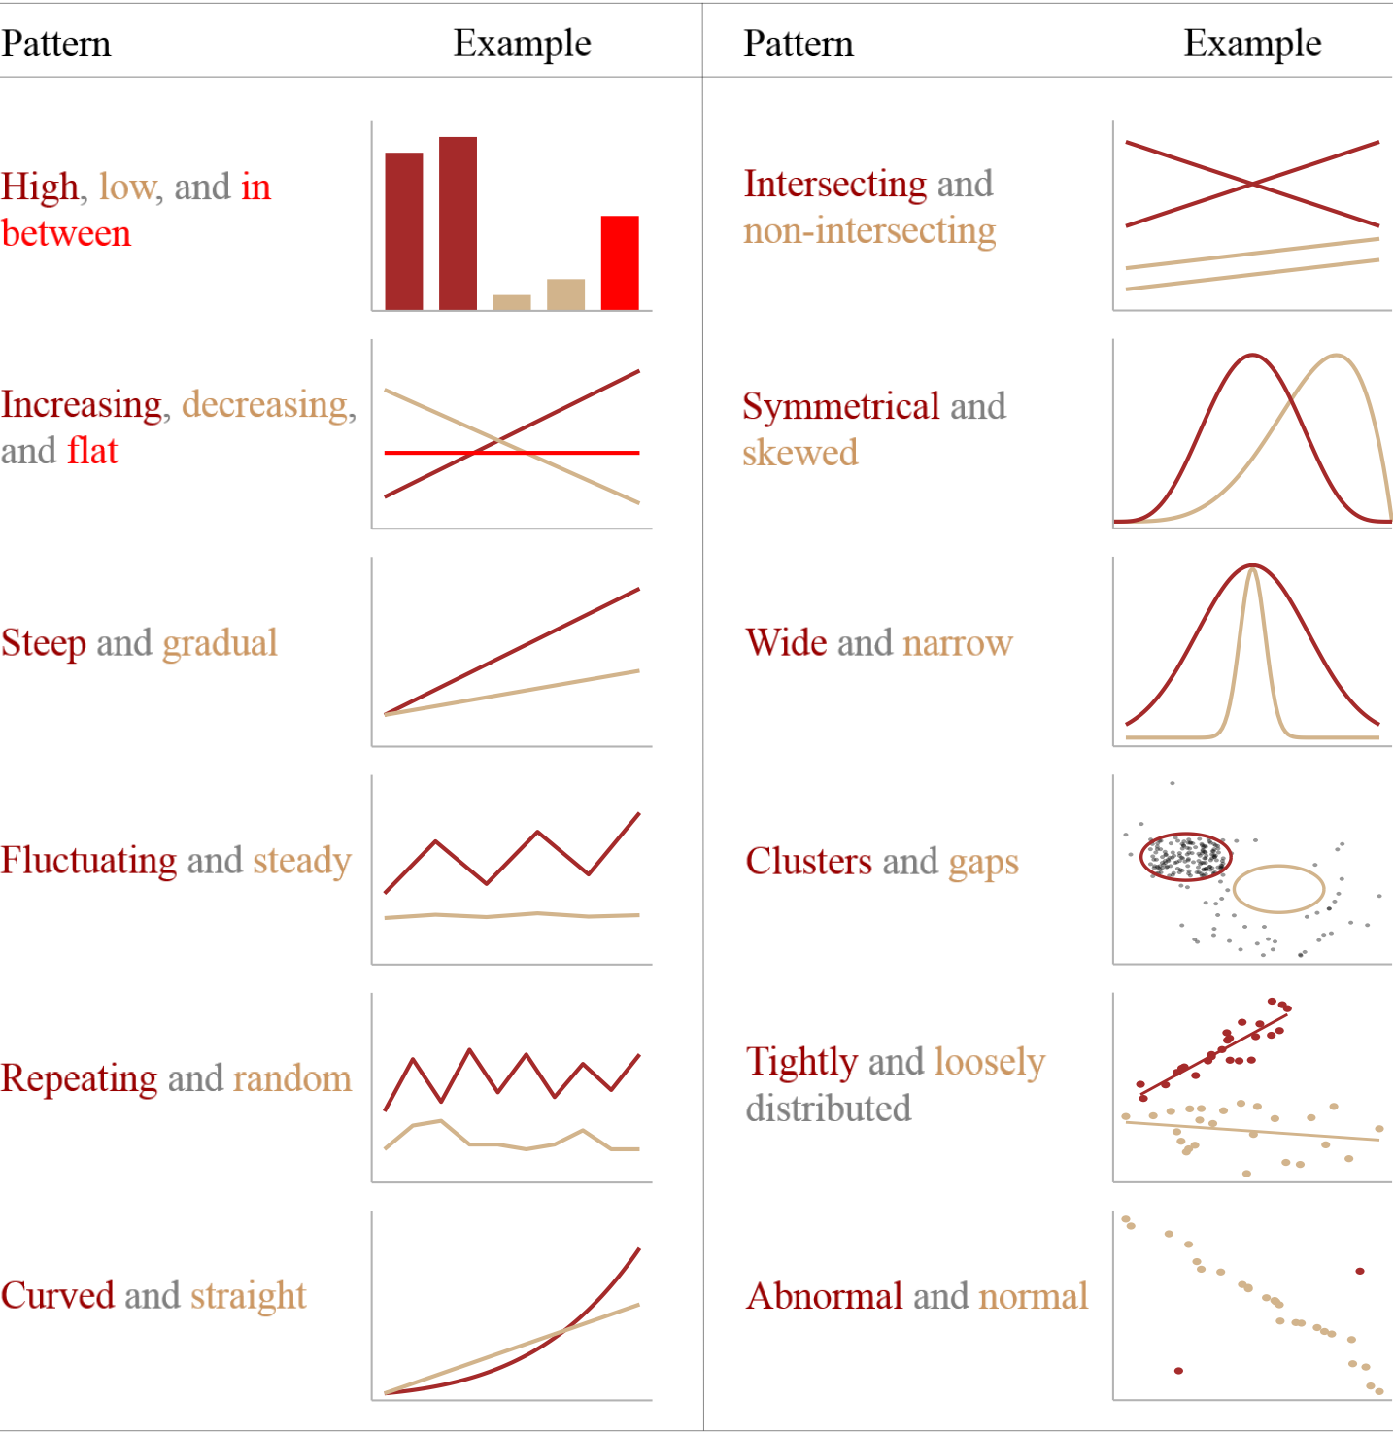
At the heart of quantitative reasoning is a single question: Compared to what?
-Edward Tufte-

Slide 20
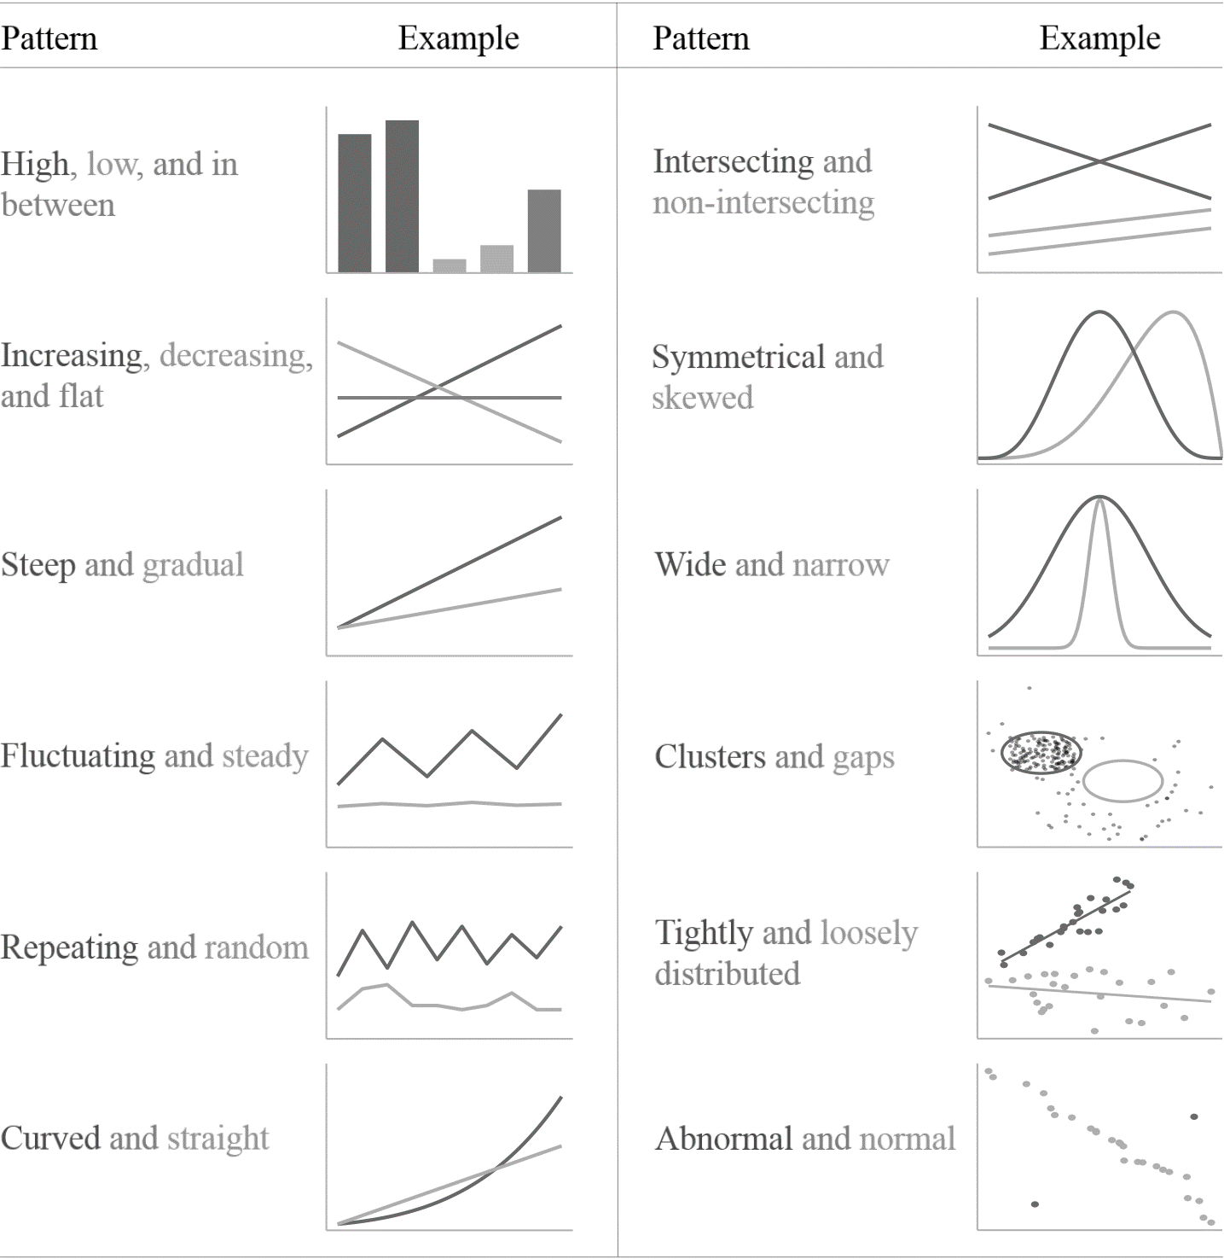
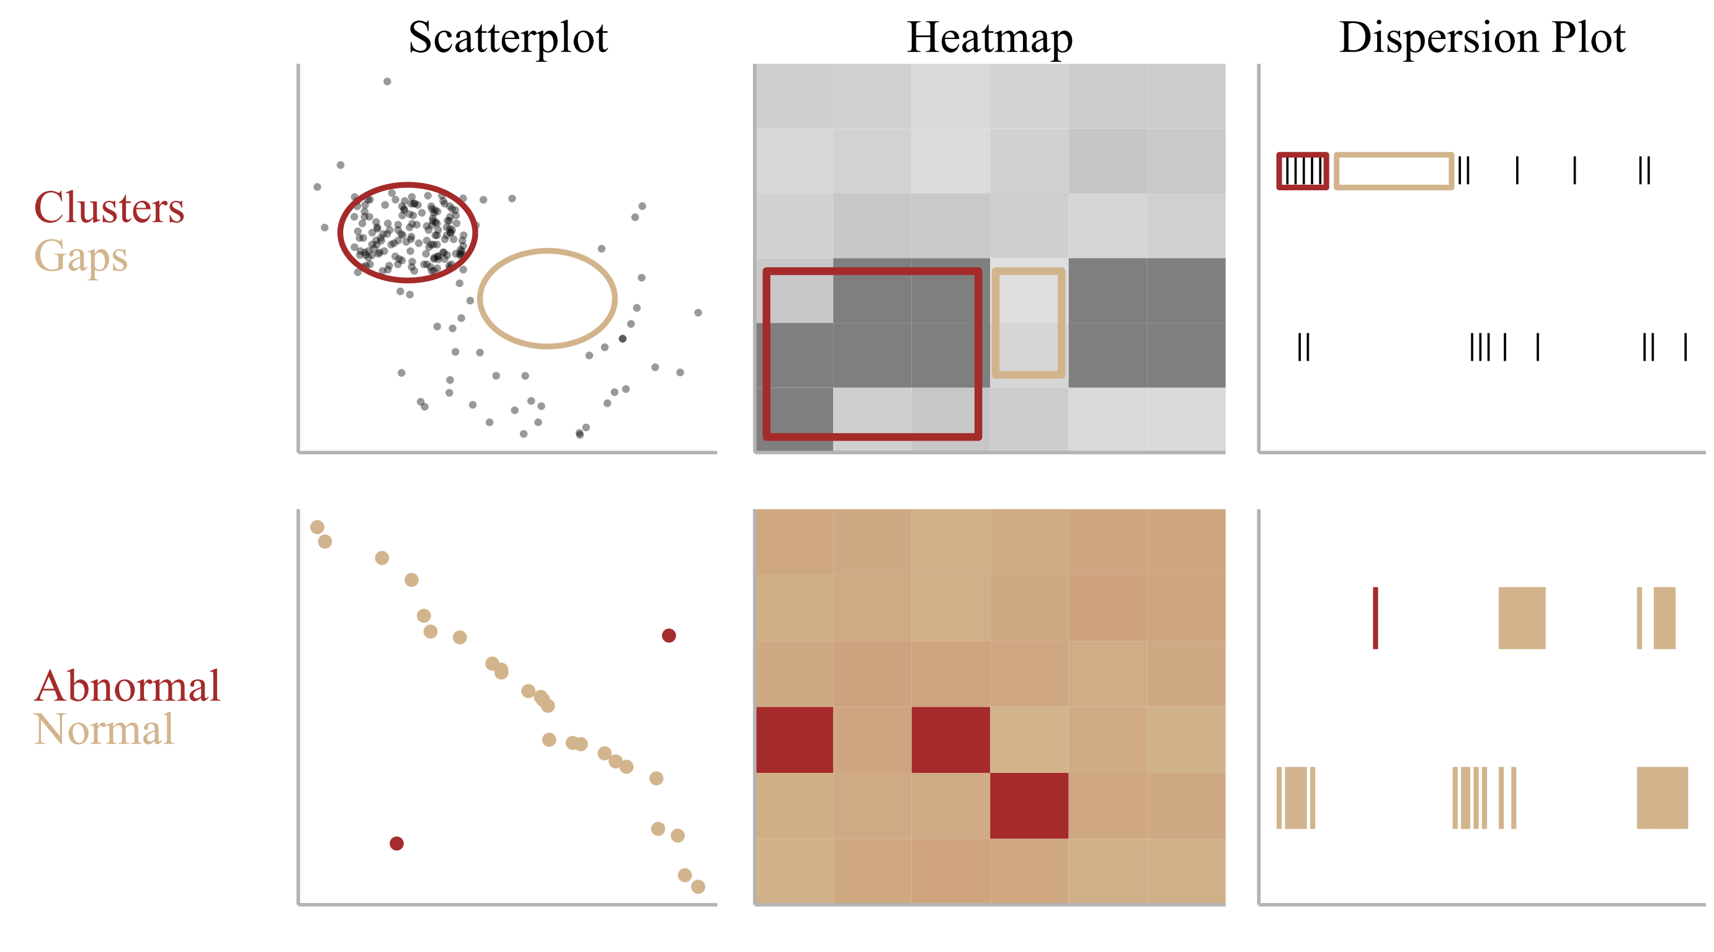
At the heart of quantitative reasoning is a single question: Compared to what?
-Edward Tufte-

Slide 21
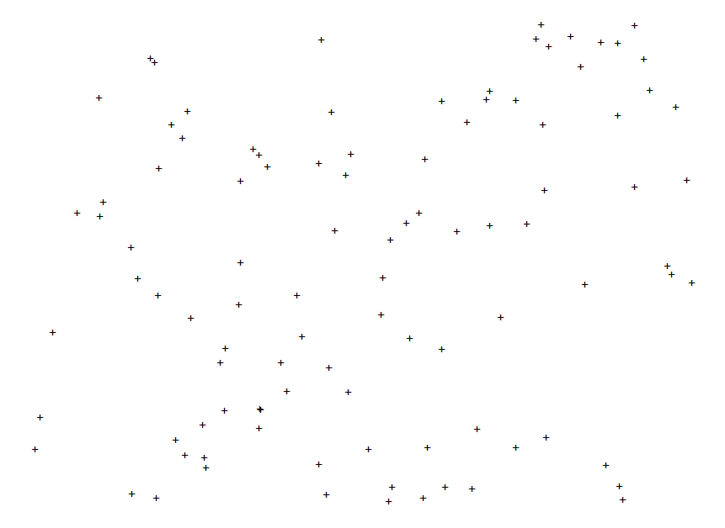
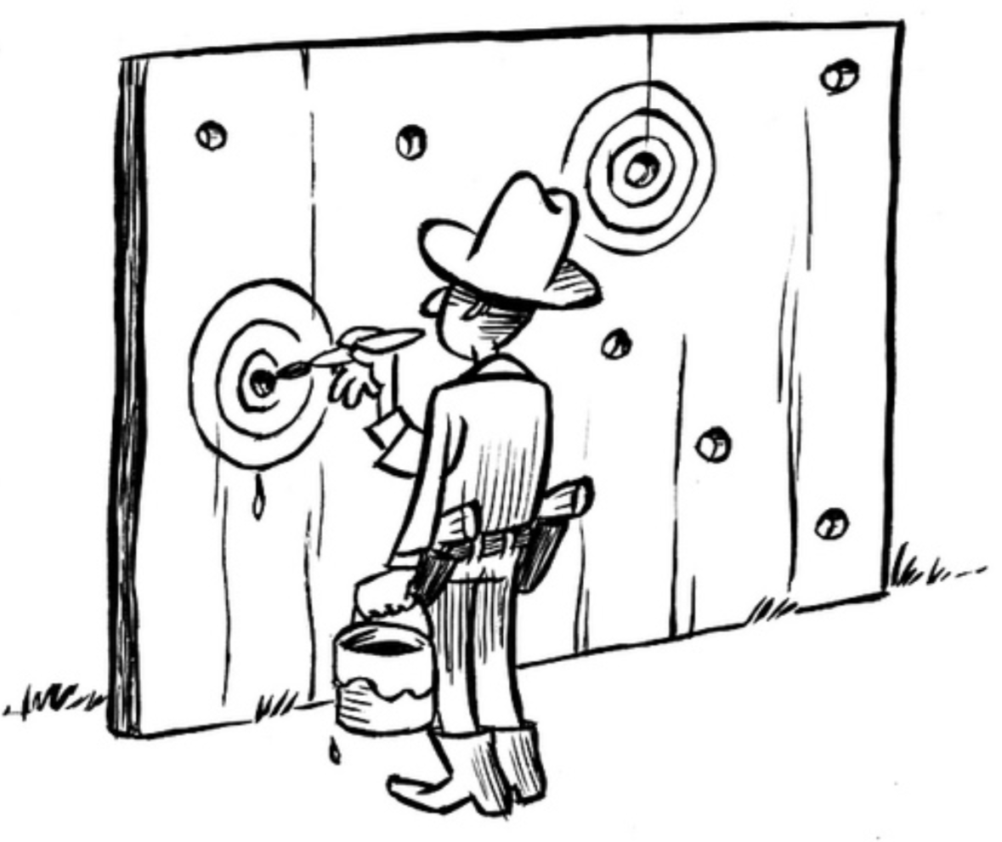

What Patterns Do You See?

Slide 22

What Patterns Do You See?
https://youtu.be/ZtQEXW0lVts?t=126

Slide 23
What Patterns Do You See?
“You didn't see what was, Jeanne.
You saw what you wanted to see.”

