Slide 1
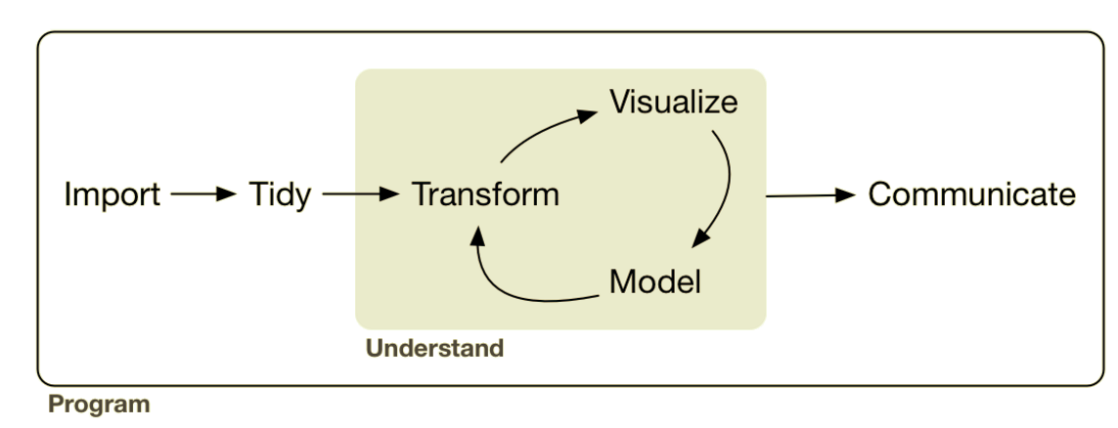
Analysis: Exploratory Data Analysis
EDA
Lesson Objective: Explore data via “question – query – learn” loop.
Notes:
We can use the tansforms to add summary representations to the visual. Adding this makes our visualizations more powerful because we can add more layers.

Slide 2





Analysis: Exploratory Data Analysis
sql ops

Slide 3

“5 verbs + one other tool can do 90% of all your data manipulation.”
Recap
select | Pick columns by name
filter | Grab rows matching a condition
arrange | Reorder rows
mutate | Add new columns/variables
summarize | Reduce variables to values
group_by | Split-Apply-Combine

Slide 4
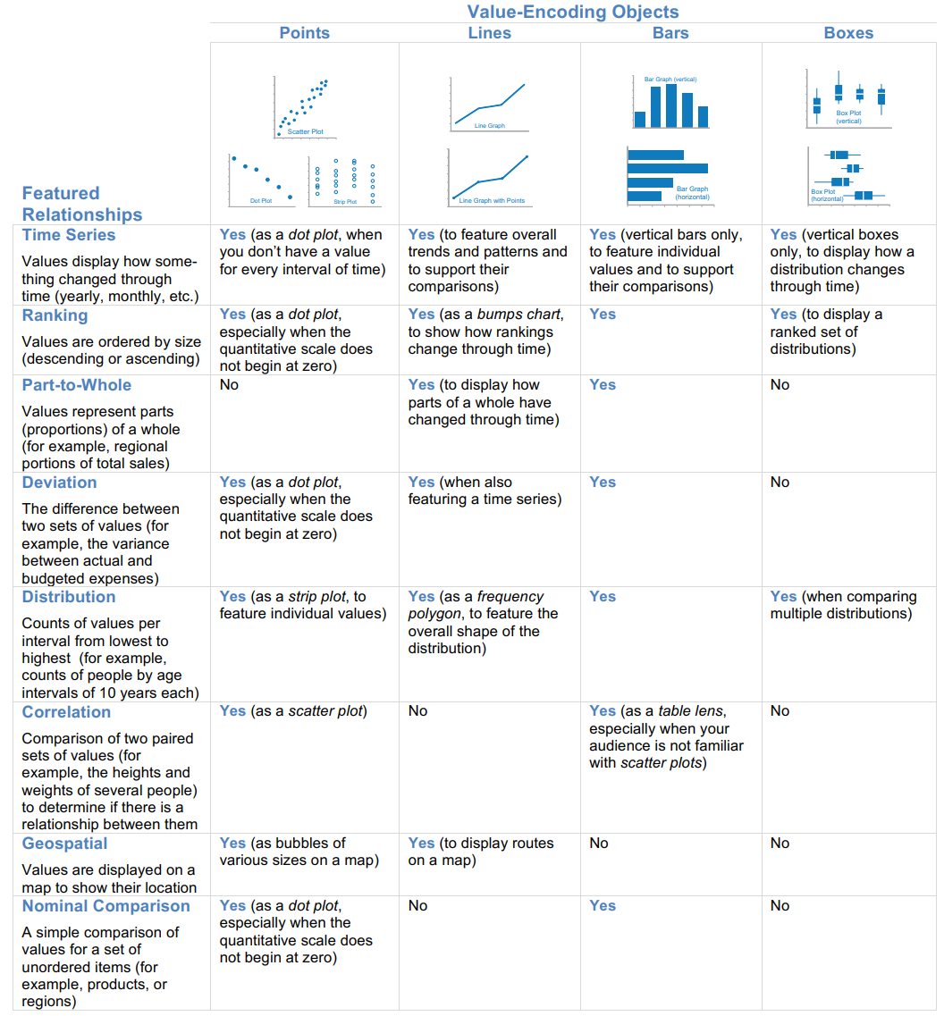
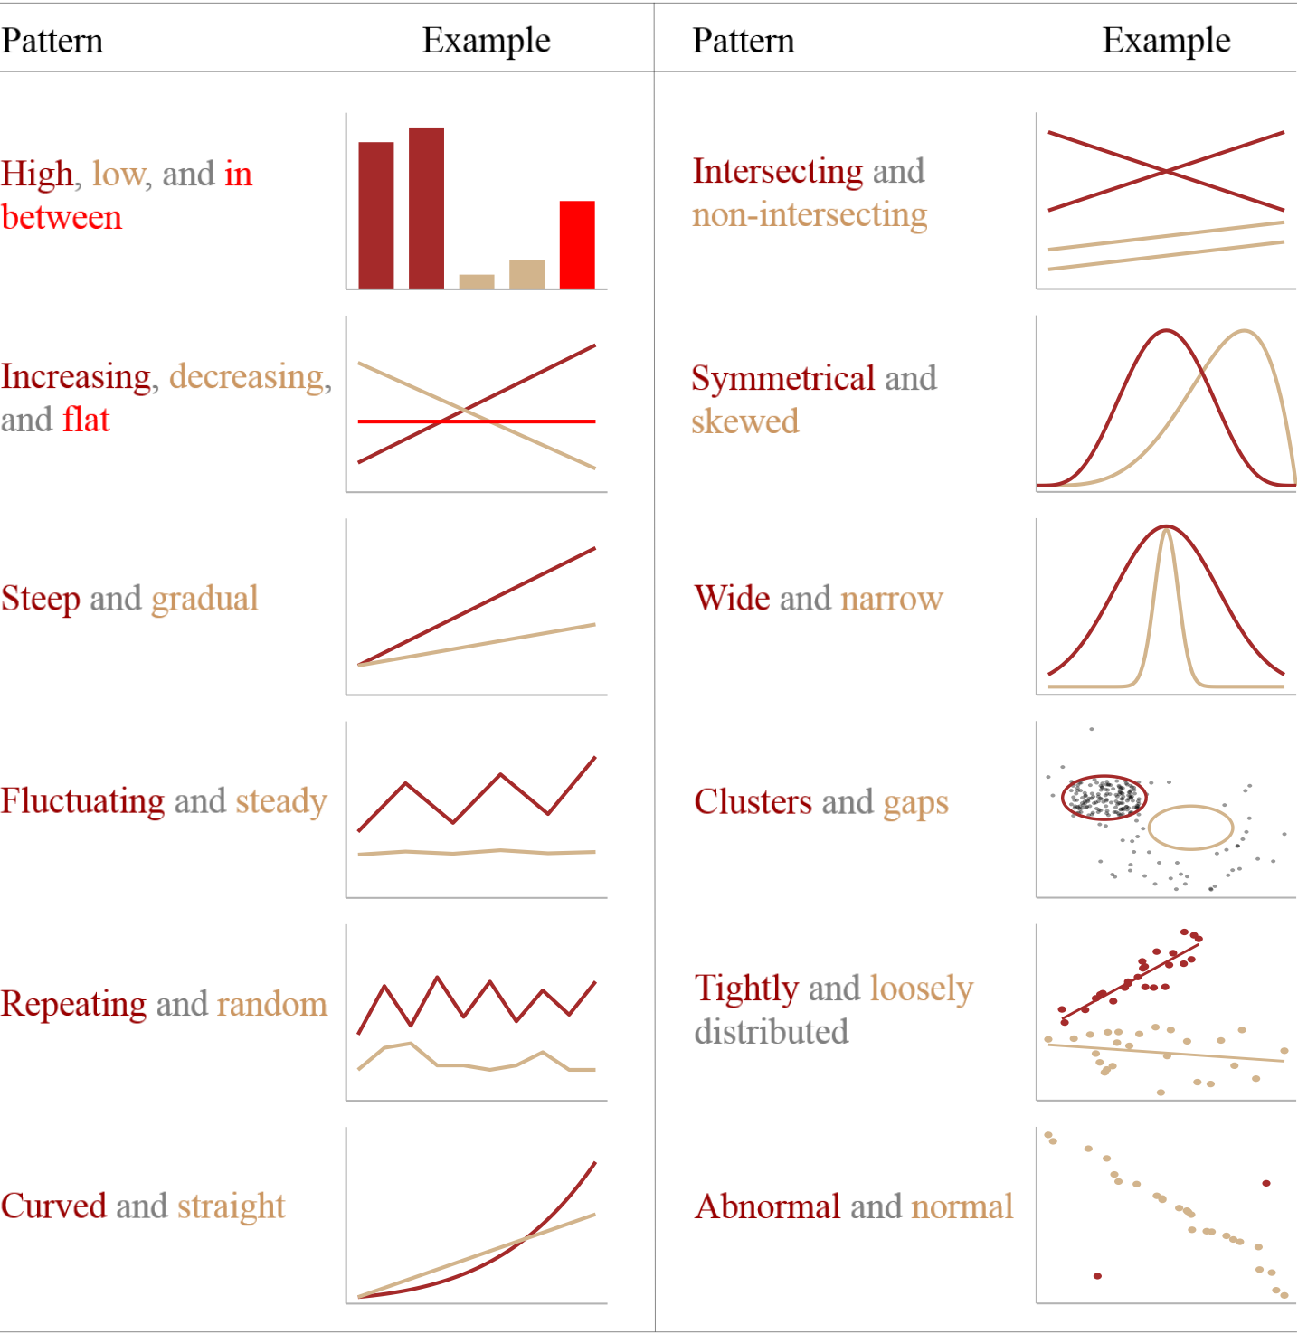
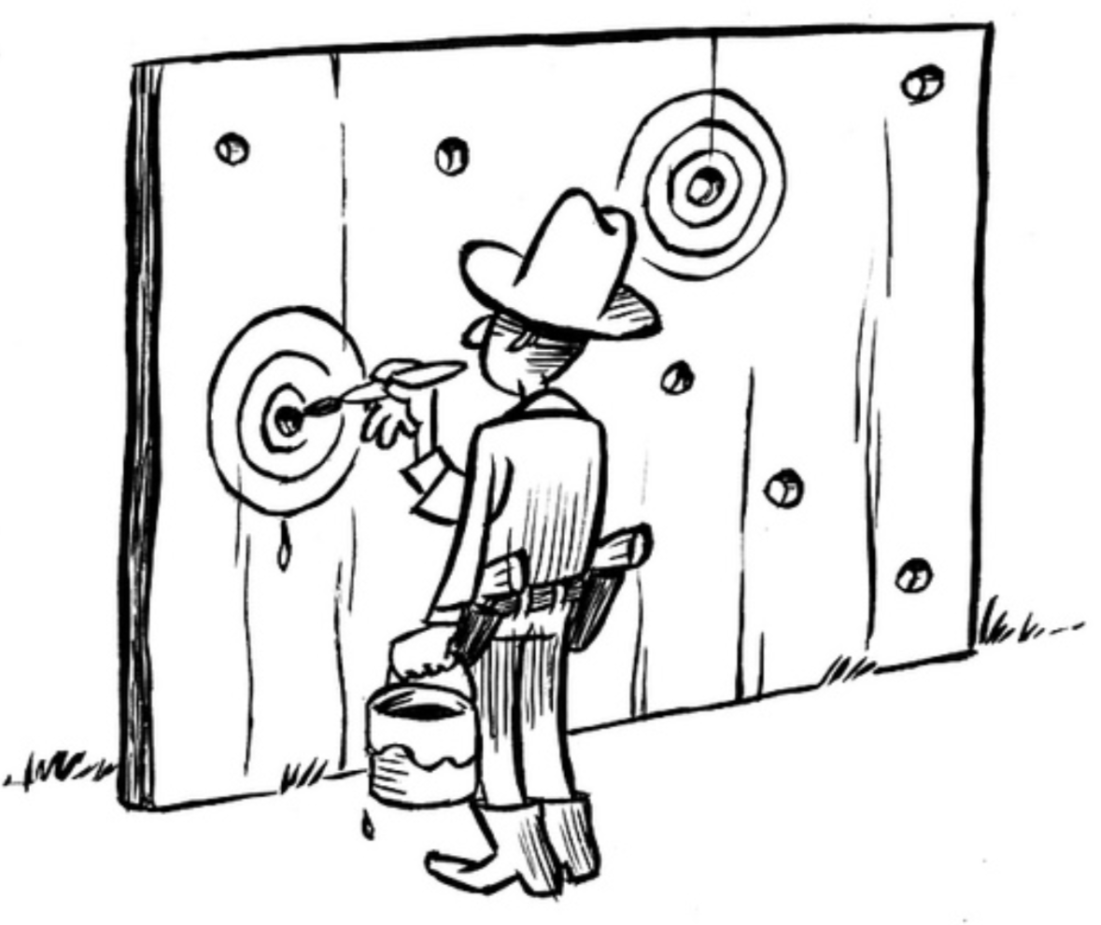

Recap
Let’s apply it.......

Slide 5
…This Enable us to do EDA
EDA
Generate questions about your data.
Search for answers by visualizing & transforming your data.
Use what you learn to refine your questions and/or generate new questions.

Slide 6
First I’ll model…. ….then, you do …..finally, you demo
Notes:
This class I’ll demonstrate the process and think aloud, you’ll start exploring here with EDA….continue for HW, and present code/process plus summaries and visuals

