Slide 1
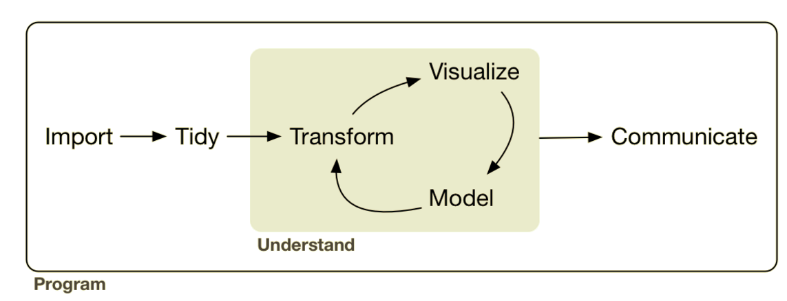
Analysis: Exploratory Data Analysis
Gathering
EDA
Lesson Objectives: Select and filter data in SQL.

Slide 2





Analysis: Exploratory Data Analysis
sql ops

Slide 3


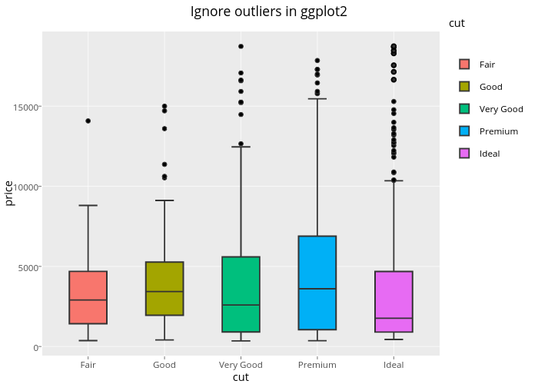


Last Session

Slide 4


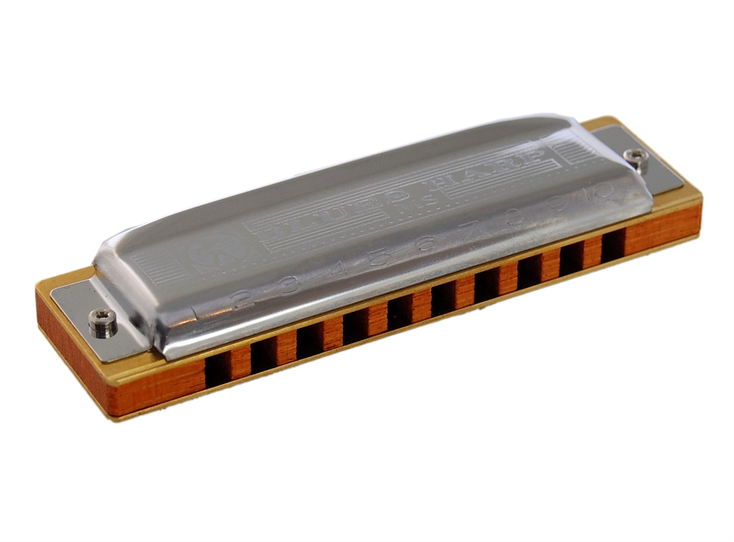
SQL: Intro to Querying & Exporting
This Session
SELECT, FROM, WHERE

Slide 5



Rules
Don’t lock-up the database
Don’t lock-up the database
If you’re unsure ask the dev manager
Use WITH(NOLOCK)[see rules 1 & 2]
Test with TOP(100)first
Long queries @ night

Slide 6


Learning SQL for Querying
Querying
About the data structure

Slide 7

R vs SQL
Case | Sensitive | Insensitive
Query Order | Flexible | Set
Lang Type | Functional | Declarative/Functional

Slide 8

R vs SQL
select() | SELECT
filter() | WHERE
== | =
!= | <>
!x %in% y c(') | NOT IN ()
arrange() | ORDER BY
group_by() | GROUP BY
mutate()
summarize() | Inside SELECT
count() | COUNT()
sum() | SUM()
mean() | AVE()
left_join() | LEFT JOIN
inner_join() | JOIN

Slide 9
SQL Boiler Plate
Let’s Play!
SELECT
columns
FROM table
WHERE condition

Slide 10
Bonus: Fuzzy Search for a Column in a DB
SELECT COLUMN_NAME, TABLE_NAME, TABLE_SCHEMA
FROM INFORMATION_SCHEMA.COLUMNS
WHERE COLUMN_NAME LIKE '%student%'

