Slide 1
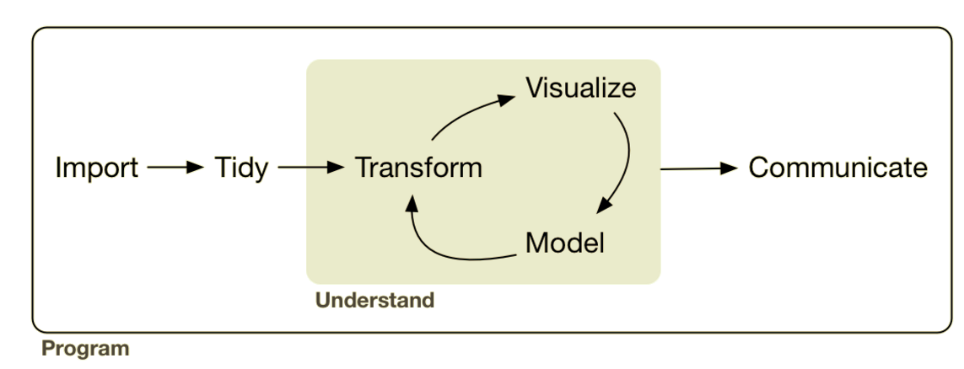
Analysis: Data Transformation
Lesson Objective: Be able to select, filter, arrange, and mutate data sets.

Slide 2





Analysis: Data Transformation
sql ops

Slide 3


Piping
https://youtu.be/K-ss_ag2k9E?list=PLNtpLD4WiWbw9Cgcg6IU75u-44TrrN3A4&t=1288

Slide 4
Let’s Code!

Slide 5
“5 verbs + one other tool can do 90% of all your data manipulation.”

Slide 6
“5 verbs + one other tool can do 90% of all your data manipulation.”
select | Pick columns by name

Slide 7
“5 verbs + one other tool can do 90% of all your data manipulation.”
select | Pick columns by name
filter | Grab rows matching a condition

Slide 8
“5 verbs + one other tool can do 90% of all your data manipulation.”
select | Pick columns by name
filter | Grab rows matching a condition
arrange | Reorder rows

Slide 9
“5 verbs + one other tool can do 90% of all your data manipulation.”
select | Pick columns by name
filter | Grab rows matching a condition
arrange | Reorder rows
mutate | Add new columns/variables

Slide 10
“5 verbs + one other tool can do 90% of all your data manipulation.”
select | Pick columns by name
filter | Grab rows matching a condition
arrange | Reorder rows
mutate | Add new columns/variables
summarize | Reduce variables to values

Slide 11
“5 verbs + one other tool can do 90% of all your data manipulation.”
select | Pick columns by name
filter | Grab rows matching a condition
arrange | Reorder rows
mutate | Add new columns/variables
summarize | Reduce variables to values
group_by | Split-Apply-Combine

Slide 12
Mutate & Summarize Use Functions
select | Pick columns by name
filter | Grab rows matching a condition
arrange | Reorder rows
mutate | Add new columns/variables
summarize | Reduce variables to values
They tell you how to apply a function

Slide 13
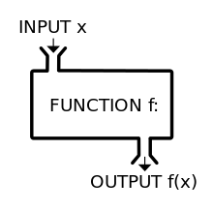
What’s a Function?
Functions take inputs, apply a rule, and return outputs

Slide 14


What’s a Function?
Functions take inputs, apply a rule, and return outputs
Two types:
Used in Mutate
Used in Summarize typically
One to one
Many to one
Takes a column(s) & returns a column
Takes a column(s) & returns a value
Notes:
Mutation tells how to apply the function

Slide 15
What’s a Function?
Functions take inputs, apply a rule, and return outputs
Two types:
Mutate: One to one
Summarize: Many to one
Takes a column(s) & returns a column
Takes a column(s) & returns a value
square root
squares
+, –, x, ÷
….
mean
median
minimum
….

Slide 16
This Session’s Focus:
This Session
select | Pick columns by name
filter | Grab rows matching a condition
arrange | Reorder rows
mutate | Add new columns/variables
summarize | Reduce variables to values
group_by | Split-Apply-Combine

Slide 17
Let’s Code!

Slide 18

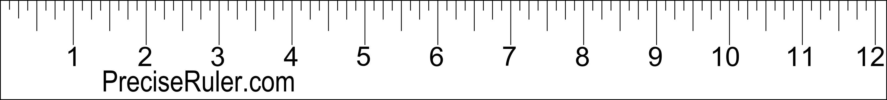
Cut Points

Slide 19

Cut Points
cut points = {5, 9}

Slide 20

Cut Points
cut points = {0, 5, 9, 11}

Slide 21
Let’s Code!

