Slide 1
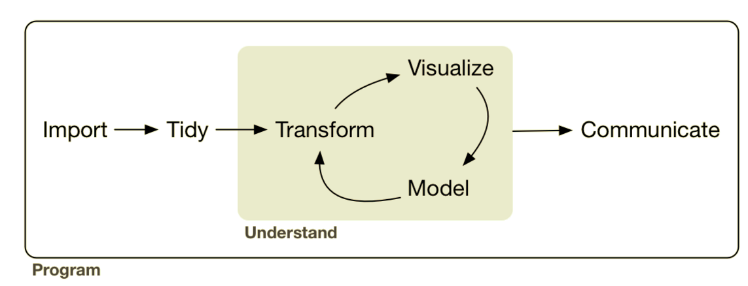
Analysis: Data Transformation cont…
Lesson Objective: Be able to mutate and summarize within groups.

Slide 2

“5 verbs + one other tool can do 90% of all your data manipulation.”
Last Session
select | Pick columns by name
filter | Grab rows matching a condition
arrange | Reorder rows
mutate | Add new columns/variables
summarize | Reduce variables to values
group_by | Split-Apply-Combine

Slide 3
“5 verbs + one other tool can do 90% of all your data manipulation.”
Last Session
select | Pick columns by name
filter | Grab rows matching a condition
arrange | Reorder rows
mutate | Add new columns/variables
summarize | Reduce variables to values
group_by | Split-Apply-Combine

Slide 4
Let’s Code!

Slide 5
“5 verbs + one other tool can do 90% of all your data manipulation.”
This Session
select | Pick columns by name
filter | Grab rows matching a condition
arrange | Reorder rows
mutate | Add new columns/variables
summarize | Reduce variables to values
group_by | Split-Apply-Combine

Slide 6
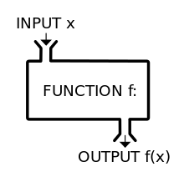


Review: What’s a Function?
Functions take inputs, apply a rule, and return outputs
Used in Mutate
Used in Summarize typically
One to one
Many to one
Takes a column(s) & returns a column
Takes a column(s) & returns a value
square root
squares
+, –, x, ÷
….
mean
median
minimum
….
Notes:
Mutation tells how to apply the function

Slide 7
“5 verbs + one other tool can do 90% of all your data manipulation.”
This Session
select | Pick columns by name
filter | Grab rows matching a condition
arrange | Reorder rows
mutate | Add new columns/variables
summarize | Reduce variables to values
group_by | Split-Apply-Combine

Slide 8
Let’s Code!

Slide 9
Group By: Split-Apply-Combine
Used w/ row verbs
select
filter
arrange
mutate
summarize

Slide 10
Group By: Split-Apply-Combine
Used w/ row verbs
select
filter
arrange
mutate
summarize
✔
✔
✔
✔

Slide 11
Group By: Split-Apply-Combine
Used w/ row verbs
select
filter
arrange
mutate
summarize
✔
✔
✔
✔

Slide 12


Group By: Split-Apply-Combine
Usually used with summarize!!

Slide 13
Group By: Split-Apply-Combine
X
Y

Slide 14
Group By: Split-Apply-Combine
X
Y

Slide 15
Group By: Split-Apply-Combine
Mean
X
Y

Slide 16
Group By: Split-Apply-Combine
X
Y
mean(y)
mean(y)
mean(y)

Slide 17
Group By: Split-Apply-Combine
X
Y
mean(y)
mean(y)
mean(y)

Slide 18
Group By: Split-Apply-Combine
Usually used with summarize!!

Slide 19
Group By: Split-Apply-Combine
Usually used with summarization!!
BUT……………………………………………!!

Slide 20
Group By: Split-Apply-Combine
X
Y

Slide 21

Group By: Split-Apply-Combine
X
Y
mutation
function
mutation
function
mutation
function

Slide 22
Group By: Split-Apply-Combine
X
Y
mutate
mutate
mutate

Slide 23
Group By: Split-Apply-Combine
X
Y
mean(y)
mean(y)
mean(y)

Slide 24
Group By: Split-Apply-Combine
X
Y
X
Y
mean(Y)
mean(y)
mean(y)
mean(y)

Slide 25
Group By: Split-Apply-Combine
X
Y
X
Y
mean(Y)
mean(y)
mean(y)
mean(y)

Slide 26
Let’s Code!

