Slide 1

Data Visualization Module
Viz Grammar & Theory
Viz Design [Relationships]
How do I make?
How do I make __ to show __?
What patterns am I looking for?

Slide 2
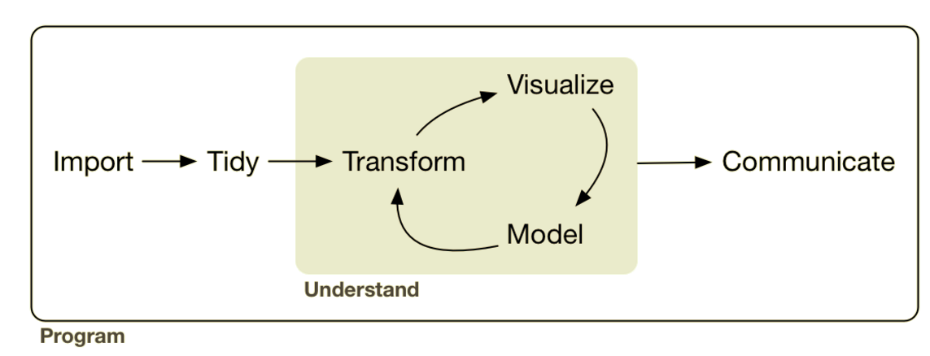
Analysis: Visualization Design & Relationships
Lesson Objective: Select geoms & aesthetics to explore relationships between
variables.
Notes:
We can use the tansforms to add summary representations to the visual. Adding this makes our visualizations more powerful because we can add more layers.

Slide 3





Analysis: Visualization Design & Relationships
sql ops

Slide 4
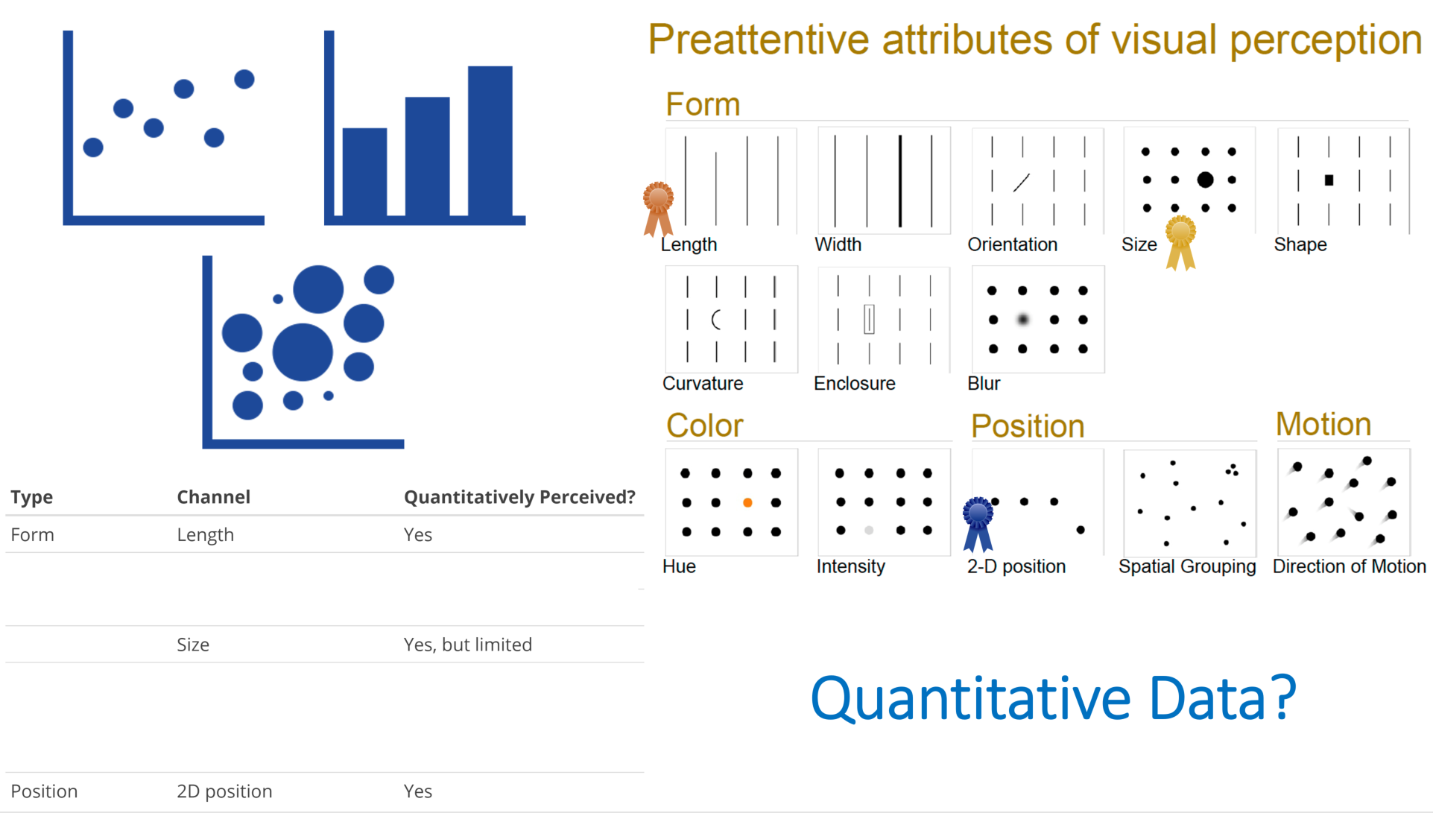
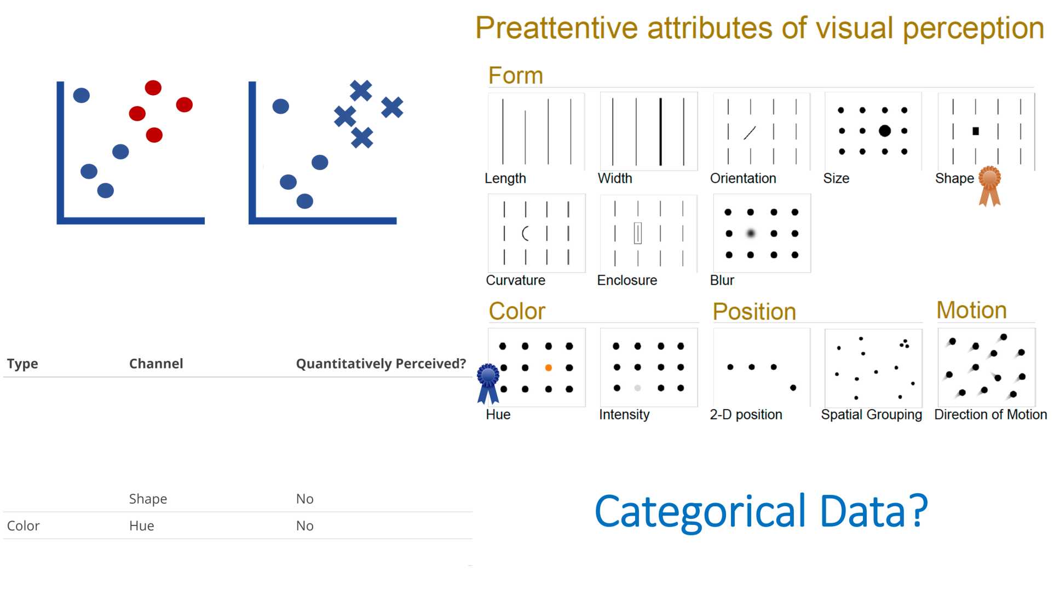
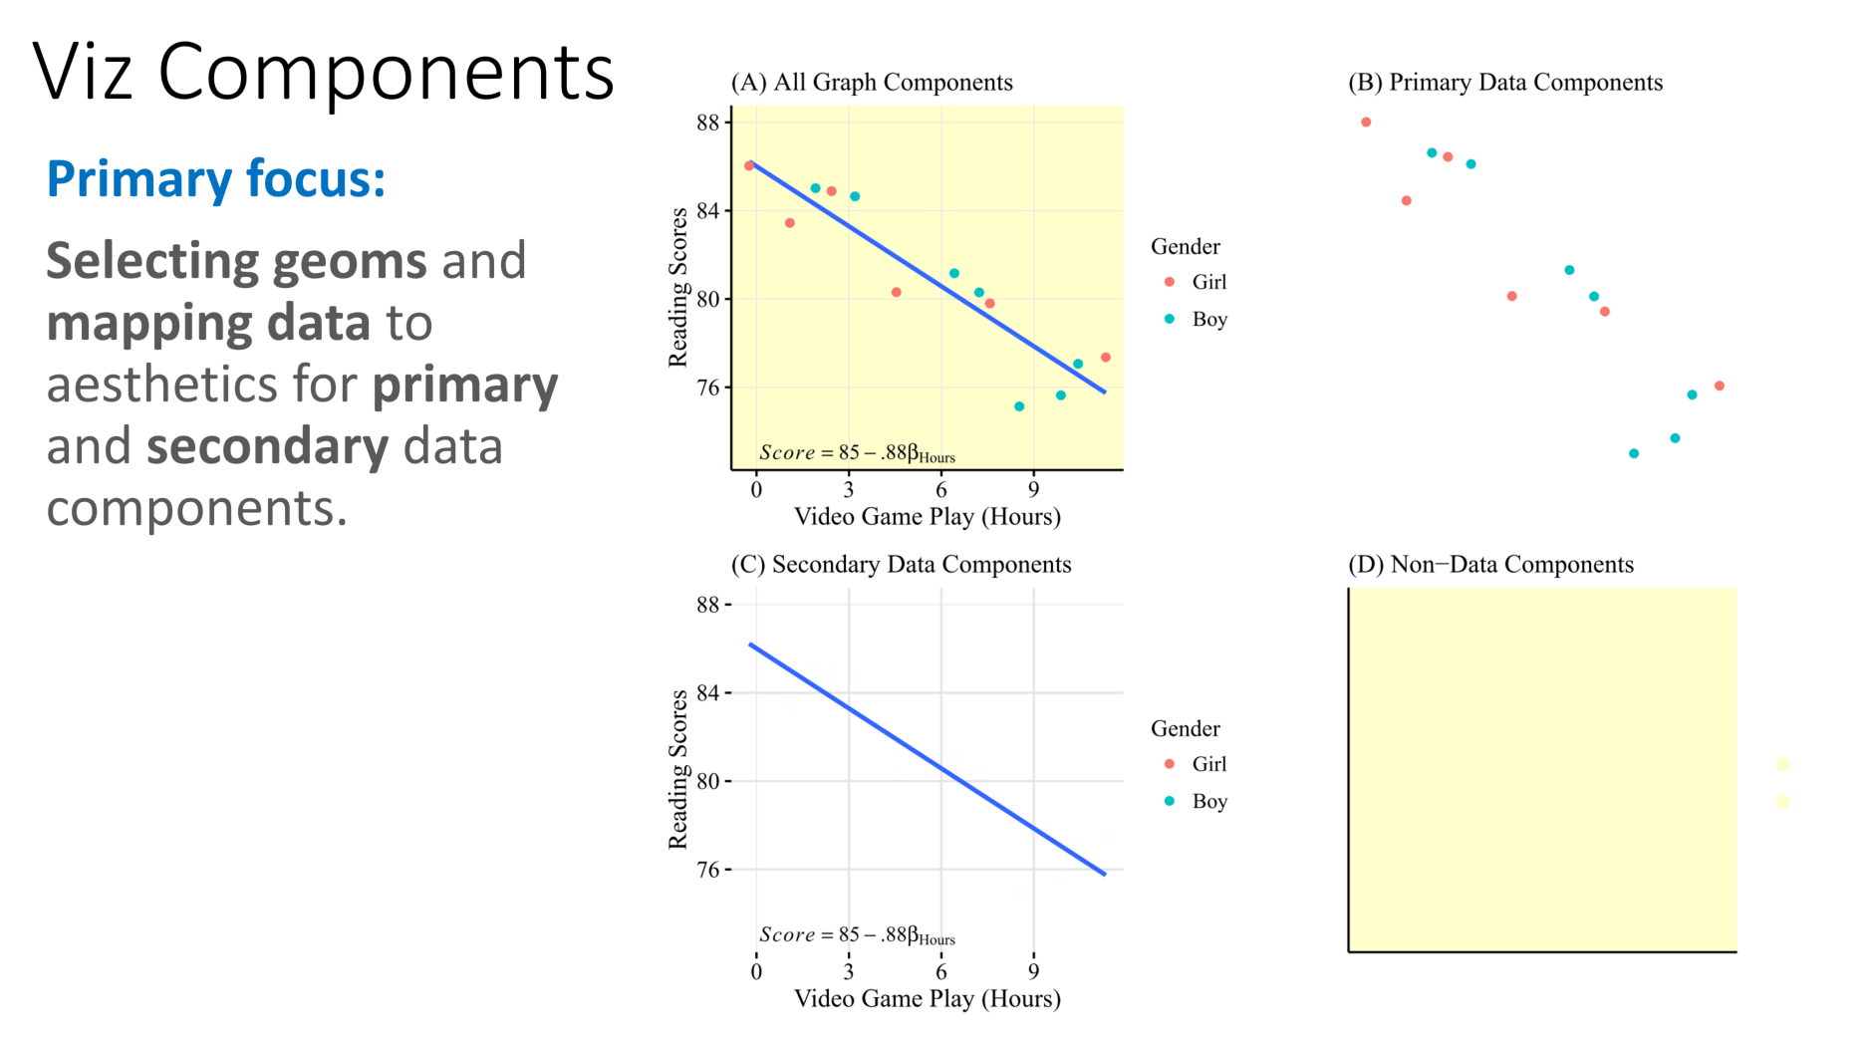
Recap
Let’s apply it.......

Slide 5
How do I make __ to show __?
What relationship(s) do I want to explore?

Slide 6
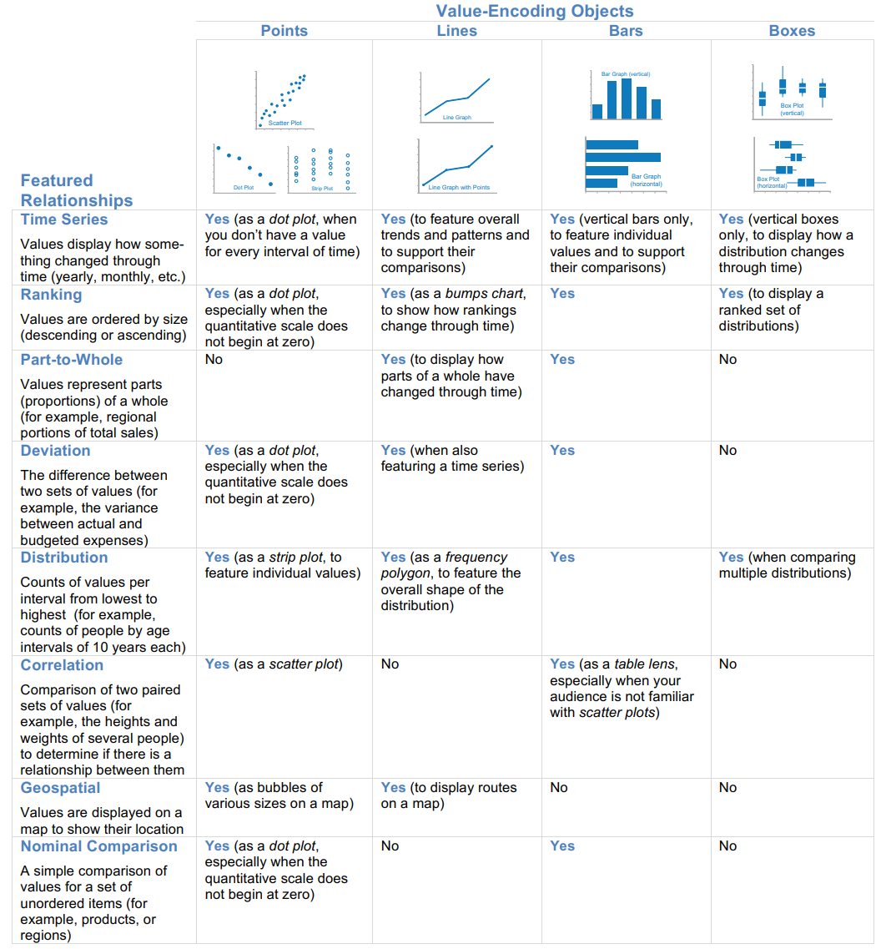
Few’s Graph Selection Matrix
What is the relationship you want to examine?
How do I make __ to show __?

Slide 7
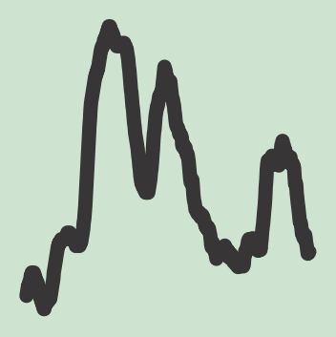
Few’s Graph Selection Matrix
What is the relationship you want to examine?

Slide 8

Few’s Graph Selection Matrix
What is the relationship you want to examine?

Slide 9
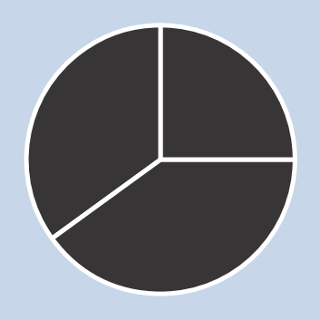
Few’s Graph Selection Matrix
What is the relationship you want to examine?

Slide 10

Few’s Graph Selection Matrix
What is the relationship you want to examine?

Slide 11
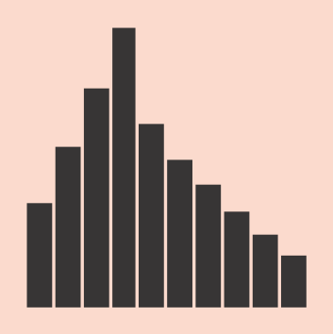
Few’s Graph Selection Matrix
What is the relationship you want to examine?

Slide 12
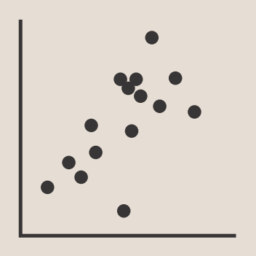
Few’s Graph Selection Matrix
What is the relationship you want to examine?

Slide 13

Few’s Graph Selection Matrix
What is the relationship you want to examine?

Slide 14
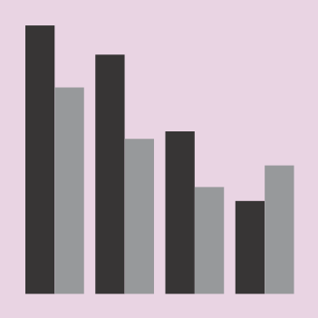
Few’s Graph Selection Matrix
What is the relationship you want to examine?

Slide 15
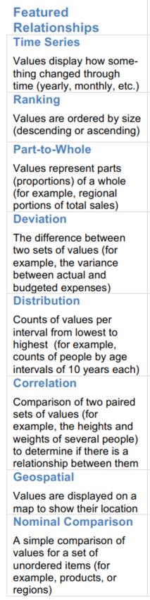
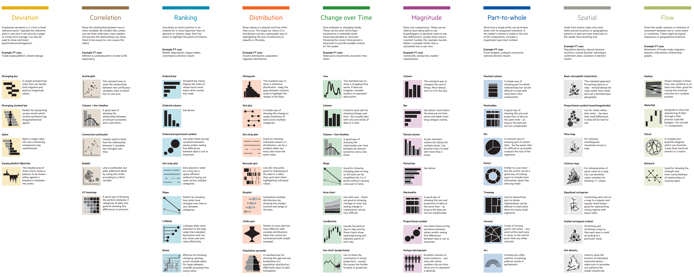
Financial Times Visual Vocabulary
What is the relationship you want to examine?

Slide 16
Financial Times Visual Vocabulary
What is the relationship you want to examine?

Slide 17
Financial Times Visual Vocabulary
What is the relationship you want to examine?

Slide 18
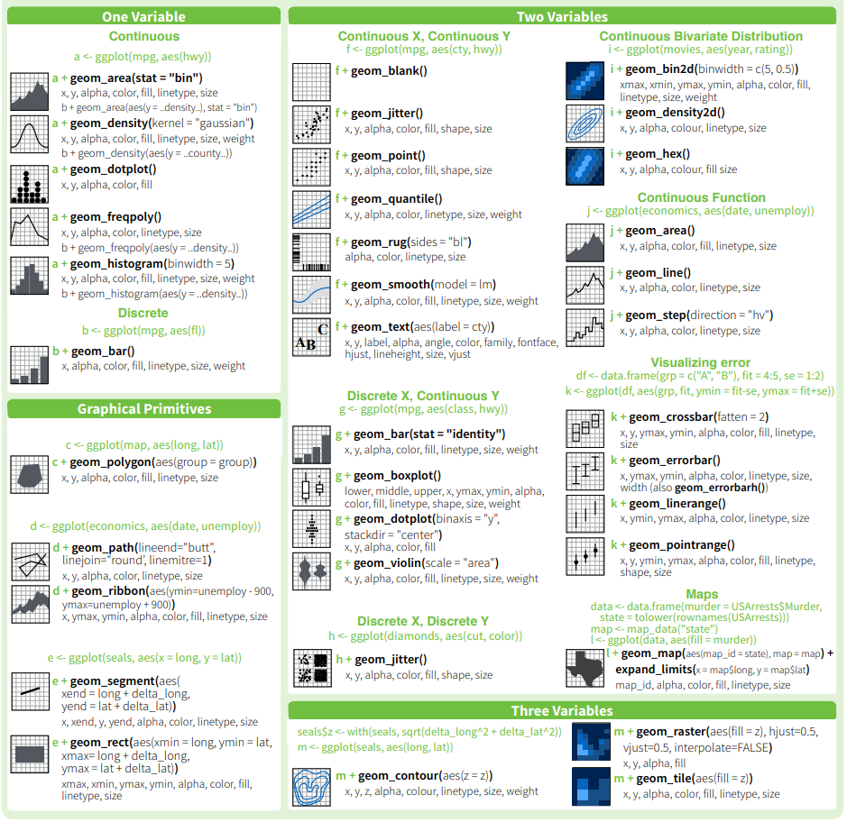
Ggplot2 Cheatsheet
What geoms for investigating 1, 2, & 3 variables?

Slide 19
Resource: Cookbook
http://r-statistics.co/Top50-Ggplot2-Visualizations-MasterList-R-Code.html
50 ggplot2 visuals
By relationship
w/ code

Slide 20
What patterns am I looking for?

Slide 21
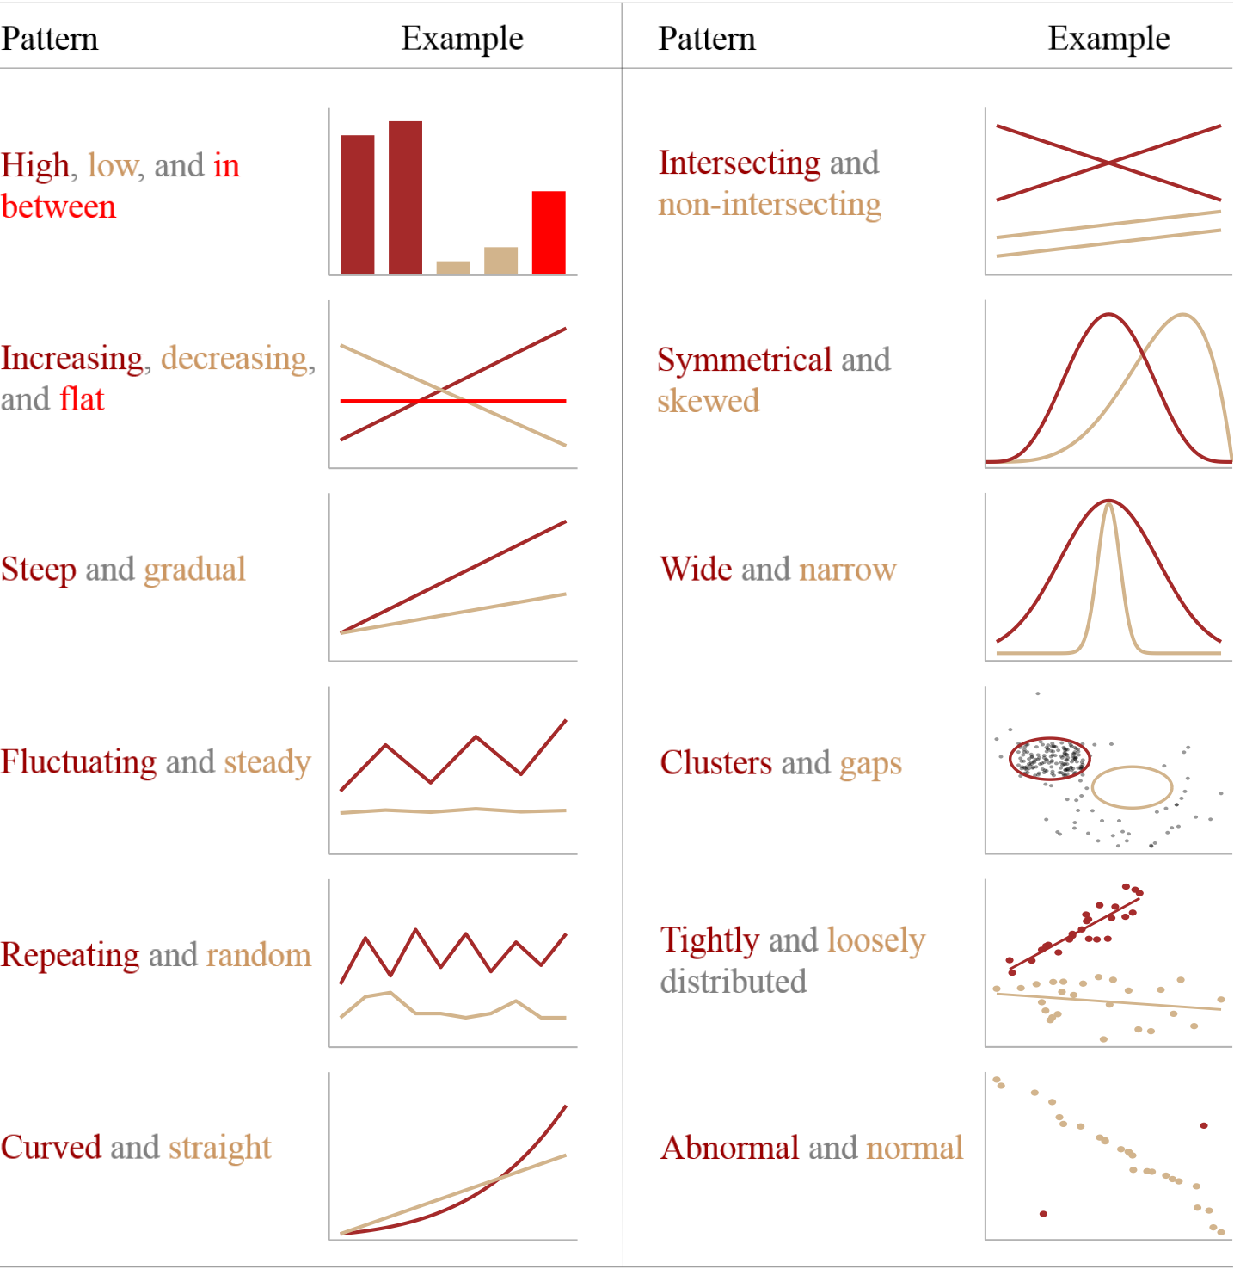
At the heart of quantitative reasoning is a single question: Compared to what?
-Edward Tufte-

Slide 22
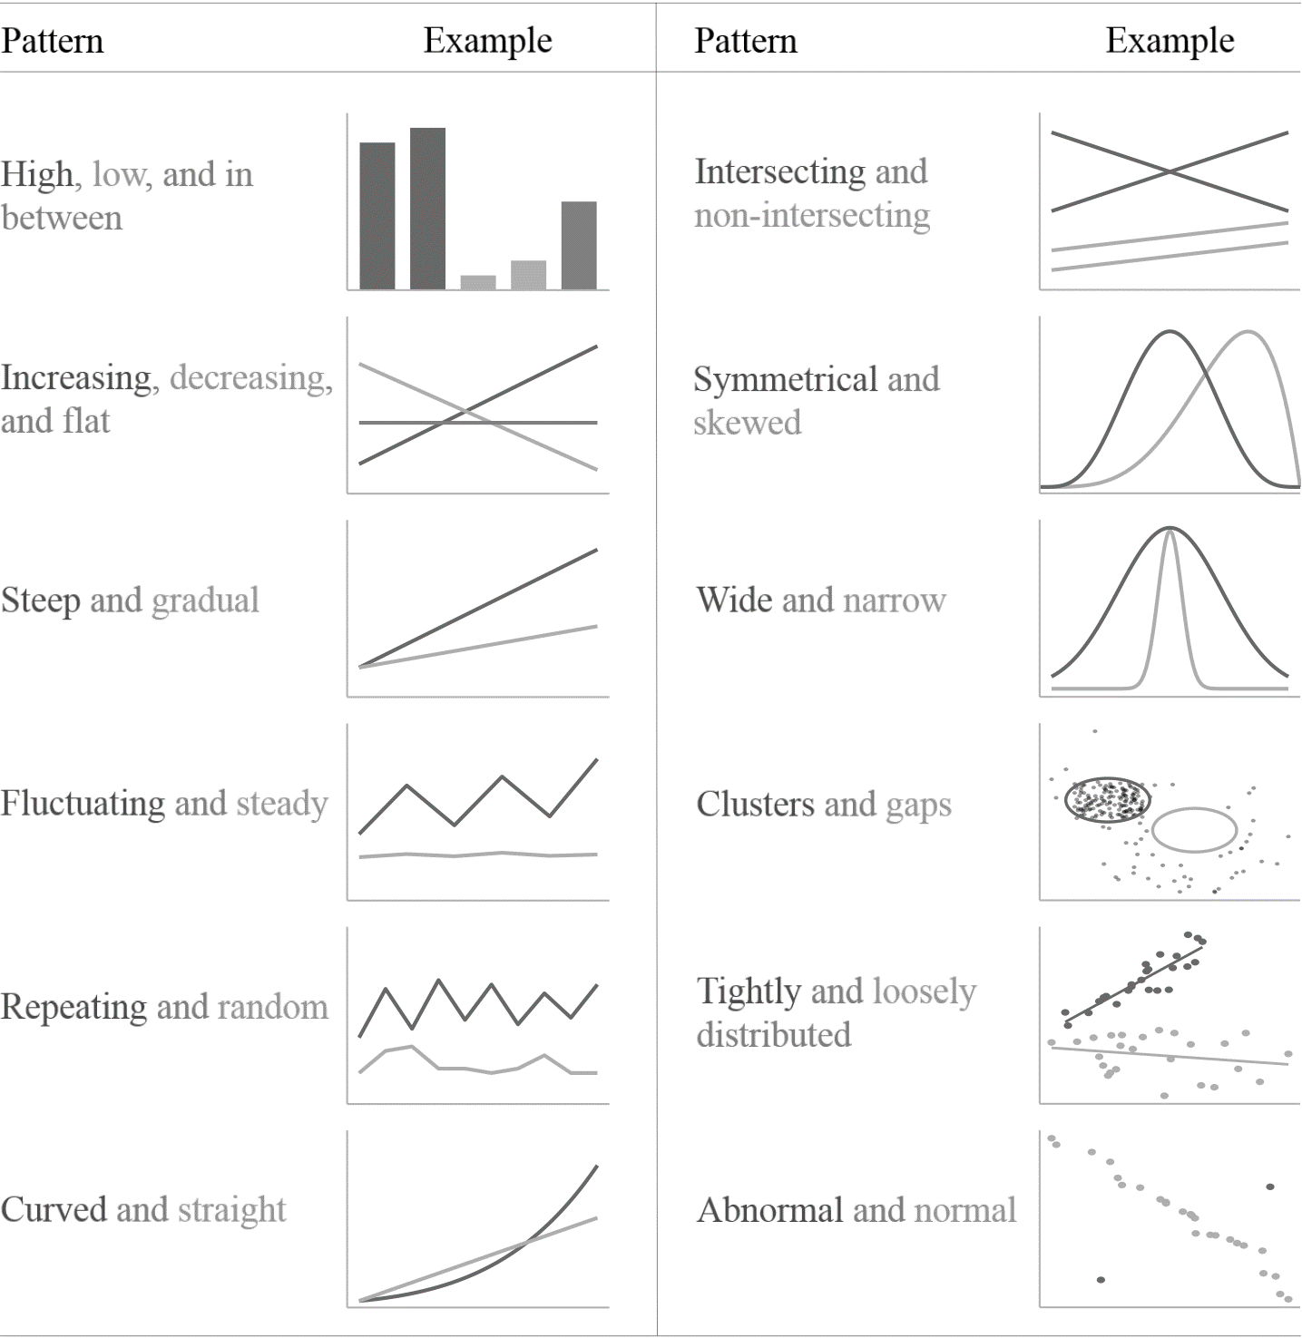
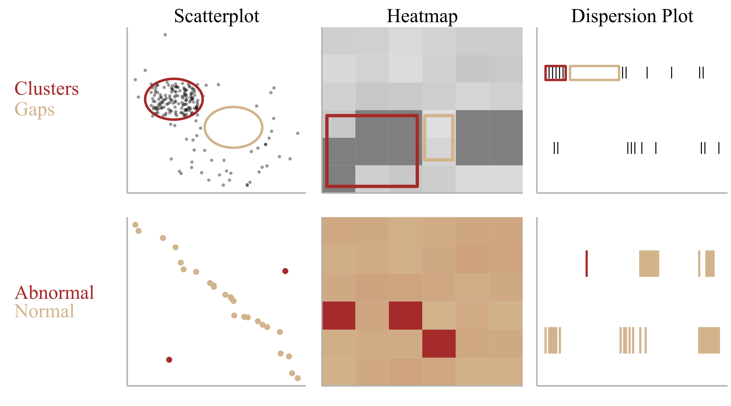
At the heart of quantitative reasoning is a single question: Compared to what?
-Edward Tufte-

Slide 23
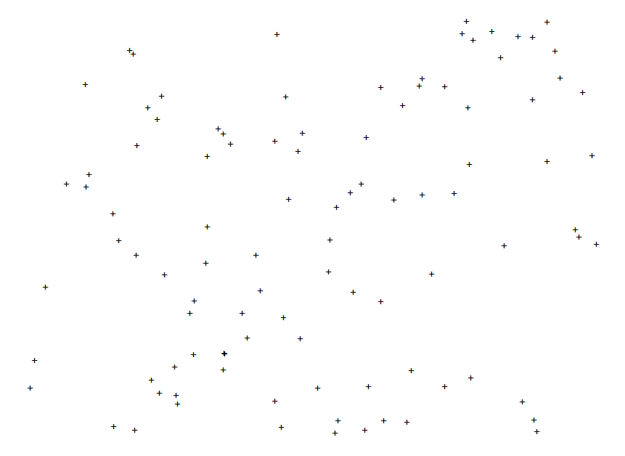
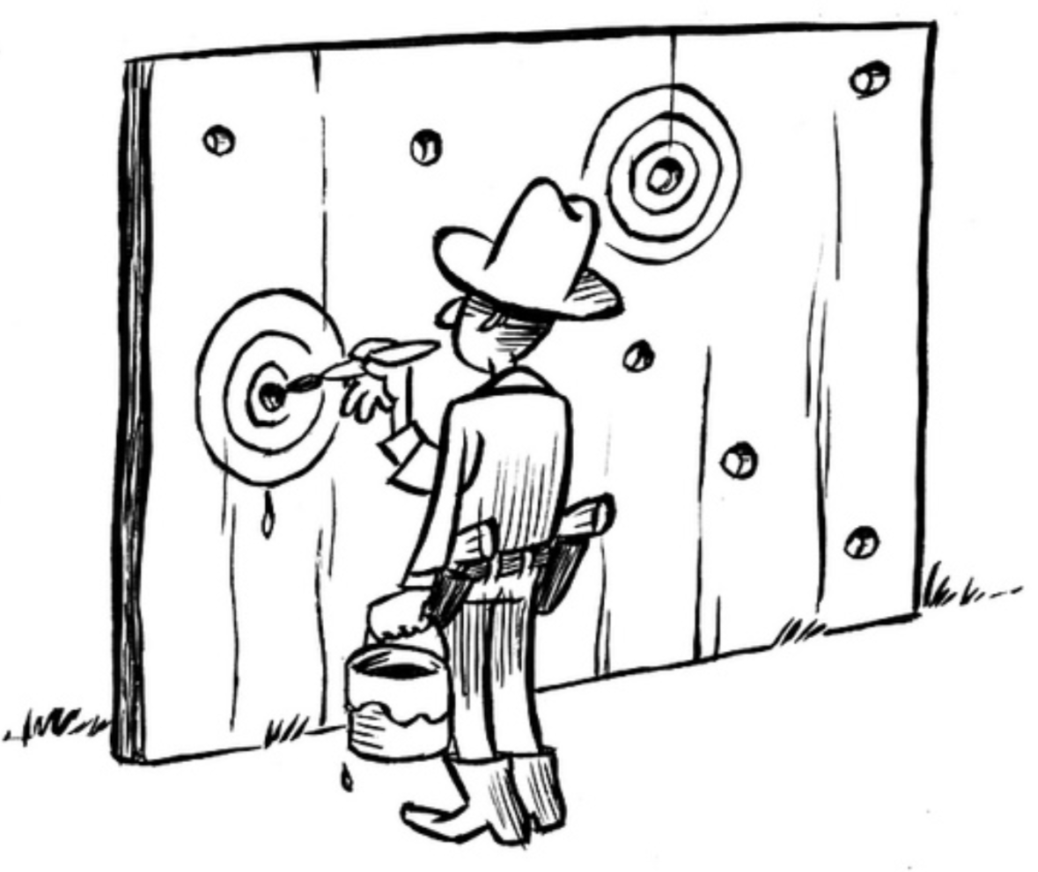

What Patterns Do You See?

Slide 24

What Patterns Do You See?
https://youtu.be/ZtQEXW0lVts?t=126

Slide 25
What Patterns Do You See?
“You didn't see what was, Jeanne.
You saw what you wanted to see.”

Slide 26
Let’s Code!

