Slide 1
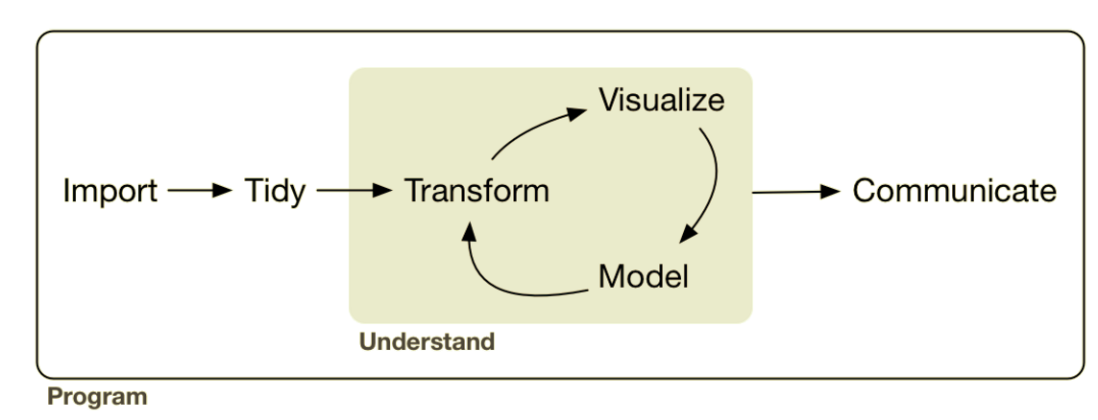
Analysis: Exploratory Data Analysis
EDA
Lesson Objective: Convert data to tidy format.
Notes:
Up til now we’ve had data in formats that were generally useful. Maybe we had to clean up a variable or compute a new variable but for the most part they were what we call tidy data sets.

Slide 2




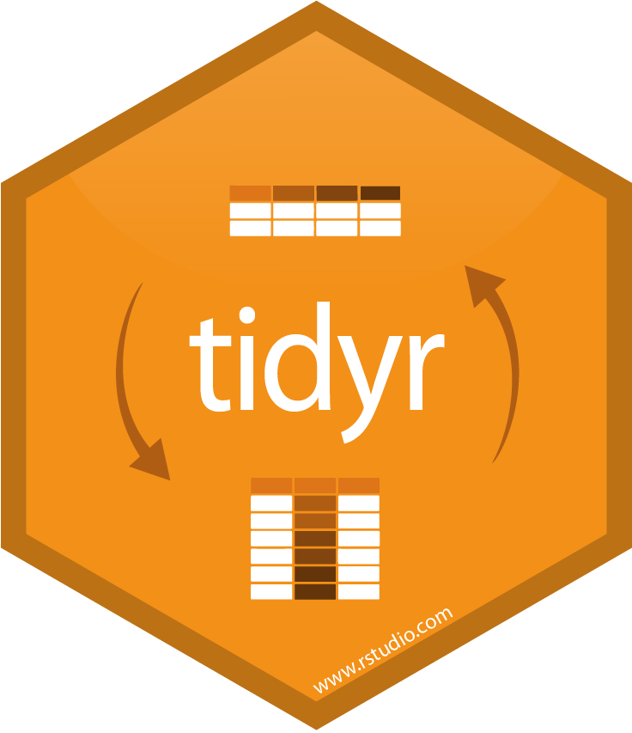
Analysis: Exploratory Data Analysis
sql ops

Slide 3
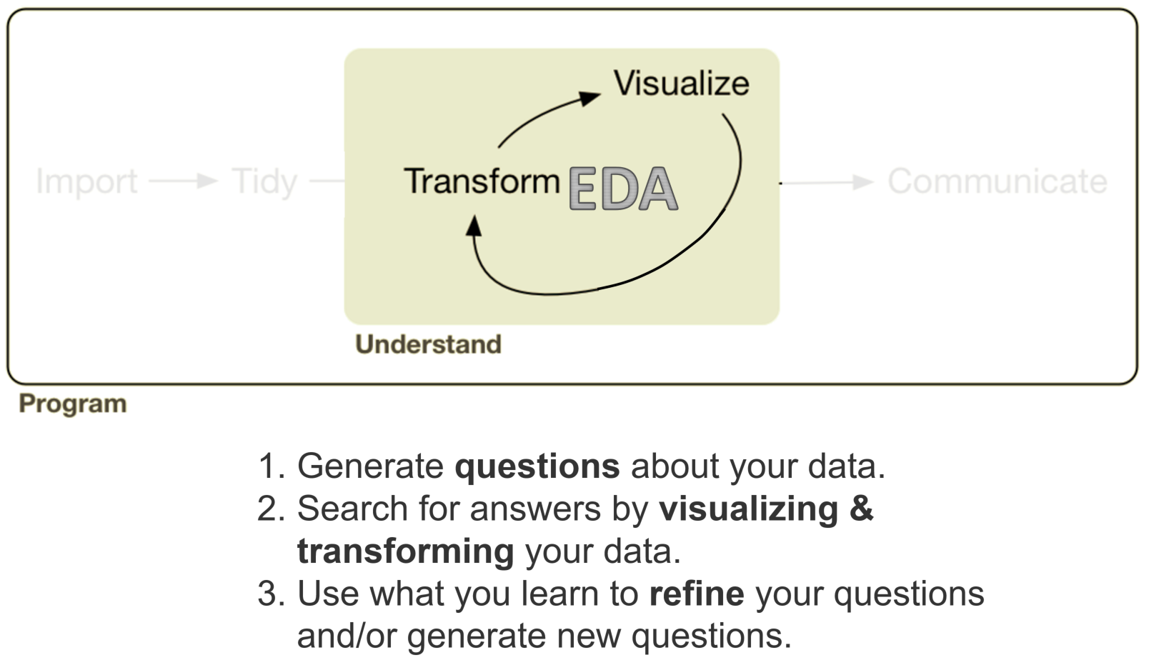
Last Session

Slide 4
Tidying Messy Data
This Session

Slide 5


“tidy datasets are all alike but every messy dataset is messy in its own way.”
“Happy families are all alike; every unhappy family is unhappy in its own way.”

Slide 6
What are the variables?
 | Course 1 Rating | Course 2 Rating
Professor X | — | 3.9
Professor Y | 4.4 | 4.3
Professor Z | 4.6 | 4.7
Course
Professor
Rating
Could also be shown as...
 | Professor X | Professor Y | Professor Z
Course 1 Rating | — | 4.4 | 4.6
Course 2 Rating | 3.9 | 4.3 | 4.7

Slide 7
What are the variables?
Professor | Course | Rating
Professor X | 2 | 3.9
Professor Y | 1 | 4.4
Professor Y | 2 | 4.3
Professor Z | 1 | 4.6
Professor Z | 2 | 4.7
Course
Professor
Rating

Slide 8
Tidy or Untidy?
Optimized: Look up ratings of professors for courses
Optimized: Thinking scientifically (variables, observations, measures)
 | Course 1 Rating | Course 2 Rating
Professor X | — | 3.9
Professor Y | 4.4 | 4.3
Professor Z | 4.6 | 4.7
Professor | Course | Rating
Professor X | 2 | 3.9
Professor Y | 1 | 4.4
Professor Y | 2 | 4.3
Professor Z | 1 | 4.6
Professor Z | 2 | 4.7
Notes:
First is a cross tab optimized for looking up ratings in courses for profs; the second is optimized for analysis and thinking about variables

Slide 9
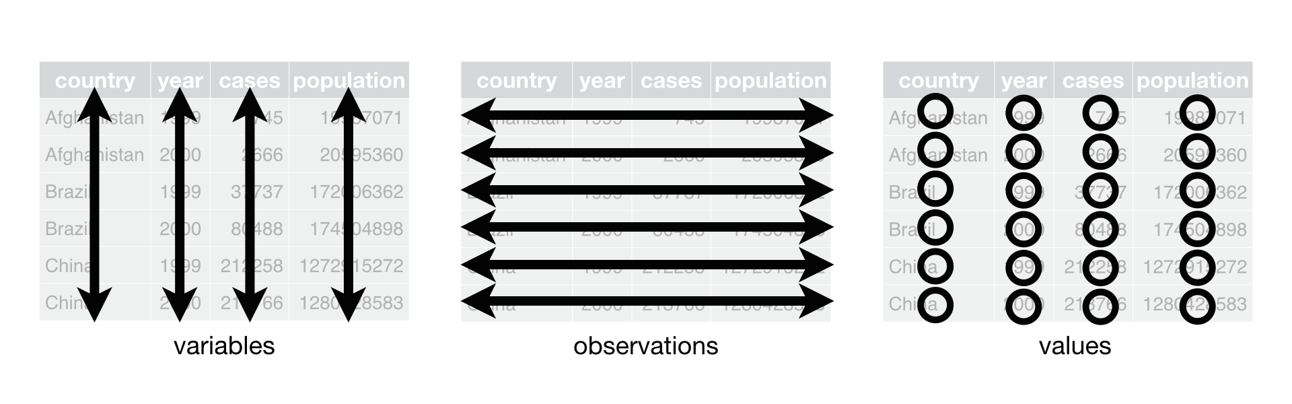
Rules of Tidy Data (any 2 results in the third)
Each variable must have its own column.
Each observation must have its own row.
Each value must have its own cell.

Slide 10
Tidy or Untidy?
Optimized: Look up ratings of professors for courses
Optimized: Thinking scientifically (variables, observations, measures)
 | Course 1 Rating | Course 2 Rating
Professor X | — | 3.9
Professor Y | 4.4 | 4.3
Professor Z | 4.6 | 4.7
Professor | Course | Rating
Professor X | 2 | 3.9
Professor Y | 1 | 4.4
Professor Y | 2 | 4.3
Professor Z | 1 | 4.6
Professor Z | 2 | 4.7
Untidy
Tidy

Slide 11
Which is Better?
Untidy
Tidy

Slide 12
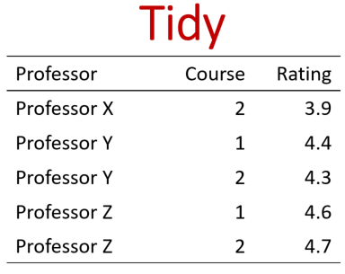
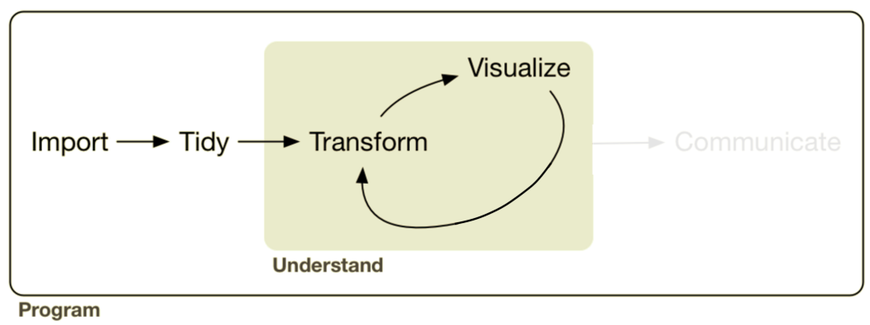
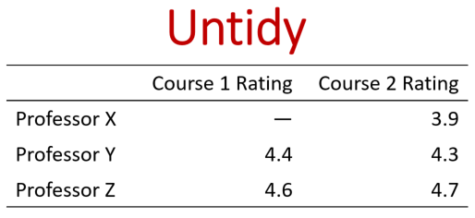
Which is Better?
Notes:
For understanding a particular question the untidy may be better, for conducting an analysis tidy is typically better.

Slide 13
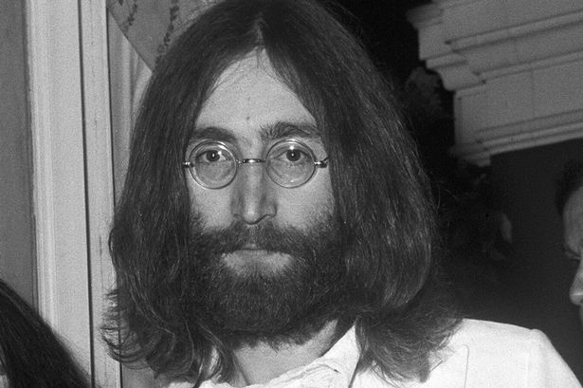
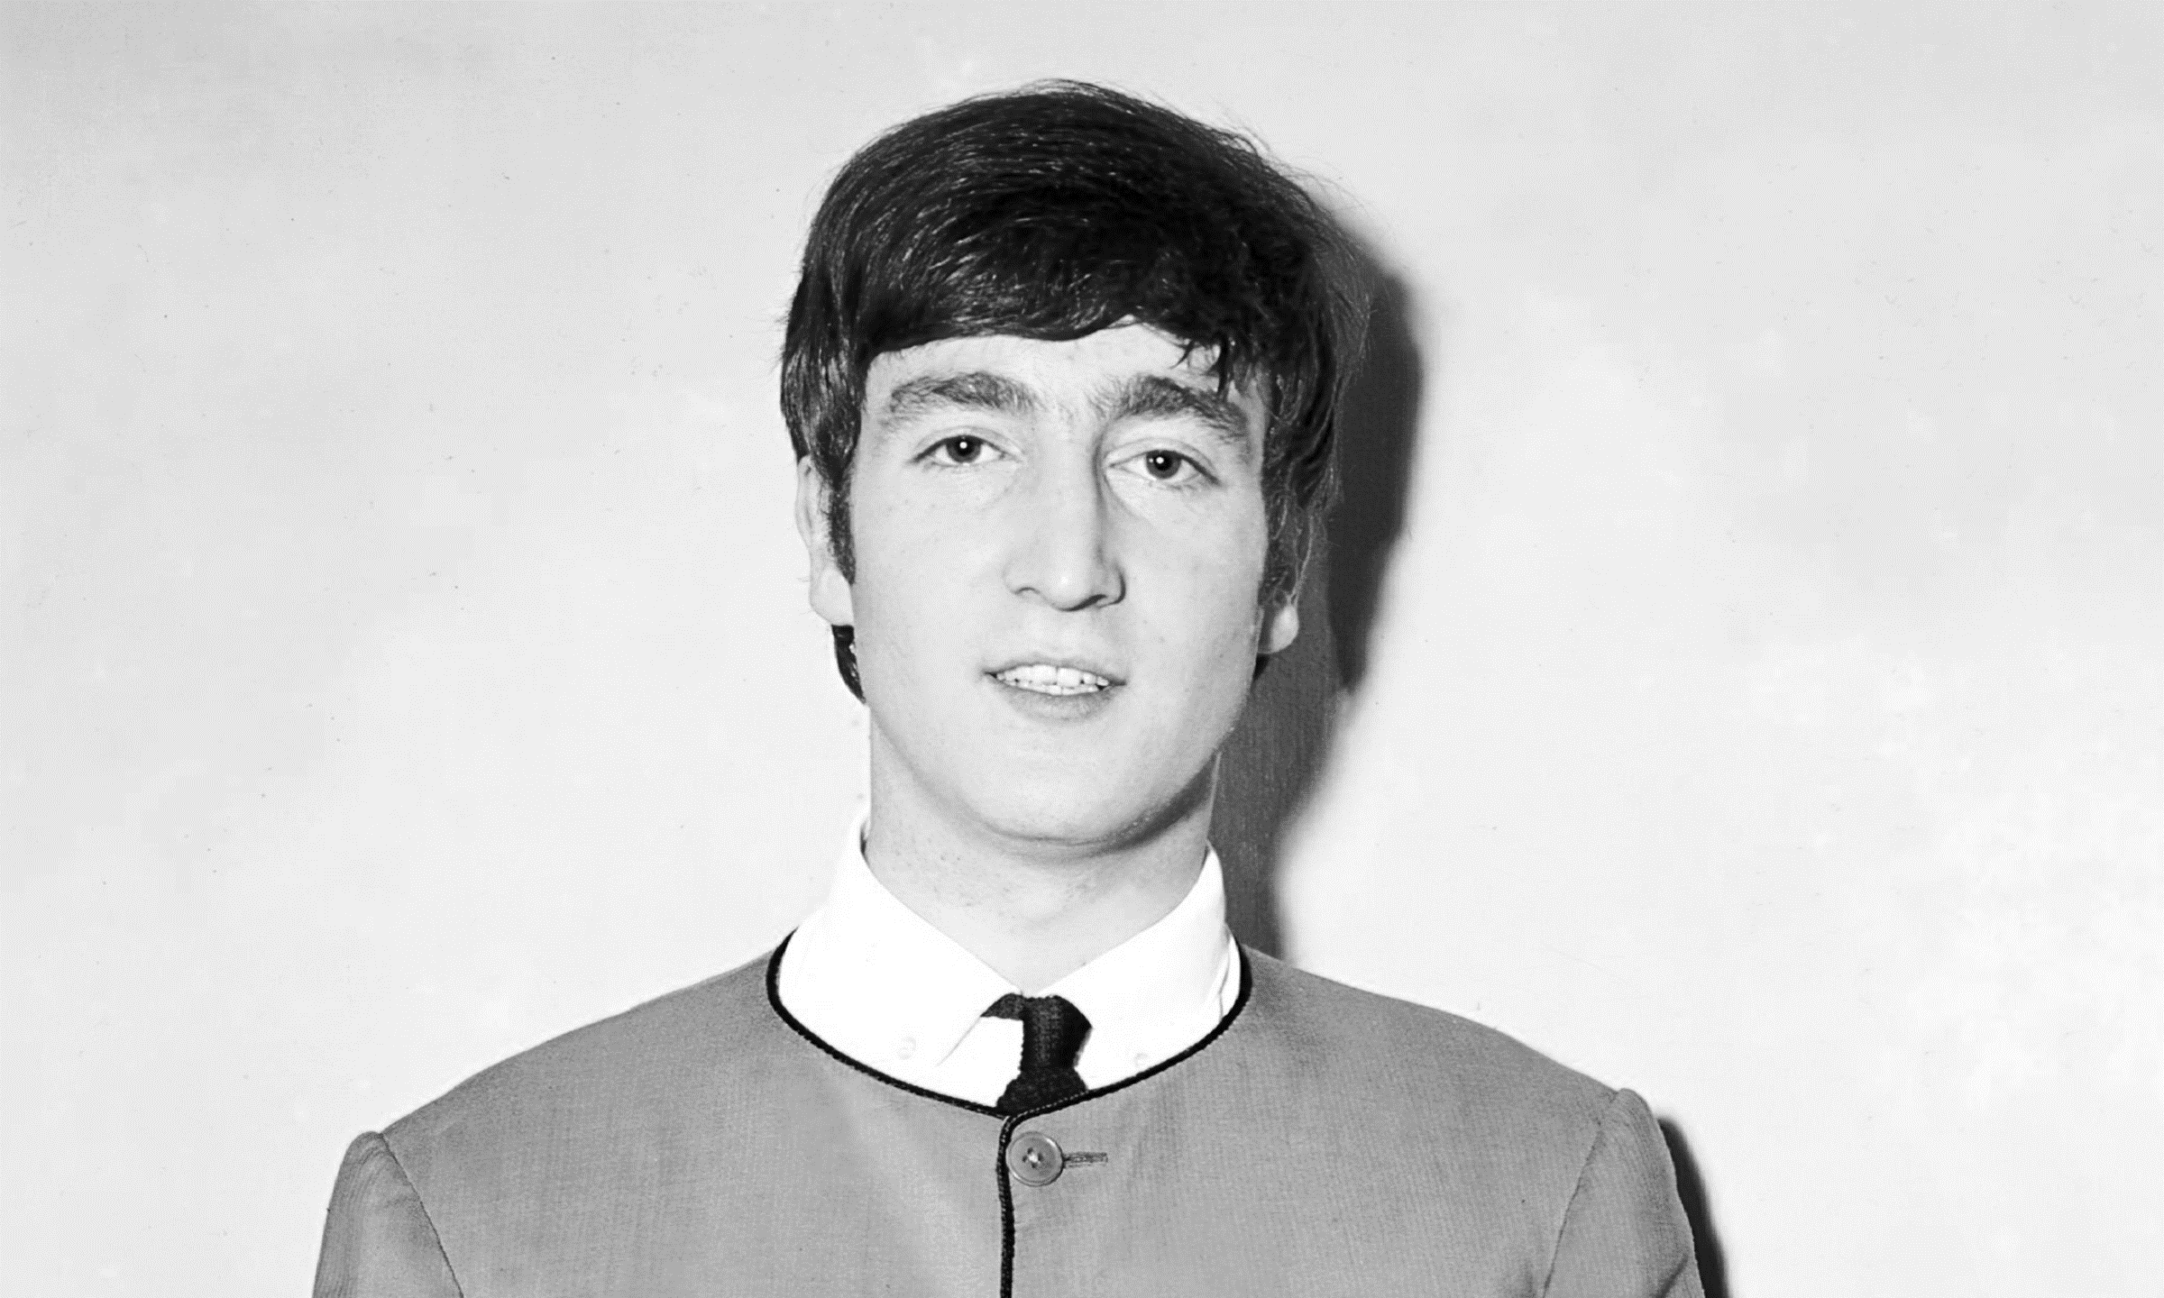


A Rose by Another Name…
Untidy
aka Wide
Tidy
aka Tall
 | Course 1 Rating | Course 2 Rating
Professor X | — | 3.9
Professor Y | 4.4 | 4.3
Professor Z | 4.6 | 4.7
Professor | Course | Rating
Professor X | 2 | 3.9
Professor Y | 1 | 4.4
Professor Y | 2 | 4.3
Professor Z | 1 | 4.6
Professor Z | 2 | 4.7

Slide 14
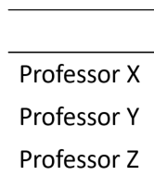
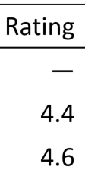


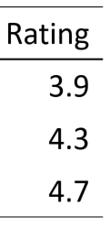

How can we turn old Lennon into young Lennon?
Doing this manually is a posterior negative subcutaneous sensation.
Notes:
W

Slide 15
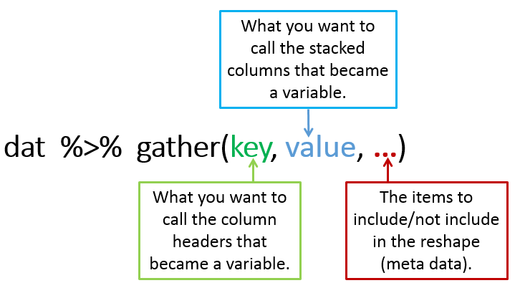
Enter the gather Function…
Name for new column of stacked values
data %>%
Name for new column of stacked headers
The columns to stack
 | Course 1 Rating | Course 2 Rating
Professor X | — | 3.9
Professor Y | 4.4 | 4.3
Professor Z | 4.6 | 4.7

