Slide 1
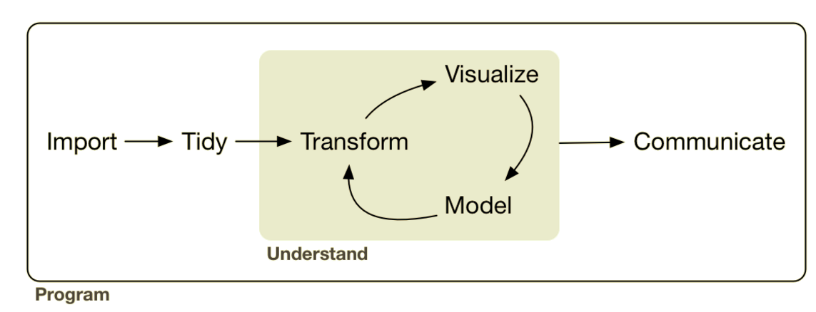
Analysis: Exploratory Data Analysis
EDA
Lesson Objectives: Import common data types.
Export graphical & tabular summaries of data.
Notes:
Up til now we’ve had data in formats that were generally useful. Maybe we had to clean up a variable or compute a new variable but for the most part they were what we call tidy data sets.

Slide 2





Analysis: Exploratory Data Analysis
sql ops

Slide 3
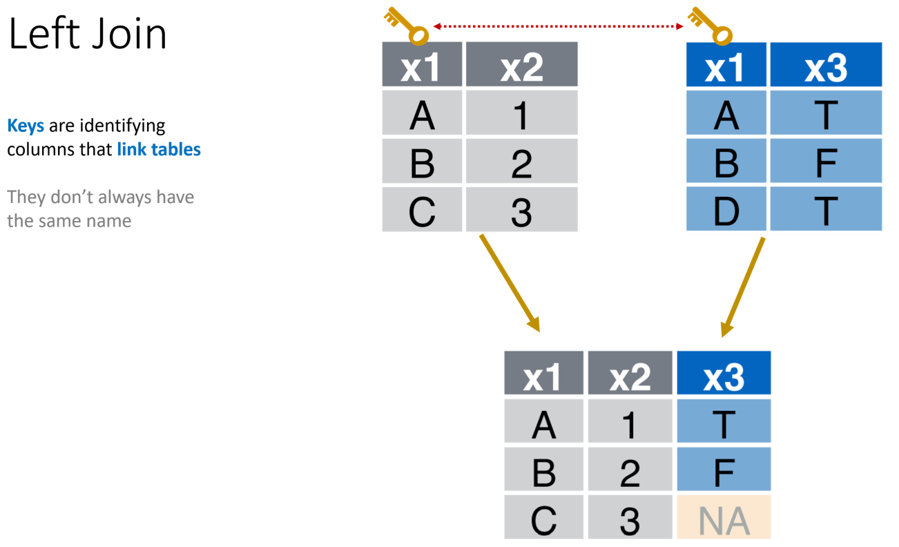
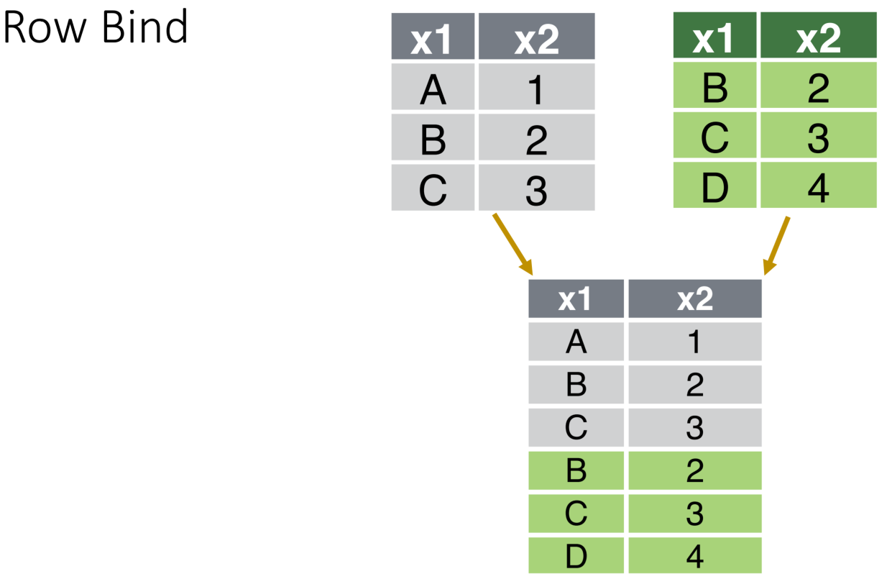
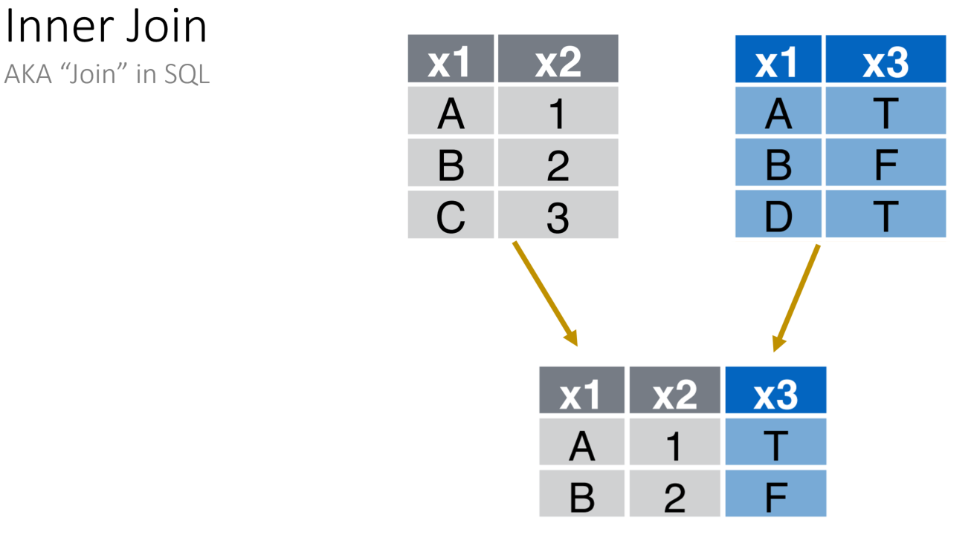
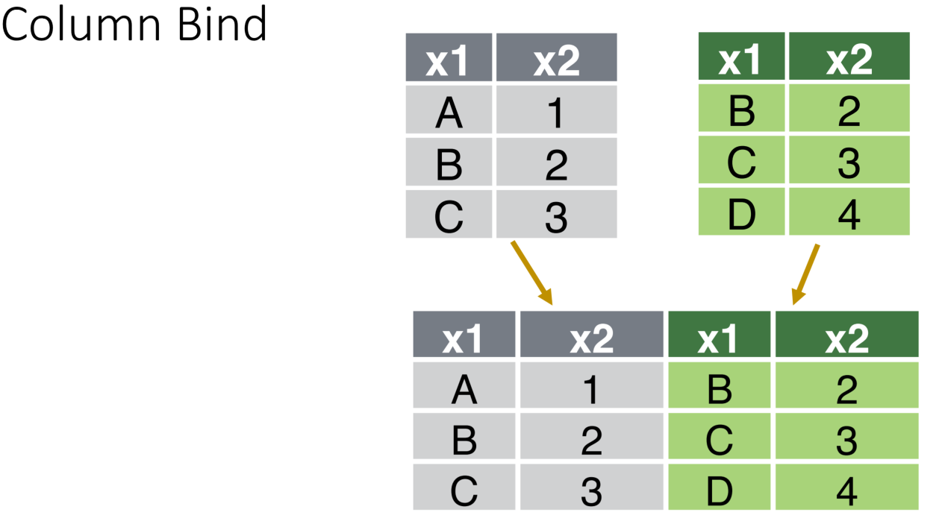
Last Session

Slide 4
Importing & Exporting: Graphical & Tabular Formats
This Session

Slide 5
Read/Write Tabular Data
Notes:
Left and inner do most all jobs (in R left usually). Anything else and you’re probably showing off.

Slide 6












R Can Handle Many Tabular Import Formats
Notes:
There are KEY columns that allow the tables to be related to one another and combined into human readable format

Slide 7
But We’re Going to Focus on .csv
Notes:
There are KEY columns that allow the tables to be related to one another and combined into human readable format

Slide 8
Read/Write Tabular Data
Read
Write
library(tidyverse)
mydata <- read_csv('path/to/file.csv')
library(tidyverse)
write_csv(mydata, 'path/to/file.csv')

Slide 9
Reading + Tidying
Considerations
Missing Values
Data Types

Slide 10
Missing Values
What are my missing values?
NA
" "
N/A
NULL
Na
n/a
999
Pass them to the na argument.
mydata <- read_csv(
'path/to/file.csv'
)

Slide 11
Missing Values
What are my missing values?
NA
" "
N/A
NULL
na
n/a
999
Pass them to the na argument.
mydata <- read_csv(
'path/to/file.csv',
na = c('NA', 'NULL', '')
)

Slide 12
Data Types
read_csv guesses
Can be set explicitly via the col_types argument
factor
logical
date
character
numeric
integer
time

Slide 13
Save Visualizations

Slide 14
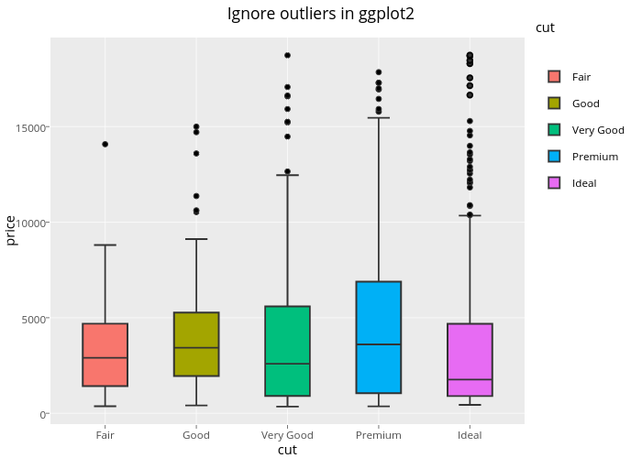
ggsave FTW
Plot in ggplot2
Save via ggsave()
File extension determines file type
ggplot(df, aes(cut, price, fill = cut)) +
geom_boxplot(outlier.shape = NA)
.eps
.ps
.tex
.pdf
.jpeg
.tiff
.png
.bmp
.svg"
.wmf"
.png
ggsave('path/to/file.pdf')
ggsave('path/to/file.png')

