Slide 1
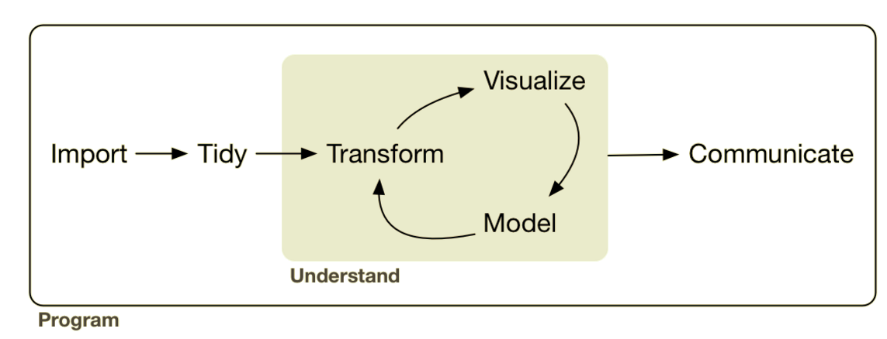
Combining: Joining & Binding
EDA
Lesson Objective: Combine data sets via joins and binds.
Notes:
Up til now we’ve had data in formats that were generally useful. Maybe we had to clean up a variable or compute a new variable but for the most part they were what we call tidy data sets.

Slide 2




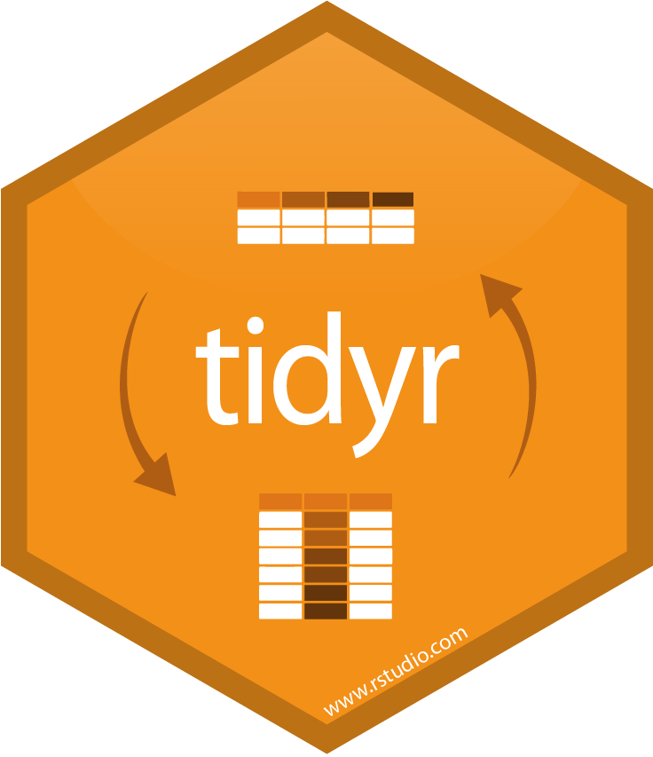
Combining: Joining & Binding
sql ops

Slide 3
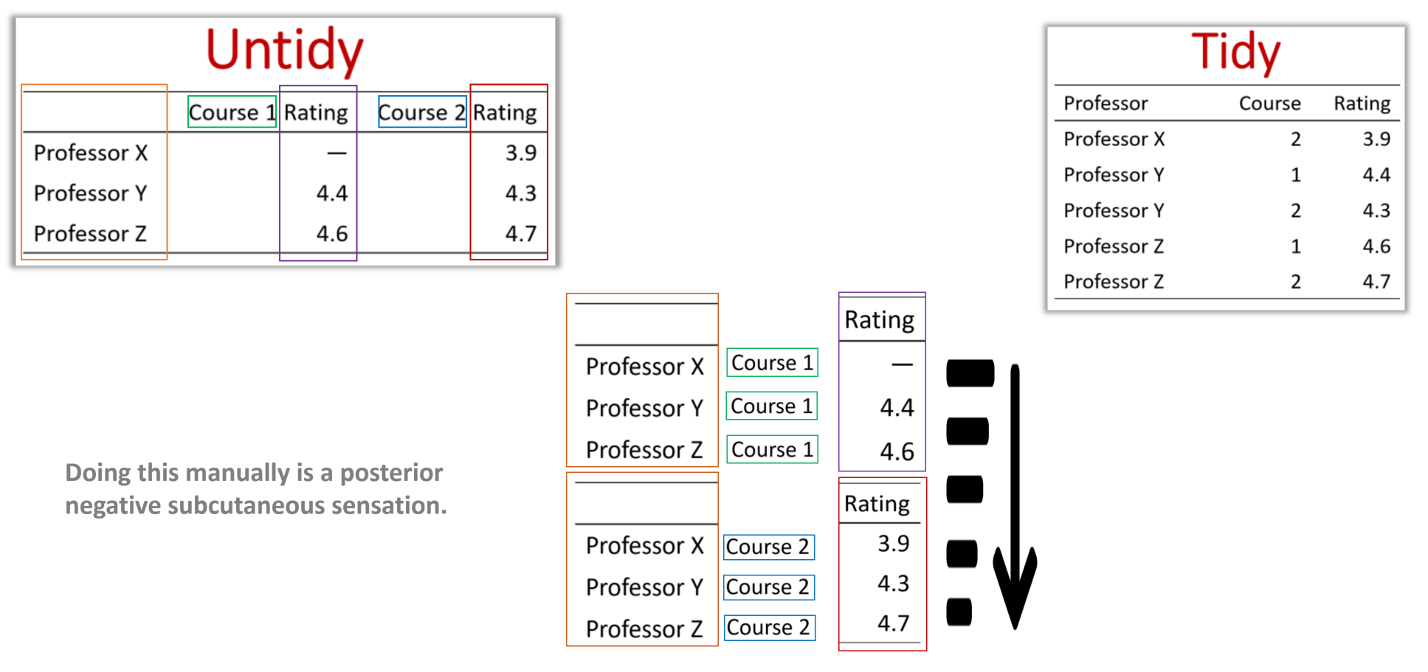
Last Session

Slide 4
Combining Data Sets: Joining & Binding
This Session

Slide 5

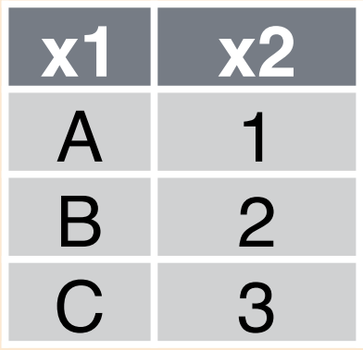
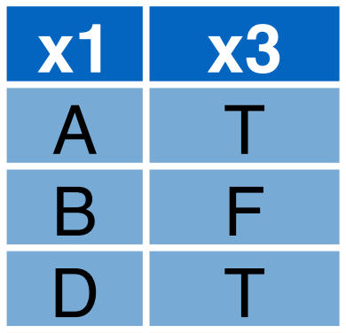
“Relational data isn’t written for humans.” -Developer-
Data is often stored in multiple tables & places
Notes:
There are KEY columns that allow the tables to be related to one another and combined into human readable format

Slide 6
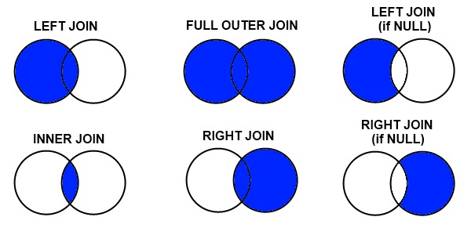
Joins
Faster
Notes:
Left and inner do most all jobs (in R left usually). Anything else and you’re probably showing off.

Slide 7

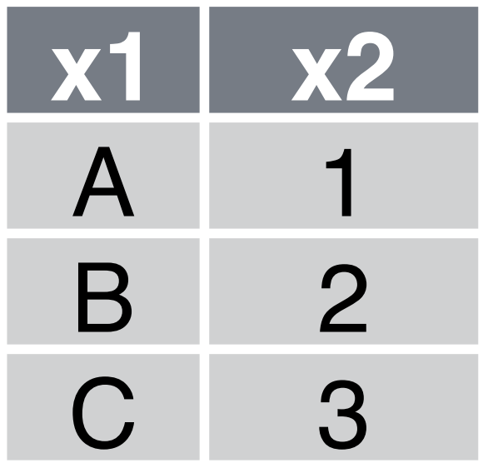
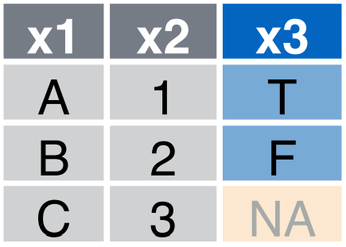
Left Join
Keys are identifying columns that link tables
They don’t always have the same name
Notes:
Often you want to know where there is no match (don’t want to discard).

Slide 8
Inner Join
AKA “Join” in SQL
Notes:
An inner join is more efficient because no fill in

Slide 9
Binds

Slide 10
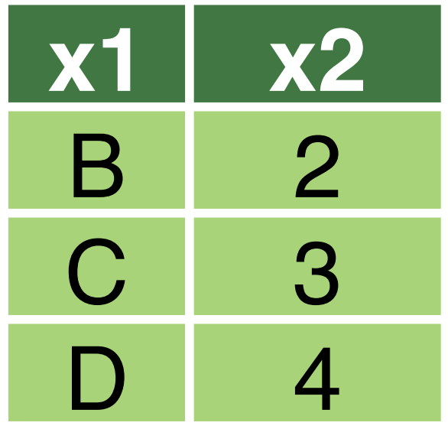
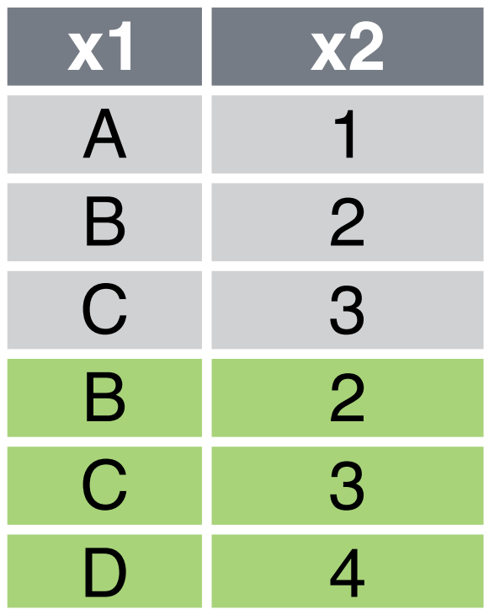
Row Bind
Notes:
Often you want to know where there is no match (don’t want to discard).

Slide 11
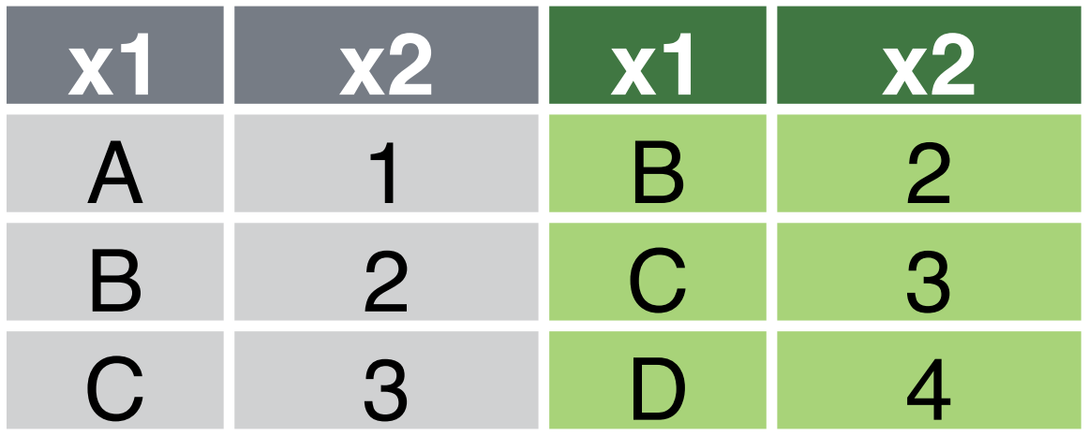
Column Bind
Notes:
An inner join is more efficient because no fill in

Slide 12
Combination Functions
Type | R: dplyr | SQL
Left Join | left_join | LEFT JOIN
Inner Join | inner_join | JOIN
Row Bind | bind_rows
Column Bind | bind_cols

