Slide 1
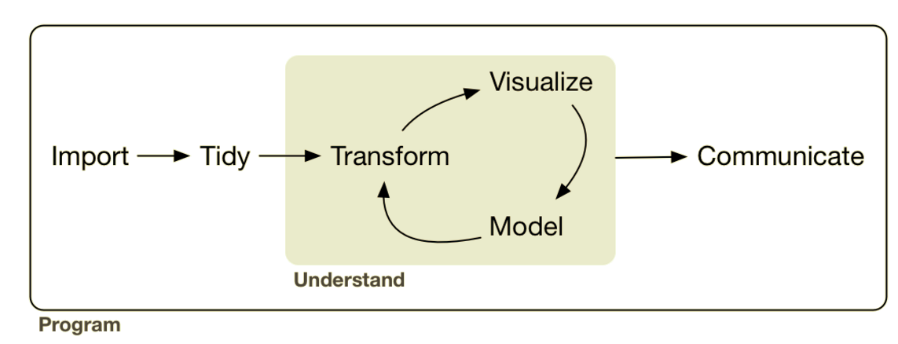
Combining: Joining & Binding
EDA
Lesson Objective: Combine data sets via joins and binds.
Notes:
Up til now we’ve had data in formats that were generally useful. Maybe we had to clean up a variable or compute a new variable but for the most part they were what we call tidy data sets.

Slide 2




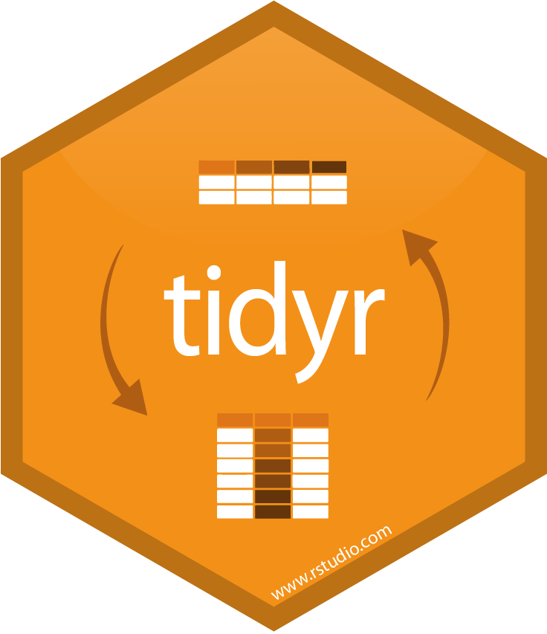
Combining: Joining & Binding
sql ops

Slide 3
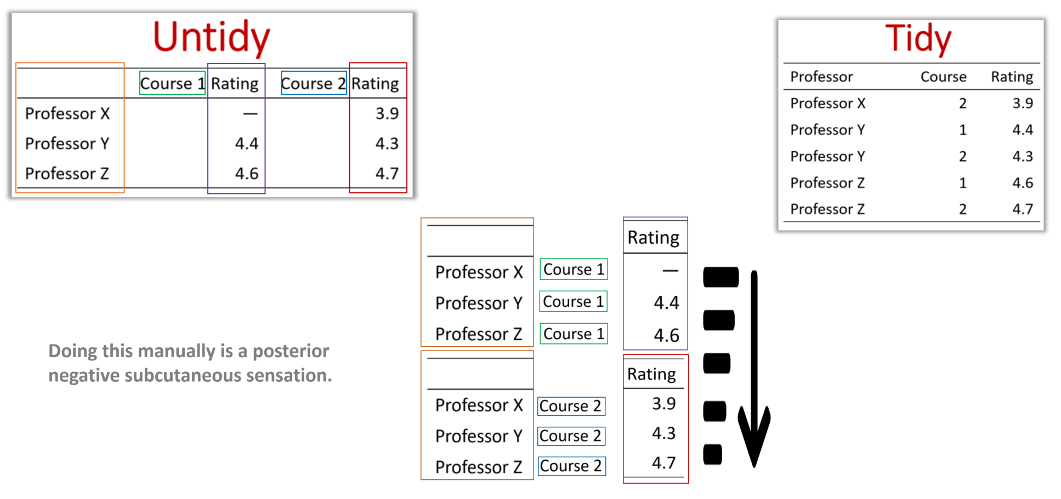
Last Session

Slide 4
Combining Data Sets: Joining & Binding
This Session

Slide 5

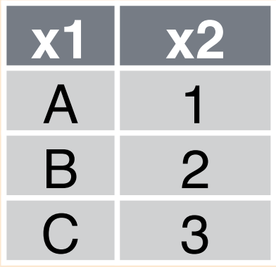
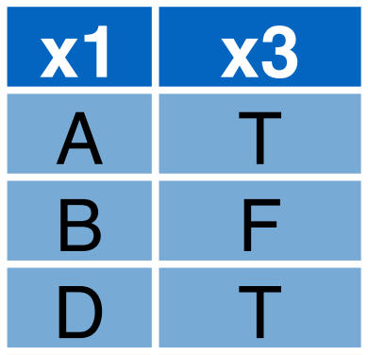
“Relational data isn’t written for humans.” -Buddy-
Data is often stored in multiple tables & places
Notes:
There are KEY columns that allow the tables to be related to one another and combined into human readable format

Slide 6

“Relational data isn’t written for humans.” -Developer-
Data is often stored in multiple tables & places
Notes:
There are KEY columns that allow the tables to be related to one another and combined into human readable format

Slide 7
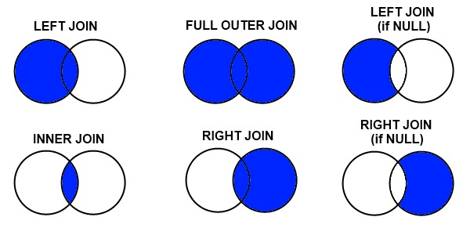
Joins
Faster
Notes:
Left and inner do most all jobs (in R left usually). Anything else and you’re probably showing off.

Slide 8

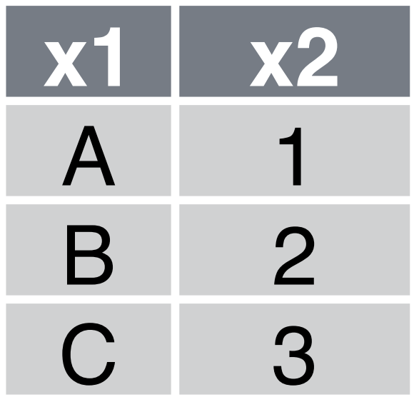
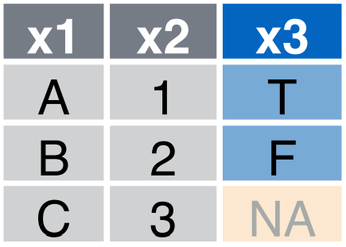
Left Join
Keys are identifying columns that link tables
They don’t always have the same name
Notes:
Often you want to know where there is no match (don’t want to discard).

Slide 9
Inner Join
AKA “Join” in SQL
Notes:
An inner join is more efficient because no fill in

Slide 10
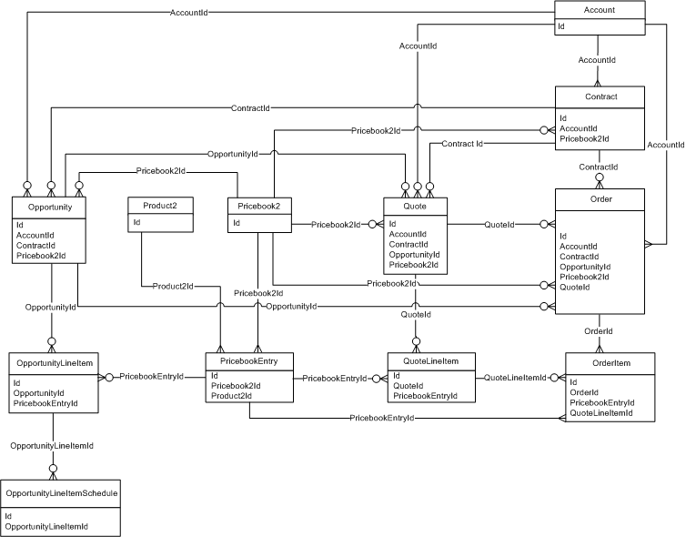

Salesforce Entity Relationship Diagram
Two Parts to Joining:
Knowing tables, fields, and key connections
Joining
2
1
https://developer.salesforce.com/docs/atlas.en-us.api.meta/api/sforce_api_erd_products.htm
https://resources.docs.salesforce.com/212/latest/en-us/sfdc/pdf/apex_api.pdf
Notes:
A mapping that shows how tables link up. Our systems don’t have a ER Diagram but the salesforce data does and can help guide you through the connections though salesforce != our SF data dump

Slide 11
Binds

Slide 12
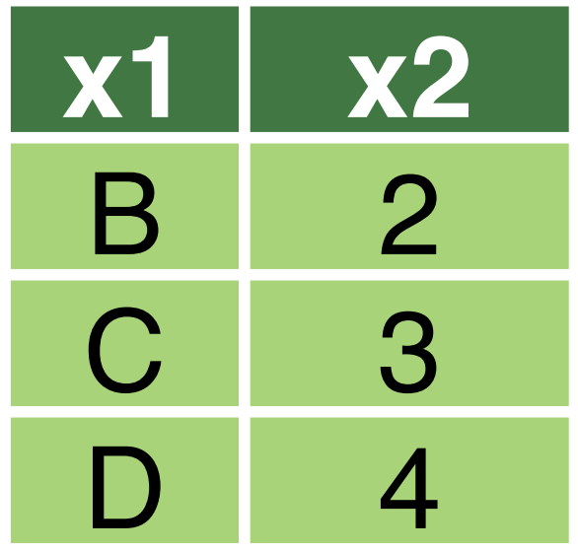
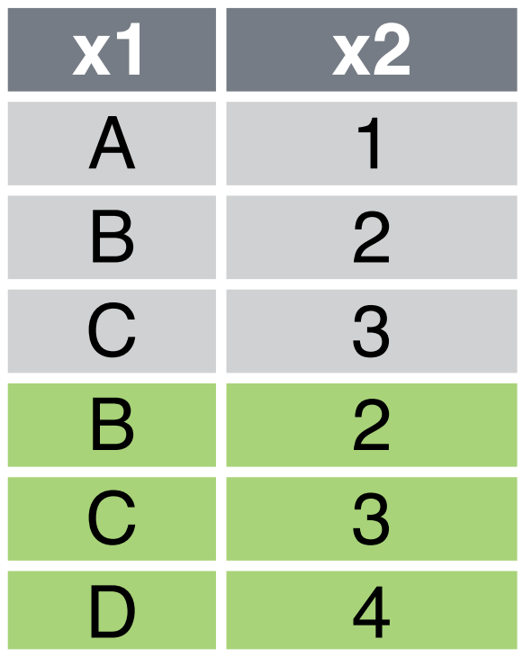
Row Bind
Notes:
Often you want to know where there is no match (don’t want to discard).

Slide 13
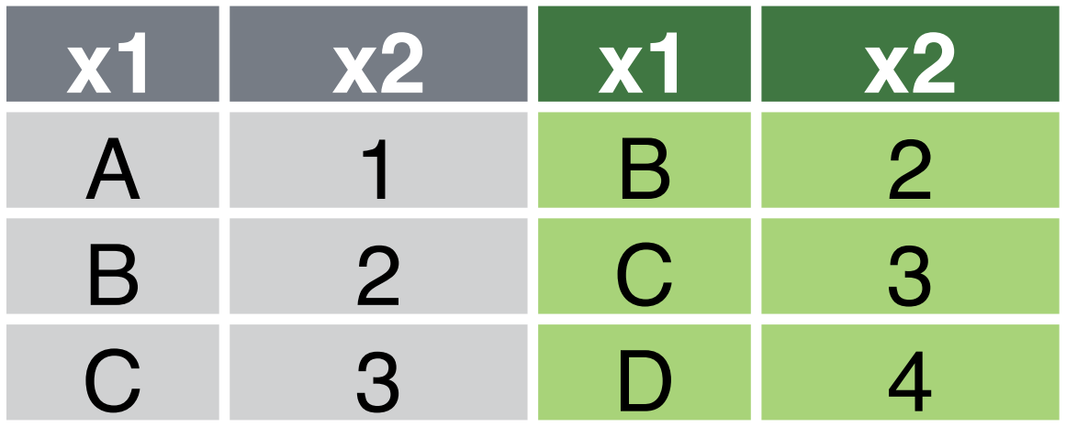
Column Bind
Notes:
An inner join is more efficient because no fill in

Slide 14
Combination Functions
Type | R: dplyr | SQL
Left Join | left_join | LEFT JOIN
Inner Join | inner_join | JOIN
Row Bind | bind_rows
Column Bind | bind_cols

