Slide 1
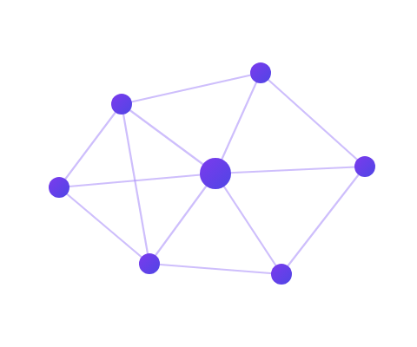
AI-FIRST DELIVERY PARTNERSHIP
Trinly × ArtSync
Work Portfolio — AI systems we have designed, built and shipped
Five production platforms across clinical trials, drone inspection, railway safety, enterprise integrity and commercial web — plus the full service and support capability behind them.
Ashish Tyagi — Founder & CEO
hello@trinly.us · hello@artsync.live

Slide 2
01
Who we are
One allied delivery group covering the complete path from raw data to a production AI product — senior strategy from the US and Europe, deep engineering and data capacity from India.
Trinly
ArtSync India
US · AI CONSULTANCY
INDIA · AI & DATA INTELLIGENCE
AI-first technology consultancy turning AI ambitions into shipped, production-ready products — RAG systems, model training, AI agents and MLOps. Architecture, strategy and delivery leadership.
AI development, data intelligence and annotation at scale — data engineering, ML/LLM engineering, automation, enterprise applications and ongoing IT support from six hubs across India.
trinly.us
artsync.live
17+
6
5
24/7
AI engineers & architects
Global delivery hubs
Countries
Follow-the-sun coverage
Trinly · ArtSync India — Work Portfolio · trinly.us · artsync.live
02 / 21

Slide 3
02
What we do
Eight capabilities, each one demonstrated by a project later in this deck.
RAG & retrieval systems
Production retrieval pipelines with vector search, semantic precedent lookup and context-aware grounding.
Model training & fine-tuning
Custom training, LoRA and domain adaptation — with evaluation harnesses and retraining loops.
AI agents & orchestration
Multi-agent, tool-using systems that carry out multi-step business workflows end to end.
Computer vision
Detection and segmentation on visual and thermal imagery, at the edge and in the cloud.
Data engineering & annotation
ETL, cleaning, labeling and ML-ready dataset delivery — including physical-AI video annotation.
MLOps & deployment
Serving, monitoring, drift detection, A/B testing and continuous deployment.
Full-stack product engineering
Web, native mobile and API platforms — monorepos, design systems, CI/CD.
Regulated & compliant systems
Audit trails, e-signatures, RBAC and submission packages for regulated industries.
Trinly · ArtSync India — Work Portfolio · trinly.us · artsync.live
03 / 21

Slide 4
03
Selected work
Five systems, deliberately spanning the range — from a regulated clinical data platform to a contractor website shipped in weeks.
PROJECT
DOMAIN
WHAT IT IS
Helix
Clinical trials · regulated life sciences
Decision-intelligence platform for the ODM → SDTM → ADaM pipeline, with AI-assisted mapping and 21 CFR Part 11 compliance.
Sentinel
Drone · infrastructure inspection
Drones survey the asset, computer vision finds the defects, the platform turns them into tracked, SLA-bound work orders.
Cortex
Railway · edge AI
Cart-mounted Raspberry Pi captures track imagery over 4G; cloud AI detects rail defects on a geospatial operator dashboard.
RDACTD
Enterprise integrity · SaaS
Encrypted complaint management, resolution workflows and organizational integrity analytics — web and native mobile.
Open Air Construction
Commercial web · local SEO
Contractor marketing site with typed content, MDX blog, lead pipeline and an admin inbox — Lighthouse SEO 100.
Trinly · ArtSync India — Work Portfolio · trinly.us · artsync.live
04 / 21

Slide 5

04
Helix
Institutional memory for clinical data mapping
CLINICAL TRIALS · REGULATED LIFE SCIENCES
THE CONTEXT
WHAT WE BUILT
Decision Intelligence Platform for Clinical Data — capturing, versioning and reusing mapping decisions across the ODM → SDTM → ADaM transformation pipeline.
CDISC ODM v1.3.2 ingestion with schema validation, then mapping decisions carried through review, comment and approval chains
Cross-study precedent reuse — semantic search over prior decisions, copied forward with lineage tracking and conflict resolution
AI-assisted mapping suggestions with confidence scoring, plus nine anomaly detectors for cross-study inconsistency
Executable SAS, R and Python code generated straight from approved decisions
Virtual trial simulation: a 17-tool agent runs synthetic cohorts visit by visit, with synthetic control arms and ML enrollment forecasting
Regulatory output — eCTD Module 5 packages, Define-XML 2.1, ClinicalTrials.gov registration, RBQM risk dashboards
THE PROBLEM
Every clinical study re-derives the same data-mapping decisions from scratch. The reasoning lives in spreadsheets and in people's heads, it is lost when staff move on, and regulators still expect a defensible audit trail for every one of them.
WHY IT IS HARD
21 CFR Part 11 compliance is not a feature you bolt on. Every action writes to an append-only audit log chained with SHA-256 checksums, backed by electronic signatures and role-based access control — so the record is tamper-evident end to end.
Trinly · ArtSync India — Work Portfolio · trinly.us · artsync.live
05 / 21

Slide 6
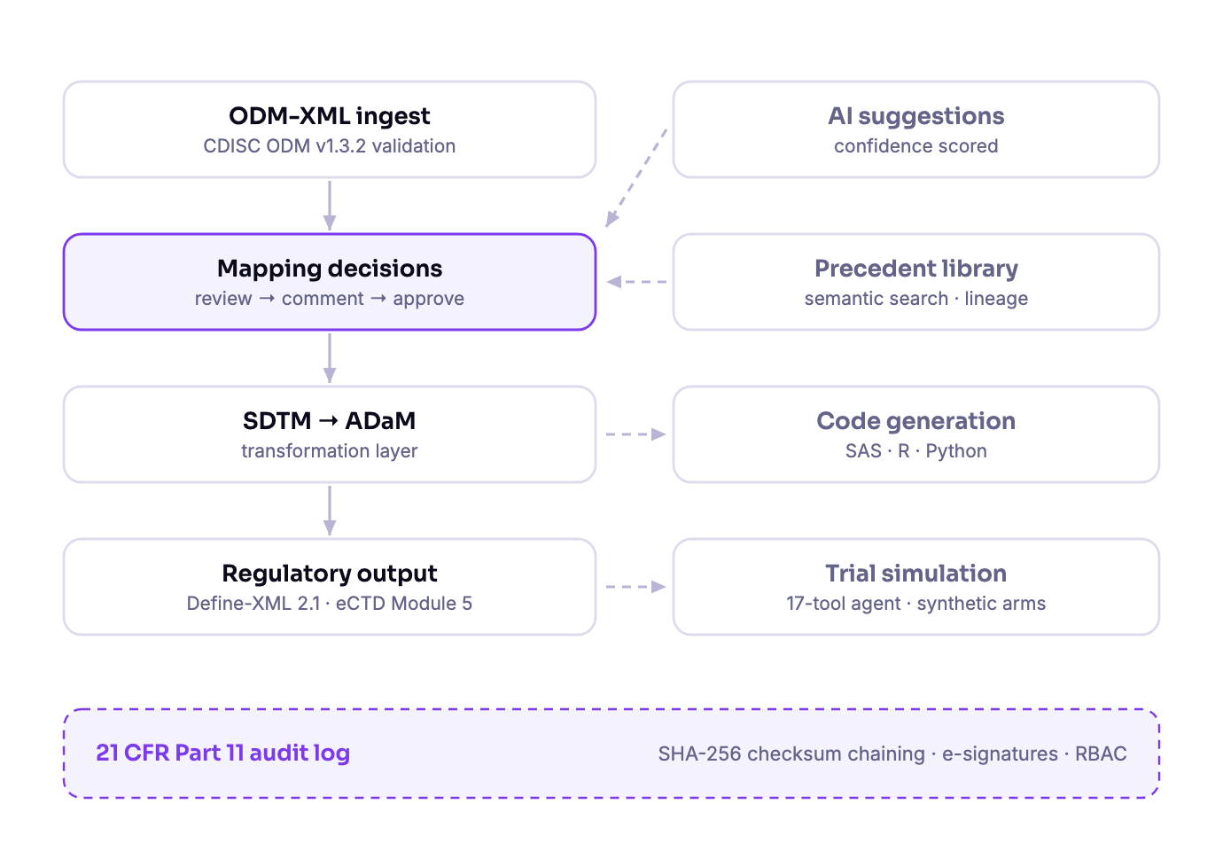
Helix
Architecture & stack
STACK
BACKEND
FastAPI · Python 3.12 · SQLAlchemy · Alembic
DATA
PostgreSQL · vector embeddings for precedent search
FRONTEND
Expo Web (React Native Web) · shared RN component library
MOBILE
Expo native app · biometric auth · mobile approvals
AI
Multi-provider LLM layer — OpenAI, Azure, Anthropic, Ollama
MONOREPO
pnpm workspaces · apps/api, apps/web, apps/mobile, packages/*
NOTABLE
Compliance by construction — append-only audit log, SHA-256 checksum chaining, e-signatures, RBAC
Integration hub with bidirectional connectors for Medidata Rave, Veeva Vault, Oracle InForm and SAS
Real-world data connectors — FDA FAERS, openFDA, PubMed, CMS — with OMOP CDM and FHIR R4 support
Eight interface languages with multilingual embeddings, so precedent search works across regions
Trinly · ArtSync India — Work Portfolio · trinly.us · artsync.live
06 / 21

Slide 7
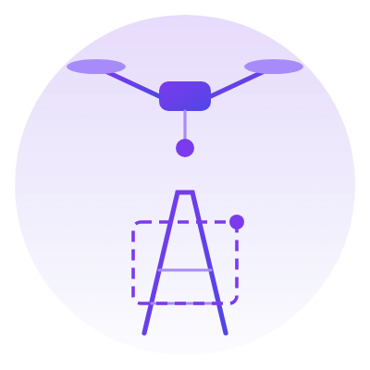
05
Sentinel
From drone survey to closed work order
DRONE OPERATIONS · INFRASTRUCTURE INSPECTION
THE CONTEXT
WHAT WE BUILT
AI-powered infrastructure inspection platform. Drones fly the asset, computer vision finds the defects, and the platform turns them into tracked, assigned, SLA-bound work.
The core loop: survey → visual and thermal imagery → YOLO26 detection → draft annotations → inspector review → work orders → field remediation → PDF report
Geospatial context — KML/Shapefile/GeoJSON import, LIDAR point clouds, corridor encroachment and terrain-risk analytics
Photogrammetry via NodeODM: orthophotos, digital surface models and textured 3D models, served as map tiles and an in-browser point-cloud viewer
Drone operations — flight planning with safety validation, no-fly checks against FAA/AirMap, autonomous and swarm missions
A PX4 SITL simulator so missions are tested in software before any aircraft leaves the ground
Web, native mobile and a public marketing site, all from one Nx monorepo
THE PROBLEM
Infrastructure inspection is manual, slow and hazardous. The findings end up in photo folders and spreadsheets, disconnected from the crews who have to fix anything — so nothing is provably closed out.
WHY IT IS HARD
The AI improves itself. Every annotation an inspector approves becomes labelled training data; the model is fine-tuned and redeployed. Human review is not a cost centre in this system — it is the training pipeline.
Trinly · ArtSync India — Work Portfolio · trinly.us · artsync.live
07 / 21

Slide 8
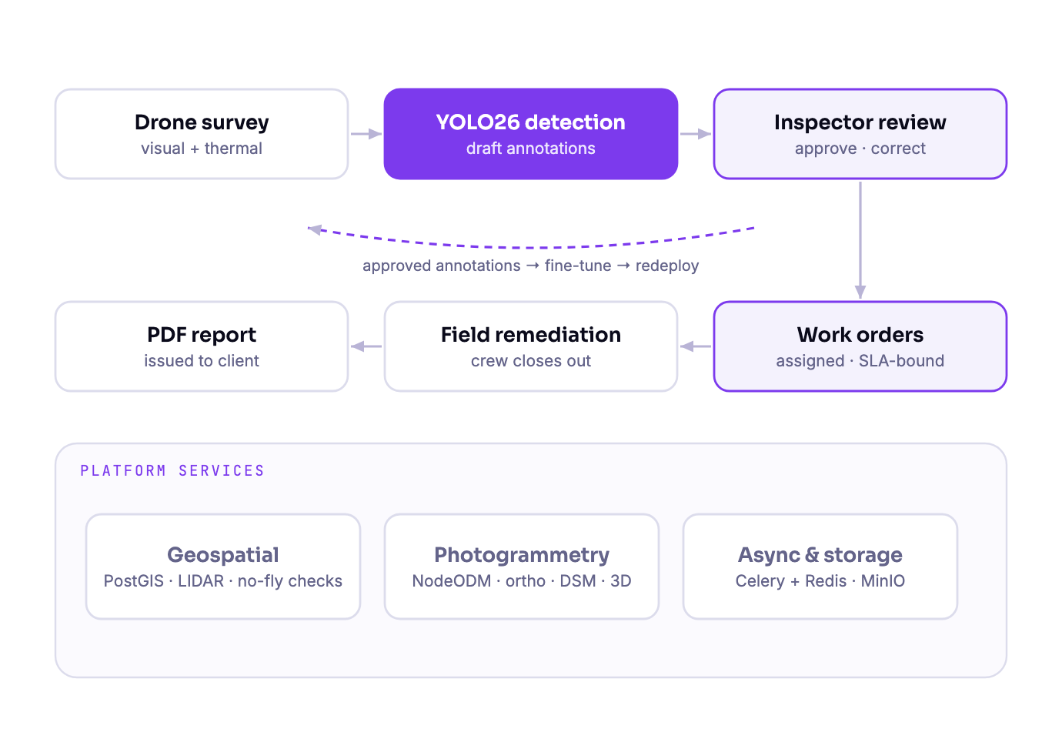
Sentinel
Architecture & stack
STACK
FRONTEND
React 19 · TypeScript 5.5 · Vite 6 · Tailwind 4 · Leaflet · Three.js · Konva
BACKEND
Python 3.11 · FastAPI · SQLAlchemy 2 · Pydantic 2 · Alembic
DATABASE
PostgreSQL + PostGIS
ASYNC
Celery + Redis — queues for AI, reports, work orders, LIDAR
AI & IMAGING
YOLO26 via Ultralytics (separate visual and thermal models) · NodeODM
PLATFORM
MinIO object storage · React Native/Expo mobile · Astro marketing · Nx
NOTABLE
Closed learning loop — approved annotations retrain the detector and redeploy it
Separate visual and thermal models, because a hot joint and a cracked insulator are not the same detection problem
Published documentation site built from the repository and deployed on every merge
Simulation-first drone testing with PX4 SITL — no hardware required to validate a mission
Trinly · ArtSync India — Work Portfolio · trinly.us · artsync.live
08 / 21

Slide 9
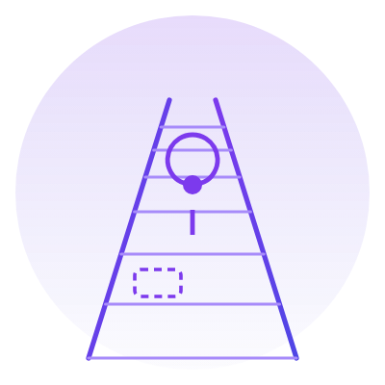
06
Cortex
AI track inspection from a cart and a Raspberry Pi
RAILWAY SAFETY · EDGE AI
THE CONTEXT
WHAT WE BUILT
Railway track inspection system. A cart-mounted Raspberry Pi captures imagery during inspection runs, uploads it over 4G, and cloud AI identifies track defects in near real time.
An edge capture daemon on a Raspberry Pi 5 with an Arducam IMX296 camera, GPS and a 4G HAT — geotagged imagery captured on the move
Local buffering and resumable upload over LTE, so a run in a dead zone is never a lost run
Cloud detection pipeline — FastAPI and Celery workers running YOLO models for rail cracks, missing fasteners and gauge deviations
PostGIS-backed findings, so every defect carries its position on the track segment
A Next.js operator dashboard with a Leaflet map, run history and per-finding review
Bot registration and API-key provisioning, so a new cart is added to the fleet in minutes
THE PROBLEM
Track is still inspected largely on foot. Coverage is slow, defects are found late, and there is no consistent geolocated record of what was seen on which run — which makes trends across a corridor invisible.
WHY IT IS HARD
Field connectivity is unreliable by default. The uploader's offline-resilience behaviour is covered by a test suite that runs on any laptop — no Pi, no camera, no track — so the hardest failure mode is verified continuously, not on site.
Trinly · ArtSync India — Work Portfolio · trinly.us · artsync.live
09 / 21

Slide 10
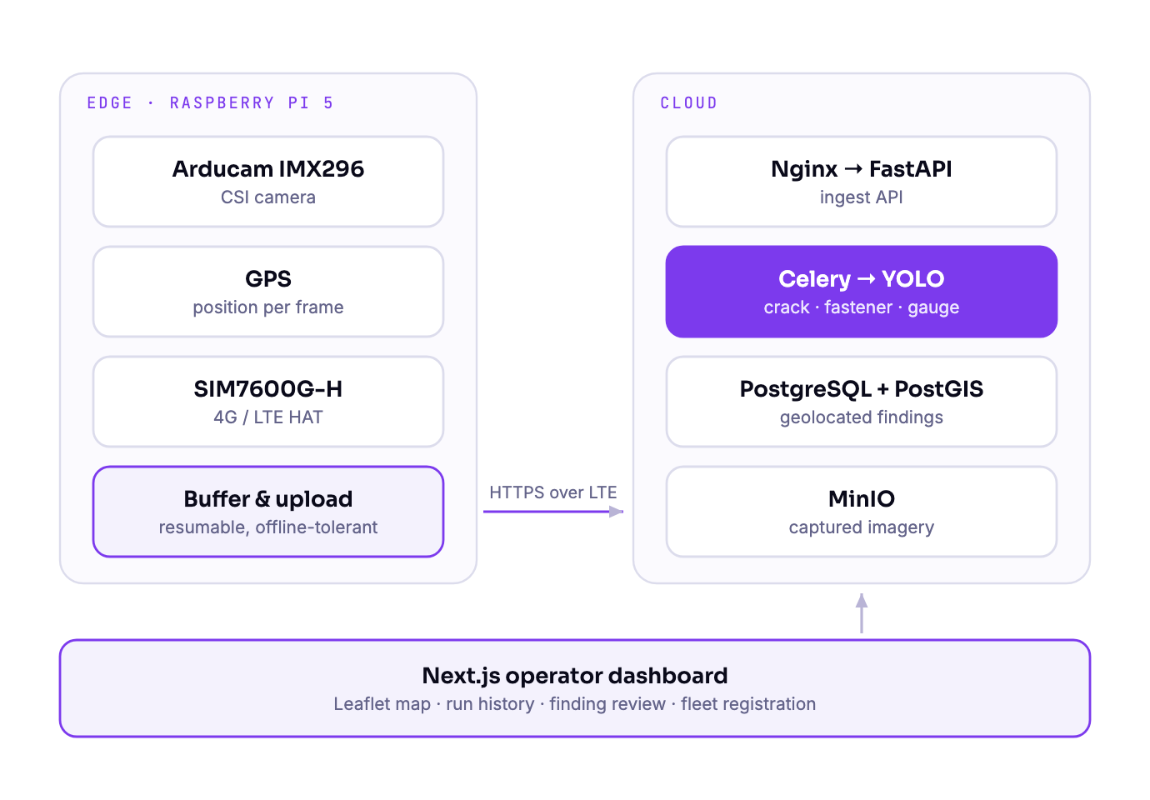
Cortex
Architecture & stack
STACK
EDGE
Raspberry Pi 5 · Python · picamera2 · pyserial · systemd daemon
HARDWARE
Arducam IMX296 (CSI) · GPS · SIM7600G-H 4G HAT
BACKEND
FastAPI · SQLAlchemy · Celery · YOLO detection workers
DATABASE
PostgreSQL + PostGIS for geolocated findings
STORAGE
MinIO (S3-compatible) for captured imagery
FRONTEND & OPS
Next.js 15 · TypeScript · Tailwind · Leaflet · Docker Compose · Nginx
NOTABLE
Runs on commodity hardware — a Pi, a camera and a 4G modem, not a specialised inspection vehicle
Offline-first by design: buffer on the cart, reconcile in the cloud
Single-command local environment (docker-compose up) with an auto-seeded admin user
Provisioning is scripted end to end, from flashing the Pi to starting the capture service
Trinly · ArtSync India — Work Portfolio · trinly.us · artsync.live
10 / 21

Slide 11

07
RDACTD
Complaints that can be trusted, tracked and measured
ENTERPRISE INTEGRITY · MULTI-TENANT SAAS
THE CONTEXT
WHAT WE BUILT
Complaint management and business analytics platform — encrypted reporting, structured resolution, and integrity analytics for multi-branch organisations.
Encrypted, evidence-backed submission flows with categorical routing and real-time status tracking
End-to-end resolution channels that let a reporter and an organisation lead work a case to closure
Organizational health dashboards for multi-branch entities, with predictive risk modelling and integrity benchmarking
AI-assisted pattern identification across cases, plus automated structural-health forecasting
Public verified profiles showing integrity scores, historical performance and resolution velocity
Multi-tier SaaS framework with billing, team governance and role-based administration
THE PROBLEM
Serious complaints still travel by email. Reporters have no privacy and no visibility, organisations have no structured record, and neither side can show afterwards that anything was actually resolved.
WHY IT IS HARD
Web and native mobile share one TypeScript core — models, service layer, tRPC client, WebSocket client, Drizzle schema and design tokens all live in shared packages. The two clients cannot drift apart, because there is only one implementation of the rules.
Trinly · ArtSync India — Work Portfolio · trinly.us · artsync.live
11 / 21

Slide 12
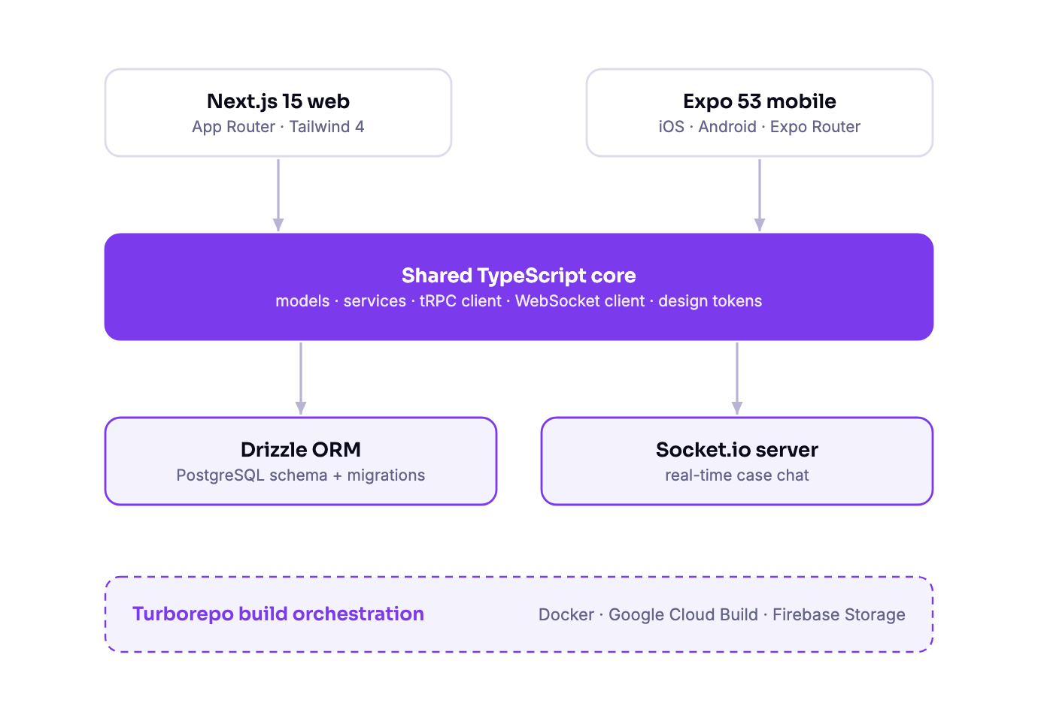
RDACTD
Architecture & stack
STACK
WEB
Next.js 15 · Tailwind CSS 4 · SEO-ready App Router
MOBILE
Expo 53 · Expo Router · native iOS and Android
SHARED CORE
packages/shared — models, services, tRPC client, WebSocket client
DATA
packages/database — Drizzle ORM schema on PostgreSQL
REALTIME
packages/websocket — Socket.io server for live case chat
BUILD & DEPLOY
Turborepo · Docker · Google Cloud Build · Firebase Storage
NOTABLE
One monorepo, four packages, two apps — a change to a business rule lands everywhere at once
Design tokens as a package, so web and native render the same product
Real-time case chat over Socket.io, with offline-tolerant client behaviour
Containerised web and websocket services, built and deployed through Cloud Build pipelines
Trinly · ArtSync India — Work Portfolio · trinly.us · artsync.live
12 / 21

Slide 13

08
Open Air Construction
A contractor site built to convert, not just to exist
COMMERCIAL WEB · LEAD GENERATION · LOCAL SEO
THE CONTEXT
WHAT WE BUILT
Charlotte deck and outdoor-living contractor website — a production marketing site with a full lead pipeline behind it.
Next.js 16 App Router with Tailwind CSS v4 over a custom Material 3 token layer, light and dark themes
A typed content layer — services, team, FAQs and metadata in TypeScript, so structural mistakes fail the build
An MDX blog the owner can add to by dropping in a file, rendered through a custom loader
Lead pipeline: contact form Server Action with Zod validation, Postgres persistence and Resend email notification
A protected admin inbox with bcrypt auth, lead filtering, status management and CRM sync hooks
Technical SEO — LocalBusiness, Service and FAQ JSON-LD, sitemap, robots, dynamic OG images
THE PROBLEM
A local contractor needs more than a brochure: fast pages, trust signals, service-area coverage, and a dependable way to turn consultation requests into leads someone actually follows up — without losing editorial control or SEO.
THE RESULT
A Lighthouse SEO score of 100, an editor workflow that needs no developer, and JobTread CRM plus AI enrichment already wired in behind environment keys — they switch on without touching the plumbing.
Trinly · ArtSync India — Work Portfolio · trinly.us · artsync.live
13 / 21

Slide 14
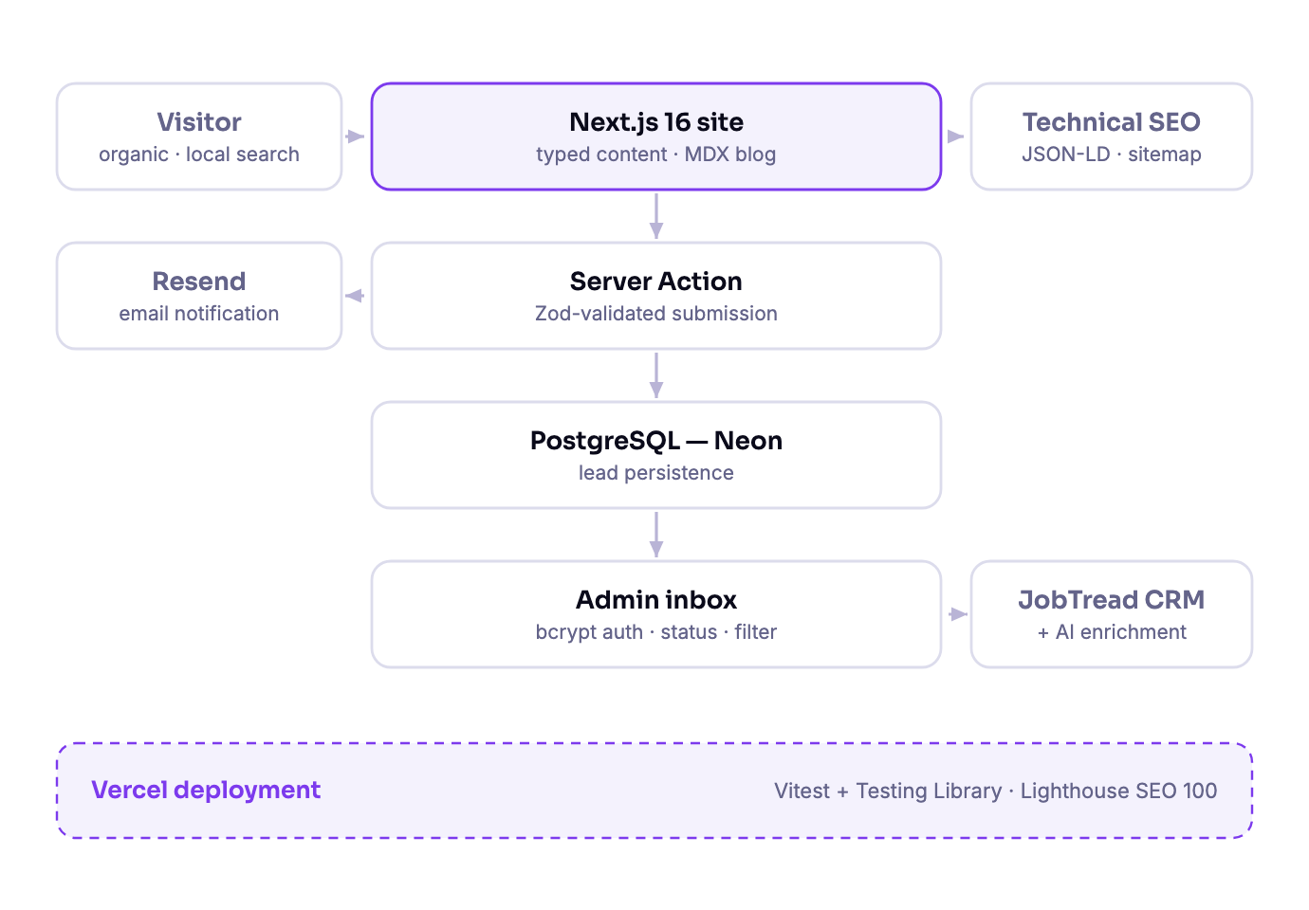
Open Air Construction
Architecture & stack
STACK
FRONTEND
Next.js 16 · TypeScript · Tailwind CSS v4 · Material 3 tokens · next-themes
CONTENT
Typed TS content modules · MDX blog via next-mdx-remote/rsc
BACKEND
Server Actions · Zod validation · PostgreSQL (Neon)
EMAIL & CRM
Resend notifications · JobTread sync seam · AI enrichment gateway
SEO
JSON-LD (LocalBusiness, Service, FAQ) · sitemap · robots · dynamic OG images
QUALITY & OPS
Vitest + Testing Library · Vercel deployment
NOTABLE
Lighthouse SEO score of 100 at launch
Non-developers publish blog posts and update service copy without touching layout code
Integrations activate by setting environment keys — no code change required
Proof that the same team that ships regulated AI platforms also ships a marketing site in weeks
Trinly · ArtSync India — Work Portfolio · trinly.us · artsync.live
14 / 21

Slide 15
09
Trinly — services
AI strategy through to shipped product. Delivered from the US and Europe, with the India engineering bench behind every engagement.
AI strategy & consulting
Where AI actually pays in your business, what to build first, and what to leave alone.
RAG & retrieval systems
Chunking, embeddings, vector search, reranking and evaluation — grounded answers with citations.
Model training & fine-tuning
Custom training, LoRA, domain adaptation, and the eval harness that proves it improved.
AI agents & automation
Tool-using agents that complete multi-step workflows, with guardrails and human checkpoints.
Computer vision
Detection, segmentation and thermal analysis — cloud pipelines or constrained edge devices.
Data pipelines & platform
Ingestion, ETL, geospatial and time-series stores, and the infrastructure underneath.
MLOps & production
Serving, monitoring, drift detection, retraining loops, CI/CD and cost control.
Web & mobile product
Full product engineering — Next.js and React web, React Native and Expo mobile, APIs and admin tooling.
Trinly · ArtSync India — Work Portfolio · trinly.us · artsync.live
15 / 21

Slide 16
10
ArtSync India — services & support
Your partner in digital excellence: software development, data intelligence and dependable IT support, delivered at scale from six hubs across India.
Custom software development
Web applications, enterprise systems and internal tools, built and maintained by dedicated teams.
Enterprise solutions & integration
ERP, CRM and line-of-business integration; APIs and middleware between systems that were never designed to talk.
Data intelligence & engineering
Data cleaning, transformation, migration and warehousing — turning messy source data into something models can use.
Data annotation at scale
Image, video, text and multimodal labeling with human-in-the-loop QA and ontology governance.
Data entry & back-office operations
High-volume, accuracy-critical processing with defined SLAs and quality sampling.
IT support & managed services
Helpdesk, infrastructure monitoring, patching and maintenance — day-to-day operational cover.
Trinly · ArtSync India — Work Portfolio · trinly.us · artsync.live
16 / 21

Slide 17
11
Specialisation — data annotation for physical AI
A core group specialisation: high-quality video and multimodal annotation for computer-vision and Vision-Language-Action systems.
Robotics and physical-AI teams are bottlenecked on demonstration data, not on model architecture. We deliver frame-accurate temporal segmentation, keypoint and object-interaction labeling, multi-view clip decomposition, and ontology-driven consistency across large demonstration datasets — backed by in-house ML teams, so datasets arrive clean, structured and training-ready rather than as a pile of raw labels someone else has to fix.
Frame-accurate temporal segmentation
Keypoint & object interaction
Action boundaries labelled to the frame, not the second.
Grasp points, contact events and manipulation states across the clip.
Multi-view decomposition
Ontology governance
Synchronised labeling across camera rigs for the same demonstration.
One label taxonomy, enforced across every annotator and every batch.
Human-in-the-loop QA
ML teams in the loop
Sampled review, inter-annotator agreement and correction loops.
The people labeling the data work alongside the people training on it.
CVAT
Labelbox
Label Studio
Temporal segmentation
Keypoint labeling
HITL QA
VLA datasets
Trinly · ArtSync India — Work Portfolio · trinly.us · artsync.live
17 / 21

Slide 18
12
How we deliver
The same four-stage path on every engagement — from a two-week website to a regulated clinical platform. Only the depth changes.
01
02
03
04
Data audit & strategy
Build & train
Production deployment
Continuous optimisation
Audit what you have, structure it, and define an approach tied to a business outcome — not to a model.
Model selection, training, pipeline and application build, with evaluation gates before anything is called done.
Scalable, monitored delivery to production — infrastructure, CI/CD, security and handover documentation.
Live telemetry drives retraining, tuning and the next increment of the roadmap.
Trinly · ArtSync India — Work Portfolio · trinly.us · artsync.live
18 / 21

Slide 19
13
Engagement & ongoing support
Four ways to work with us, and a support commitment that does not end at launch.
ENGAGEMENT MODELS
WHAT SUPPORT INCLUDES
Fixed-scope project
Production monitoring
Defined deliverable, defined price, defined timeline. Best when the outcome is clear.
Uptime, error and performance monitoring with defined incident response.
Retained / dedicated team
Model health
A named team on a monthly retainer, working your roadmap as priorities shift.
Drift detection, evaluation on live data, and a scheduled retraining cadence.
Staff augmentation
Security & maintenance
Senior AI, data and full-stack engineers embedded in your existing team.
Dependency patching, vulnerability response, access reviews and backups.
Managed support & SLA
Cost optimisation
We operate what we built — or what someone else built — under an agreed response SLA.
Inference, storage and cloud spend reviewed and tuned as usage grows.
Enablement
Documentation, handover and training so your team can run the system themselves.
Trinly · ArtSync India — Work Portfolio · trinly.us · artsync.live
19 / 21

Slide 20
14
Industries & why clients choose us
INDUSTRIES WE SERVE
WHY CLIENTS CHOOSE US
Healthcare & clinical trials
End-to-end ownership
Raw data to deployed product, with no hand-off gap between strategy, data and engineering.
Rail & transport infrastructure
Drone & geospatial
Robotics & physical AI
Financial services & fintech
Regulated-domain experience
We have built to 21 CFR Part 11 with tamper-evident audit trails and electronic signatures.
B2B SaaS & enterprise software
Construction & home services
Senior plus scale
US and Europe based architects, with a deep India engineering and data bench behind them.
From early-stage startups to established enterprises.
Production-first
Monitored systems running in production — not proofs of concept that stall at the demo.
Follow-the-sun delivery
Hubs across five countries keep work moving while your team sleeps.
Trinly · ArtSync India — Work Portfolio · trinly.us · artsync.live
20 / 21

Slide 21
LET'S TALK
Tell us what you are trying to build
Every engagement starts the same way: a 15-minute scoping call, then a written proposal with scope, timeline and price. No obligation, and no charge for the conversation.
Ashish Tyagi — Founder & CEO
hello@trinly.us · hello@artsync.live
US +1 919 578 4944 · IN +91 84484 12144
Trinly · ArtSync India — Work Portfolio · trinly.us · artsync.live
21 / 21

