Slide 1

24IT504L - MINI PROJECT-I
Batch Number: 04
IoT Based Multi-Hazard Forest Protection System
Team Members:
Supervisor:
Mrs .A. Mohanadevi/ M.E.,(Ph.D)
Assistant Professor / IT
Madhesh V
Akash R
Ranjith kumar P
621324205027 621324205002 621324205305
Review - 0
DATE:14.07.2026

Slide 2
Contents
S.No | Table Of Contents | Page No
1 | Project Title & Type of Project | 3
2 | Existing Solutions | 4
3 | Motivation & Gaps | 9
4 | Project Requirements | 10
5 | Objectives | 13
6 | Expected Outcomes | 14
7 | SDG Number and Global Challenge | 15
8 | Project Domain and Mapping with Pos /PSOs with Justification | 16
9 | Conclusion | 17
10 | References | 18

Slide 3
1.Project Title and Type of Project
IoT Based Multi-Hazard Forest Protection System
Type Of Project : Product / Hardware (IoT)

Slide 4
Literature Survey
S-No | Author & Year of Publication | Journal | Title of the paper | Advantages & Limitations
1 | Badary et al. & 2026 | IEEE Access | Survey of AI-Enabled IoT for Wildfire Prediction, Detection, and Post-Operations | Comprehensive survey of AI-enabled IoT architectures combining UAVs, satellites, and ground sensor networks for wildfire prediction, detection, and post-fire operations. Survey-only synthesis of existing methods; no dedicated gas sensing or logging detection proposed.
2 | Gul, İ. & 2025 | IEEE Internet of Things Journal | Dual-Purpose and Low-Cost IoT-Based Sensor Network for Real-Time Rainfall and Urban Flood Monitoring | Advantages: Single low-cost sensor node combines rainfall and flood-level sensing for dual-purpose real-time hazard monitoring. Limitations: Rainfall/flood-hazard focus; not forest-tailored, no fire, gas, or logging sensing.
4

Slide 5
Contd.
S-No | Author & Year of Publication | Journal | Title of the paper | Advantages & Limitations
3 | Rosa-Bilbao et al. & 2025 | IEEE Internet of Things Journal | IoT-Based Indoor Air Quality Management System for Intelligent Education Environments | Advantages: Self-manufactured IoT sensor network monitors CO2, PM2.5 and TVOCs with CEP and ML/DL-based real-time prediction. Limitations: Indoor deployment only; no forest fire or logging detection capability.
4 | Aldhaheri et al. & 2024 | IEEE Internet of Things Journal | LoRa Communication for Agriculture 4.0: Opportunities, Challenges, and Future Directions | Advantages: Reviews LoRa's long-range, low-power connectivity for remote agricultural/rural IoT nodes with limited network coverage. Limitations: Agriculture-focused review of open challenges; no fire, gas, or logging sensing proposed.

Slide 6
Contd.
S-No | Author & Year of Publication | Journal | Title of the paper | Advantages & Limitations
5 | C.C. Chan et al. & 2024 | IEEE Access | A Survey on IoT Ground Sensing Systems for Early Wildfire Detection: Technologies, Challenges and Opportunities | Comprehensive review of IoT ground-sensing hardware and architectures for wildfire detection. Survey-only; not a deployed or field-validated system.
6 | N.Dilshad et al. & 2024 | IEEE IoT Journal | Toward Efficient Fire Detection in IoT Environment: A Modified Attention Network and Large-Scale Data Set | Lightweight attention-based CNN on a large-scale fire dataset for real-time IoT fire detection. Vision-only; needs camera/compute, no gas or logging detection.

Slide 7
Contd.
S-No | Author & Year of Publication | Journal | Title of the paper | Advantages & Limitations
7 | Tripathi et al. & 2024 | IEEE Sensors Journal | Real-Time Monitoring of Illegal Logging Events Using Intelligent Acoustic Sensor Nodes | Spectrogram features with classifiers on a microcontroller plus LoRa achieve 96.61% logging-detection accuracy. Logging-only; no fire/gas sensing; tested in lab, not full field trials.
8 | Ahmad et al. & 2023 | IEEE Sensors Journal | Two-Level Sensor Self-Calibration Based on Interpolation and Autoregression for Low-Cost Wireless Sensor Networks | Clustering with interpolation and autoregression lets low-cost WSN nodes self-detect and correct sensor drift without extra hardware. Validated on a generic WSN calibration dataset; not forest-specific, no fire/logging sensing addressed.

Slide 8
Contd.
S-No | Author & Year of Publication | Journal | Title of the paper | Advantages & Limitations
9 | Ahmad et al. & 2023 | IEEE Internet of Things Journal | Sustainable Environmental Monitoring via Energy and Information Efficient Multi-Node Placement | Advantages: Optimizes multi-node sensor placement for energy- and information-efficient continuous environmental monitoring. Limitations: General environmental-monitoring placement study; not forest-specific, no fire, gas, or logging sensing.
10 | Dargie et al. & 2023 | IEEE Sensors Journal | Monitoring Toxic Gases Using Nanotechnology and Wireless Sensor Networks | Nanosensor-based WSN nodes give high-sensitivity, low-latency toxic-gas detection with multi-hop communication across a 21-node deployed network. Toxic-gas sensing only; not forest-tailored, no fire or logging detection.

Slide 9
3.Motivation and Gaps
MOTIVATION
Existing forest monitoring systems usually detect only a single hazard (fire, gas, or illegal logging), reducing overall monitoring effectiveness.
There is a growing need for a low-cost, real-time multi-hazard monitoring system that can quickly alert forest authorities with the hazard location.
GAPS
Most existing solutions do not integrate multiple sensors (fire, gas, vibration/chainsaw) into a single field-deployable IoT node.
Many proposed systems depend on continuous cloud or GSM connectivity, making them less reliable in remote forest areas with poor network coverage.

Slide 10
4.Project Requirements
Functional Requirements
Forest Fire Detection: Use an IR flame sensor, MQ-2 smoke sensor, and DHT22 to detect flame, smoke, and abnormal temperature/humidity spikes at each node location.
Toxic Gas Monitoring: Use an MQ-135 sensor to continuously measure CO2, ammonia, and smoke-related air-quality levels and flag unsafe concentrations.
Illegal Logging Detection: Use an SW-420 vibration sensor on the trunk plus a sound sensor to identify chainsaw acoustic signatures and cutting vibrations.
Location-Tagged Alerting: Tag every sensor node with its forest zone/GPS location so every alert maps to an exact spot for rapid response.
Local & Remote Alerting: Trigger an on-site buzzer/LED immediately on threshold breach and push a notification to a cloud dashboard for forest authorities.

Slide 11
Contd.
Non-Functional Requirements
Fast Response Time: Detect a threshold breach and trigger a local alert within a few seconds of the reading crossing the limit.
Low Power Consumption: Run the ESP32 and all sensors on a solar/battery-backed supply so the node can operate unattended in remote forest areas.
Reliable Operation: Keep sensor readings stable across varying temperature, humidity, and outdoor dust/wind conditions with minimal false alerts.
Easy Maintenance: Use a compact, weatherproof enclosure and modular wiring so sensors can be inspected, calibrated, or replaced quickly in the field.
Communication Resilience: Fall back to LoRa or GSM for alert delivery in zones with no Wi-Fi coverage, ensuring alerts still reach forest staff.

Slide 12
Contd.
Technical & Architectural Requirements
Sensor Layer: IR flame sensor, MQ-2, DHT22, MQ-135, SW-420 vibration sensor, and a sound/mic module, all wired to a single ESP32 microcontroller.
Processing & Logic: ESP32 firmware reads all sensor values at fixed intervals and compares them against calibrated fire, gas, and vibration/acoustic thresholds.
Alerting Layer: An onboard buzzer/LED activates immediately on-site, while the ESP32 pushes the hazard type, sensor readings, and node location over Wi-Fi/LoRa.
Monitoring Dashboard: A simple web dashboard displays live sensor readings, active hazard alerts, and node locations on a forest map for patrol staff.

Slide 13
5.Objectives
To continuously monitor a forest zone for fire, toxic gases, and illegal tree cutting using a single low-cost IoT sensor node.
To reduce reliance on manual forest patrols by automating hazard detection with a low-cost, ESP32-based unit that runs unattended in the field.
To enable a faster forest-authority response by sending instant, location-tagged alerts the moment a fire, gas, or logging threshold is crossed.

Slide 14
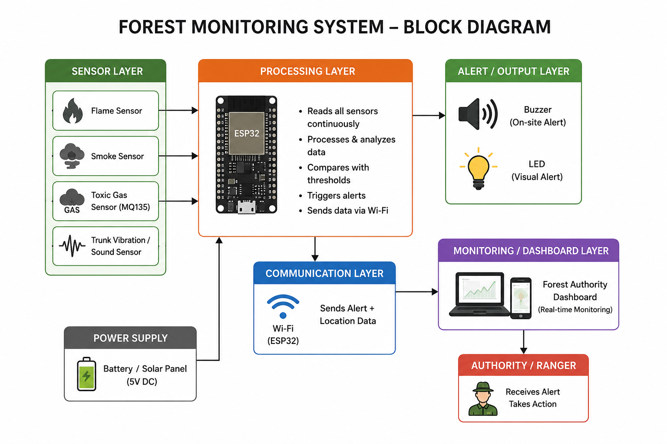
6.Expected Outcome
Working Prototype – A functional ESP32-based node that continuously monitors flame, smoke, toxic gas, and trunk vibration/sound at a forest location.
Real-Time Alerts – Instant on-site buzzer/LED and a notification with the node’s location sent to a forest-authority dashboard the moment a hazard is detected.
Reduced Manual Patrolling – Fewer routine manual forest patrols, since staff are notified only when a fire, gas, or logging threshold is crossed.
Safer, Better-Protected Forest – Early warning of fire, toxic gases, and illegal logging supports faster ranger response and reduces ecological damage.

Slide 15
7.SDG Number and Global Challenge
SDG Number:
SDG 15 – Life on Land
Global Challenge & Relevance:
Protecting Forest Ecosystems – Early detection of fire, illegal logging, and toxic gas build-up helps rangers stop damage before it spreads, directly supporting SDG 15 (Life on Land).
Climate & Community Resilience – Faster fire and toxic-gas alerts reduce carbon-releasing wildfires and protect nearby communities’ air quality, supporting SDG 13 (Climate Action).
Supporting Low-Cost Forest Governance – A single affordable IoT node makes continuous, multi-hazard forest surveillance practical for resource-limited forest departments.

Slide 16
8.Project Domain Mapping with POs / PSOs with justification
Course Code | PO1 | PO2 | PO3 | PO4 | PO5 | PO6 | PO7 | PO8 | PO9 | PO10 | PO11 | PSO1 | PSO2
C308.1 | 3 | 3 | 2 | 2 | 2 | 1 | 2 | 1 | 1 | 2 | 2 | 2 | 2
C308.2 | 2 | 3 | 2 | 3 | 2 | 1 | 2 | 2 | 1 | 2 | 3 | 2 | 3
C308.3 | 3 | 2 | 3 | 2 | 3 | 2 | 3 | 2 | 2 | 2 | 2 | 3 | 3
C308.4 | 3 | 2 | 3 | 2 | 3 | 2 | 3 | 2 | 3 | 2 | 2 | 3 | 3
C308.5 | 1 | 1 | 1 | 1 | 2 | 1 | 1 | 2 | 3 | 3 | 2 | 2 | 2
C308 Avg. | 2.4 | 2.2 | 2.2 | 2.0 | 2.4 | 1.4 | 2.2 | 1.8 | 2.0 | 2.2 | 2.2 | 2.4 | 2.6
HIGH: 3; MEDIUM: 2; LOW: 1; NO CONTRIBUTION: –

Slide 17
9.Conclusion
The IoT-Based Multi-Hazard Forest Protection System offers a low-cost approach to detecting forest fire, toxic gases, and illegal tree cutting using a single ESP32-based sensor node.
It enables early detection of fire, unsafe gas levels, and chainsaw/logging activity before they cause major ecological damage, allowing forest authorities to act before conditions worsen.
By combining flame, gas, vibration, and acoustic sensing with location-tagged alerts, the system pinpoints exactly which forest zone needs attention, cutting down manual patrol time.
The design supports safer, better-protected forests by warning rangers of fire, toxic gas build-up, or illegal cutting before it escalates.
Overall, the system provides a practical, scalable step toward smarter forest surveillance, supporting SDG 15 (Life on Land) and SDG 13 (Climate Action).

Slide 18
10.References
Ahmad, R., Rinner, B., Wazirali, R., Abujayyab, S.K.M. and Almajalid, R. (2023) ‘Two-Level Sensor Self-Calibration Based on Interpolation and Autoregression for Low-Cost Wireless Sensor Networks’, IEEE Sensors Journal, 23(20), pp.25242–25253.
Ahmad, S., Uyanık, H., Ovatman, T., Sandıkkaya, M.T., De Maio, V., Brandić, I. and Aral, A. (2023) ‘Sustainable Environmental Monitoring via Energy and Information Efficient Multi-Node Placement’, IEEE Internet of Things Journal.
Aldhaheri, L., Alshehhi, N., Manzil, I.I.J., Khalil, R.A., Javaid, S., Saeed, N. and Alouini, M.S. (2024) ‘LoRa Communication for Agriculture 4.0: Opportunities, Challenges, and Future Directions’, IEEE Internet of Things Journal.
Badary, A., Karray, F. and Saddik, A.E. (2026) ‘Survey of AI-Enabled IoT for Wildfire Prediction, Detection, and Post-Operations’, IEEE Access.
Chan, C.C., Alvi, S.A., Zhou, X., Durrani, S., Wilson, N. and Yebra, M. (2024) ‘A Survey on IoT Ground Sensing Systems for Early Wildfire Detection: Technologies, Challenges and Opportunities’, IEEE Access, 12, pp.172785–172819.
Dargie, W., Wen, J., Panes-Ruiz, L.A., Riemenschneider, L., Ibarlucea, B. and Cuniberti, G. (2023) ‘Monitoring Toxic Gases Using Nanotechnology and Wireless Sensor Networks’, IEEE Sensors Journal, 23, pp.12274–12283.
Dilshad, N., Khan, S.U., Alghamdi, N.S., Taleb, T. and Song, J. (2024) ‘Toward Efficient Fire Detection in IoT Environment: A Modified Attention Network and Large-Scale Data Set’, IEEE Internet of Things Journal, 11(8), pp.13467–13481.
Gül, İ. (2025) ‘Dual-Purpose and Low-Cost IoT-Based Sensor Network for Real-Time Rainfall and Urban Flood Monitoring’, IEEE Internet of Things Journal.
Rosa-Bilbao, J., Sajid Butt, F., Merkl, D., Wagner, M.F., Schäfer, J. and Boubeta-Puig, J. (2025) ‘IoT-Based Indoor Air Quality Management System for Intelligent Education Environments’, IEEE Internet of Things Journal, 12(11), pp.18031–18041.
Singh, V., Ray, K.C. and Tripathi, S. (2024) ‘Real-Time Monitoring of Illegal Logging Events Using Intelligent Acoustic Sensor Nodes’, IEEE Sensors Journal.

