Slide 1

24IT504L - MINI PROJECT-I
Batch Number: 06
Smart Medicine Cabinet with Expiry Alerts and Inventory Management
Team Members:
Supervisor:
Mr. R.V. Viswanathan, M.E., (Ph.D) Assistant Professor / IT
Harsath S Mathan P
Vikhash J
621324205019 621324205304 621324205062
Review - 0
DATE: 14.07.2026

Slide 2
Contents
S.No | Table Of Contents | Page No
1 | Project Title & Type Of Project | 3
2 | Existing Solutions | 4
3 | Motivation And Gap | 9
4 | Project Requirements | 10
5 | Objectives | 13
6 | Expected Outcomes | 14
7 | SDG Number, Global Challenges and Its Justification | 15
8 | Project Domain and Mapping with Pos /PSOs with Justification | 16
9 | Conclusion | 17
10 | References | 18
2

Slide 3
1.Project Title and Type of Project
Smart Medicine Cabinet with Expiry Alerts and Inventory Management
Type Of Project : Product / Embedded Hardware (IoT)
3

Slide 4
2.Literature Survey
S-No | Author & Year of Publication | Journal | Title of the paper | Advantages &Limitations
1 | Sushma Shekhar Kumbar, Geeta R Bharamagoudar, Shahikumar G Totad, (2026) | IEEE Access | Smart Medicine Alert Kit | Presents an IoT-based Smart Medicine Alert Kit that issues scheduled notifications reminding patients to take the correct medicine on time. Focuses on medication-time alerting only; does not address expiry-date tracking or stock-level/inventory management.
2 | Dhananjay Satanure, Siddhant Kamlaskar, Yogita Vaidya, Shilpa Metkar, (2025) | IEEE Access | Design and Implementation of a Smart Medicine Reminder Kit for Elderly Care | Integrates an ESP32 microcontroller with a SIM900A GSM module to deliver phone-call medication reminders alongside dual LED/buzzer alerts, with a mobile app letting caregivers set schedules. Focused solely on medication-time reminders for elderly users; does not track medicine expiry dates or maintain a stock/inventory count.
4

Slide 5
Cont.
S-No | Author & Year of Publication | Journal | Title of the paper | Advantages &Limitations
3 | Chetan Awari, Akashprasad Yadav, Madhuri Sahu ,(2025) | IEEE Access | AI-Integrated Smart Medicine Dispenser with IoT Connectivity | Uses QR-code logging with a Firebase real-time database, reaching 96% alert accuracy and cutting dosing errors by up to 98%. Designed for hospital bedside dispensing rather than compact home or pharmacy cabinet inventory.
4 | Carrighan G. Brittain, Isabela Guilarte Lau, Avery L. Jones, (2024) | IEEE Access | Application of RFID Inventory Tracking Technology in the Hospital Pharmacy Setting | Fixed dual-antenna RFID reader (up to 1,100 tags/sec) enables fast, semi-automated batch inventory counting of medicine vials. Single-antenna handheld readings were not accurate enough for reliable use, requiring costlier fixed-reader hardware.
5

Slide 6
Cont.
S-No | Author & Year of Publication | Journal | Title of the paper | Advantages &Limitations
5 | S. Vimal, S.Vishnu Shiva Prakash, P.S. Surendar, R. Veeravasanthan , (2024) | IEEE Access | A Smart Pill Dispenser with Real Time Alerts, Remote Access, and Enhanced Safety | Combines an easy-to-use interface, pill-removal sensors, and remote caregiver monitoring to track adherence and alert on missed doses in real time. Centered on dosage-reminder adherence; does not track medicine expiry dates or maintain a stock/inventory count.
6 | de Lima. M.R, Jouaiti. M, Wairagkar. M, Malhotra. P, Barnaghi. P, and Vaidyanathan. R, (2023) | IEEE Access | Discovering Behavioral Patterns Using Conversational Technology for In-Home Health and Well-Being Monitoring | Fuses IoT environmental-sensor data with a voice assistant (Alexa) to detect behavioural patterns and flag deviations for at-risk users living at home, showing a practical in-home IoT + alerting architecture. Targets general well-being/behavioural monitoring for dementia care; does not address medicine expiry tracking or stock-level sensing.
6

Slide 7
Cont.
S-No | Author & Year of Publication | Journal | Title of the paper | Advantages &Limitations
7 | Ghafurian. M, Wang. K, Dhode, I, Kapoor. M, Morita, P.P ,(2023) | IEEE Access | Smart Home Devices for Supporting Older Adults: A Systematic Review | Systematically reviews smart-home sensor devices used to support older adults' health, safety and independent living, informing which sensor types suit an unattended home medicine cabinet. Reviews general smart-home devices; does not address medicine-specific expiry dates or automated stock/inventory counting.
8 | Xu. J, Ye, Y, Wu, L. and Wang, X, (2023) | IEEE Access | The Principle, Methods and Recent Progress in RFID Positioning Techniques: A Review | Reviews RFID identification and positioning methods applicable to tagging and reading individual medicine items at shelf/compartment level. Survey-level treatment of RFID theory; not specific to medicine expiry-date logic or cabinet-based inventory design.
7

Slide 8
Cont.
S-No | Author & Year of Publication | Journal | Title of the paper | Advantages &Limitations
9 | Himi, S.T., Monalisa, N.T., Whaiduzzaman, M., Barros, A. and Uddin, M.S., (2023) | IEEE Access | MedAi: A Smartwatch-Based Application Framework for the Prediction Common Diseases Using Machine Learning | Demonstrates a low-cost wearable-sensor and mobile-app framework delivering real-time health alerts, a usable pattern for on-device sensing paired with app notifications. Aimed at disease prediction from body sensors; not medicine expiry tracking or stock/inventory management.
10 | Isharyani, Sopha, Tjahjono, and Wibisono, (2023) | IEEE Access | Exploring the Smart Retail Scenario for Traditional Retailers: Case Studies From a Developing Country | Case studies show how small, resource-constrained retailers/pharmacies can adopt IoT-enabled smart inventory practices affordably. General retail-inventory case studies; does not address medicine-specific expiry-date logic or RFID/QR item-level tagging.
8

Slide 9
3.Motivation and Gaps
Motivation:
Most households and pharmacies still track medicine expiry manually, so expired or near-expiry drugs often go unnoticed until they are consumed or wasted.
Most published work remains at the prototype or simulation stage, highlighting the need for a practical, low-cost, real-world deployable smart medicine cabinet.
Gaps:
Few low-cost smart cabinets combine automatic stock/inventory counting with expiry alerts, forcing users to manage both tasks separately.
There is limited guidance on integrating RFID/QR-based identification, expiry-date tracking, and stock-level sensing into one compact, field-deployable ESP32-based cabinet.
Many proposed medicine-box systems depend heavily on continuous internet or cloud connectivity, making them unreliable in low-connectivity homes or clinics.
9

Slide 10
4.Project Requirements
Functional Requirements
Expiry Detection: Scan each medicine's RFID/QR tag to read its expiry date and continuously check it against the current date to flag items nearing expiry.
Inventory / Stock Tracking: Use a load cell/IR sensor and RFID tagging to log each item added to or removed from the cabinet and maintain a live medicine stock count.
Low-Stock & Expiry Alerts: Send a push notification/app alert as soon as a medicine nears its expiry date or its stock falls below a set reorder threshold.
Local and Remote Alerting: Trigger an on-cabinet LED/buzzer immediately on detection and push a notification to an ESP32-connected mobile app or dashboard for the user.
10

Slide 11
Project Requirements
Non-Functional Requirements
Fast Response Time: Detect an expired or low-stock item and trigger a local alert within a few seconds of the scheduled inventory check.
Low Power Consumption: Run the ESP32 and connected sensors on a rechargeable battery supply so the cabinet can operate continuously without being plugged in at all times.
Reliable Operation: Keep RFID/QR readings and stock counts stable and accurate under normal household or pharmacy handling, with minimal false alerts.
Easy Maintenance: Use a compact cabinet enclosure with modular shelving and wiring so sensors and tags can be inspected or replaced quickly by the user.
11

Slide 12
Project Requirements
Technical & Architectural Requirements
Sensor Layer: RC522 RFID reader / QR code camera module for item identification, a load cell for stock-weight sensing, and an RTC module for date tracking, all wired to a single ESP32 microcontroller.
Processing & Logic: ESP32 firmware reads each tagged item's expiry date and stock count at fixed intervals and compares them against set thresholds to classify items as fresh, near-expiry, expired, or low-stock.
Alerting Layer: An onboard LED/buzzer signals immediately on the cabinet, while the ESP32 pushes expiry and stock status to a cloud database over Wi-Fi.
Monitoring Dashboard: A simple mobile/web app displays live medicine inventory, expiry alerts, and stock levels for the user or pharmacy staff.
12

Slide 13
5.Objectives
To detect medicine expiry early using automated RFID/QR-based date tracking, before expired drugs are accidentally consumed or wasted.
To reduce manual stock-checking by automating inventory counts with a low-cost ESP32-based cabinet that tracks items as they are added or removed.
To enable timely restocking by sending instant low-stock and expiry alerts to the user's mobile app as soon as a threshold is crossed.
13

Slide 14
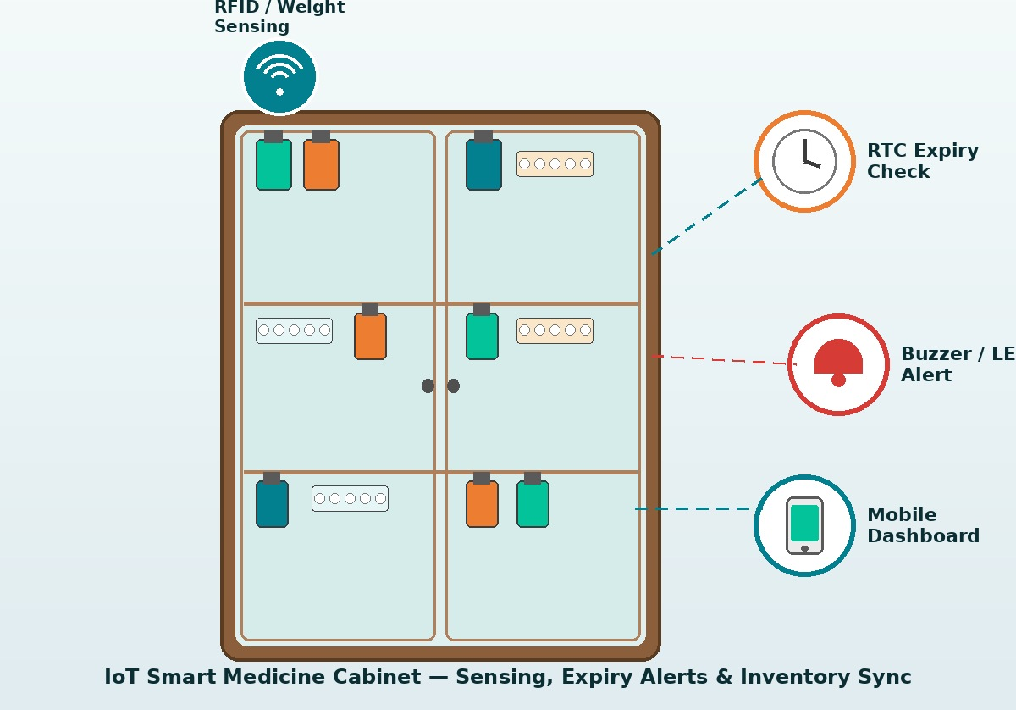
6.Expected Outcome
Working Prototype – A functional ESP32-based cabinet that continuously scans stored medicines and tracks their expiry dates and stock levels.
Real-Time Alerts – Instant on-cabinet LED/buzzer alert and a mobile app notification the moment a medicine nears expiry or stock runs low.
Reduced Manual Inspection – Fewer manual medicine-cabinet checks, since the user is notified only when an item actually needs attention.
Reduced Medicine Wastage – Early expiry warnings let users consume or discard medicines in time, cutting down accidental use of expired drugs and unnecessary waste.
14

Slide 15
7.SDG Number and Global Challenge
SDG Number:
SDG 12 – Responsible Consumption and Production
Global Challenge & Relevance:
Reducing Medicine Wastage – Automated expiry tracking lets households and pharmacies use or dispose of medicines before they expire, cutting down avoidable pharmaceutical waste.
Promoting Efficient Resource Use – Real-time stock and inventory tracking prevents over-purchasing and over-stocking of medicines, ensuring resources are consumed responsibly.
Encouraging Sustainable Consumption Practices – A low-cost, IoT-based cabinet promotes accountable, waste-conscious medicine management for households, clinics, and small pharmacies.
15

Slide 16
8.Project Domain Mapping with POs / PSOs with justification
Course Code | PO1 | PO2 | PO3 | PO4 | PO5 | PO6 | PO7 | PO8 | PO9 | PO10 | PO11 | PSO1 | PSO2
C308.1 | 2 | 3 | 1 | 2 | 1 | 2 | 1 | 1 | 1 | 1 | 1 | 2 | –
C308.2 | 1 | 3 | 1 | 3 | 1 | 1 | – | 1 | 2 | – | 2 | 2 | 1
C308.3 | 2 | 2 | 3 | 1 | 3 | 1 | – | 2 | 1 | 1 | 2 | 3 | –
C308.4 | 3 | 1 | 2 | 1 | 3 | 2 | 1 | 3 | 1 | 2 | 1 | 3 | –
C308.5 | – | 1 | – | – | – | – | 1 | 1 | 3 | 1 | 1 | 1 | 1
C308 Avg. | 1.6 | 2.0 | 1.4 | 1.4 | 1.6 | 1.2 | 0.6 | 1.6 | 1.6 | 1.0 | 1.4 | 2.2 | 0.4
HIGH: 3; MEDIUM: 2; LOW: 1; NO CONTRIBUTION: –
16

Slide 17
9.Conclusion
The Smart Medicine Cabinet offers a low-cost, real-time approach to managing home and pharmacy medicine stock using RFID/QR-based expiry tracking and inventory sensing on a single ESP32-based unit.
It enables early detection of expiring or low-stock medicines before they are consumed unsafely or run out unexpectedly, allowing users to act before the problem escalates.
By combining expiry tracking with automated stock counting and mobile alerts, the system pinpoints exactly which medicines need attention, cutting down manual search and checking time.
The design supports safer medication use by warning of impending expiry before a medicine is taken or dispensed.
Overall, the system provides a practical, scalable step toward smarter medicine management, reducing pharmaceutical waste and promoting responsible consumption in line with SDG 12.
17

Slide 18
10.References
Brittain, C.G. and Lau, I.G. and Jones, A.L. (2024) 'Application of RFID Inventory Tracking Technology in the Hospital Pharmacy Setting', IEEE.
de Lima, M.R. and Su, T. and Jouaiti, M. and Wairagkar, M. and Malhotra, P. and Soreq, E. and Barnaghi, P. and Vaidyanathan, R. (2023) 'Discovering Behavioral Patterns Using Conversational Technology for In-Home Health and Well-Being Monitoring', IEEE Internet of Things Journal, Vol.10, pp.18537-18552.
Ekharkar, S. and Awari, C. and Yadav, A. and Sahu, M. and Thomas, A. (2025) 'AI-Integrated Smart Medicine Dispenser with IoT Connectivity', IEEE.
Ghafurian, M. and Wang, K. and Dhode, I. and Kapoor, M. and Morita, P.P. and Dautenhahn, K. (2023) 'Smart Home Devices for Supporting Older Adults: A Systematic Review', IEEE Access, Vol.11, pp.47137-47158.
Himi, S.T. and Monalisa, N.T. and Whaiduzzaman, M. and Barros, A. and Uddin, M.S. (2023) 'MedAi: A Smartwatch-Based Application Framework for the Prediction of Common Diseases Using Machine Learning', IEEE Access, Vol.11, pp.12342-12359.
Isharyani, M.E. and Sopha, B.M. and Tjahjono, B. and Wibisono, M.A. (2023) 'Exploring the Smart Retail Scenario for Traditional Retailers: Case Studies From a Developing Country', IEEE Transactions on Engineering Management, Vol.71, pp.9325-9341.
Kumbar, S.S. and Bharamagoudar, G.R. and Totad, S.G. (2026) 'Smart Medicine Alert Kit', IEEE.
Satanure, D. and Kamlaskar, S. and Vaidya, Y. and Metkar, S. (2025) 'Design and Implementation of a Smart Medicine Reminder Kit for Elderly Care', 2025 Global Conference on Emerging Technology (GINOTECH), pp.153-157.
Vimal, S. and Vishnu Shiva Prakash, S. and Surendar, P.S. and Veeravasanthan, R. and Sumathi, S. (2024) 'A Smart Pill Dispenser with Real Time Alerts, Remote Access, and Enhanced Safety', IEEE.
Xu, J. and Ye, Y. and Wu, L. and Wang, X. (2023) 'The Principle, Methods and Recent Progress in RFID Positioning Techniques: A Review', IEEE Journal of Radio Frequency Identification, Vol.7, pp.50-63.
18

