Slide 1
Word Alignment and Bilingual Embeddings
Name: Triparna Samanta
Roll No: 22075108
Professor: Anil Singh
Institute: IIT(BHU), Varanasi

Slide 2
Motivation
a.Cross-lingual NLP requires mapping words across languages.
b.Hindi–English resources are limited → need good bilingual representations.
c.Word alignment + embedding alignment enables:
1.Machine translation
2.Bilingual dictionaries
3.Cross-lingual search
4.Representation sharing

Slide 3
Data Used
Parallel Corpus
Source: AI4Bharat Samanantar
Files: en.txt, hi.txt
Comparable Corpus
Manually scraped Wikipedia articles (Sports, Tech, Education)
Monolingual Corpus
IIT Bombay English & Hindi monolingual dataset

Slide 4
Project Overview
Pipeline consists of three stages:
a.Parallel corpora → FastText embeddings → Word alignment
b.Comparable corpora → Enhanced embeddings
c.Monolingual corpora → Final high-quality embeddings

Slide 5
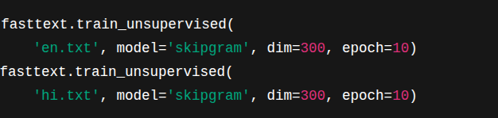
FastText Embedding Training (Parallel Stage)
For English and Hindi separately:
Outputs:
eng.bin → English vector model
hin.bin → Hindi vector model
These embeddings are unaligned initially.

Slide 6
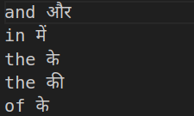
Word Alignment Using SimAlign
Why?
Parallel sentences allow extraction of bilingual word pairs.
Method:
Use SimAlign with:
Model: xlm-roberta-base
Token type: BPE
Matching method: MWMF (best performing)

Slide 7
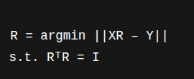
Aligning Embeddings (Procrustes)
Using the SimAlign seed:
a.Build matrices X (English vectors) and Y (Hindi vectors)
b.Solve Orthogonal Procrustes:
This brings both languages into the same embedding space.

Slide 8
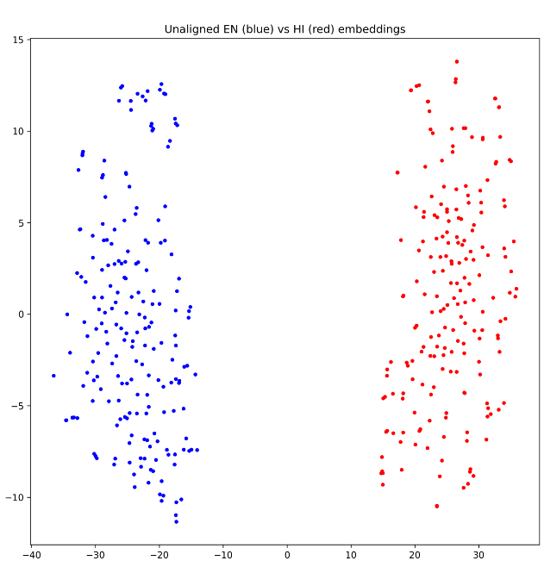
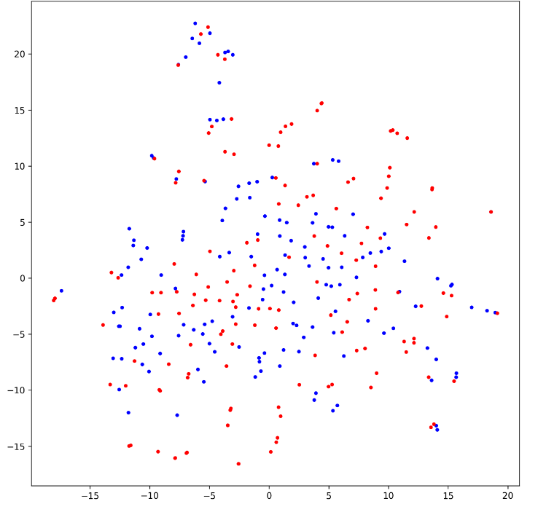
Visualization (t-SNE)
Unaligned HI vs EN emb.
Aligned EN(B) and HI(R) embeddings

Slide 9
Comparable Corpus Stage
Added:
Wikipedia English text
Wikipedia Hindi text
Synthetic sports corpora
Then:
Combined parallel + comparable corpora
Trained bigger FastText models
Re-applied Procrustes using same SimAlign seed
Generated better dictionary + visualization

Slide 10
Monolingual Corpus Stage
Using IIT Bombay monolingual data:
Train large FastText models
Again align with Procrustes
Produce best-quality bilingual embedding space
Outputs:
eng_mono.bin
hin_mono.bin
R_mono.npy
dictionary_mono.json

Slide 11
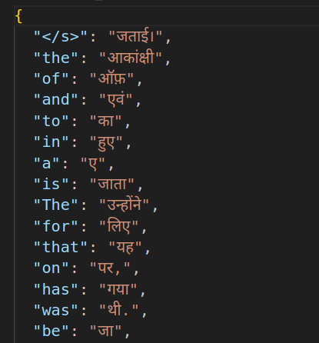
Dictionary Generation
Map English vector → Hindi space
Compute cosine similarity
Pick top candidate
Comparable corpora bilingual dictionary

Slide 12
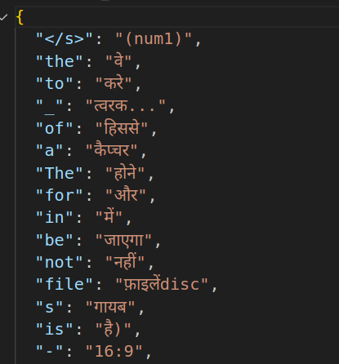
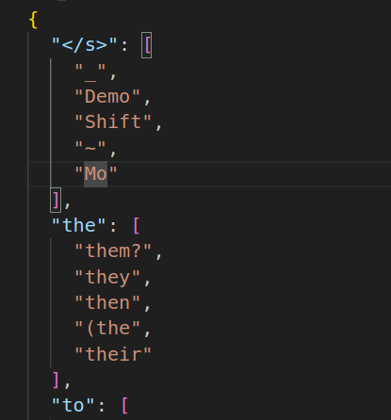
Monolingual corpora bilingual dictionary
English monolingual dictionary

Slide 13
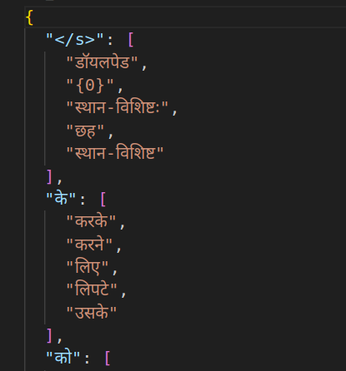
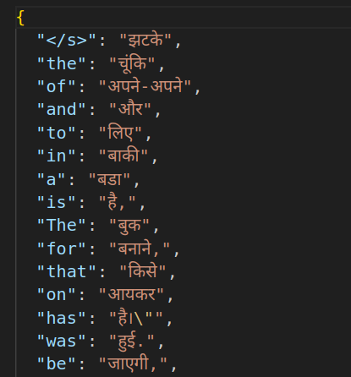
Hindi monolingual dictionary
Parallel bilingual dictionary

Slide 14
Conclusion
This work:
Demonstrates a full bilingual embedding pipeline
Uses modern NLP tools (SimAlign, FastText, XLM-R)
Produces aligned vector spaces for Hindi–English
Generates human-like translation dictionaries

Slide 15
Thank You

