Slide 1
Version Control System
What is version control ?
- Version control systems are a category of software tools that help a software team manage changes to source code over time.
- Version control software keeps track of every modification to the code in a special kind of database.
- Version control system can not only be applied to software/source code but any set of human readable files.

Slide 2
Why do we need version control system ?
- Software teams that do not use any form of version control often run into problems like not knowing which changes that have been made are available to users or the creation of incompatible changes between two unrelated pieces of work that must then be painstakingly untangled and reworked.
- Version control protects source code from both catastrophe and the casual degradation of human error and unintended consequences.
- If a mistake is made, developers can turn back the clock and compare earlier versions of the code to help fix the mistake while minimizing disruption to all team members.

Slide 3
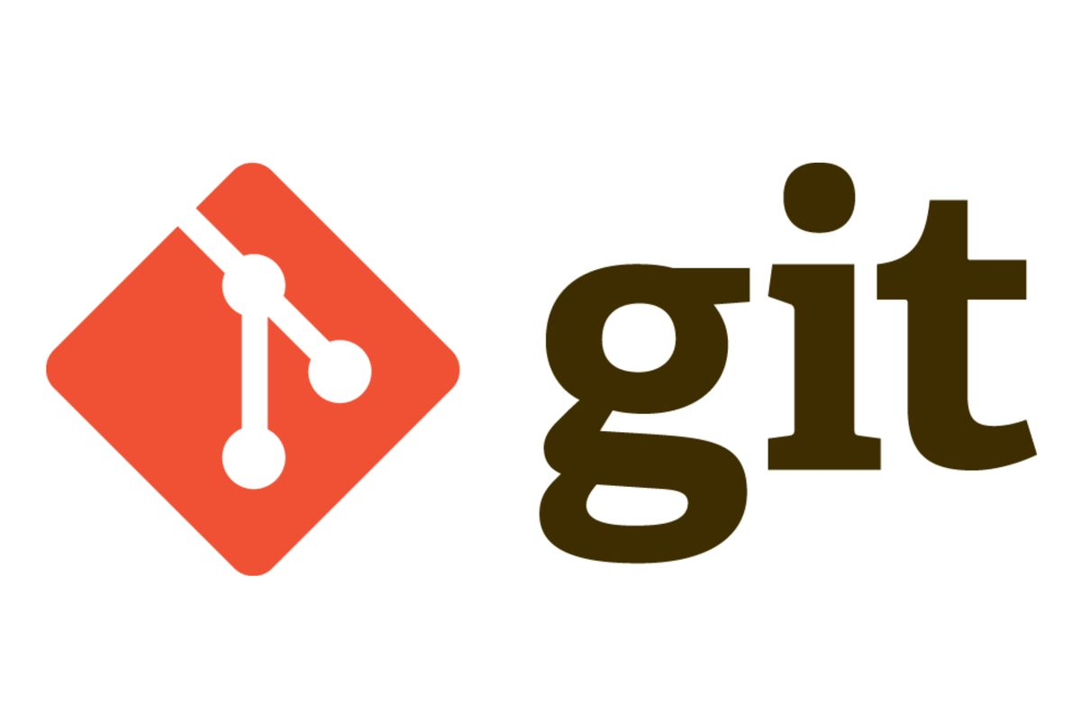

Slide 4
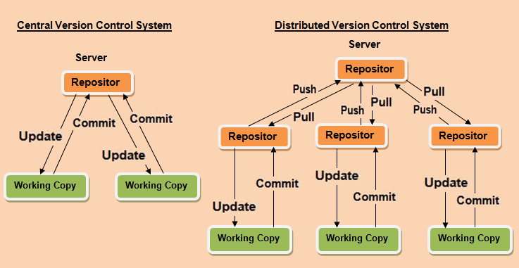
Types of Version Control System
Version control systems are two types :
Central Version Control System
Distributed Version Control System

Slide 5
Central Version Control System(CVS)
It is second generation version control system.
CVS has only on copy of the code in the central server.
Any commit/update will be done to and from the central server.
All commits get automatically reflected to all developer working on that repository.
Developer needs dedicated internet connection to commit or update.

