Slide 1

SMART INDIA HACKATHON 2026
Problem Statement ID – 26182
Problem Statement Title- Automated Attribution of Unknown Cryptocurrency Wallets to the Nearest Virtual Asset Service Providers (VASPs) for Stronger Cross-Border Investigations
Theme- Blockchain & Cybersecurity
PS Category- Software
Team ID- 78
Team Name- TROVER

Slide 2


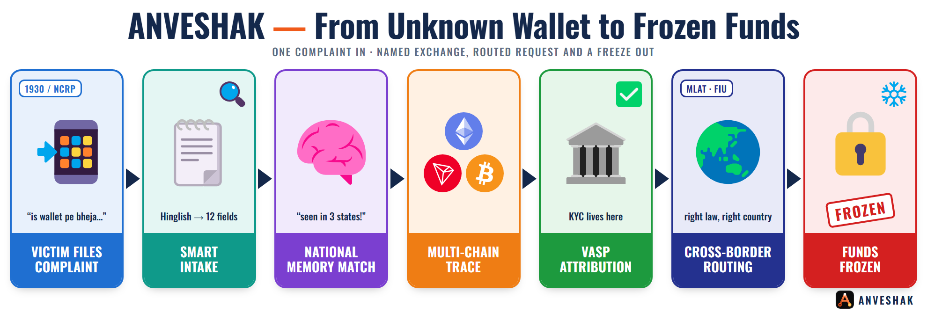
Team
TROVER
ANVESHAK
PROPOSED SOLUTION
KEY FEATURES
ANVESHAK (अन्वेषक, “the seeker”): An investigator console that turns an unknown wallet into the nearest VASP holding the KYC, shows exactly why, routes the right legal request to the right country and tracks it until the money is frozen.
✔ Smart Intake (complaint → case in seconds): reads Hinglish, checksum-verifies every wallet, masks phones & UPI IDs at the door
✔ SAHYOG National Memory (India never forgets a wallet): the 2nd complaint from any state is matched instantly, with who saw it first
✔ Golden-Hour Queue (work the case you can still save): ranked by minutes left before the money reaches an exchange
✔ Glass-Box Attribution: every VASP verdict shows its evidence, weights and maths, plus “what would flip the verdict”
Reads the complaint as typed in Hinglish (“shaam 7:42”, “12.4 lakh”) and opens the case in seconds.
Remembers every wallet India has ever reported.
Traces & attributes across TRON, Ethereum & Bitcoin to the nearest VASP.
Follows the rupee out of crypto into UPI mule accounts.
Drafts & routes BNSS/BSA notices, or MLAT / INTERPOL / FIU-to-FIU requests abroad.
INNOVATION AND UNIQUENESS
✔ Pre-emptive Freeze: predicts the gang's next exchange and alerts it before the money lands.
✔ Rupee Exit Trail: follows money out of crypto into UPI mule accounts.
✔ Cold-Trail Re-acquisition: operator habits re-find money lost in a mixer.
✔ Cross-Border Autopilot: foreign VASP? Auto-picks MLAT, INTERPOL or FIU-to-FIU.
✔ Sanctions-Proximity Radar: flags wallets “one shell away” from sanctions.
✔ We Red-Team Ourselves: 7 laundering tricks vs our own engine; misses published.

Slide 3
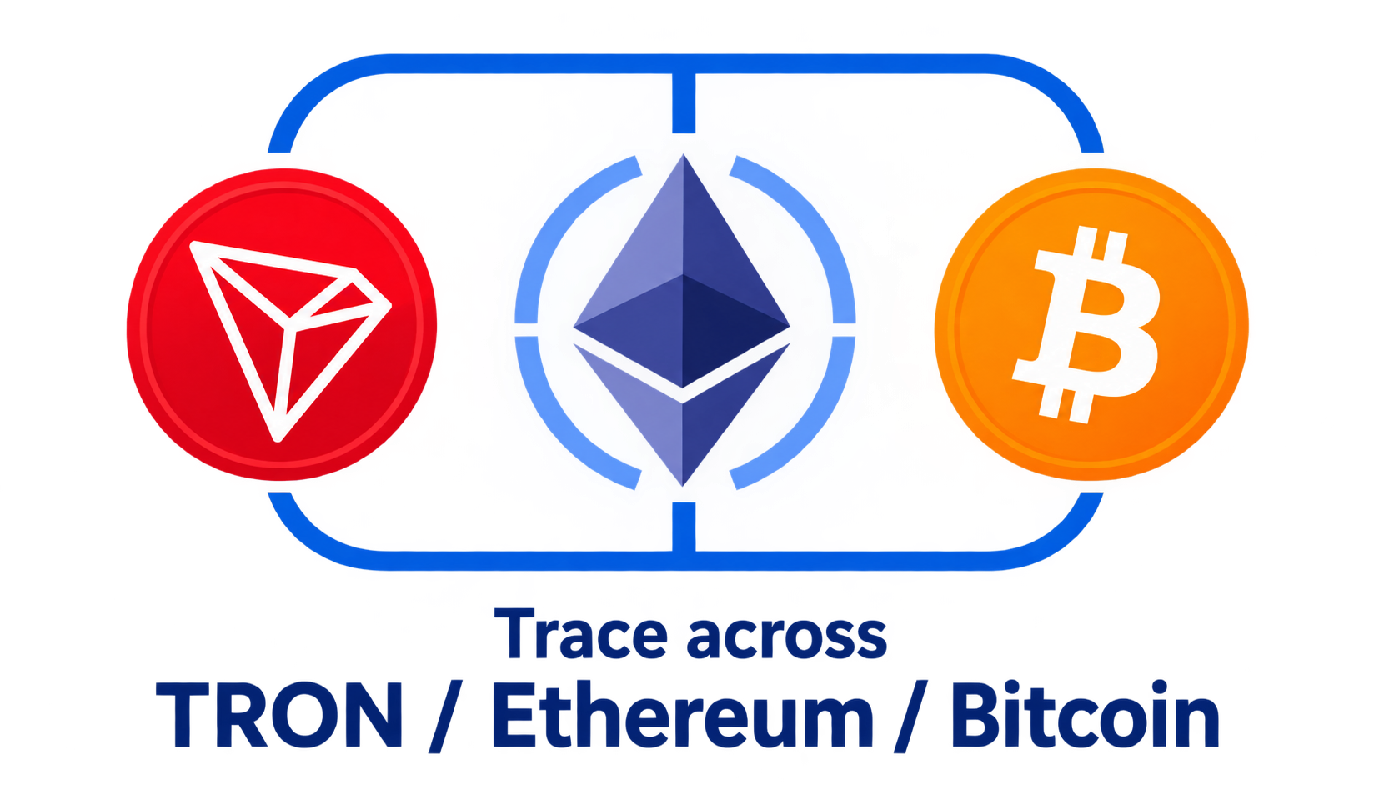
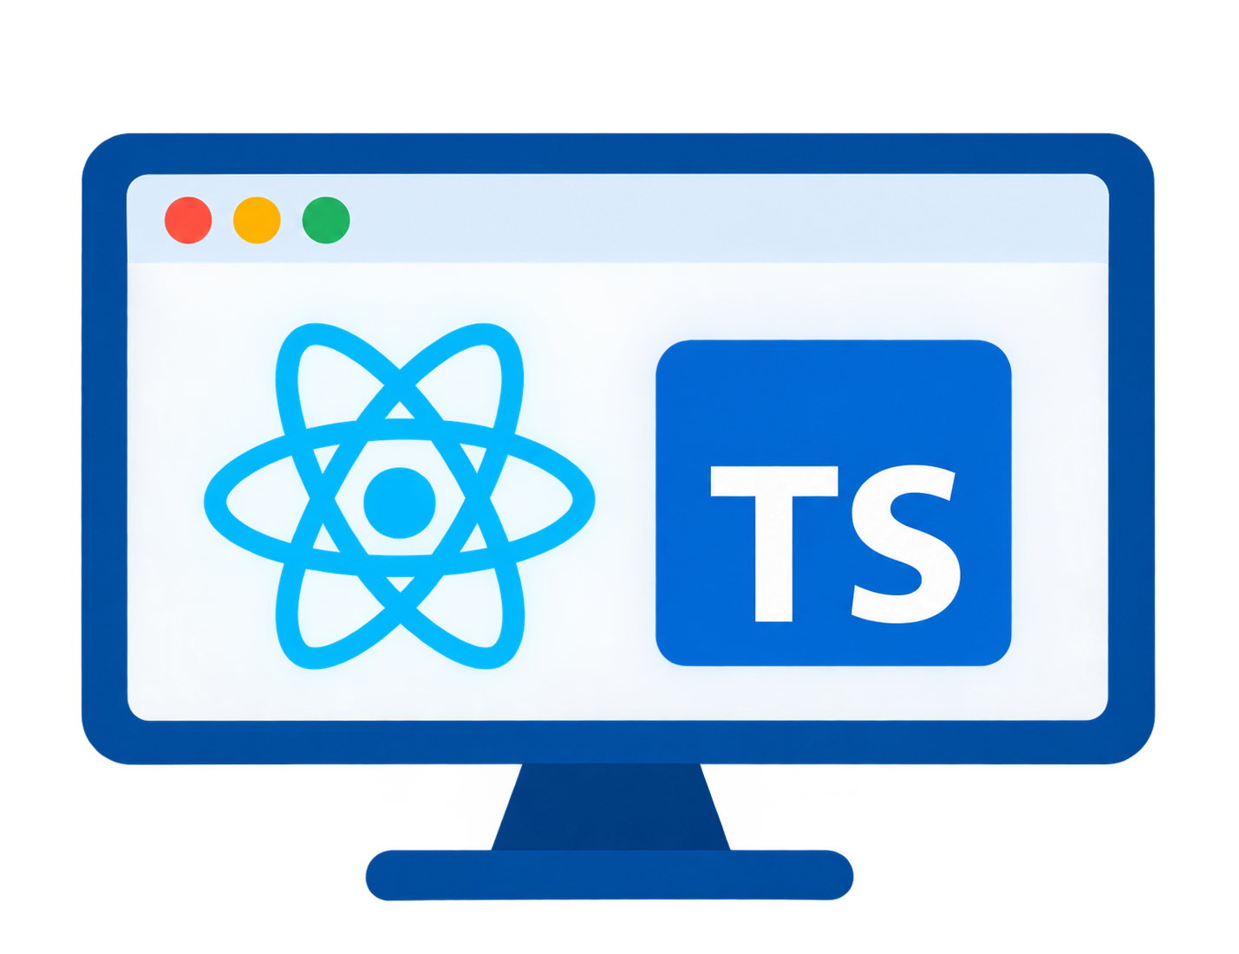





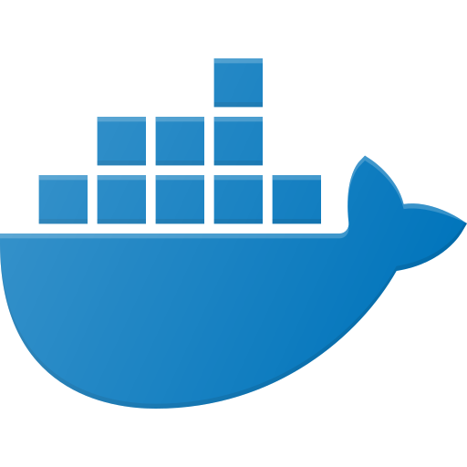


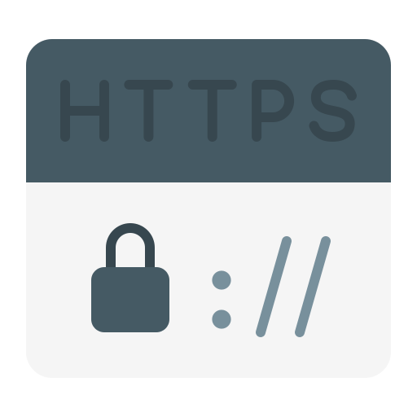
TECHNICAL APPROACH
Team TROVER
WORKFLOW
Victim files complaint in any language
Smart Intake + national memory
Hop-by-hop checks
Gang / FIR‑dedup‑check
Risk +
VASP attribution
Officer approval + send request (BNSS/MLAT)
Final Output
Technologies to be used
Trace Funds
CLIENT LAYER
(React + TS Browser)
BACKEND LAYER (FastAPI)
EXTERNAL SERVICES
Backend: Python, FastAPI, PostgreSQL, Redis, Celery
Smart Intake
Memory
Tracing Engine
Attribution
Evidence pack
TronGrid/ Etherscan APIs
Every wallet
Cross-state match
Graph & Detection: Rustworkx, Union-Find, BFS, risk diffusion
Hinglish NER
Checksums + PII mask
Multichain trace
Sweep + bridge + cold-trail
Noisy-OR + SHAP
What-if verdict
Hash manifest
Integrity Verification
On-chain data
Intake
Machine Learning: LightGBM, SHAP, PyTorch Geometric
Live Trace
OCR + NLP
Notices & Routing
Audit Log
Sanctions + Diffusion
Pre-emptive Freeze
Hinglish-ready
Attribution
BNSS/BSA drafts
SAHYOG export
MLAT / FIU routing
Hash-chained
2-officer review
Immutable record
OFAC / UN lists
Proximity risk spread
USDT freeze check
Next-hop model
VASP alerts
SLA tracker
Frontend: React 19, TypeScript, Tailwind, Motion
Memory
AUTH API
Identity verification
Email + OTP
Blockchain Data: TronGrid, Blockstream, Etherscan
Notices
DATABASE LAYER (PostgreSQL)
Freeze Alert
Case Collection
Trace Collection
Evidence Collection
Audit Collection
Memory Collection
Redis + Celery
Deployment: Docker Compose
PostgreSQL
INFRASTRUCTURE LAYER
Docker Compose (Containers)
Nginx
(Reverse Proxy)
JWT
(Auth Tokens)
HTTPS
(TLS Encryption)
PROTOTYPE LINK: github.com/tripathidhruv/Anveshak
FINAL OUTPUT
VIDEO LINK: to be added
Fund Flow Graph
Investigation Report/ Evidence pack
Named VASP + confidence
Routed request + freeze alert

Slide 4

FEASIBILITY AND VIABILITY
Team TROVER
FEASIBILITY:
VIABILITY:
Technical: Already running, not a concept: 490 passing tests. Hinglish intake, checksum-verified wallets, national memory, multi-chain trace, risk and evidence pack, live on localhost today. Sweep signature needs zero labelled fraud data.
People will use it:
I4C gets one national graph, not 28 state silos
An IO gets the exchange's name before the chai gets cold
Works at scale:
Every complaint makes the memory smarter, no labelled data needed
One trace closes many cases; syndicates surface on their own
Low risk to adopt:
Plugs into NCRP and SAHYOG, no rip-and-replace
Officer approves every output, no new legal liability
Operational: Single Docker host, offline-capable, no GPU. Imports NCRP read-only, exports SAHYOG payloads, so it slots into the I4C workflow police already use.
Social: Built for a constable, not a crypto analyst: reads complaints the way people actually write them. Every score shows its factors, so it can clear an innocent wallet, not just accuse.
Potential Challenges and Strategies to overcome it
Economical: Zero licensing vs. Chainalysis-class tools; one trace closes many cases, so cost per case falls as volume grows. No recurring cloud/GPU cost.
RISK | CHALLENGES | HOW WE OVERCOME IT
Wrong VASP named | Wrong exchange gets a notice | Glass-box verdict: every weight shown; infrastructure, never people; under 0.70 → human
Trail dies in a mixer | Most tools stop dead at the mixer | Cold-trail leads ranked by operator habits, always marked “lead, not proof”
Offshore VASP | Sits outside Indian law | Cross-border autopilot: MLAT / FIU-to-FIU, preserve-first request, SLA escalation
BUSINESS POTENTIAL:
State Licences:
Per-state licence for cyber cells: ₹25-50L/year × 36 states & UTs = ₹9-18Cr/year at 70% margins.
VASP Compliance Feed: FIU-registered exchanges subscribe to flagged-wallet alerts + SLA dashboard: 50 VASPs × ₹10-25L = ₹5-12Cr/year.
Global FIU Network: cross-border routing + Travel Rule checks as a service for FIUs across South & South-East Asia. By Year 5, ₹100Cr+ revenue.

Slide 5





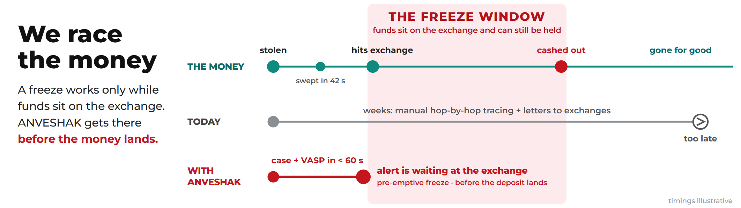
IMPACT AND BENEFITS
Team TROVER
Potential impact on the target audience
Benefits of the solution
Investigating Officer
Pastes a Hinglish complaint, gets the exchange's name. Zero crypto training needed.
Social
protects the elderly, students and first-time investors
works in Hindi & Hinglish
Economic
frozen before cash-out
weeks of tracing cut
₹0 licence cost against lakhs per seat annually
Legal
glass-box verdicts a defence lawyer can examine
hash-chained, tamper-evident evidence
Strategic
case data never leaves India
national memory becomes a sovereign asset
Environmental
marginal, and stated honestly: no mining, no node syncing, commodity hardware
I4C, SAHYOG and State Cells
One gang across 11 states shows up as one syndicate with one lead state, not 38 separate FIRs.
The Victim
The alert can be waiting at the exchange before the money lands. A real path to recovery replaces “nothing will happen.”
VASP Compliance Teams
Get structured, evidence-backed requests with a clear deadline and a public scorecard, so they act fast and refuse fewer.

Slide 6
RESEARCH AND REFERENCES
Team TROVER
DEPLOYED LINK: to be added
PROTOTYPE LINK: https://github.com/tripathidhruv/Anveshak
References
VIDEO LINK: to be added
Research & practice
Weber, M. et al. “Anti-Money Laundering in Bitcoin.” KDD Workshop, 2019 (LINK)
Möser, M. et al. “Money Laundering Tools in the Bitcoin Ecosystem.” APWG eCrime, 2013 (LINK)
FATF — Risk-Based Approach to Virtual Assets and VASPs, 2021 (LINK)
Research & Benchmarking of Existing Systems
EXISTING PLATFORM | WHAT THEY DON'T HAVE | WHAT ANVESHAK HAS
Commercial Analytics Chainalysis · TRM Labs · Elliptic · Merkle Science | ✗ Free access ✗ Open method ✗ Data stays in India | ✓ Free, self-hostable ✓ Every weight shown ✓ Data never leaves India
Open-Source Analytics GraphSense · BlockSci | ✗ Complaint intake ✗ National wallet memory ✗ TRON/USDT support | ✓ Single-host Docker, OFFLINE ✓ Remembers every wallet ✓ TRON/USDT-first
Public Block Explorers Tronscan · Etherscan · Blockchair | ✗ Wallet clustering ✗ Names receiving exchange ✗ Usable without expertise | ✓ Automated multi-hop trace ✓ Names VASP + confidence ✓ No expert skill needed
NCRP / SAHYOG (I4C) | ✗ Links cases across states ✗ Cross-border routing | ✓ National memory + cross-border routing
Exchange / VASP Internal AML | ✗ Acts before deposit ✗ Evidence-backed format | ✓ Pre-emptive alert + evidence-backed request
Datasets & label sources
Elliptic Data Set / Elliptic++ — labelled Bitcoin transactions
OFAC SDN crypto address list — home.treasury.gov
BigQuery public blockchain datasets — Bitcoin, Ethereum
Existing systems
NCRP — (LINK)
GraphSense — (LINK)
Chainalysis — (LINK) · TRM Labs — (LINK)
Tronscan — (LINK) · Etherscan — (LINK)

