Slide 1
Credit EDA Case-Study
By Anurag and Vinit

Slide 2
Problem Statement
Basically two types of risks associated with the problem statement:
Target 0: If the applicant is likely to repay the loan, the company will suffer a loss of business if the loan is not approved.
Target 1: If the applicant is unlikely to repay the loan on time, the corporation will lose money again by authorizing the loan.

Slide 3
Analysis on Application Data frame
Missing value treatment
Checking and treating outliers
Checking data imbalance
Univariate, bivariate, and multivariate analysis of Target 0(NON DEFAULTERS) and Target 1 application data (DEFAULTERS).

Slide 4
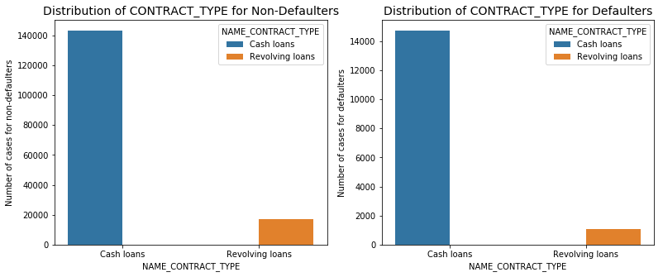
Categorical Univariate Analysis (CONTRACT_TYPE)
Inference: Less defaulters for Revolving loans

Slide 5
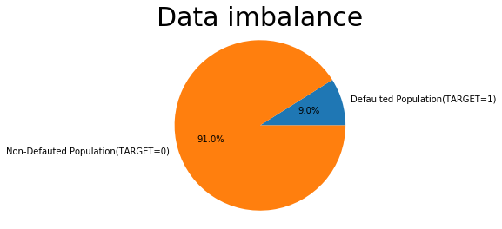
Proportion of Defaulters in the Application data-set

Slide 6
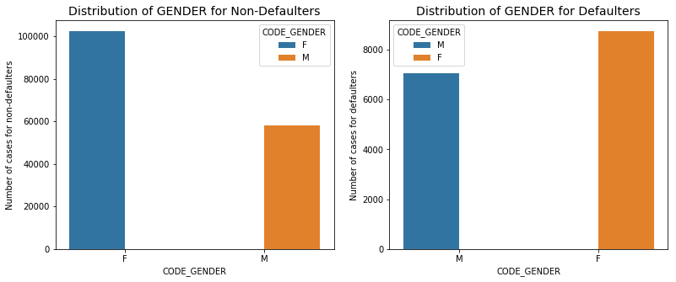
Categorical Univariate Analysis(GENDER)
Inference: Male tends to be more Defaulters

Slide 7
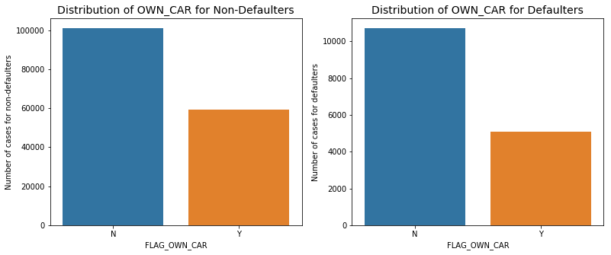
Categorical Univariate Analysis(OWN_CAR)
INFERENCE: People own cars Defaults less

Slide 8
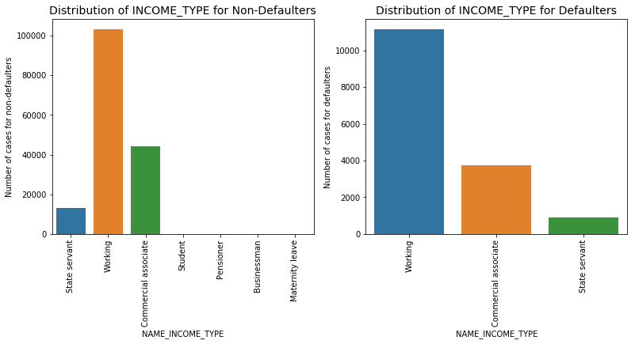
Categorical Univariate Analysis(INCOME_TYPE)
Inference: Proportion of Working in Defaulters is maximum , where State servant and Commercial Associate is less in Defaulters.

Slide 9
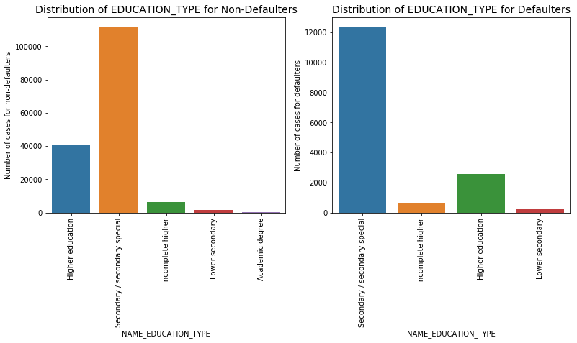
Categorical Univariate Analysis(EDUCATION_TYPE)
Inference: People with Higher Education tends to Default less.

Slide 10
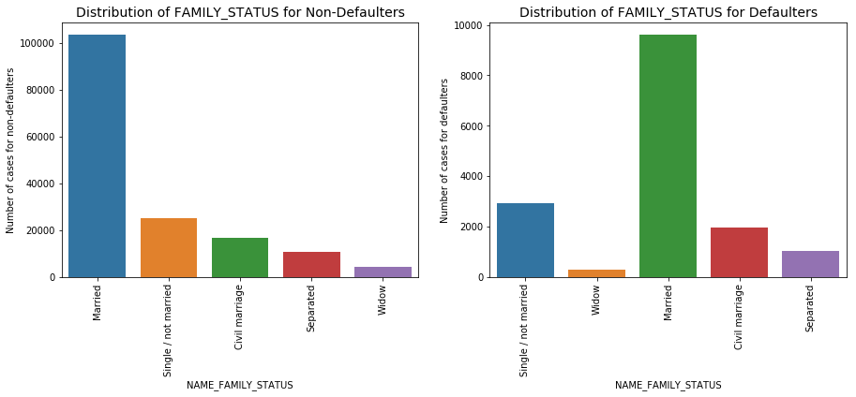
Categorical Univariate Analysis(FAMILY_STATUS)
Inference: The proportion of single/non-married people and civil marriages are more likely to default.

Slide 11
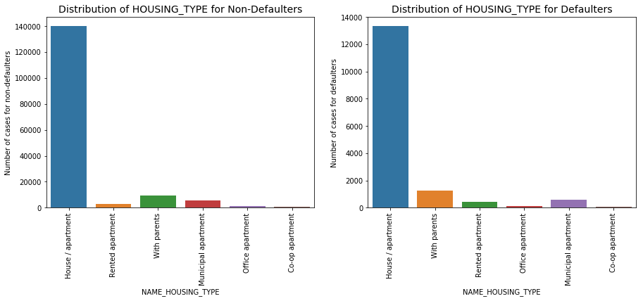
Categorical Univariate Analysis(HOUSING_TYPE)
Inference: People who live with their parents and in rented apartments are more likely to default.

Slide 12
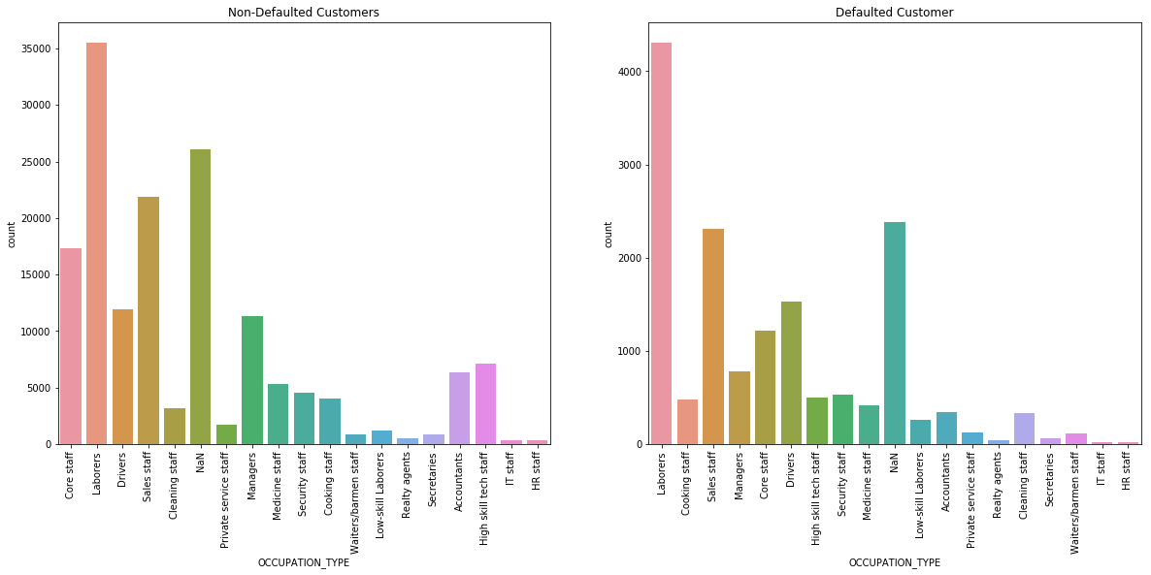
Categorical Univariate Analysis(OCCUPATION_TYPE)
Inference: Core employees, salespeople, accountants, highly qualified technical personnel, and managers are less likely to default.

Slide 13
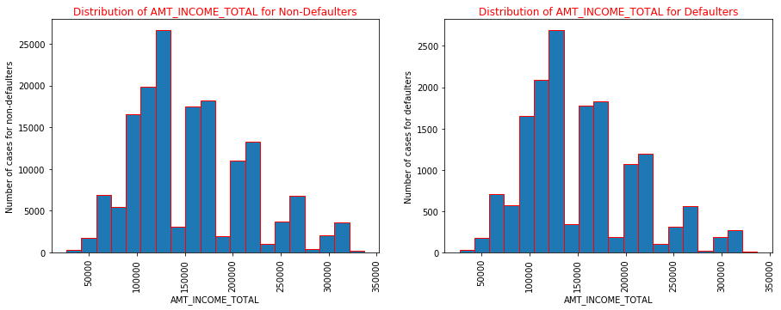
Numerical Univariate Analysis(INCOME_TOTAL)
Inference: People with incomes of more than 2 lakhs are less likely to default.

Slide 14
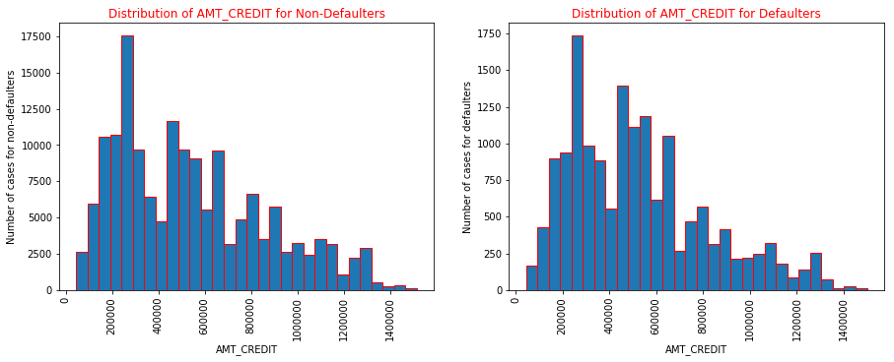
Numerical Univariate Analysis(AMT_CREDIT)
Inference: People with credit scores of 8 lakhs to 12 lakhs are less likely to default.

Slide 15
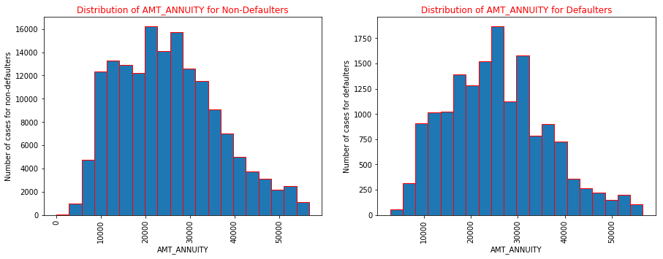
Numerical Univariate Analysis(AMT_ANNUITY)
Inference: People paid annuity more than 30000 tends to Default less.

Slide 16
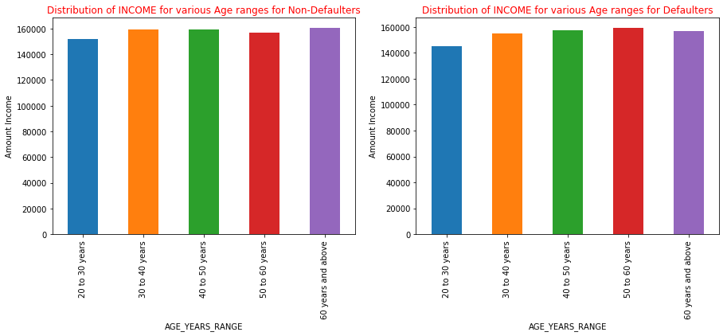
Bivariate Analysis (AGE_YEARS_RANGE VS AMT_INCOME)
Inference: People having Age 50-60 years and Income range 14-16 lakhs tends to default more.

Slide 17
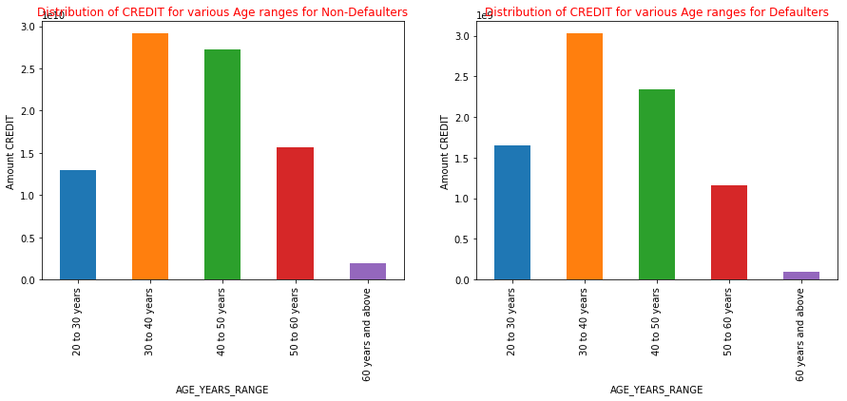
Bivariate Analysis (AGE_YEARS_RANGE VS AMT_CREDIT)
Inference: People in their 40s and 50s are credited with a total sum of roughly 2750 crores, while those in their 50s and 60s are credited with a total sum of around 1600 crores and are less likely to default.

Slide 18
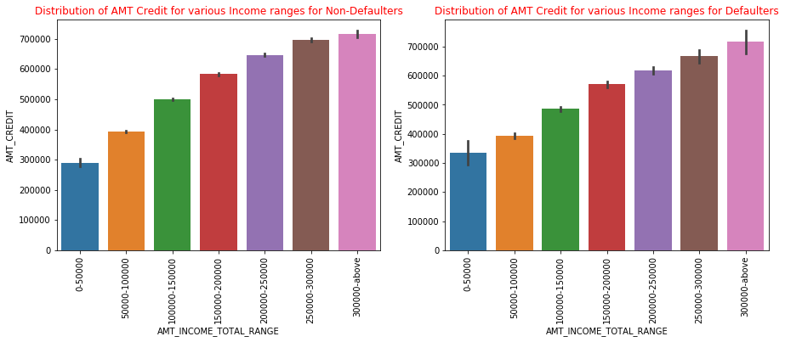
Bivariate Analysis (AMT_INCOME_TOTAL_RANGE VS AMT_CREDIT)
Inference: People with an income of 0-50000 and a credit balance of more than 3 lakhs are more likely to default.

Slide 19
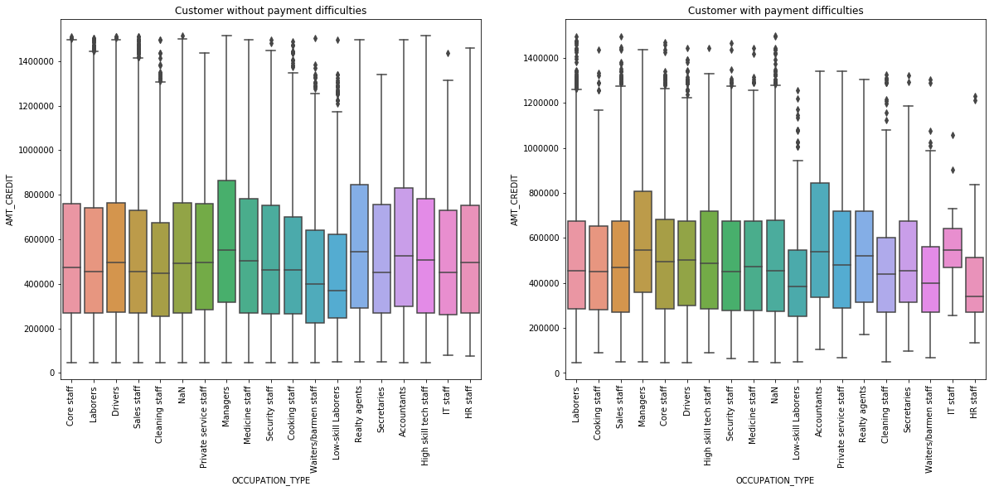
Bivariate Analysis (AMT_CREDIT VS OCCUPATION_TYPE)
Inference1: Realty Agents takes more credit defaults less.
Inference2: The IQR of IT staff and HR staff is less for defaulters.

Slide 20
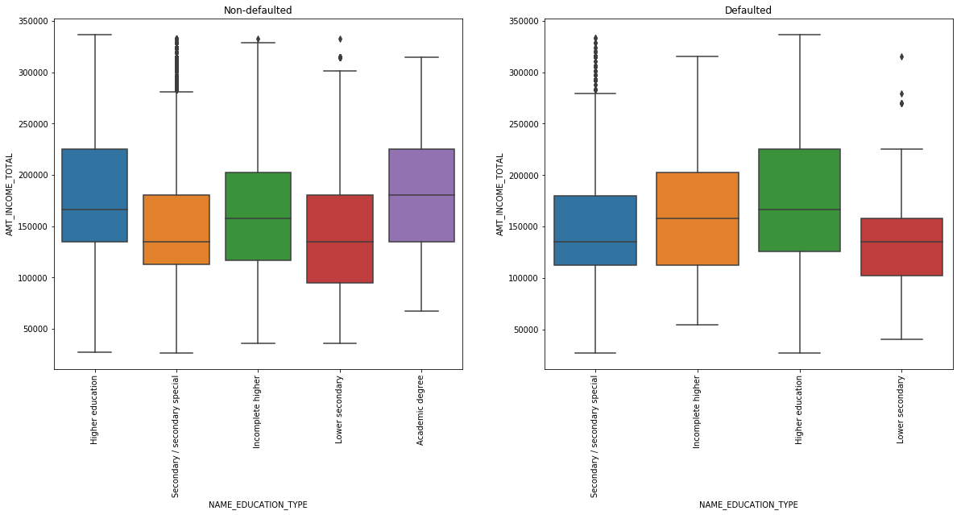
Bivariate Analysis (NAME_EDUCATION_TYPE VS AMT_INCOME_TOTAL)
Inference: People having Academic degree are Non-defaulters.

Slide 21
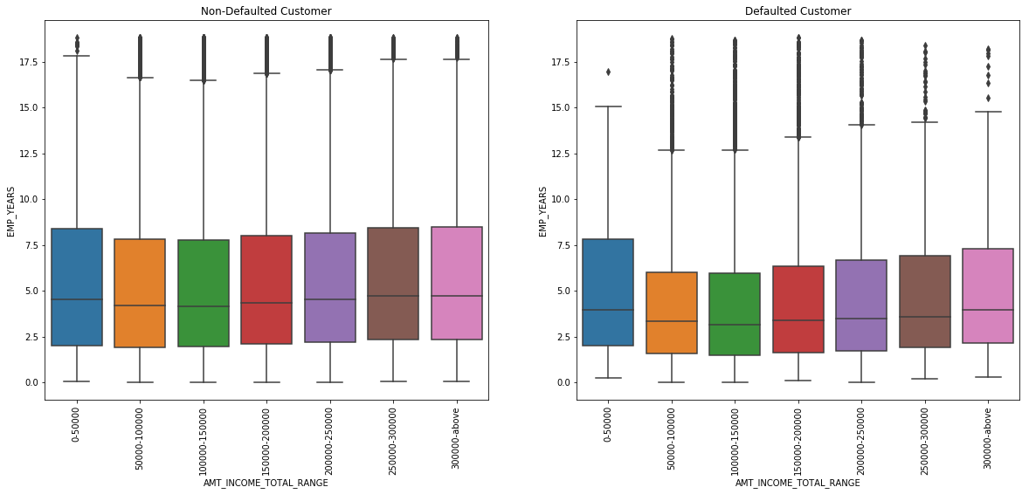
Bivariate Analysis (EMP_YEARS VS AMT_INCOME_TOTAL_RANGE)
Inference: People having less years of employment experience tend to default more.

Slide 22
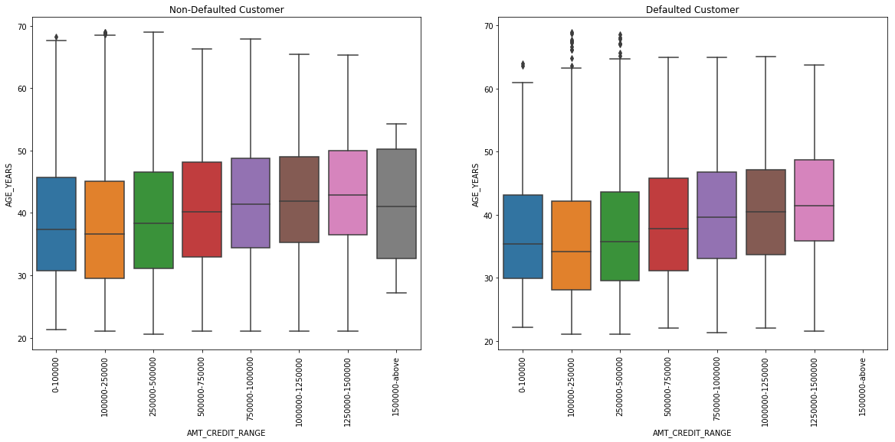
Bivariate Analysis (AGE_YEARS VS AMT_CREDIT_RANGE)

Slide 23
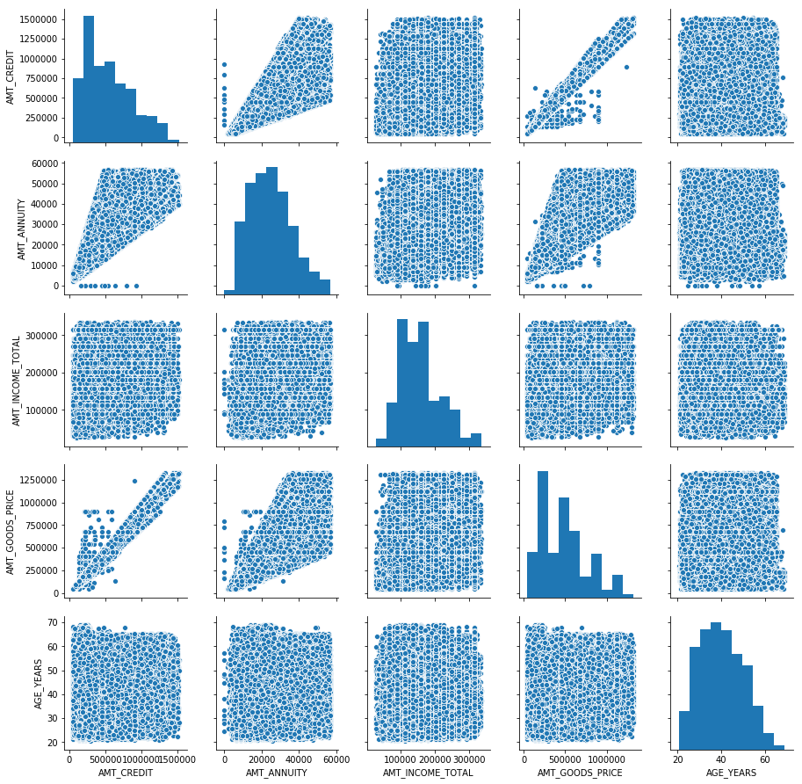
Multivariate Analysis (AMT_CREDIT, AMT_ANNUITY, AMT_INCOME_TOTAL, AMT_GOODS_PRICE, AGE_YEARS) for Target 0

Slide 24
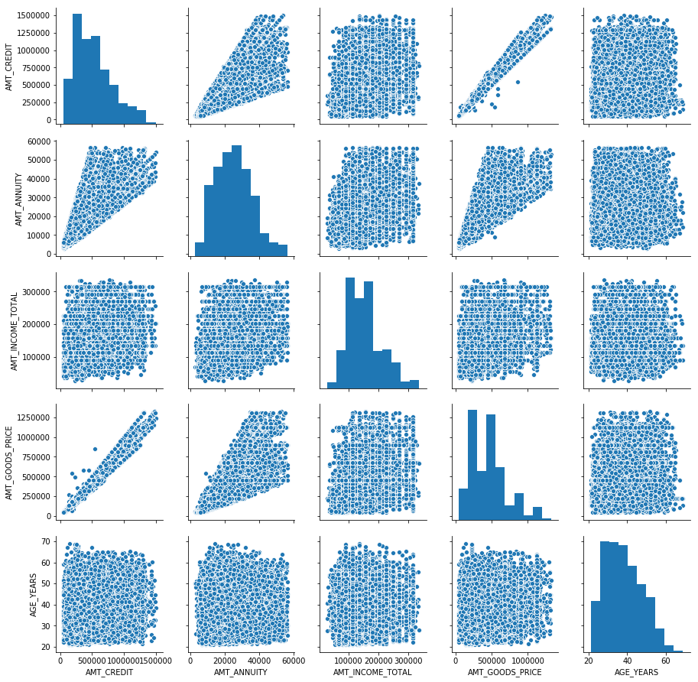
Multivariate Analysis (AMT_CREDIT, AMT_ANNUITY, AMT_INCOME_TOTAL, AMT_GOODS_PRICE, AGE_YEARS) for Target 1

Slide 25
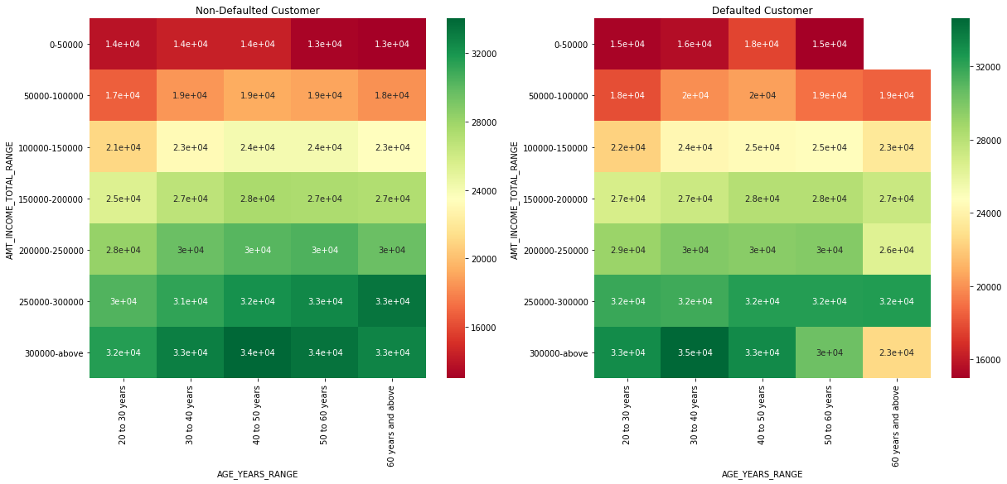
HEAT MAP (INCOME_RANGE ,AGE YEARS, AMT_ANNUITY)

Slide 26
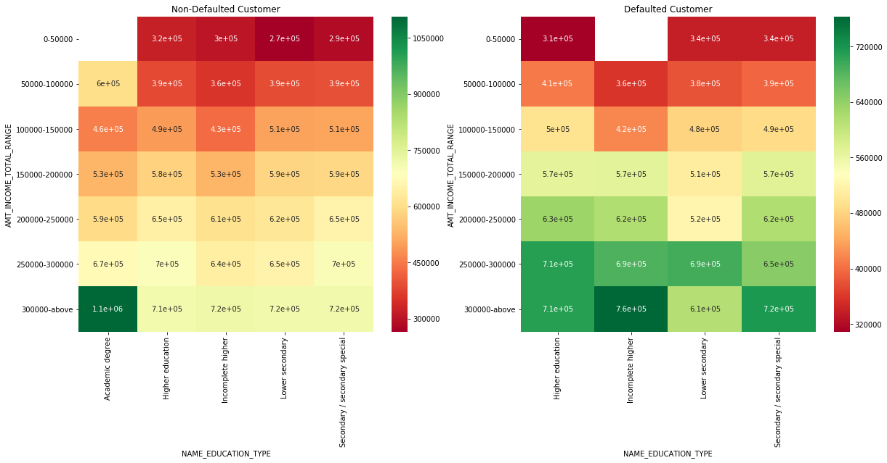
HEAT MAP (AMT_INCOME_TOTAL_RANGE, NAME_EDUCATION_TYPE,AMT_CREDIT)

Slide 27
MERGING THE PREVIOUS APPLICATION DATAFRAME TO APPLICATION DATAFRAME
Missing value treatment
Checking and treating outliers
Checking data imbalance
Univariatre, Bivariate and multivariate analysis on All_APPLICATION data
Correlation between the columns of a for the defaulted and Non-defaulted population.

Slide 28
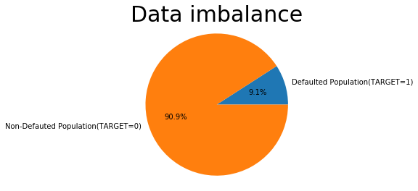
CHECKING DATA IMBALANCE for Merged Dataset

Slide 29
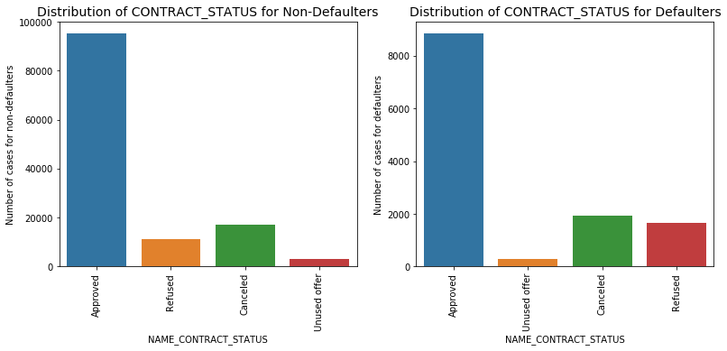
CATEGORICAL UNIVARIATE ANALYSIS (CONTRACT_STATUS)

Slide 30
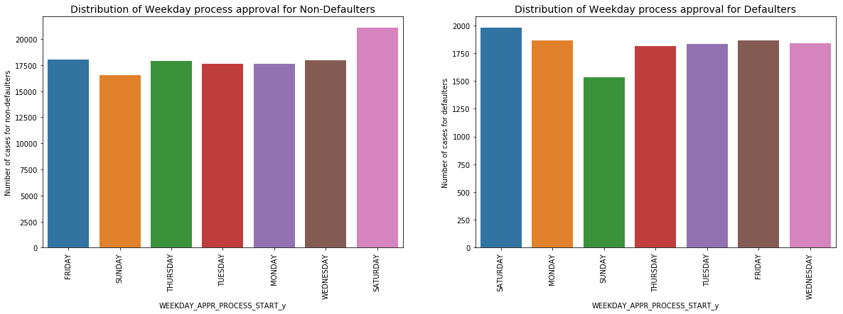
CATEGORICAL UNIVARIATE ANALYSIS (WEEKDAY PROCESS APPROVAL)

Slide 31
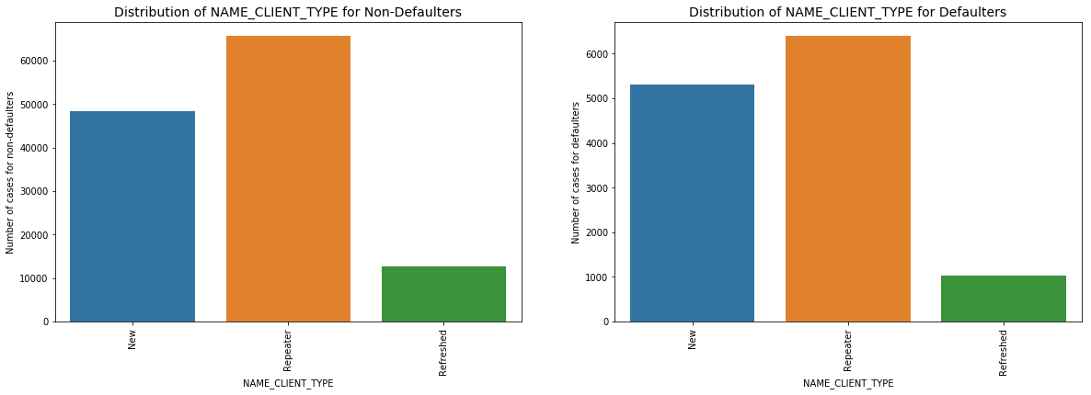
CATEGORICAL UNIVARIATE ANALYSIS(NAME_CLIENT_TYPE)
Inference: New clients tends to default more.

Slide 32
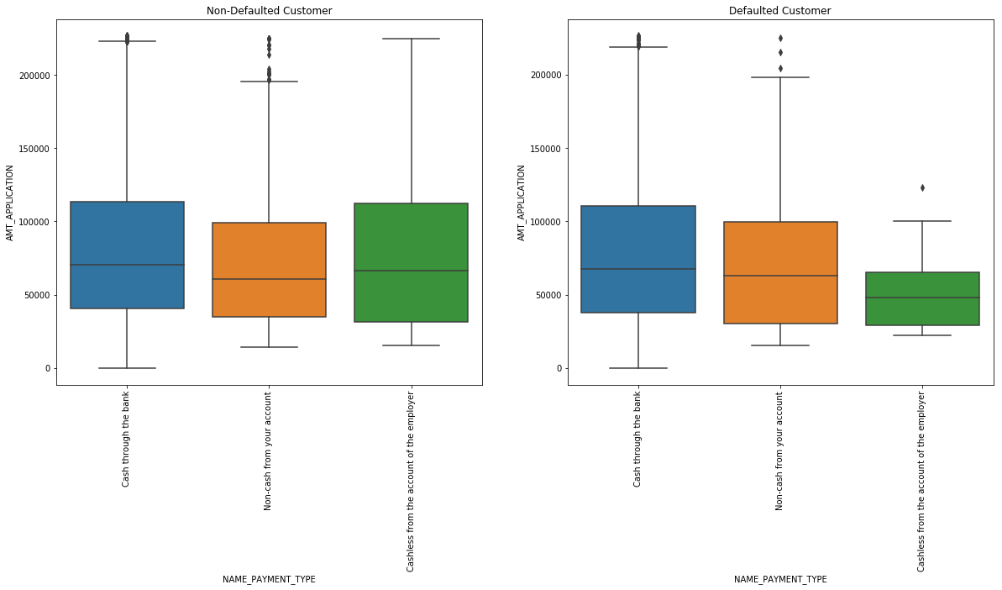
BIVARIATE ANALYSIS (AMT_APPLICATION AND NAME_PAYMENT_TYPE)
Inference: People who pay with a cashless payment method from their employer's account are less likely to default.

Slide 33
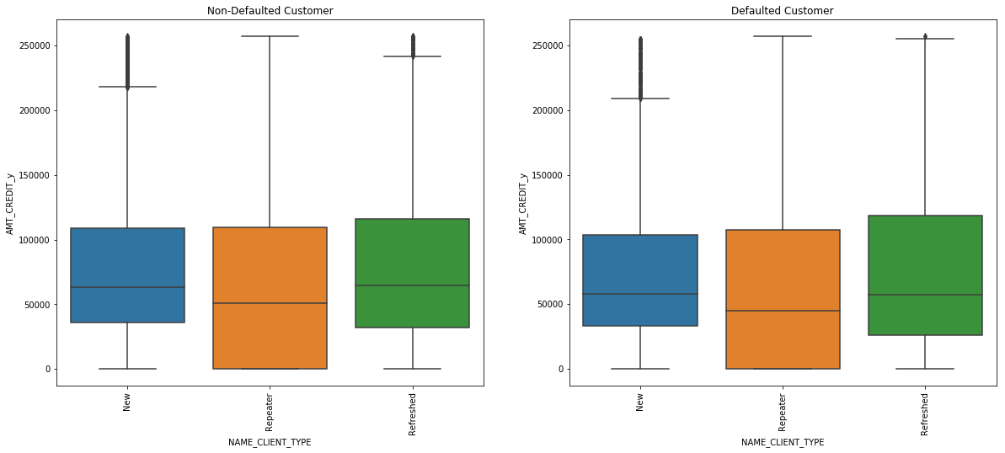
BIVARIATE ANALYSIS(AMT_CREDIT_y AND NAME_CLIENT_TYPE)

Slide 34
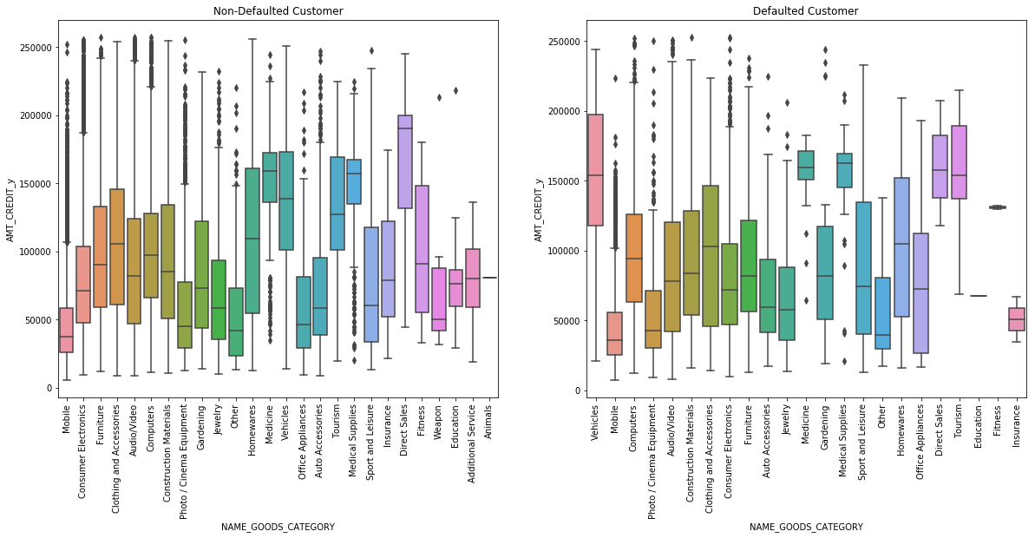
BIVARIATE ANALYSIS (AMT_CREDIT_y AND NAME_GOODS_CATEGORY)
Inference: People who have things such as education, fitness, and insurance are less likely to default.

Slide 35
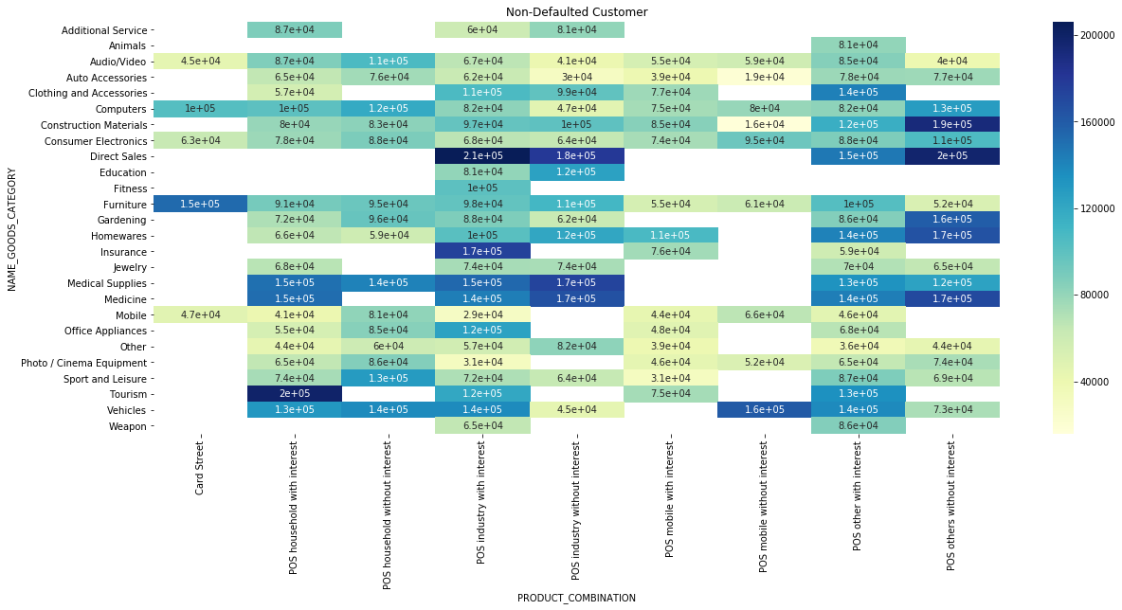
MULTI_VARIATE ANALYSIS (NAME_GOODS_CATEGORY, PRODUCT_COMBINATION, AMT_CREDIT_y) for NON_DEFAULTED_CUSTOMER
Inference: People with goods category Direct sales and Product combination POS industry with interest tends to default less.
Inference2: People with interest in the Goods category Tourism and the Product combo POS Household likely to default less.

Slide 36
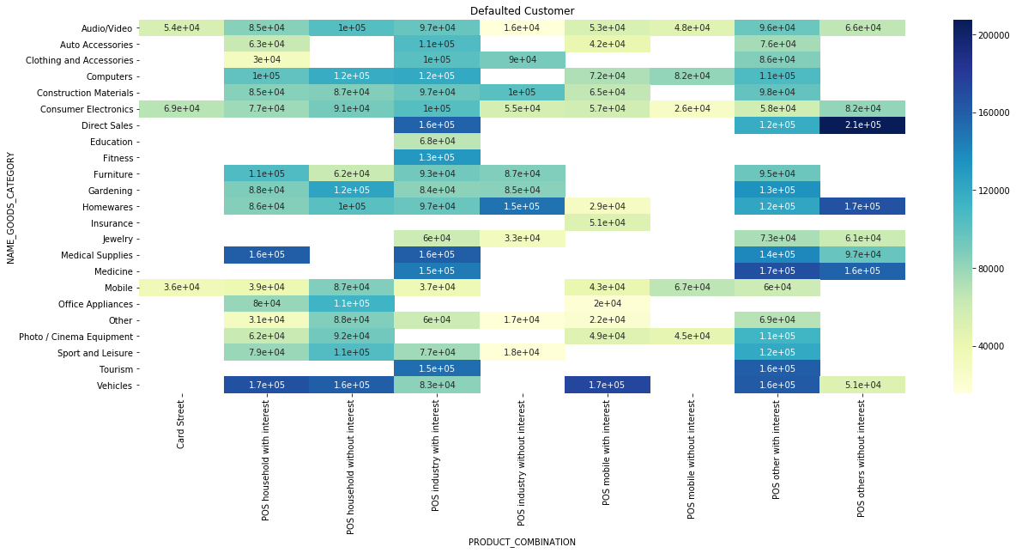
MULTI_VARIATE ANALYSIS (NAME_GOODS_CATEGORY, PRODUCT_COMBINATION, AMT_CREDIT_y) for DEFAULTED_CUSTOMER

Slide 37
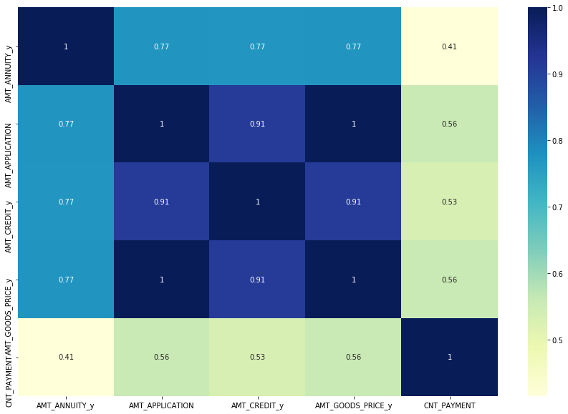
CORRELATION Columns for for DEFAULTED_CUSTOMER

Slide 38
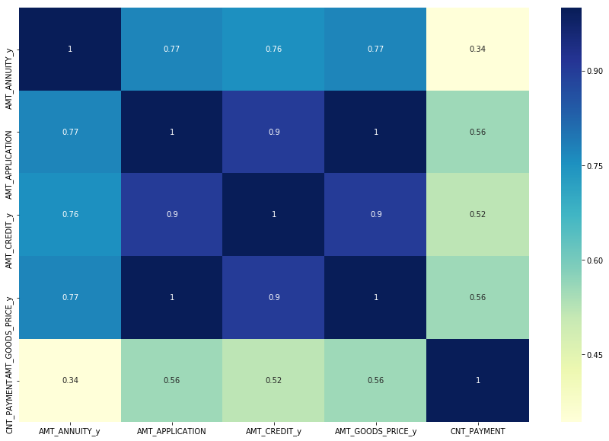
CORRELATION Columns:

Slide 39
FINAL INFERENCE AND CONCLUSION :
Inferences from Application Data set:
Core employees, salespeople, accountants, highly qualified technical personnel, and managers are less likely to default.
People having Academic degree are Non-defaulters.
People having less years of employment experience tend to default more.
Inferences from Final merged All Application Data set:
The number of 'Refused' entries in 'NAME CONTRACT STATUS' is quite low, and it also has the highest percentage of payment difficulties—around 13%. As a result, clients with a contract status of "Refused" in a previous application are the main drivers of Loan Defaulters.
The count of ‘Revolving Loans’ in ‘NAME_CONTRACT_TYPE’ is comparatively very less and it also has maximum % of payment difficulties- around 12%. As a result, clients whose contract type in the previous application was 'Revolving loans' are the driving factors for Loan Defaulters.
Clients with 'Revolving loans' and 'Refused' past applications had larger percent of payment troubles in the current application, as seen in the graph. Since the count of both 'Revolving loans' and ‘Refused’ is comparatively less(from the graphs in previous slide), clients with ‘Revolving Loans’ and ‘Refused’ previous application are driving factors for Loan Defaulters

Slide 40
THANK YOU

