Slide 1

Maximizing Long-Term Portfolio Returns: Index vs Dividend Investing
Trip Fernandes
Springboard DSC
9/19/23
Mentor & Advisor: Ramkumar Hariharan

Slide 2
Index vs Dividend Investing Strategy – A brief introduction
Index Investing Strategy
Investing in a broad market index (e.g., S&P500) to mirror its performance
Capture market returns with minimal management (passively traded)
Exchange-Traded Funds (ETFs) or Index Mutual Funds
Dividend Investing Strategy
Investing in individual stocks that pay regular dividends
Generate consistent income through dividend payments while potentially benefiting from capital appreciation
Dividend-paying stocks, Dividend Growth Funds

Slide 3
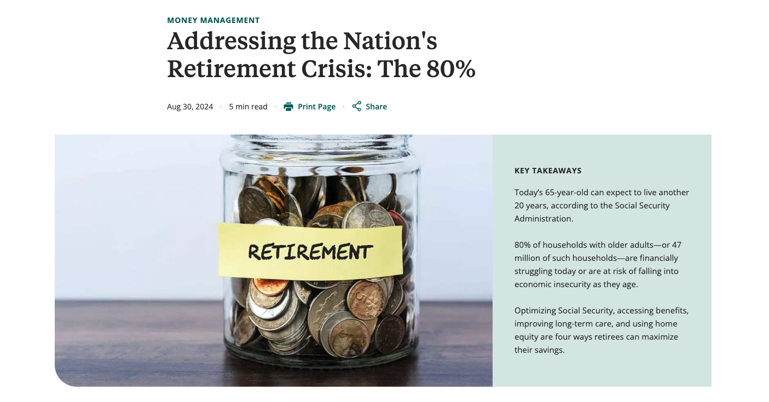
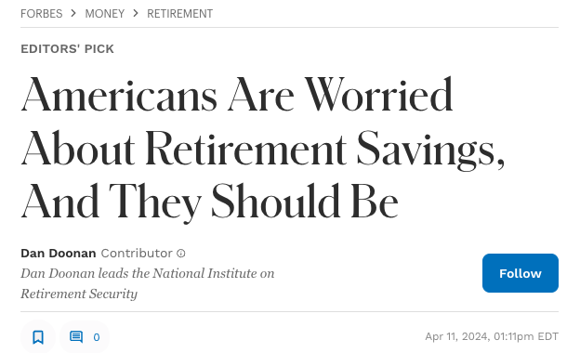
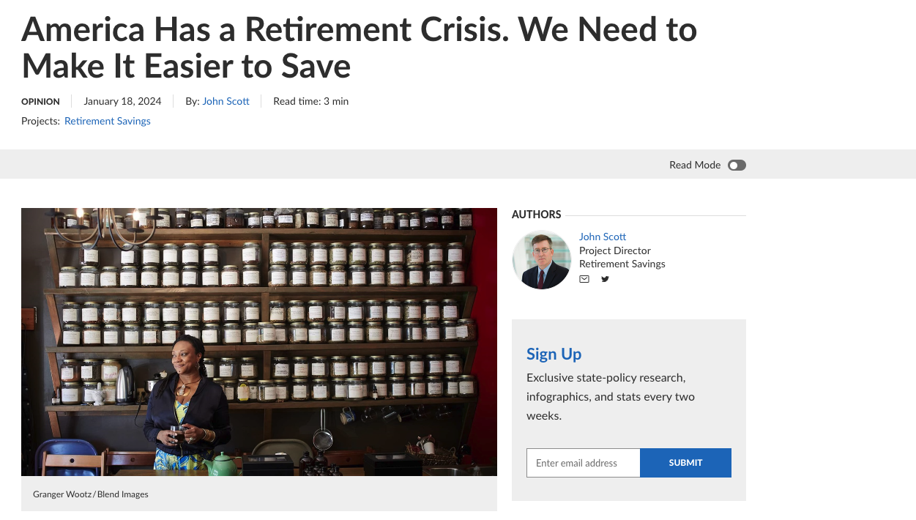
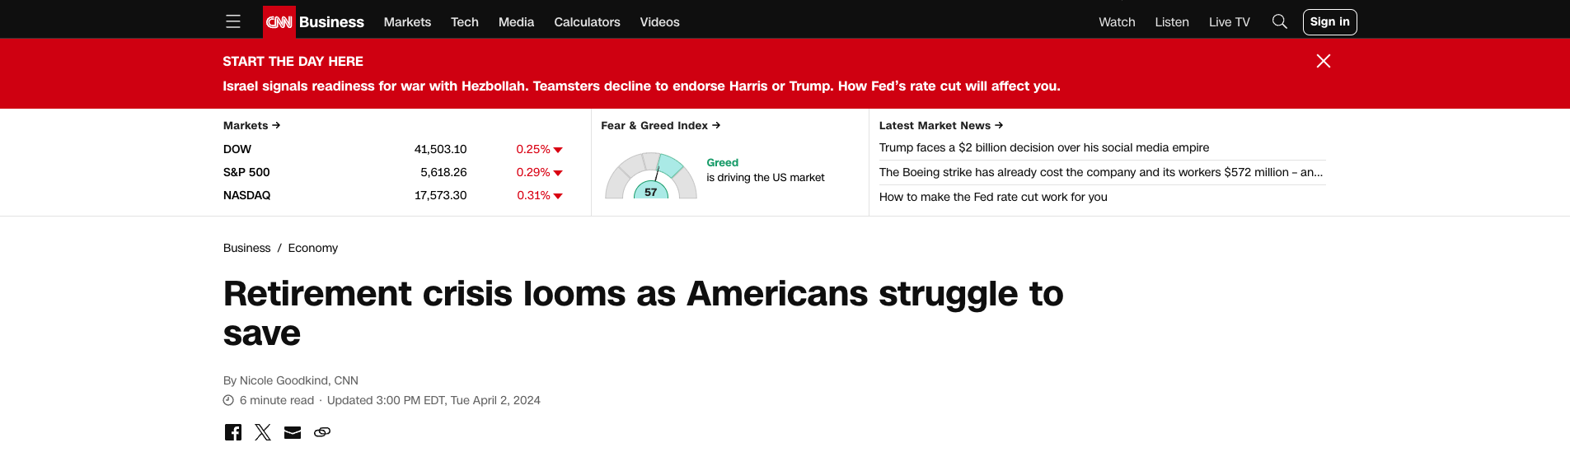
Why is this important?
There is a retirement crisis looming on the US horizon
Future generations can avoid this entirely by proactively planning for their financial future
The retirement onus is now on the individual whereas in previous generations retirement depending on the corporation via pensions
Pensions have largely been replaced by 401k’s and individual brokerage accounts

Slide 4
Which Strategy is Best?
Hotly contested topic
Many people provide anecdotal evidence against dividend investing from being burned (dividend cut) by a dividend payer in the past
What does the data say?
Examined 30-years of data across 6 different portfolios. Each portfolio had a different composition of companies.
Used dividend aristocrats for the dividend paying stocks
Used SPY as the S&P500 broad market index
Notes:
Portfolio 1:
3M (MMM)
AbbVie (ABBV)
A. O. Smith (AOS)
Archer Daniels Midland (ADM)
AT&T (T)
Cardinal Health (CAH)
Cincinnati Financial (CINF)
Cintas (CTAS)
Coca-Cola (KO)
Colgate-Palmolive (CL)
Portfolio 2:
Chevron (CVX)
Dover Corporation (DOV)
Ecolab (ECL)
Edwards Lifesciences (EW)
Essex Property Trust (ESS)
Fastenal (FAST)
Fifth Third Bancorp (FITB)
Franklin Templeton (BEN)
General Dynamics (GD)
Genuine Parts Company (GPC)
Portfolio 3:
Hormel Foods (HRL)
Illinois Tool Works (ITW)
Johnson & Johnson (JNJ)
Kroger (KR)
Leggett & Platt (LEG)
Linde plc (LIN)
Lowe’s (LOW)
McDonald’s (MCD)
Medtronic (MDT)
Nucor Corporation (NUE)
Portfolio 4:
PepsiCo (PEP)
Procter & Gamble (PG)
Sherwin-Williams (SHW)
Stanley Black & Decker (SWK)
Sysco Corporation (SYY)
Target Corporation (TGT)
Walgreens Boots Alliance (WBA)
Walmart (WMT)
Waste Management (WM)
3M (MMM)
Portfolio 5:
3M (MMM), AbbVie (ABBV), A. O. Smith (AOS), Archer Daniels Midland (ADM), AT&T (T), Cardinal Health (CAH), Cincinnati Financial (CINF), Cintas (CTAS), Coca-Cola (KO), Colgate-Palmolive (CL)
Chevron (CVX), Dover Corporation (DOV), Ecolab (ECL), Edwards Lifesciences (EW), Essex Property Trust (ESS), Fastenal (FAST), Fifth Third Bancorp (FITB), Franklin Templeton (BEN), General Dynamics (GD), Genuine Parts Company (GPC)
Hormel Foods (HRL), Illinois Tool Works (ITW), Johnson & Johnson (JNJ), Kroger (KR), Leggett & Platt (LEG), Linde plc (LIN), Lowe’s (LOW), McDonald’s (MCD), Medtronic (MDT), Nucor Corporation (NUE)
PepsiCo (PEP), Procter & Gamble (PG), Sherwin-Williams (SHW), Stanley Black & Decker (SWK), Sysco Corporation (SYY), Target Corporation (TGT), Walgreens Boots Alliance (WBA), Walmart (WMT), Waste Management (WM)
SPY Portfolio:
SPY ETF (S&P 500 Benchmark)

Slide 5
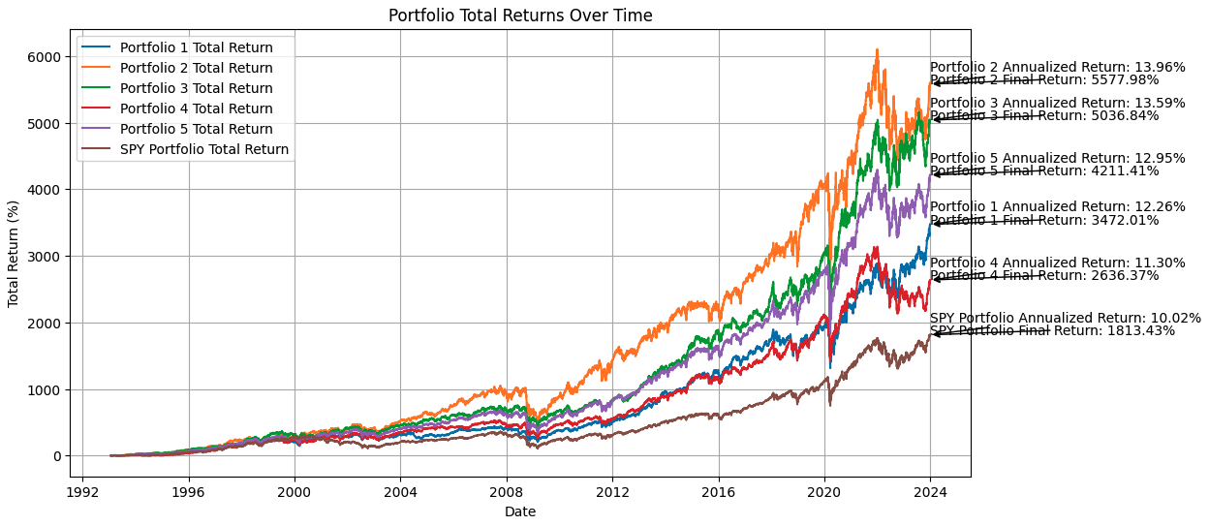
Dividends!
Each dividend portfolio beat the broader market index
Portfolio | Total Return
Portfolio 1 | 3472.01%
Portfolio 2 | 5577.98%
Portfolio 3 | 5036.84%
Portfolio 4 | 2636.37%
Portfolio 5 | 4211.41%
SPY Portfolio | 1813.43%
Portfolio | Annualized Return
Portfolio 1 | 12.26%
Portfolio 2 | 13.96%
Portfolio 3 | 13.59%
Portfolio 4 | 11.30%
Portfolio 5 | 12.95%
SPY Portfolio | 10.02%

Slide 6
The result: Dividends!
Portfolio | Total Return
Portfolio 1 | 3472.01%
Portfolio 2 | 5577.98%
Portfolio 3 | 5036.84%
Portfolio 4 | 2636.37%
Portfolio 5 | 4211.41%
SPY Portfolio | 1813.43%
Portfolio | Annualized Return
Portfolio 1 | 12.26%
Portfolio 2 | 13.96%
Portfolio 3 | 13.59%
Portfolio 4 | 11.30%
Portfolio 5 | 12.95%
SPY Portfolio | 10.02%

Slide 7
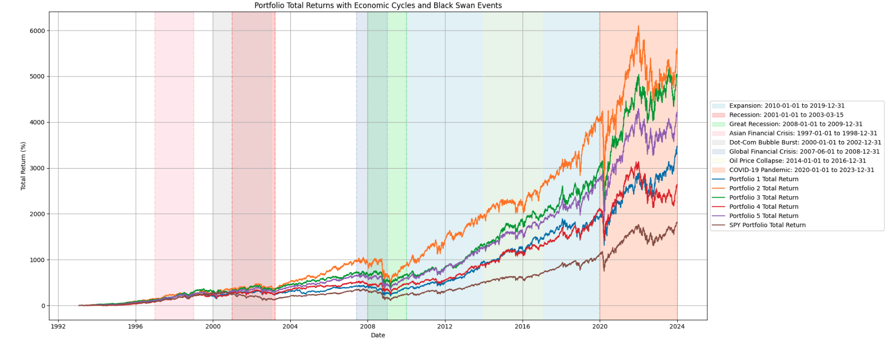
Deeper Dive
Portfolio | Total Return
Portfolio 1 | 3472.01%
Portfolio 2 | 5577.98%
Portfolio 3 | 5036.84%
Portfolio 4 | 2636.37%
Portfolio 5 | 4211.41%
SPY Portfolio | 1813.43%
Portfolio | Annualized Return
Portfolio 1 | 12.26%
Portfolio 2 | 13.96%
Portfolio 3 | 13.59%
Portfolio 4 | 11.30%
Portfolio 5 | 12.95%
SPY Portfolio | 10.02%

Slide 8
Can we predict what companies will be future Dividend Aristocrats?
Approach
Looked at companies with a 5-year and 20-year history of paying dividends compared to the Dividend Aristocrats
Focused on key factors: dividend yield, payout ratios, market capitalization, etc
Model Used: Random Forest Classifier

Slide 9
What are the results?
5-year model result
Accuracy 93.18%
ROC-AUC Score: 0.77
Key Feature: Dividend Yield
20-year model result
Accuracy: 89.45%
ROC-AUC: 0.85
Key Feature: Dividend Consistency, Market Cap
Top 5 companies (5-year model):
Verizon Communication (VZ) - Probability: 0.53
Peabody Energy (BTU) - Probability: 0.43
Kohl’s Corporation (KSS) - Probability: 0.36
Williams Companies (WMB) - Probability: 0.30
OneMain Holdings (OKE) - Probability: 0.28
Top 5 companies (20-year model):
Patterson Companies (PDCO) - Probability: 0.36
Kimberly-Clark (KMB) - Probability: 0.32
Verizon Communications (VZ) - Probability: 0.30
United States Steel Corporation (X) - Probability: 0.28
Eli Lilly and Company (LLY) - Probability: 0.27
Notes:
Key Takeaways:
5-Year Model: Offers insights into recent dividend behaviors but is limited in capturing long-term sustainability.
20-Year Model: Provides a more robust prediction for future Aristocrats, highlighting the importance of long-term financial health and dividend consistency.

Slide 10
Future Work and Next Steps
Enhance
Feature selection
Expand
Dataset and sources
Incorporate
Macroeconomic Indicators
Deploy
Predictive Model in Real-Time

Slide 11
Conclusion
Predictive Power
Analysis demonstrated that both 5-year and 20-year dividend histories provide valuable insights for identifying future Dividend Aristocrats
20-year model proved to be more reliable in forecasting long-term dividend sustainability and future Aristocrat status.
This research underscores the importance of long-term dividend sustainability for identifying future Dividend Aristocrats and offers a solid foundation for future predictive modeling in dividend growth investing.

Slide 12

Thank you to my advisor and mentor Ramkumar Hariharan!

Slide 13

Questions

