Slide 1
Predicting Client Subscription using Machine Learning Techniques
Trupti D.
Gomathi T.
Shraddha D

Slide 2

Problem Statement
A Portuguese banking Institution runs direct marketing campaigns based on phone calls. In order to access if the client has subscribed to the term deposit, more than one contact is made to the client.
The main purpose of this project is to predict if the client will subscribe (yes/no) a term deposit by using Machine Learning Algorithms.

Slide 3
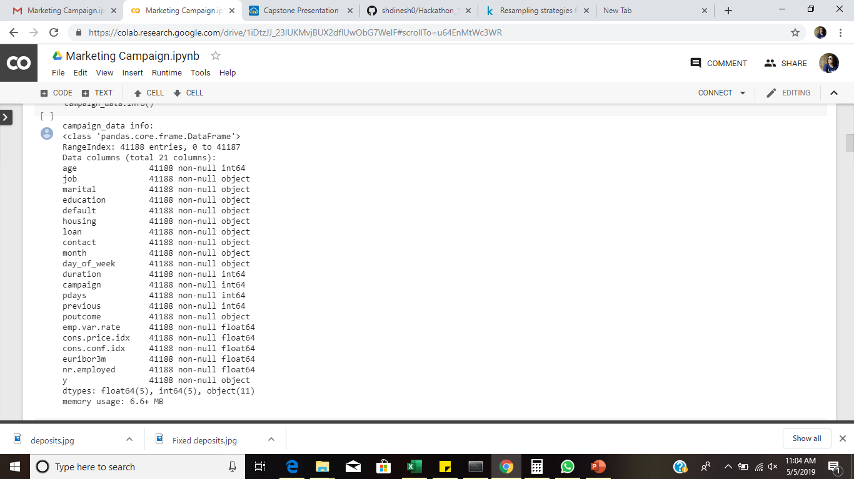
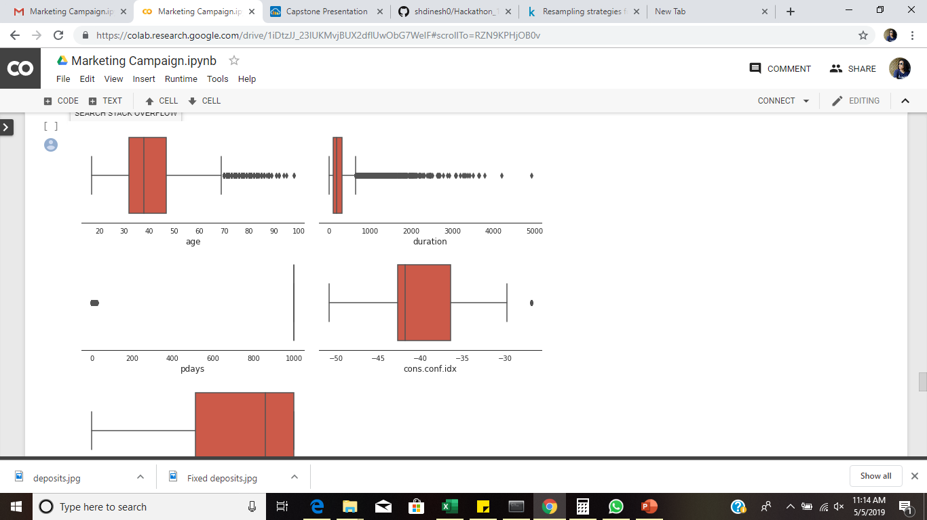
Pre processing Data and Balancing
The Dataset had most of the descriptive data in the "categorical columns". Not much insights could be gathered initially.
Data Visualization showed anomalies in data, which were handled.

Slide 4
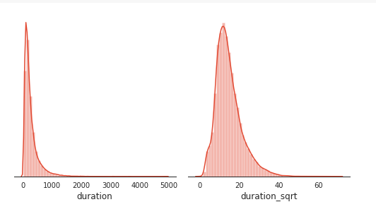
Pre processing Data and Balancing
Data Showed Skewness in ‘Duration’, which is also highly correlated to the Target variable. Hence we applied square root to handle Skewness.
Data Analysis showed imbalanced data. Hence, Under sampling, Oversampling, class weights etc. were applied on the datasets to balance it.

Slide 5
Feature engineering
New features were created from Age, pdays, Duration .
Data Binning was done on the existing features.
Features were reduced from 20 to 16 features.

Slide 6
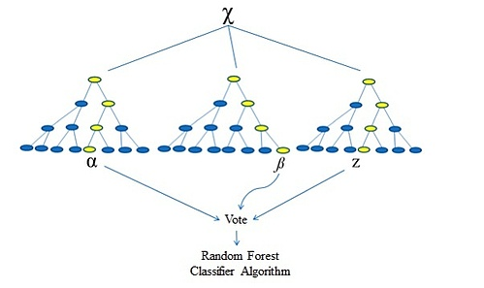
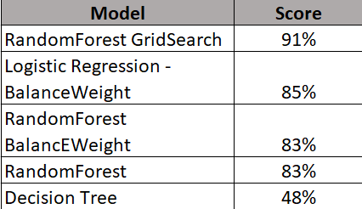
Model Fitting
Random Forest Grid Search Wins!
Random Forest Grid Search is of the best useful technique to predict our goal on whether a client will subscribe to a term deposit or not at 91% accuracy.

Slide 7
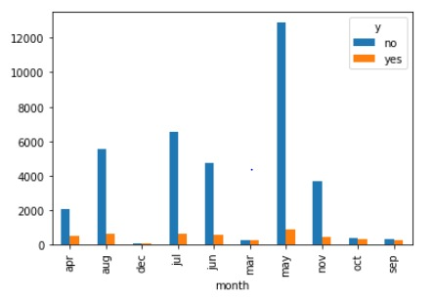
Conclusion & Suggestions
Months: The month of May shows highest number of rejection cases for subscription to Term Deposit. However every campaign included lot of investments. Hence, the suggestion to the banking institution would be to focus the marketing campaign during the other months of the year.
Coverage of Months in a year:- As seen in the graph, the campaign is only covered for 10 months in a year. For more profit, the suggestion would be to increase coverage in terms of month and run the campaign for all 12 months.

