Slide 1

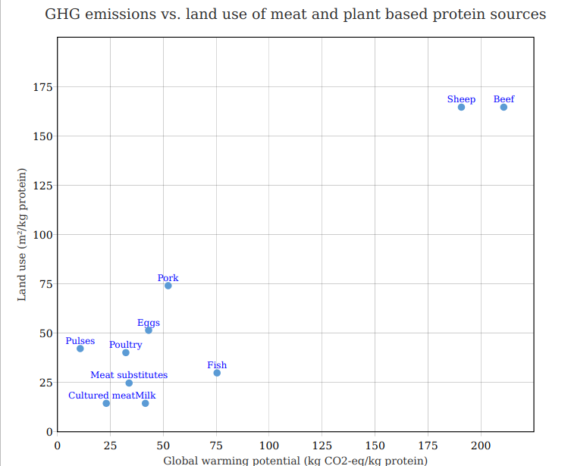
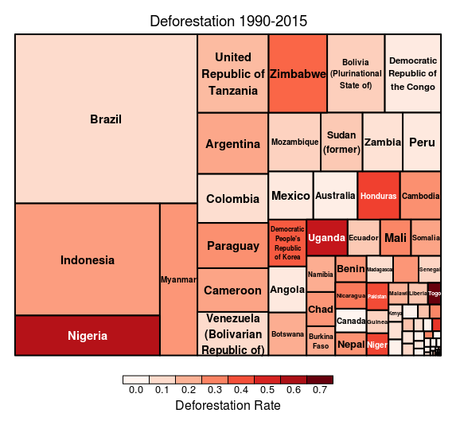
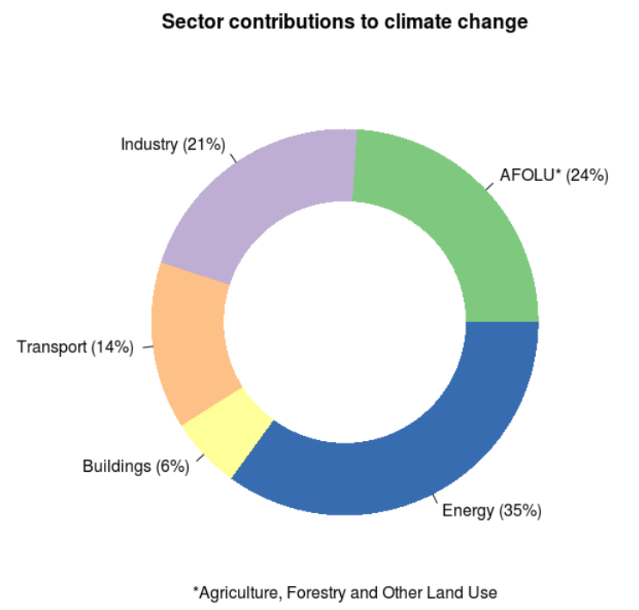
Livestock's Environmental Impact
Introduction
To date, attention in climate protection has focused primarily on power plants and transportation. However according to the United Nations, livestock farming is responsible for almost 15% of the problem.
The issue has long been discussed at UN level. The Food and Agriculture Organization (FAO) estimated back in 2008 that industrial livestock farming is one of the two to three most important causes of the biggest environmental problems: climate change, extinction of species, land degradation and water scarcity.
This poster is intended to shed light on some of these aspects.
Objectives
In the sector contributions to climate change diagram, agriculture, forestry and other land use are grouped together. This implies that there is a strong relationship between them, which is to be investigated in the following.
GHG Emissions and Land Use
Research on the environmental benefits of cultured meat predicts figures visualized in the following diagram. The numbers are on a relative scale with regards to the produced amount of protein, which makes them well comparable. Besides different types of meat also plant based sources are being considered.
Deforestation
It is estimated, that agriculture is responsible for around 80% of deforestation worldwide (https://bit.ly/2jazipU). Let us take a look at where this is happening and to what extent.
Data source: LCA Food, 2014 (https://bit.ly/2BHBCex)
Conclusions
Livestock farming is a major driver of climate change.
In addition to the high GHG emissions, it also contributes to deforestation on a large scale, which further increases its impact.
Cultured meat could be an environmentally friendly alternative, but the production industry doesn’t yet exist.
Plant based diets are an immediately available, environmentally friendly alternative.
Data source: FAO, 2016 (https://bit.ly/2LvU91Q)
Data source: FAO, 2016 (https://bit.ly/2uM9fsX)

Slide 2
Sources:
Icon made by Freepik from www.flaticon.com
Agriculture is the direct driver for worldwide deforestation: https://www.sciencedaily.com/releases/2012/09/120925091608.htm

