Slide 1
Information Retrieval & Text Mining
Marius Popescu
popescunmarius@gmail.com
2022 - 2023

Slide 2
Project 2
Textract 2018 Machine Learning Hackathon: Task 1

Slide 3
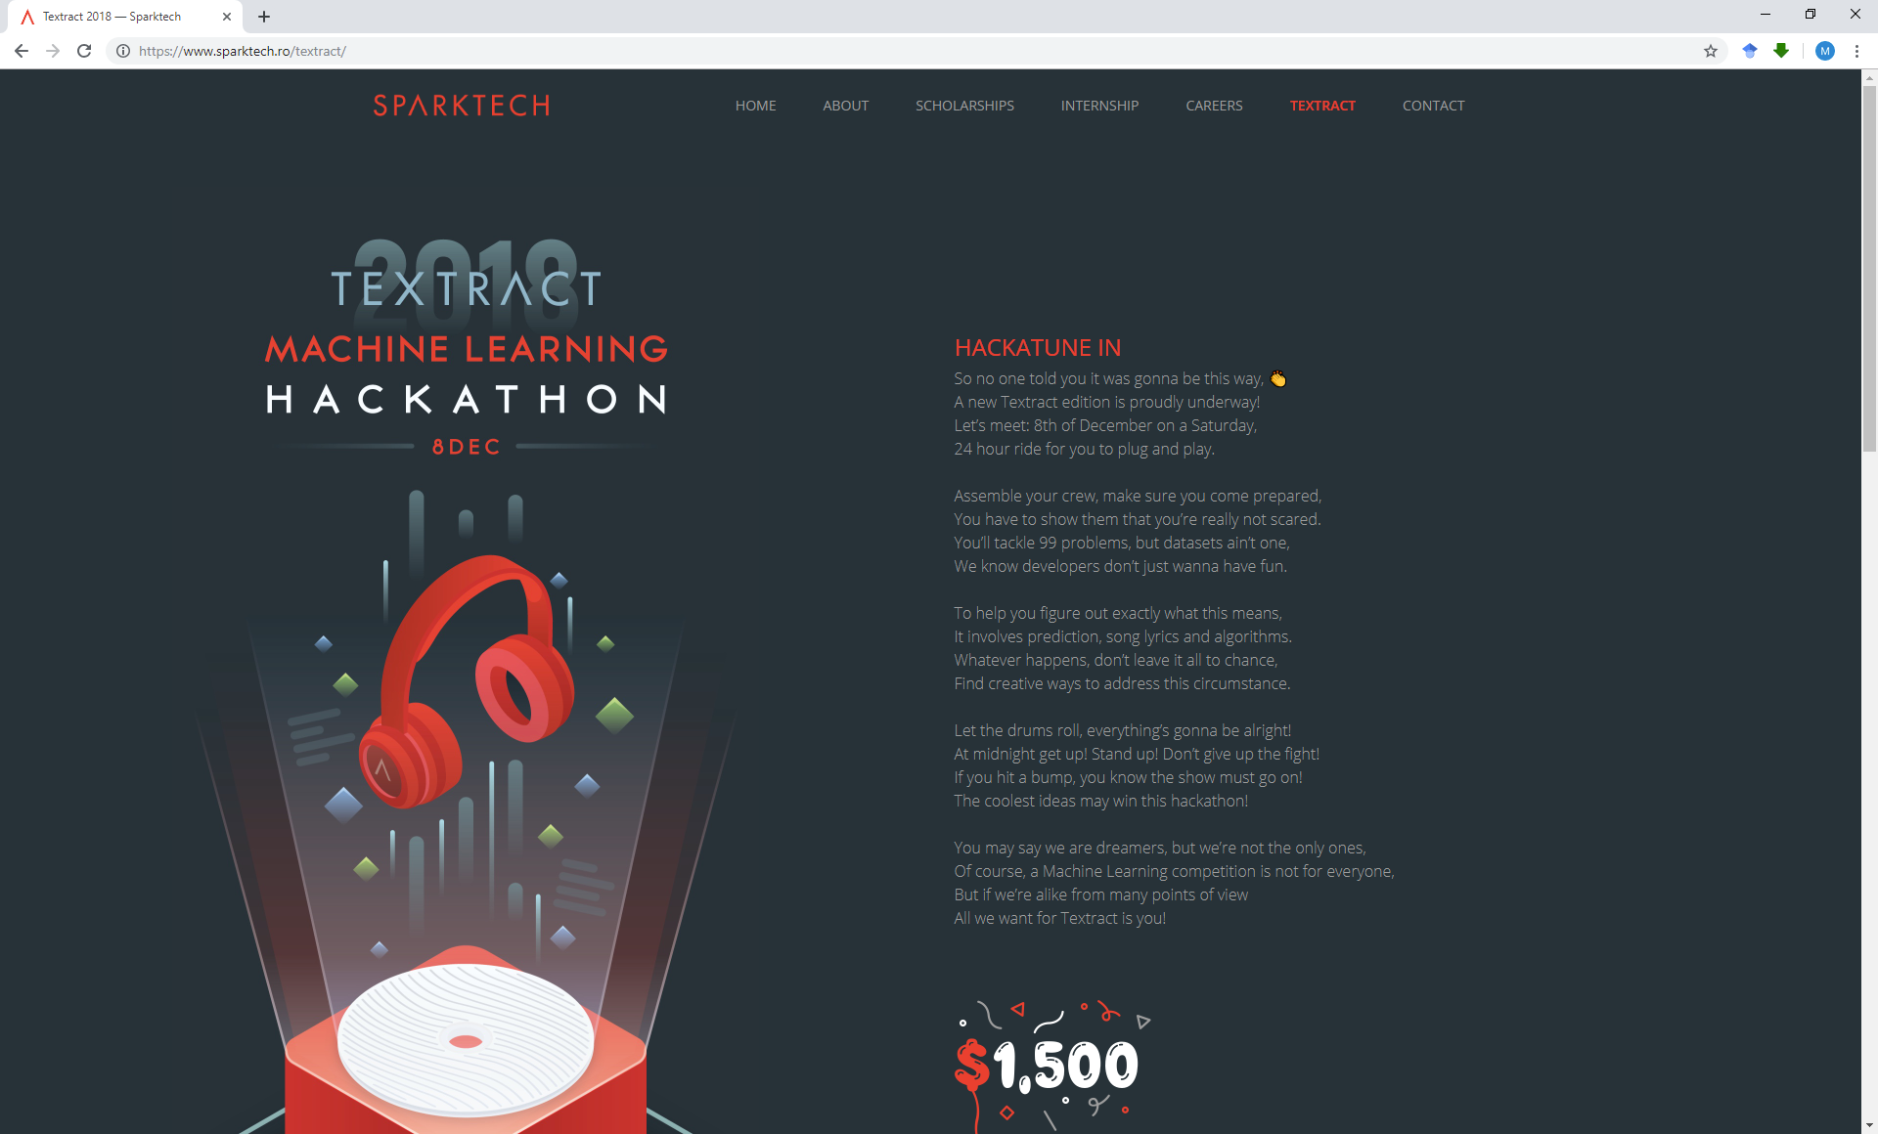

Slide 4
Task 1
The file “Lyrics-Genre-Training.csv” is a dataset of ~18000 songs and the file “Lyrics-Genre-Test-GroundTruth.csv” is a test dataset with ~8000 songs. For each song, the dataset contains its title, artist, year, complete lyrics and genre. Your task is to build and compare models which predicts the song’s genre using ONLY its lyrics.
The files “Lyrics-Genre-Training.csv” and “Lyrics-Genre-Test-GroundTruth.csv” are on the Moodle

Slide 5
The Data
Song | Song year | Artist | Genre | Lyrics | Track_id
Forest-enthroned | 2007 | catamenia | Metal | I am a night in to the darkness, only soul lost with me, … | 18096

Slide 6
The Task
Try different features: content words (BOW, word embeddings), stylistic markers (stop words), rhyme, rhythm, etc.
Try different learning algorithm
Find good combinations
Don’t overfit (report results on (cross)validation and test)

Slide 7
Deliverables
Research Report: document everything you tried and results obtained
Code

Slide 8
Custom tasks are possible, but you must discuss with me in advance

Slide 9
Hard Deadline: January 19, 2023 23:59

