Slide 1
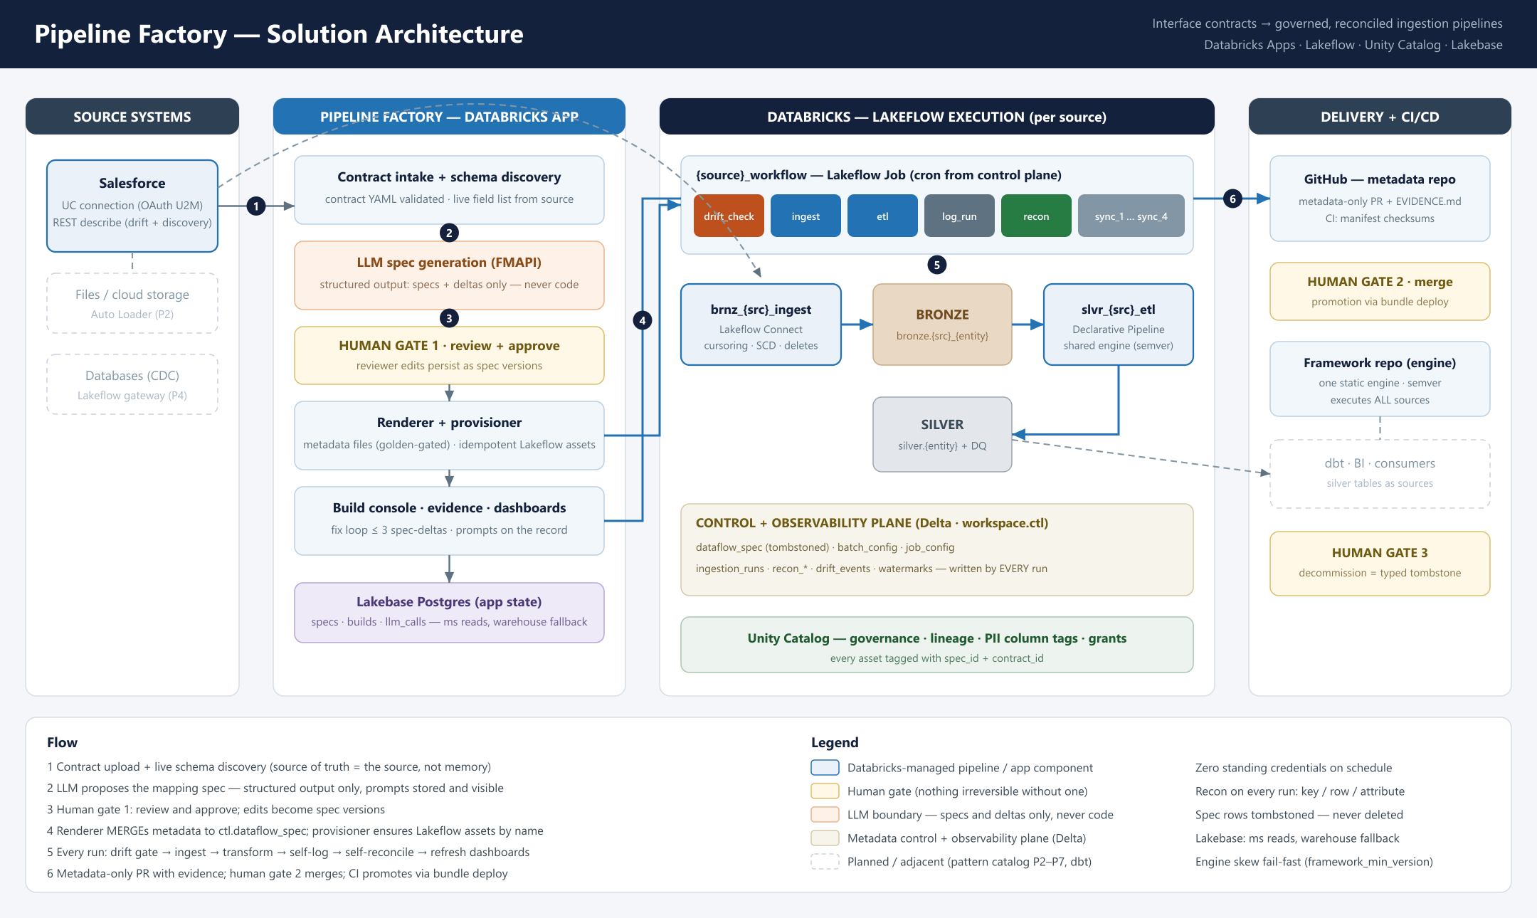
Pipeline Factory
The elevator pitch: an LLM drafts the mapping, metadata drives one shared engine, humans hold every gate — a new interface ships in hours, provably correct on every run.
Interface contracts in → governed, reconciled, evidence-backed ingestion pipelines out. Built on Databricks.
PROBLEM — interface builds are hand-made
ARCHITECTURE
Every new source costs weeks: hand-typed column lists, bespoke pipeline code, manual QA, docs that drift on day one. N sources = N codebases to maintain forever — and no systematic proof the data arrived intact.
SOLUTION — automate construction, keep judgment human
A Databricks App turns the contract into everything else: live schema discovery, an LLM-drafted mapping spec (specs only — never code), human approval, then auto-provisioned Lakeflow assets: managed ingestion → bronze, ruleset transforms → silver, one workflow that drift-checks, tests, logs and reconciles every run — closing with a metadata-only PR carrying the evidence.
IMPACT — proven live, not projected
Live today: Salesforce → Databricks with 100% reconciliation on every run, drift caught before ingestion, PII auto-tagged in Unity Catalog — including the 3 AM scheduled run with zero standing credentials and the app switched off.
Weeks → hours
0 code
100%
3 gates
1 engine
per new interface; humans review, machines construct
per source — one YAML contract, one metadata row
source-to-target reconciliation, every single run
approve · merge · decommission — nothing irreversible without a human
semver-versioned, executes all sources — fix once, everywhere
Faster onboarding: source #2 costs a YAML file — approve, build, done; it joins the same workflow and pipelines.
Trust by default: drift gate, DQ rulesets, recon rates and record-level diffs are produced by the platform, not asserted by a team.
Governed & auditable: every table, job and PR traces to its contract, spec and the exact LLM prompt; specs are tombstoned, never deleted.
Standard Databricks: Lakeflow Connect, Declarative Pipelines, Jobs, Unity Catalog, Lakebase — nothing bespoke to operate.

