Slide 1
LLM writes the spec
Pipeline Factory
Metadata drives behavior
One static engine executes
Interface contracts in.
Governed, reconciled, evidence-backed ingestion pipelines out.
Humans hold every gate
Every run reconciles itself
Databricks App | Lakeflow Connect + Declarative Pipelines + Lakebase | 2026

Slide 2
Onboarding a new interface today
Weeks of manual work per source
And the risk compounds
Analysts re-type column lists from memory (a real Salesforce Account has ~70 fields, not the 6 someone recalled)
Every source gets its own hand-written pipeline code
Mapping documents drift from the code the day after go-live
No systematic source-to-target reconciliation, parity is assumed
Schema drift at the source is discovered in production
Decommissioning is folklore: tables vanish or linger forever
N sources = N codebases to review, test, patch and audit, forever.

Slide 3
The idea: separate what changes from what executes
LLM for specs
Metadata for behavior
One static engine
Humans at gates
The model reads the contract and proposes the mapping spec. It only ever produces structured specs and deltas, never code or files.
A single semver-versioned framework executes every source: transforms, data quality, recon, logging, drift.
Approve the spec. Merge the PR. Confirm any decommission. Nothing irreversible happens on model output alone.
Each source contributes one row per entity in ctl.dataflow_spec plus a metadata-only PR. Nothing to code-review, nothing to drift.
The marginal cost of source #2 is a YAML file - not a codebase.

Slide 4
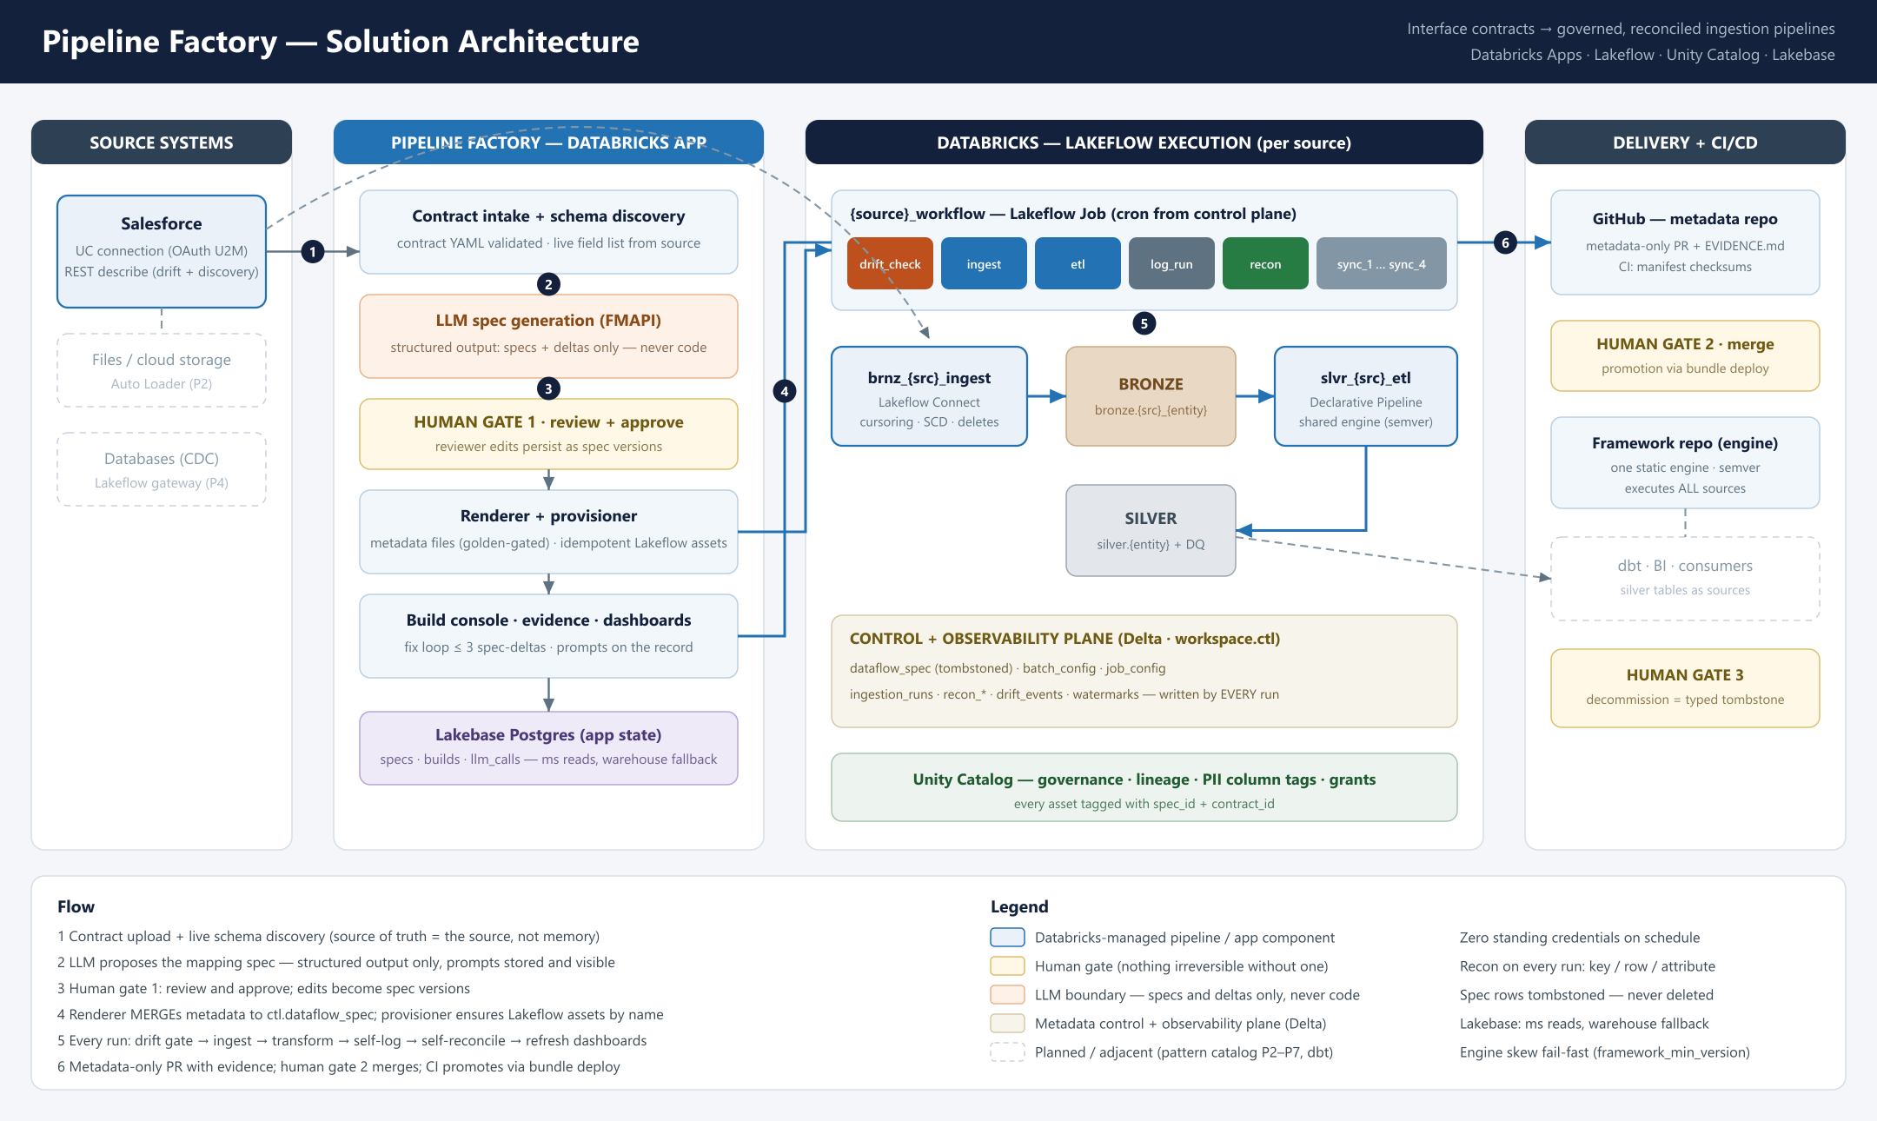
Solution architecture

Slide 5
One click: what the Build actually does
1 Render
2 Branch + commit
Deterministic templates emit metadata files only. Golden-file tests gate any format change.
Metadata-only commit. There is no per-source code that could drift.
3 Spec upsert
4 Provision
MERGE into ctl.dataflow_spec, seed batch and job config (operator edits survive).
Idempotent create/update of ingestion pipeline, ETL pipeline and workflow by name.
5 Run workflow
6 Test + reconcile
drift_check, ingest, etl, log_run, recon - the same graph every scheduled run uses.
Data-quality expectations, then row-by-row key / row / attribute match rates.
7 PR with evidence - counts, match rates, DQ results in EVIDENCE.md. On failure: bounded fix loop, at most 3 LLM spec-deltas, then escalate to a human with the full trail.

Slide 6
Standard Databricks primitives - nothing bespoke to operate
drift_check
ingest
etl
log_run
recon
sync_1..4
live schema vs contract, policy warn / fail
Lakeflow Connect managed sync
engine builds silver + DQ
counts to ctl.ingestion_runs
source vs target rates + diffs
dashboards refresh themselves
brnz_{src}_ingest
slvr_{src}_etl
{src}_workflow
Lakeflow Connect ingestion pipeline. Connector owns cursoring (SystemModstamp), SCD 1/2, soft deletes, schema evolution. Columns = exactly what the contract selected.
Declarative Pipeline running the shared engine. Transforms, expectations and crosswalk all come from dataflow_spec metadata at runtime.
Lakeflow Job on the contract cron. Retries, notifications, SLA and pause state are config-table-driven and editable live from the app.

Slide 7
Where the LLM collapses build time
Mapping spec: minutes, not days - generated from the contract, human reviews instead of authors
Pipeline code: zero - metadata replaces per-source code entirely
Testing + recon: automatic on every run, not a manual QA phase
Docs + evidence: the PR writes itself with proof attached
Fixes: failure evidence loops back as spec deltas, max 3 tries
Weeks per interface → hours, dominated by human review, not construction.

Slide 8
Governance: three human gates, zero silent actions
Gate 1 - Approve
Gate 2 - Merge
Gate 3 - Decommission
Reviewer walks mappings, transforms, DQ rules and PII flags; edits persist as a new spec version before anything is provisioned.
The metadata-only PR ships with EVIDENCE.md: counts, match rates, DQ outcomes. CI validates manifest checksums.
Typed-confirmation tombstone. Spec rows are never deleted; a drop-guard makes silent table drops impossible.
Also non-negotiable: credentials only in secret scopes and UC connections, never in contracts, code or git | every LLM prompt and response stored and visible in the app | scheduled runs are token-free | every asset tagged with its spec and contract id | PII columns get UC tags at build.

Slide 9
Observability: every run proves itself (live numbers)
43 = 43
100%
+5 rows
64
Salesforce rows vs silver rows, exact on every run
key, row and attribute match rates, computed row-by-row
mid-demo inserts visible as the next run's delta on the dashboard
drift events per run: live fields the contract chose not to ingest
Every workflow run - build-triggered, cron or manual - writes ctl.ingestion_runs (bronze/silver counts, trigger type) and full recon results keyed by the same run id, with the app completely out of the loop. Change-data-feed synced tables stream it into Lakebase Postgres, so the Reconciliation dashboard answers in milliseconds: runs, row deltas, parity trends, SLA breaches, record-level diffs. The final workflow tasks refresh the replicas — dashboards are current the moment a run finishes, with zero standing credentials.

Slide 10
Day-2 operations, built in from day 1
Config control plane
Schema drift gate
Cron, pause, retries, SLA, notifications, drift policy live in ctl.batch_config - edited in Settings, applied to live jobs without a rebuild.
First task of every run compares the live source schema to the contract. Policy warn records events; fail halts the chain before bad data lands.
Full refresh / backfill
Lineage + audit
Typed confirmation resets watermarks and full-refreshes both pipelines - the standard answer to hard deletes and replays.
Source to workflow graph per entity via API; every asset traceable to spec, contract and the exact LLM prompts that produced it.
Resilient state
Pattern catalog
Lakebase Postgres for ms reads with per-call warehouse fallback - a database outage degrades, never breaks.
P1 managed connectors, P2 Auto Loader files, P3 pre-landed Delta, CDC and streaming reserved - one decision table, no design meetings.

Slide 11
The live demo (25 minutes)
1
Architecture - C4 diagrams rendered inside the app itself
2
Contract intake - upload YAML, discover the real 70-field schema, prune to 6
3
Gate 1 - review LLM mappings and DQ rules, apply a reviewer edit, approve
4
Build - watch pipelines and the workflow appear, run, test and reconcile
5
Evidence - 100% recon, DQ table, exact prompts, PR on GitHub
6
The 3 AM story - insert 5 Salesforce rows, run from Databricks with the app closed, dashboard shows +5
7
Operations - live schedule edit, drift policy, full refresh, decommission gate

Slide 12
One contract file became a governed pipeline, a scheduled workflow that proves itself, and an auditable PR.
Faster
Interface build time from weeks to hours - construction is generated, humans only review.
Safer
Three human gates, tombstoned metadata, zero standing credentials, prompts on the record.
Provable
Source-to-target reconciliation and drift detection on every single run.

