Slide 1


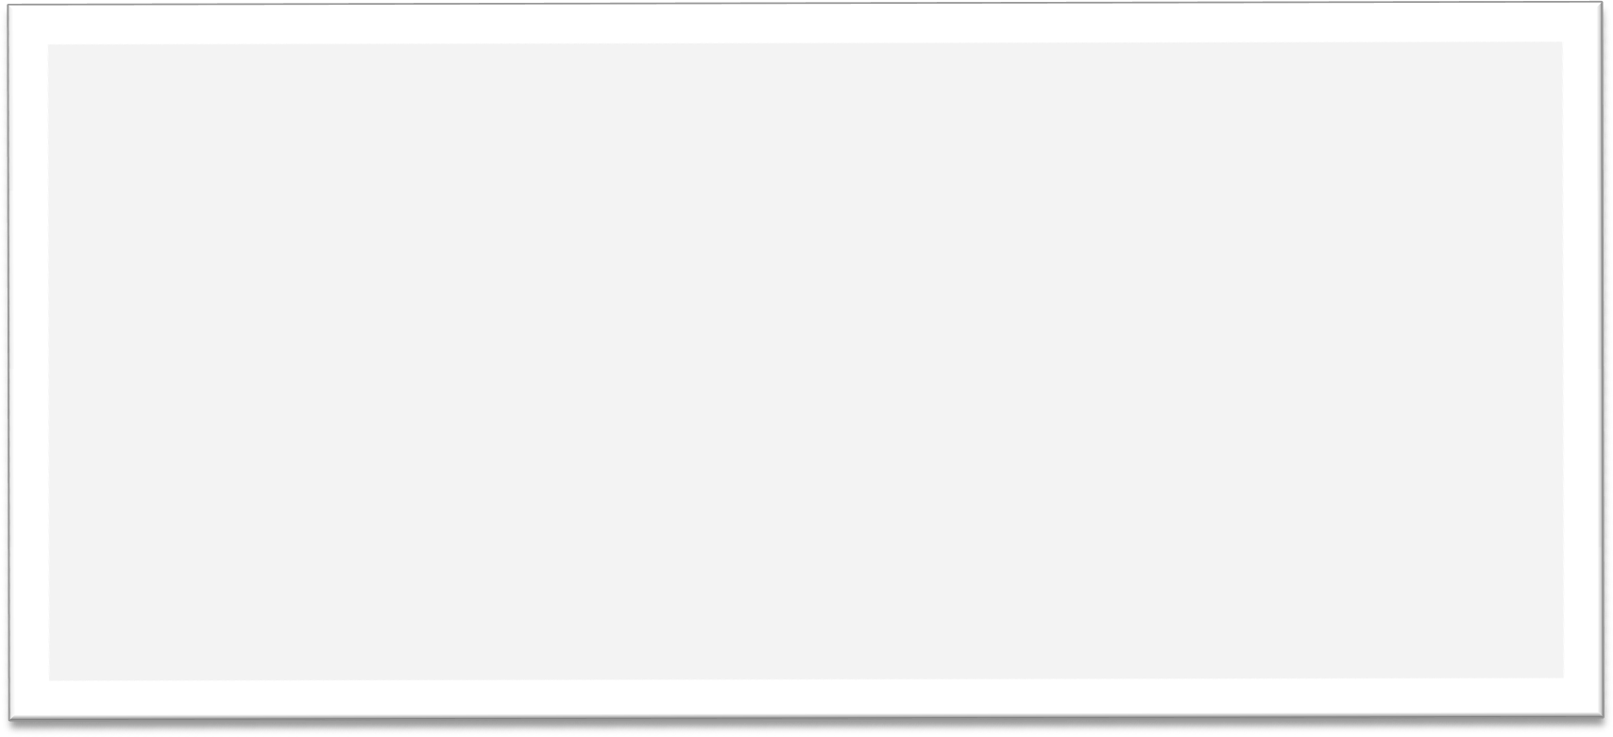


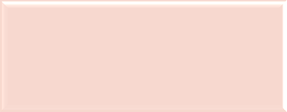














Created from your prompt

Slide 2
Overview
This presentation was generated from your prompt
Original prompt: Generate a marketing strategy presentation for launching a new mobile app...
Please refine your prompt for better results

Slide 3
Next Steps
Review the generated content
Make necessary adjustments
Add more specific details to your prompt

