Slide 1
CONTENTS
Introduction
Markov Model
Hidden Markov model (HMM)
Three central issues of HMM
Model evaluation
Most probable path decoding
Model training
•
Application Areas of HMM
References

Slide 2
Hidden Markov Models
A hidden Markov model (HMM) is a statistical model,in which the system being modeled is assumed to be a Markov process (Memoryless process: its future and past are independent ) with hidden states.
● Hidden Markow Models:
–

Slide 3
Hidden Markov Models
● Hidden Markow Models:
– Has a set of states each of which has limited number of transitions and emissions,
Each transition between states has an assisgned probability,
Each model strarts from start state and ends in end state,
–
–

Slide 4
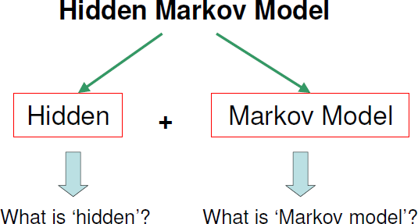
Hidden Markov Models

Slide 5



Hidden Markov Models
● Markov Models :
●
●
Talk about weather,
Assume there are three types of weather:
– Sunny,
–
Rainy,
–
Foggy.

Slide 6
Markov Models
●
Weather prediction is about the what would be the weather tomorrow,
– Based on the observations on the past.

Slide 7
Markov Models
_{ Weather at day n is} q_{n} ∈{sunny ,rainy , foggy}
–
q_{n} depends on the known weathers of the past days (q_{n-1}, q_{n-2},…)

Slide 8
Markov Models
● We want to find that:
–
means given the past weathers what is the probability of any possible weather of today.

Slide 9


Markov Models
Markow Models:
For example:
● if we knew the weather for last three days was:
● the probability that tomorrow would be
P(q₄ = | q₃ = q₂ = q₁ =
is:
,
,
)

Slide 10
Markov Models
● Markow Models and Assumption (cont.):
– Therefore, make a simplifying assumption Markov assumption:
● For sequence:
● the weather of tomorrow only depends on today
(first order Markov model)

Slide 11
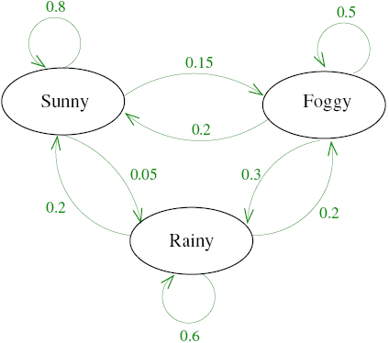
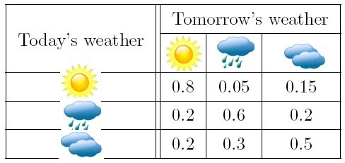
Markov Models
● Markow Models and Assumption (cont.):
Examples:
● HMM:

Slide 12
Markov Models
● Markow Models and Assumption (cont.):
Examples:
● If the weather yesterday was rainy and today is foggy what is the probability that tomorrow it will be sunny?

Slide 14

Markov Models
● Markow Models and Assumption (cont.):
– Examples:
● If the weather yesterday was rainy and today is foggy what is the probability that tomorrow it will be sunny?
Markov assumption

Slide 15
Hidden Markov Models
Hidden Markov Models (HMMs):
What is HMM:
Suppose that you are locked in a room for several days,
you try to predict the weather outside,
The only piece of evidence you have is whether the person who comes into the room bringing your daily meal is carrying an umbrella or not.

Slide 16
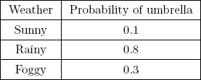

Hidden Markov Models
● Hidden Markov Models (HMMs):
– What is HMM (cont.):
● assume probabilities as seen in the table:

Slide 17
Hidden Markov Models
● Hidden Markov Models (HMMs):
– What is HMM (cont.):
● Finding the probability of a certain weather
q_{n} ∈{sunny ,rainy , foggy}
● is based on the observations x_{i}:

Slide 18

Hidden Markov Models
● Hidden Markov Models (HMMs):
– What is HMM (cont.):
● Using Bayes rule:
● For n days:

Slide 20
Application Areas of HMM
On-line handwriting recognition
Speech recognition
Gesture recognition
Language modeling
Motion video analysis and tracking
Stock price prediction and many more….

Slide 21
ACKNOWLEDGEMENT: SLIDES BORROWED FROM ONLINE RESOURCES
HMM TO BE CONTD. IN THE NEXT CLASS

