Slide 1
Burglars and Earthquakes
You are at a “Done with the AI class” party.
Neighbor John calls to say your home alarm has gone off (but neighbor Mary doesn't).
Sometimes your alarm is set off by minor earthquakes.
Question: Is your home being burglarized?
Variables: Burglary, Earthquake, Alarm, JohnCalls, MaryCalls
Network topology reflects "causal" knowledge:
A burglar can set the alarm off
An earthquake can set the alarm off
The alarm can cause Mary to call
The alarm can cause John to call

Slide 2
Bayes Nets
In general, joint distribution P over set of variables (X₁ x ... x X_{n}) requires exponential space for representation & inference
BNs provide a graphical representation of
conditional independence relations in P
– usually quite compact
– requires assessment of fewer parameters, those being quite natural (e.g., causal)
– efficient (usually) inference: query answering and belief update

Slide 3
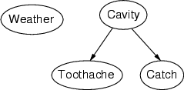
Back at the dentist’s
Topology of network encodes conditional independence assertions:
Weather is independent of the other variables
Toothache and Catch are conditionally independent of each
other given Cavity

Slide 4
Syntax
a set of nodes, one per random variable
a directed, acyclic graph (link ≈"directly influences")
a conditional distribution for each node given its parents: P (X_{i} | Parents (X_{i}))
– For discrete variables, conditional probability table (CPT)= distribution over X_{i} for each combination of parent values
•8

Slide 5
Burglars and Earthquakes
Pr(E=t) Pr(E=f)
0.002 0.998
Earthquake Burglary
Pr(B=t) Pr(B=f) 0.001 0.999
Pr(A|E,B) e,b 0.95 (0.05)
e,b
e,b
Pr(JC|A) a 0.9 (0.1)
0.29 (0.71)
0.94 (0.06)
Alarm
a 0.05 (0.95)
e,b 0.001 (0.999)
JohnCalls
MaryCalls
Pr(MC|A)
a 0.7 (0.3)
a 0.01 (0.99)
•9

Slide 6
Earthquake Example (cont’d)
Earthquake
Burglary
Alarm
JohnCalls
MaryCalls
If we know Alarm, no other evidence influences our degree of belief in JohnCalls
P(JC|MC,A,E,B) = P(JC|A)
also: P(MC|JC,A,E,B) = P(MC|A) and P(E|B) = P(E)
By the chain rule we have
P(JC,MC,A,E,B) = P(JC|MC,A,E,B) ·P(MC|A,E,B)·
P(A|E,B) ·P(E|B) ·P(B)
= P(JC|A) ·P(MC|A) ·P(A|B,E) ·P(E) ·P(B)
Full joint requires only 10 parameters (cf. 32)
•© D. Weld and D. Fox

Slide 7
Earthquake Example (Global Semantics)
Earthquake
Burglary
Alarm
JohnCalls MaryCalls
We just proved
P(JC,MC,A,E,B) = P(JC|A) ·P(MC|A) ·P(A|B,E) ·P(E) ·P(B)
In general full joint distribution of a Bayes net is defined as
P( X 1, X 2,..., Xn) = ∏ P( Xi | Par( Xi))
i=1
n

Slide 8
Examples
Earthquake
Burglary
Alarm
JohnCalls
MaryCalls

Slide 9
Applications of Bayesian Net
Medical Diagnosis
Computational Biology and Bioinformatics
Natural Language Processing
Document classification
Image processing
Decision support systems
Ecology & natural resource management
Robotics
Forensic science…•

Slide 10
Inference in BNs
The graphical independence representation
– yields efficient inference schemes
We generally want to compute
– Marginal probability: Pr(Z),
– Pr(Z|E) where E is (conjunctive) evidence
Z: query variable(s),
E: evidence variable(s)
everything else: hidden variable
Computations organized by network topology

Slide 11
P(B | J=true, M=true)
Earthquake Burglary
Alarm
JohnCalls MaryCalls
P(b|j,m) = α Σ P(b,j,m,e,a)
e,a

Slide 12
P(B | J=true, M=true)
Earthquake Burglary
Alarm
JohnCalls MaryCalls
P(b|j,m) = αP(b) ΣP(e) ΣP(a|b,e)P(j|a)P(m|a)
e a

Slide 13
Inferencing by enumeration
P(b|j,m) = αP(b) Σ_{e} P(e) Σ_{a} P(a|b,e)P(j|a)P(m,a)
Repeated computations ➔ Dynamic Programming

Slide 14
Variable Elimination
A factor is a function from some set of variables into a specific value: e.g., f(E,A,N1)
– CPTs are factors, e.g., P(A|E,B) function of A,E,B
VE works by eliminating all variables in turn until there is a factor with only query variable
To eliminate a variable:
– join all factors containing that variable (like DB)
– sum out the influence of the variable on new factor
– exploits product form of joint distribution

Slide 15
Example of VE: P(JC)
P(J)
= Σ_{M,A,B,E} P(J,M,A,B,E)
= Σ_{M,A,B,E} P(J|A)P(M|A) P(B)P(A|B,E)P(E)
= Σ_{A}P(J|A) Σ_{M}P(M|A) Σ_{B}P(B) Σ_{E}P(A|B,E)P(E)
= Σ_{A}P(J|A) Σ_{M}P(M|A) Σ_{B}P(B) f1(A,B)
= Σ_{A}P(J|A) Σ_{M}P(M|A) f2(A)
= Σ_{A}P(J|A) f3(A)
= f4(J)
Earthqk
Burgl
Alarm
JC
MC
•© D. Weld and D. Fox

Slide 16
Notes on VE
Each operation is a simple multiplication of factors and summing out a variable
Complexity determined by size of largest factor
– in our example, 3 vars (not 5)
– linear in number of vars,
– exponential in largest factor elimination ordering greatly impacts factor size
– optimal elimination orderings: NP-hard
– heuristics, special structure (e.g., polytrees)
Practically, inference is much more tractable using
structure of this sort.

Slide 17
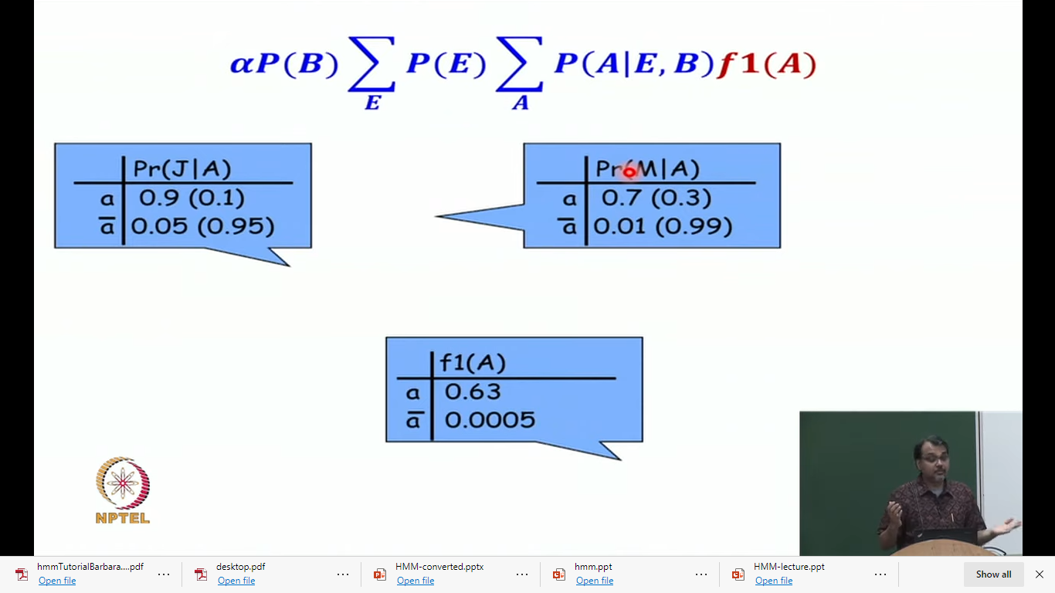
P(b|j,m) = αP(b) ΣP(e) ΣP(a|b,e)P(j|a)P(m|a)

Slide 18
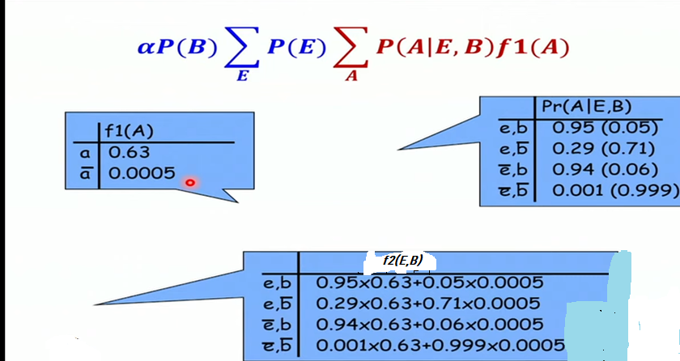

Slide 19
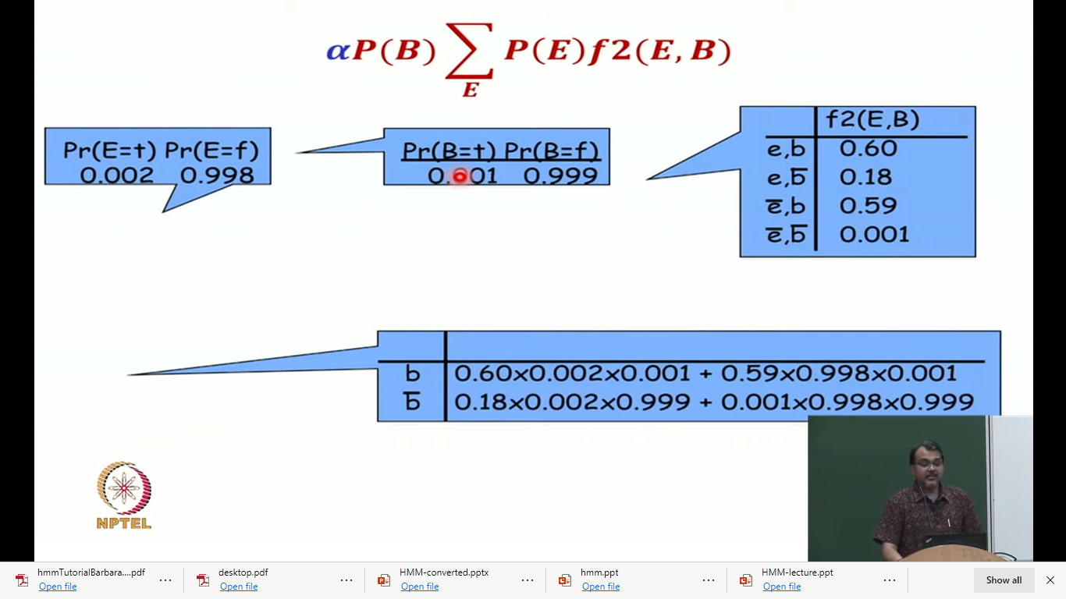

Slide 20
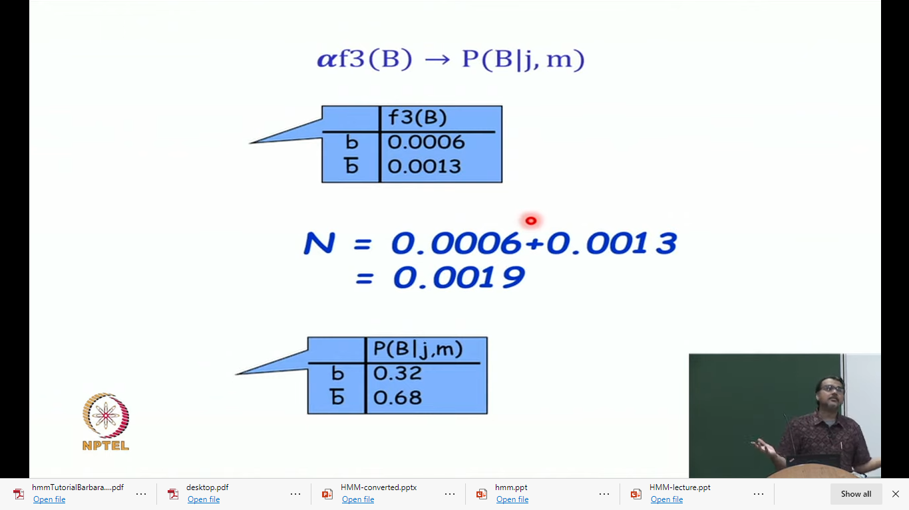

Slide 22
Acknowledgements:
The slides are taken from the online resources

