Slide 1
Capstone Project
BATTLE OF NEIGHBORHOODS

Slide 2
Introduction – Problem Statement
A major food-chain firm, XYZ is looking at opening its first restaurant in New York. We are to suggest the cuisine and borough/neighborhood for XYZ to open a restaurant.
Assumption is that XYZ does not have much budget constraint and is looking at entering the market. The investment is majorly driven by the demand and customer preferences.
We will be focusing on 2 key parameters:
The most famous cuisines/restaurant types in New York
The location wherein an opportunity exist
Target Audience is XYZ leadership.

Slide 3
Data Sources
New York City data that contains list of Borough, Neighborhoods along with latitude & longitude information
Source: https://cocl.us/new_york_dataset
Foursquare API data
We will be using this data to get details on the venues in each neighborhood and exploring the different types of restaurants
.

Slide 4
Methodology
We have first looked at the major cuisines among Restaurants in New York
We have identified Chinese cuisine as one of the major category (~414 restaurants in New York)
Compared the following:
Number of Chinese restaurants among the boroughs & Neighborhood
Average Rating of Restaurants among the boroughs & Neighborhood

Slide 5
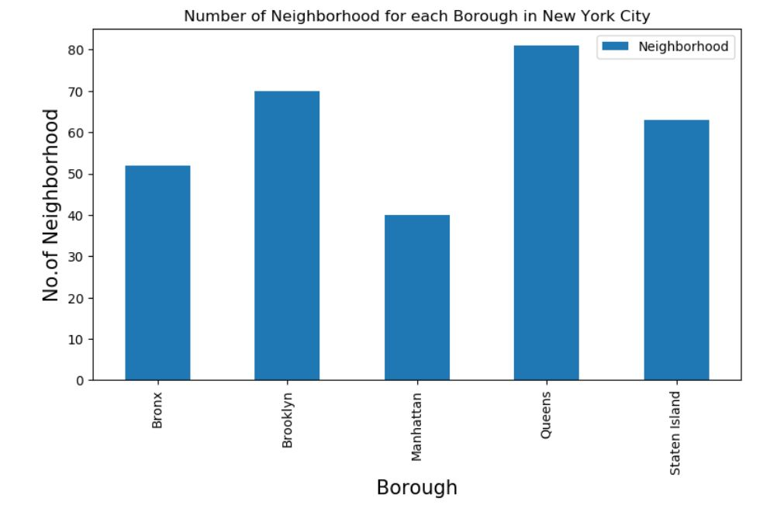
Key Observations

Slide 6
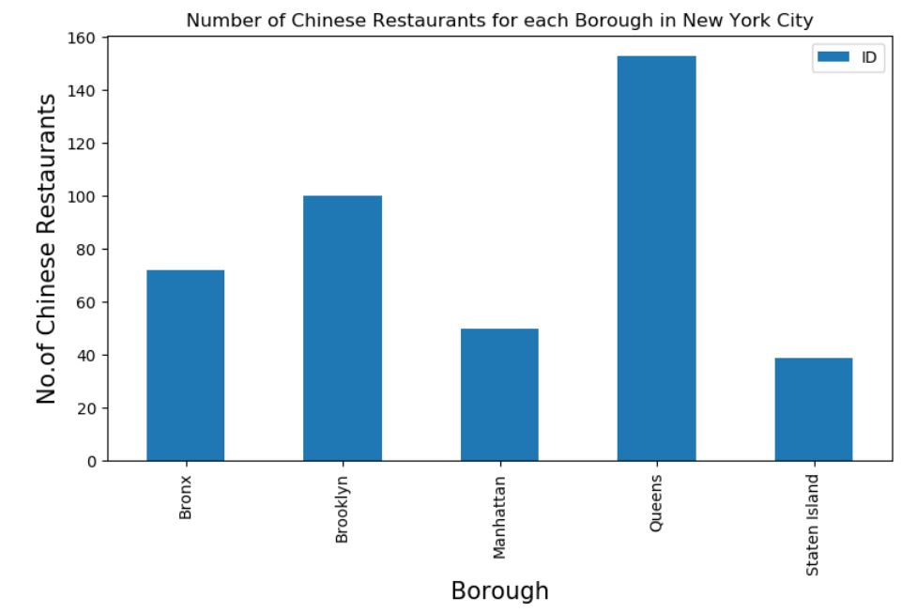
Key Observations

Slide 7
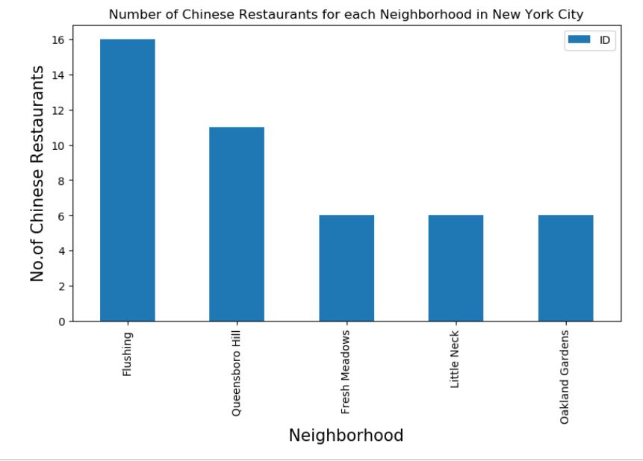
Key Observations

Slide 8
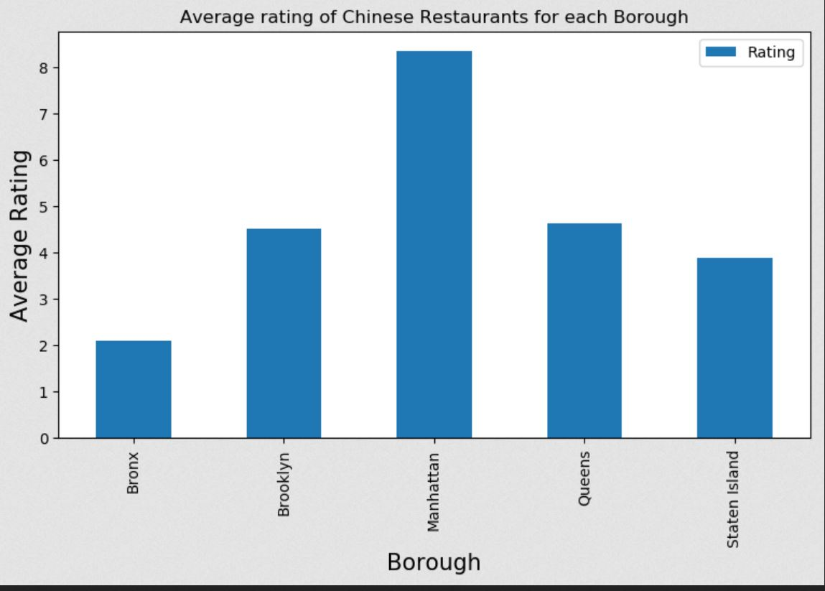
Key Observations

Slide 9
results
Among boroughs, Queens is having the highest number of Chinese Restaurants.
Within the neighborhoods, Flushing is having the highest number of Chinese Restaurants.
The restaurant Budakkan in Chelsea, Manhattan has the highest rating, likes as well as tips.
While Manhattan is having the highest average rating, Bronx is at the lowest.

Slide 10
Conclusion
We can look at Manhattan & Brooklyn as a potential borough for opening the restaurant depending on the strategy in place for the competition along with other factors.
Depending on the competitive landscape, XYZ can look at neighborhood like Chelsea in Manhattan or Greenpoint in Brooklyn.

Slide 11
Thank you

