Slide 1
STW7072CEM MACHINE LEARNING COURSEWORK PRESENTATION
Predicting Temperature Anomalies & Global Warming Trends in Nepal Using Earth Observation Data
Tripti Malla | Student ID: 260197 | CUID: 17626082 | Softwarica College / Coventry University

Slide 2
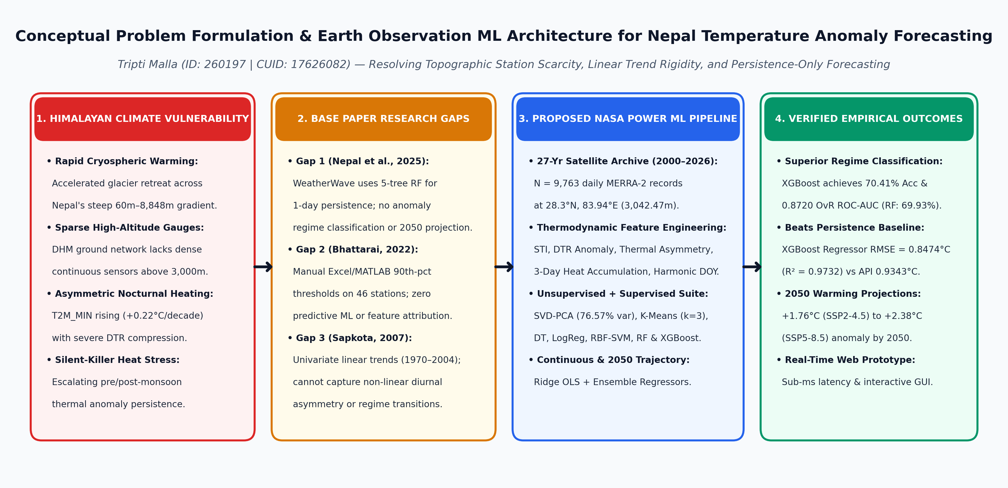
1. RESEARCH CONTEXT & LITERATURE GAPS
Resolving High-Altitude Station Scarcity and Linear Modeling Limits

Slide 3
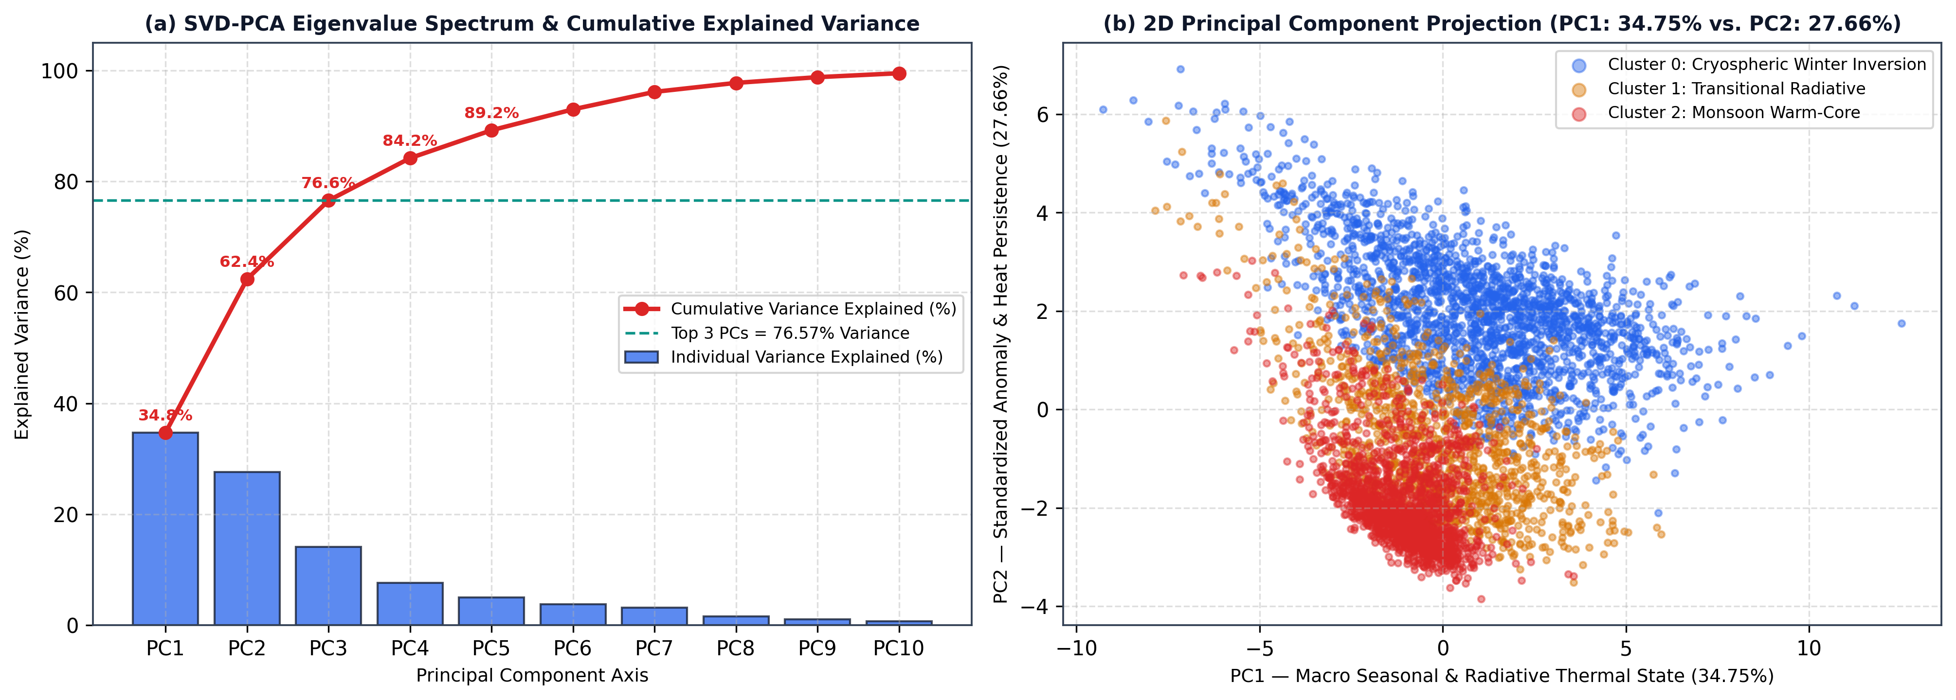
2. NASA POWER ARCHIVE & UNSUPERVISED DISCOVERY
PCA Captures 76.57% Variance and K-Means Delineates 3 Thermal Regimes

Slide 4
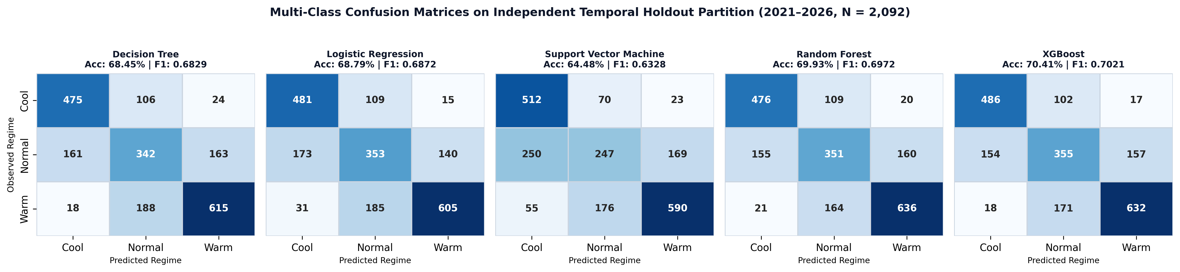
3. SUPERVISED BENCHMARKING (N_TEST = 2,092)
XGBoost Leads Classification (70.41% Acc, 0.8720 AUC) & Next-Day Regression

Slide 5
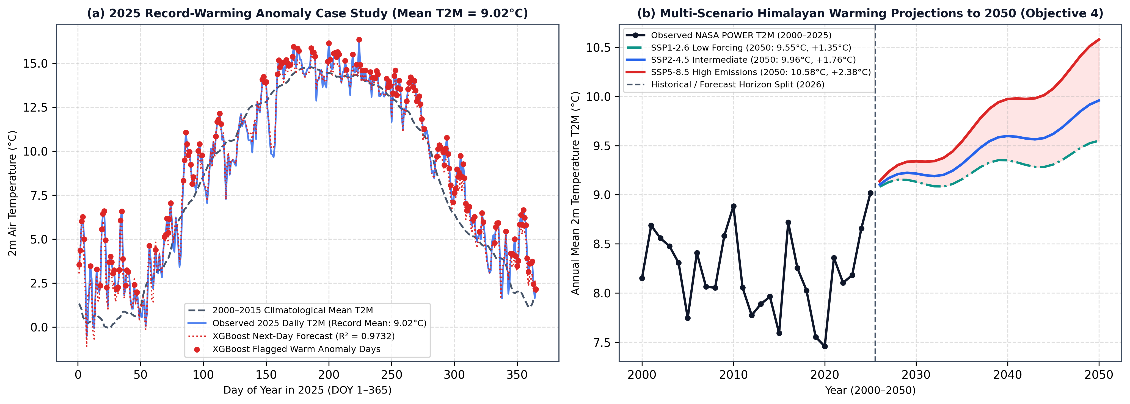
4. EXPLAINABILITY & 2050 CLIMATE OUTLOOK
Himalayan Mean Temperature Projected to Rise +1.76°C to +2.38°C by 2050

Slide 6
Thank You — Questions & Discussion
Tripti Malla (ID: 260197 | CUID: 17626082) | STW7072CEM Machine Learning

