Slide 1
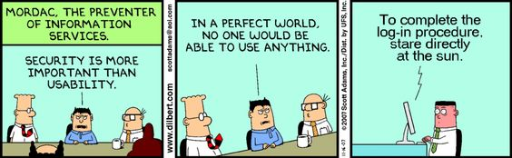

Slide 2

ColdFusion: Code Security Best Practices
Presented at CCFUG Mar 2016
By Denard Springle

Slide 3



Who is Denny?
Denard Springle
CEO – Virtual Solutions Group LLC
Over two decades of IT experience
Developing in CFML since version 4
Node.js, Python, jQuery, Bootstrap, etc.
Lucee as primary CFML engine
denard.springle@gmail.com
@ddspringle (Twitter, Slack)
blog.vsgcom.net

Slide 4
Who Am I?
Trip Ward
Just a web guy
20+ years of IT experience
Developing in CFML since version 3
jQuery, Bootstrap, etc.
ACF primary CFML engine
king@werwards.com
@tripward (Twitter, Slack)

Slide 5
Presentation Outline
Who are we
Obfuscation
Encryption
Attack Vectors
How/Where Do We start
Secure Authentication
Two-Factor Authentication

Slide 6
Who are we
Who writes these insecure apps???
Who works on insecure project
Requesting time to fix??
Why does security enhancements fall on deaf ears? Expectations
What is PII?
Real threats are silent – in and out
Most common intrusions
SQL Injection
File Traverse
Not properly identifying surfer to rest password
How do we Help the Bad People
Displaying error information
Not parameterizing database queries
What fields needed to be hashed/encrypted?

Slide 7
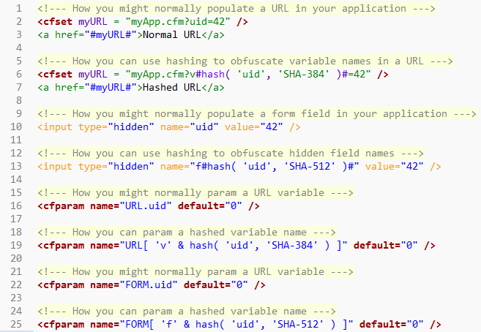
Obfuscation

Slide 8
Encryption Primer
ColdFusion defaults to ECB (electronic code book) block cipher mode
In ECB mode, the message is divided into blocks, and each block is encrypted separately. Can be decrypted in parallel.
In CBC mode, each block of plaintext is XORed with the previous ciphertext block before being encrypted. This way, each ciphertext block depends on all plaintext blocks processed up to that point.
You *must* specify CBC mode by passing it as an additional option to ‘algorithm’

Slide 9
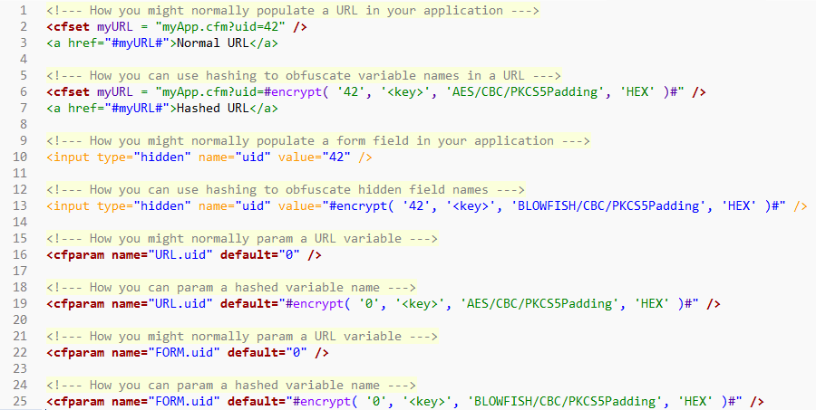
Encryption

Slide 10
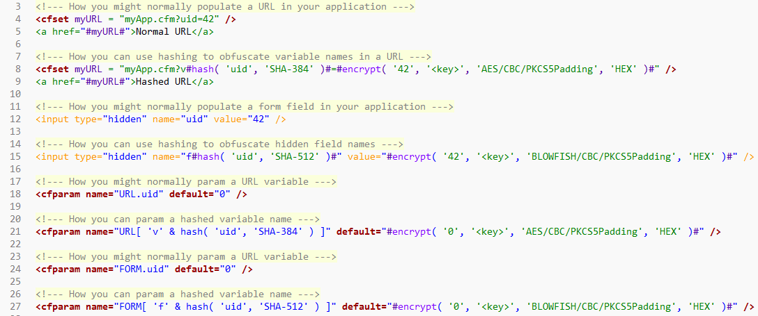
Obfuscated and Encrypted

Slide 11
Too much of a good thing
DO NOT attempt to hash and encrypt *everything* in the request context
DO NOT expect good performance dynamically hashing and encrypting large lists of data
DO pick and choose important data (database id’s) to obfuscate and encrypt
DO hash() keys and encrypt() values before looping
DO use pagination for large lists of data that require hash() and encrypt()
DO fall back to ECB and/or 128 bit keys if performance is an issue – better some security than none

Slide 12
Attack Vectors Overview
SQL Injection
XSS (Cross-Site Scripting)
CSRF (Cross-Site Request Forgery)
Cookies
Tidbits
Cflocation
File upload validation
Form Methods
File Injection
Application Naming

Slide 13
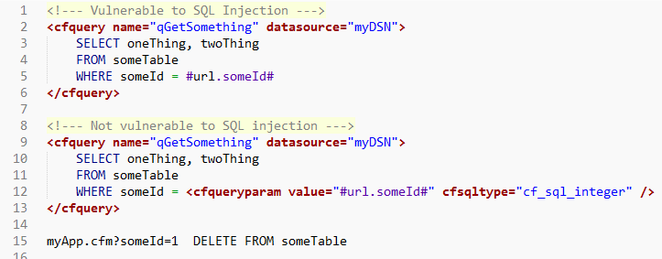
SQL Injection
http://codecurmudgeon.com/wp/sql-injection-hall-of-shame/

Slide 14
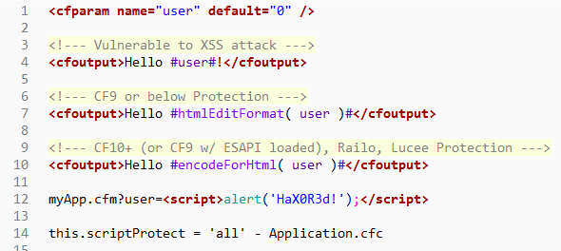
XSS (Cross-Site Scripting)
Cross-Site Scripting (XSS) attacks are a type of injection, in which malicious scripts are injected into otherwise benign and trusted web sites. XSS attacks occur when an attacker uses a web application to send malicious code, generally in the form of a browser side script, to a different end user.

Slide 15
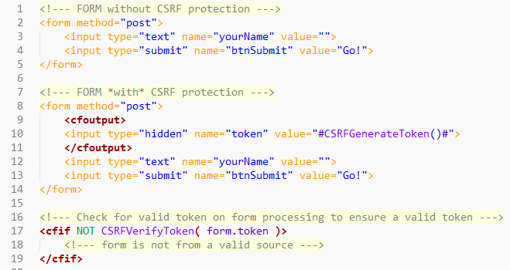
CSRF (Cross-Site Request Forgery)
Cross-Site Request Forgery (CSRF) is an attack that forces an end user to execute unwanted actions on a web application in which they're currently authenticated. CSRF attacks specifically target state-changing requests, not theft of data, since the attacker has no way to see the response to the forged request.

Slide 16
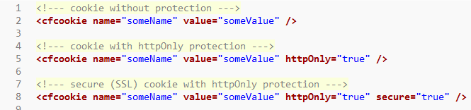
Cookies. Yummy.
In ColdFusion 11 Admin > Server Settings > Memory Variables
*** Set httpOnly and secure but strictly rely on them. Use Cookie browser plugin to look at them.

Slide 17
HTTP Headers for Security
// use HTTP headers to help protect against common attack vectors
getPageContext().getResponse().addHeader( 'X-Frame-Options', 'deny' );
getPageContext().getResponse().addHeader( 'X-XSS-Protection', '1; mode=block' );
getPageContext().getResponse().addHeader( 'X-Content-Type-Options', 'nosniff' );
The X-Frame-Options HTTP response header can be used to indicate whether or not a browser should be allowed to render a page in a <frame> , <iframe> or <object>
The X-XSS-Protection HTTP response header enables the Cross-site scripting (XSS) filter built into most recent web browsers.
The X-Content-Type-Options HTTP response header has only one defined value, "nosniff", which prevents Internet Explorer and Google Chrome from MIME-sniffing (drive-by download prevention).
See Dave Epler W3C Content Policy session video
SEE ALSO: Content Security Policy (CSP) and Check Your Headers (http://cyh.herokuapp.com/cyh)

Slide 18
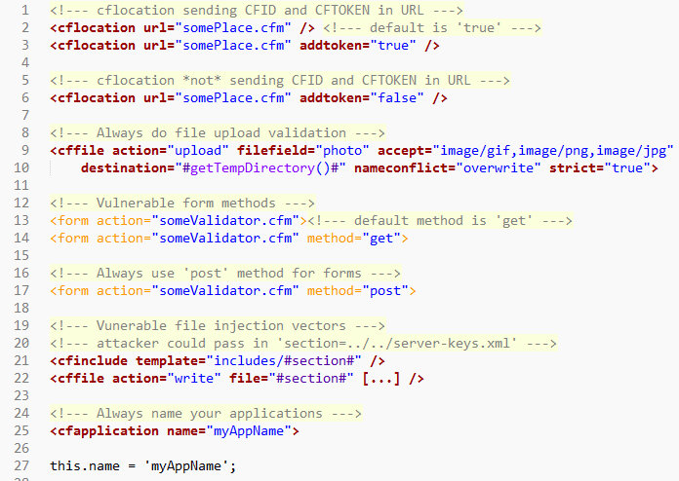
Other Tidbits

Slide 19
More Tidbits
Webserver (htaccess/web.config)
Deny access e.g. /cfide
Disable options (All not listed), get and post
Set 403/500 status code paths, don’t rely default
Remove .BAK, .old – displays as text in browser
LAYERS

Slide 20
Security Object
First thing you implement in new project
3rd Party – Portcullis, etc
All security functionality
Hash
Encrypt/Decrypt
Xss/csrf
List of acceptable file types as default
Throwing security message – stop processing immediately , stops crawlers
Log catch
Application scope, call in onrequestStart
Hide all errors on external facing applications

Slide 21
Multi-Factor Authentication
There are three factors:
Something the user knows (password, etc.)
Something the user has (phone, smartcard, etc.)
Something the user is (biometrics – iris, fingerprint, etc.)
We’ll use two of the three factors:
Something the user knows (password)
Something the user has (phone)

Slide 22
Two-Factor Authentication
https://tfa.vsgcom.net/ - DEMO
https://github.com/ddspringle/framework-one-two-factor-auth - FOSS Code (CF10+, Lucee 4.5+, FW/1 3.5)

Slide 23
Two-Factor Authentication
NIST has recommended that using mobile phones as the second factor should now be considered insecure (see https://pages.nist.gov/800-63-3/sp800-63b.html). Most notable statement from the new recommendations is:
If the out of band verification is to be made using a SMS message on a public mobile telephone network, the verifier SHALL verify that the pre-registered telephone number being used is actually associated with a mobile network and not with a VoIP (or other software-based) service. It then sends the SMS message to the pre-registered telephone number. Changing the pre-registered telephone number SHALL NOT be possible without two-factor authentication at the time of the change. OOB using SMS is deprecated, and will no longer be allowed in future releases of this guidance.

Slide 24
Additional Resources
www.owasp.org – Open Web Application Security Project – makers of ESAPI
css.dvdmenubacks.com – Multi-Factor Auth Preso’s and code (tag based)
cfdocs.org/security – Security documentation
www.petefreitag.com – CFML security blog, FuseGuard and HackMyCF developer.

Slide 25
Securing Legacy Application
Get your headers straight
Capitalize on Application.cfc
onSessionStart()
onRequestStart()
See Code
Security Object / Portcullis
CF Admin Settings
Bite the bullet and queryParam

