Slide 1

Deployment of Parallel Processing in Weather Forecast Prediction Model through Domain Decomposition
Made by :
S Shruti, Trishaa S
(CSE, Third Year)

Slide 2
Application Description
A simple, preliminary weather forecast prediction model which takes images of different atmospheric conditions as input, and tries to analyze the pattern in order to generate a scientific interpretation by making use of parallel processing for heavy image processing related computations. We intend to deploy domain decomposition for achieving the same.
Domain Decomposition - split of the three-dimensional computational grid into a set of logical subdomains which are worked on by separate workers (threads). The coordinated work done by separate worker is then synchronized via some form of message passing interface (MPI).

Slide 3
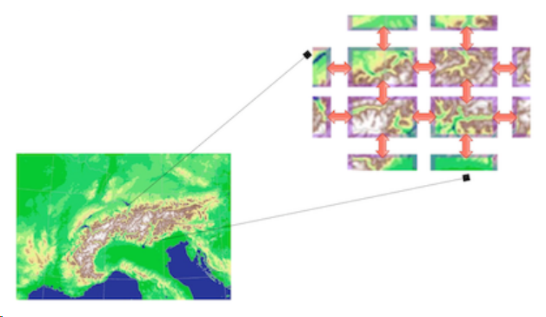
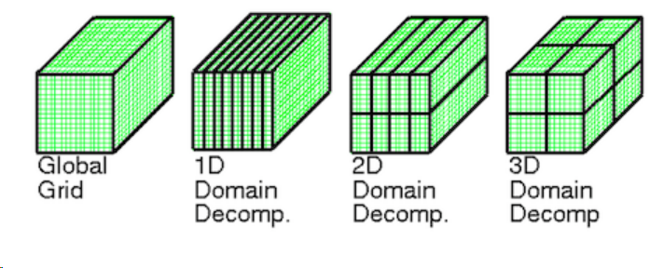
Aspects of Parallelization
Algorithm:
We attempt to parallelize the Sliding Window Algorithm used for extracting features from the input images. The data will be decomposed into smaller chunks so that we can apply parallelization to the mathematical operations independent of each other.
Platform :
We will be using C++ and OpenMP (with NVIDIA GPU) in Visual Studio Code to implement the model.
Symbolic Representation of Domain Decomposition

Slide 4
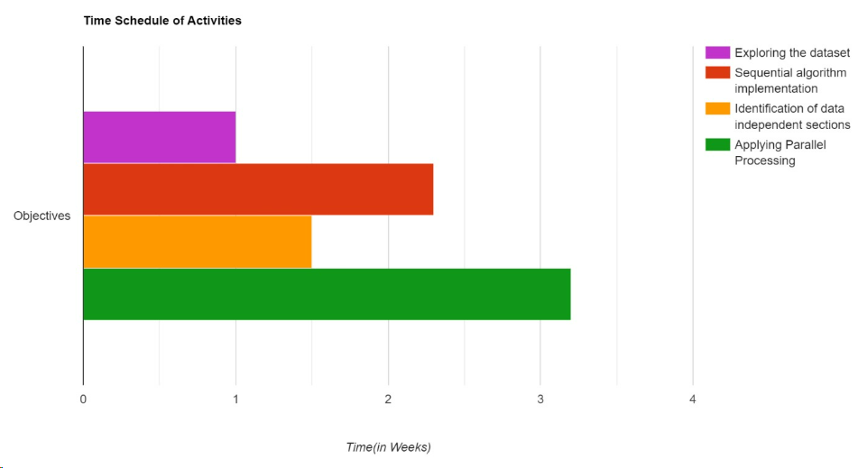
Timeline

Slide 5
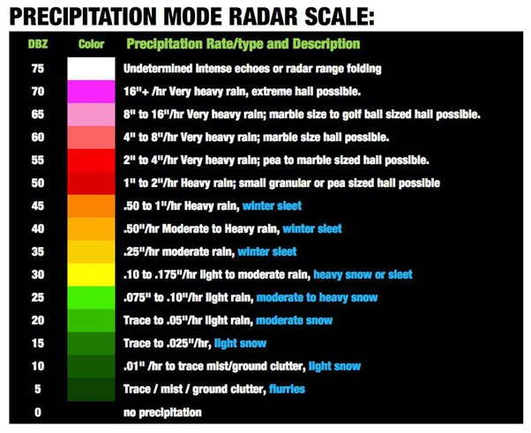
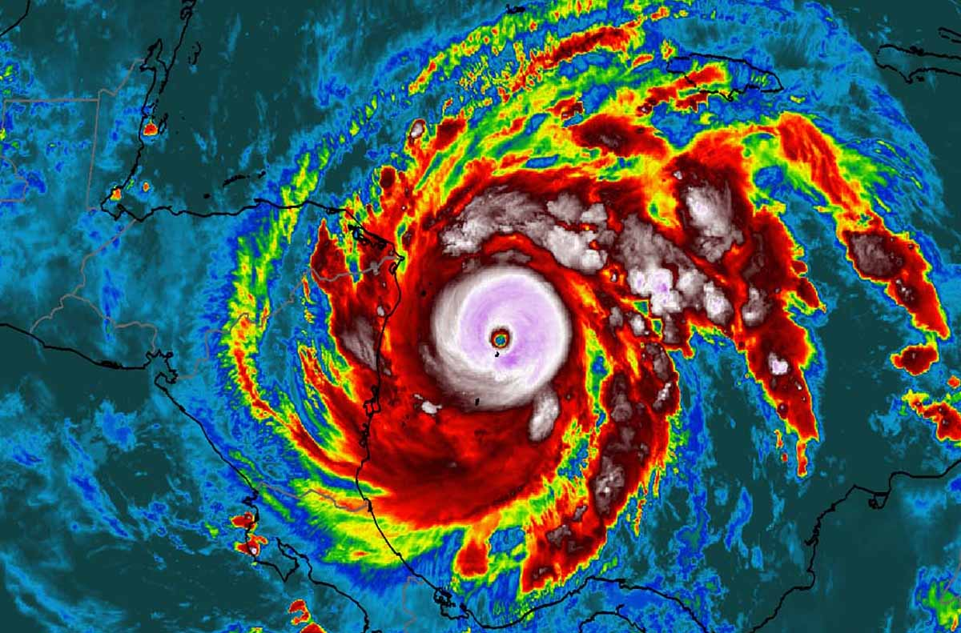
Approach
Divide the Image into Subdomains: Split the tensor file (image_patch_tensor.pt) into smaller subdomains. Each subdomain will be processed independently.
Parallel Processing of Subdomains: Assign each subdomain to a separate thread or process for parallel computation. Each thread/process will independently process its assigned subdomain to calculate the average temperature.
Aggregate Results: Once all subdomains have been processed, aggregate the results to obtain the final average temperature.

Slide 6
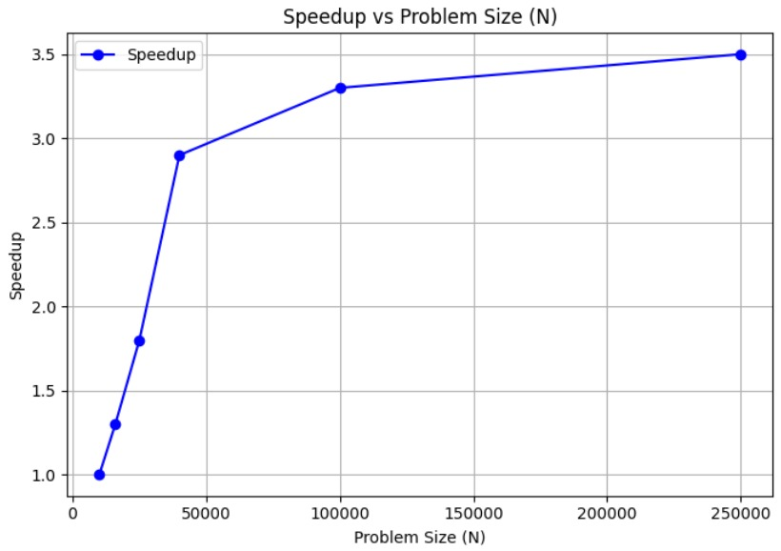
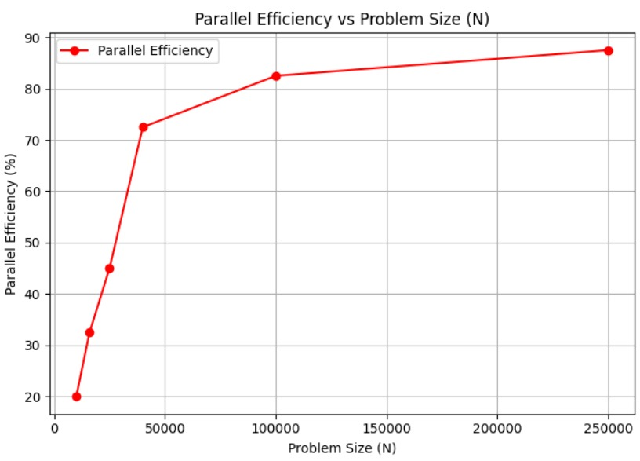
Performance Metrics
Serial Execution in C++ for processing the first 250000 pixels got completed in 245s.
Parallel Execution in C++ using OpenMP for processing the same number of pixels has cut down the execution time to approximately 50s (usage: 4 cores).
So by allocating 4 threads per core (16 threads in total), we expect a significant speedup.

Slide 7
Advantages of using HPC Architecture
Parallelism: parallelism can significantly accelerate the processing of weather images by distributing the workload across multiple processing units or cores.
Resource Utilization: we can maximize the utilization of processing units, memory, and storage, ensuring efficient use of hardware resources for weather image processing tasks.
Complexity Handling: provide the computational resources and capabilities to handle weather related complex tasks efficiently, enabling advanced analysis and modelling of weather phenomena.
Data-Intensive Computing: weather forecasting and analysis generates vast amounts of data from various sources, including satellite imagery, radar data, and sensor networks. HPC platforms are well-suited for data-intensive computing tasks.

Slide 8
Challenges
As C++ is not used to deal with images predominantly, it was be dicey to use this language for image processing, without the involvement of Python in minimal form.
As images related to climate and weather are highly dimensional, de-structuring them in a suitable manner to incorporate parallelization demanded considerable efforts.
Additionally, it was difficult to determine which sections of the images will be data independent to deploy parallel processing.
References
https://www.researchgate.net/publication/237201484_Role_of_Parallel_Computing_in_Numerical_Weather_Forecasting_Models
https://github.com/mrnorman/miniWeather/blob/main/README.md#common-problems
https://github.com/ofuhrer/HPC4WC/blob/main/day3/03-domain-decomposition.ipynb

