Slide 1
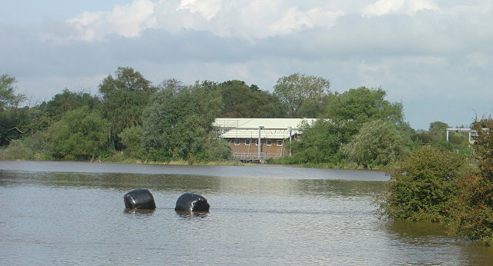
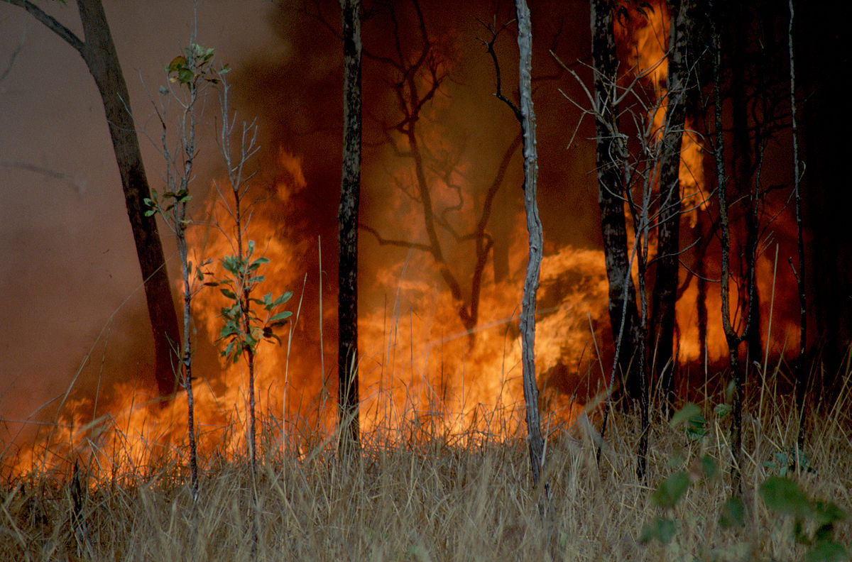
Change the Story!

Slide 2
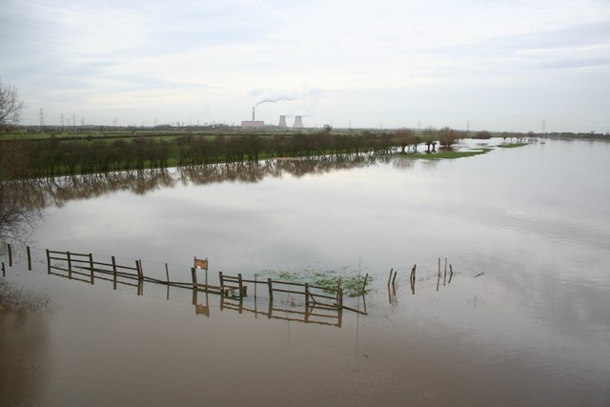
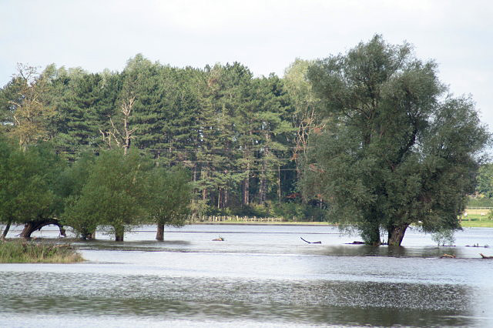
PROBLEM …
Flooding is getting worse because of the world getting warmer
This is known as global warming

Slide 3
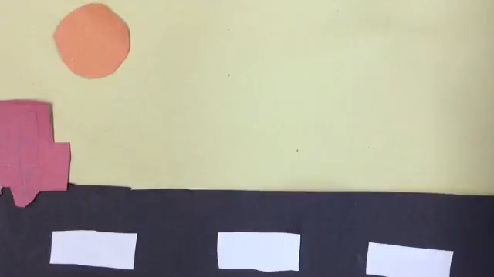
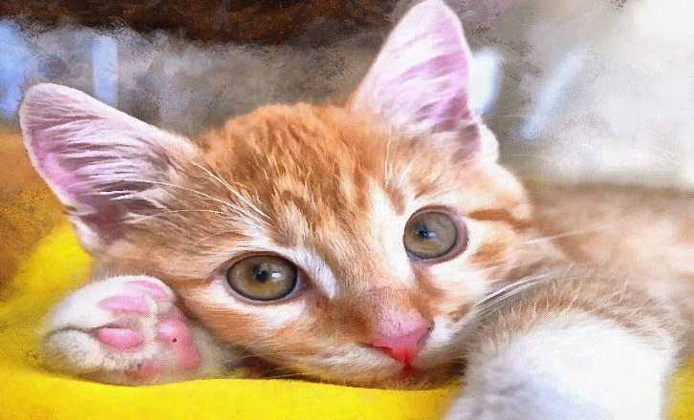
STOP POLUTING OUR PLANET…
IF WE CARY ON WE WILL CUT DOWN TREES AND THE
ORANG –U-TANGS WILL LOSE THERE HOME AND ALSO
FIRE AND FLOODING WILL BE MORE OFTEN

Slide 4
IF WE CARRY ON AS WE ARE …
FLOODING WILL BE WORSE BECAUSE OF THE CLOUDS
HOLDING TOO MUCH
CROP FALIURE AND FOREST FIRES
STORMS ARE GOING TO BE MORE OFTEN
ANIMALS ARE GOING TO CARY ON LOSING THE HOMES
ANIMALS ARE GOING TO BE ENDANGERD

Slide 5
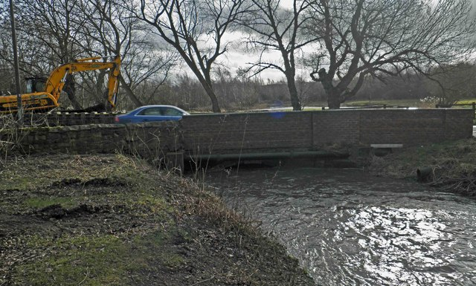
THE SOLUTION…
WE NEED TO SAVE OUR PLANET BY USING ELETRIC CARS AND BY ISULATING OUR HOUSES . USE SOLAR PANELS AND EAT VEG MORE OFTEN FOR EVERY MEAL OR PERHAPS BECOME A VEGITARIAN AND WALK / CYCLE MORE .

Slide 6
THE END

