Slide 1
Change the Story

Slide 2
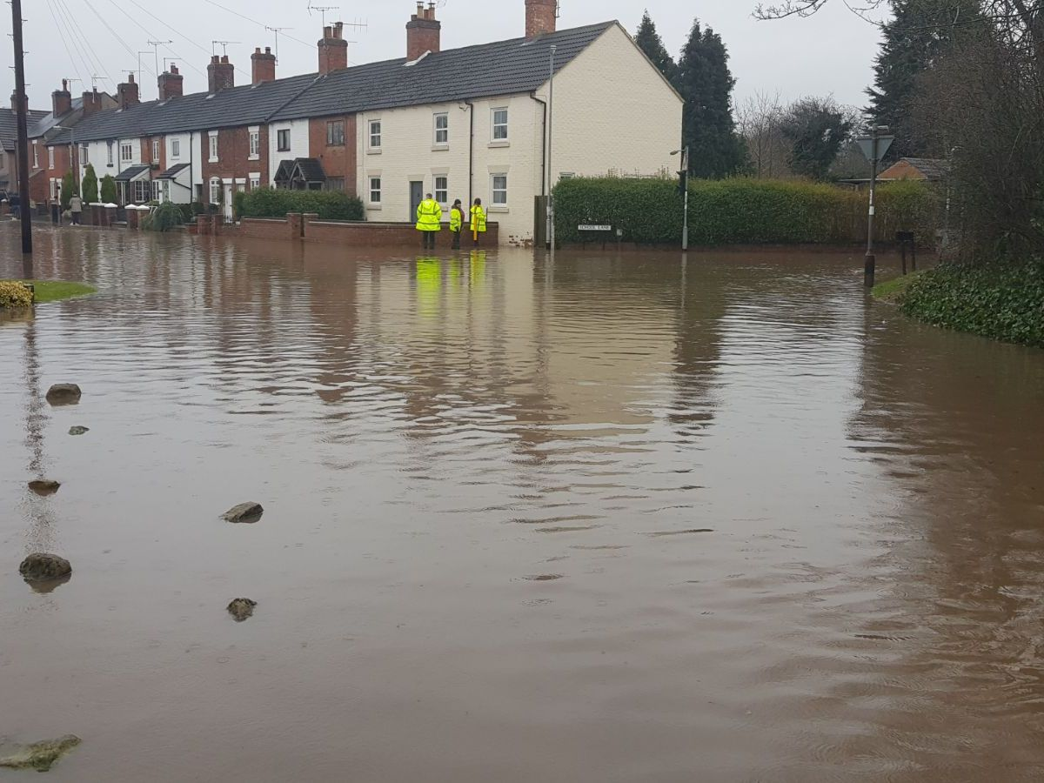
Problem
When it rains in Rolleston it floods
And the water goes into the houses

Slide 3
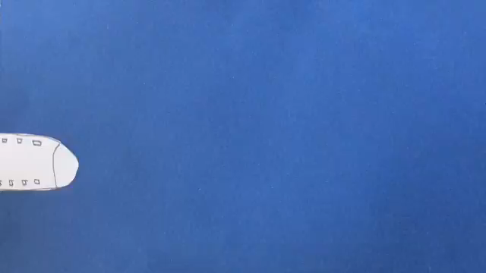
climate change is where green house gas rises into the sky and traps the heat inside the atmosphere

Slide 4
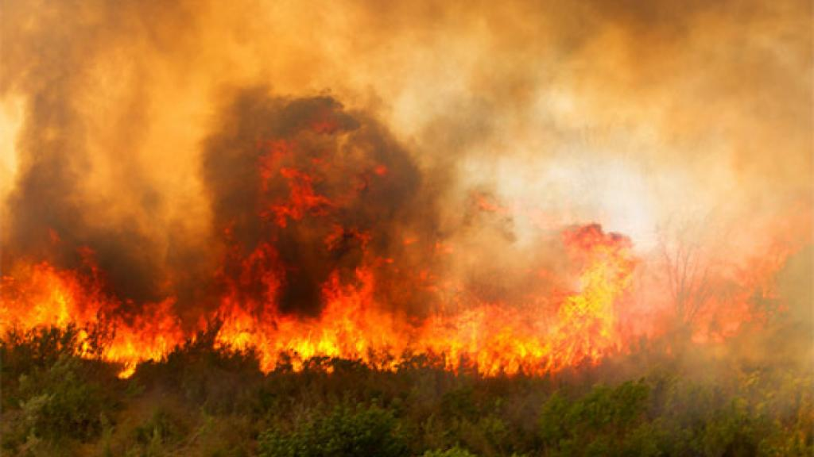
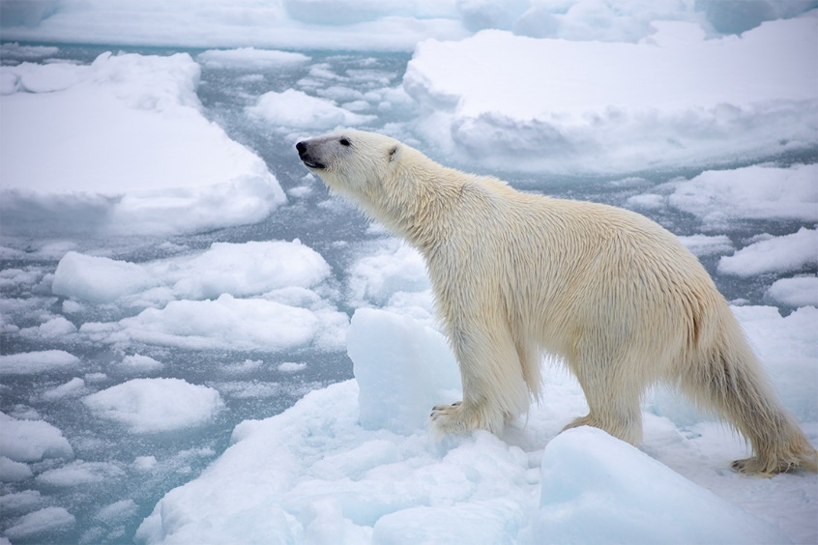
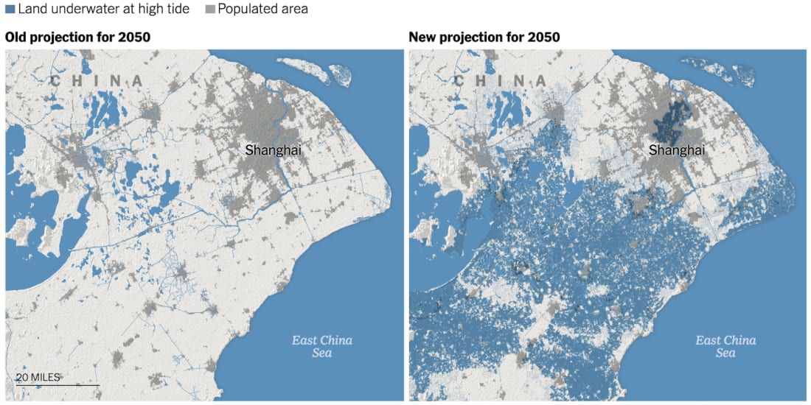
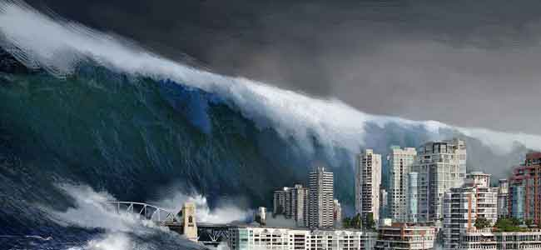
If we don’t change
If we don’t change animals will face extinction , ice will
melt, the world will get super hot and sea levels will rise.

Slide 5
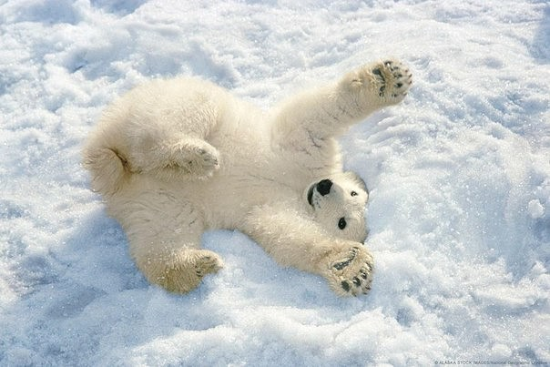
If we change our ways
If we change, animals such as polar bears
will be more common and the world will
get cooler also sea levels will lower.

