Slide 1
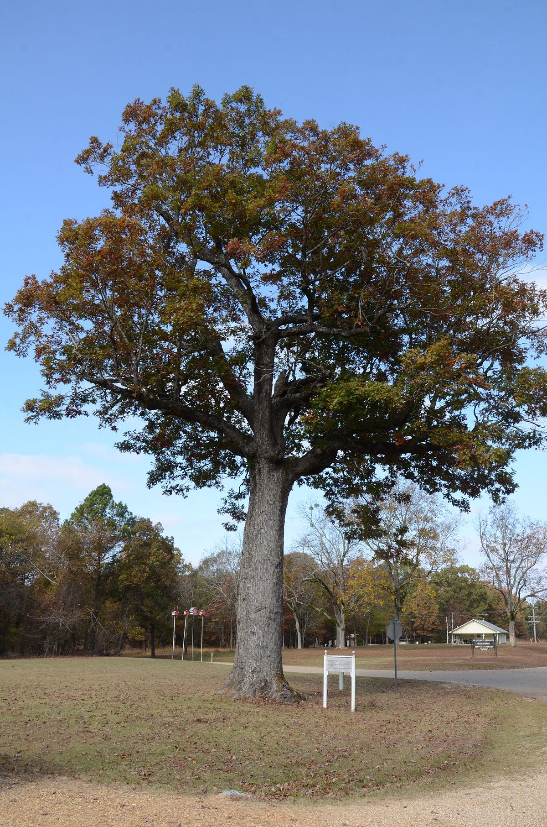
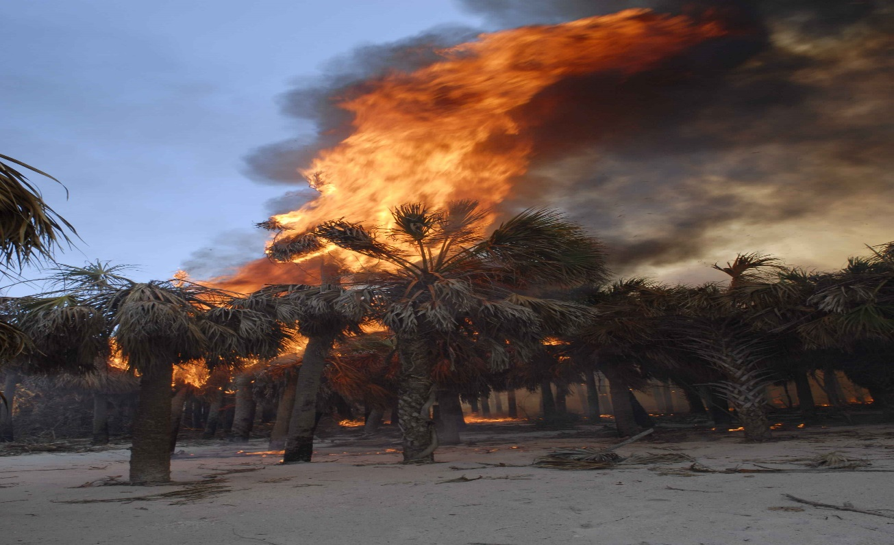
Change
THE
Story
Change the
story !

Slide 2
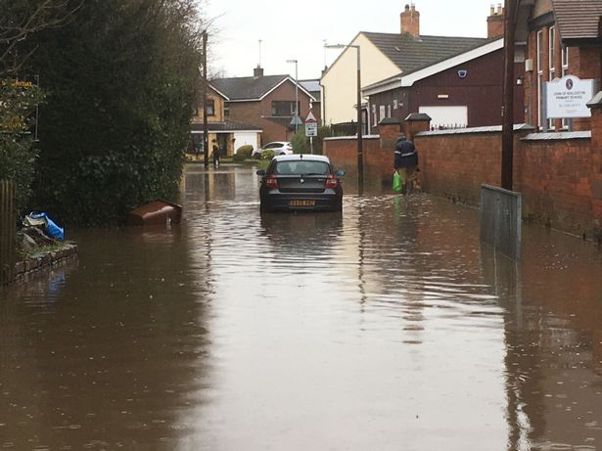
Flooding in Rolleston
The flooding
If we don’t look after our planet .
This is BAD !
This flooding is bad we need to stop this climate change is bad for the planet making the planet hotter day by day

Slide 3
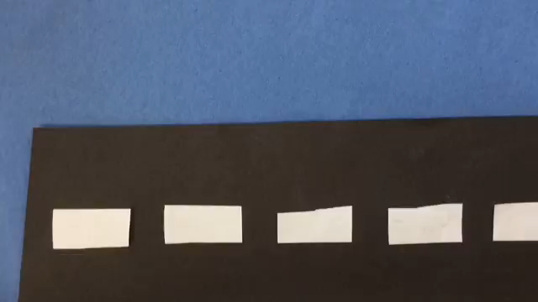
Causes
This video shows you we need to stop climate change .

Slide 4
The consequences
. Crop failure
. Ice caps melting
. animals becoming extinct and endangered
. forest fires
. Flooding
. Storms and severe weather
. Sea levels rising

Slide 5
Solutions
. Consume less
. Use solar panels
. Eat vegan food
. Have an electric car
. Insulated houses
. Walk and cycle more
. Conserve electricity

Slide 6
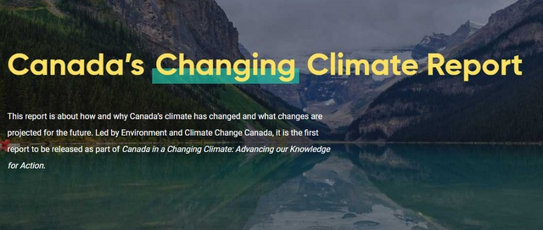
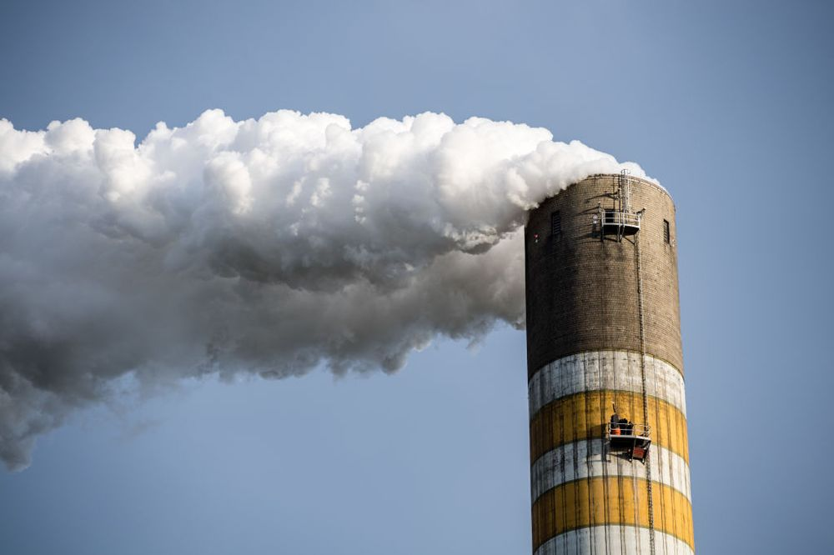
If we carry on like this any more this will happen in lots of countries. 31c is a lot but in Canada it’s 50 c

