Slide 1
Data Visualization ADTA 5250 | IPAC 4250 | CSCE 5320
2010 TableauCeutical
Annual Review
Trisa Nguyen

Slide 2
Executive Summary
TableauCeutical continues to be a top competitor in the nation however, there are opportunities for growth!
Today’s focus:
Rising distribution costs affects Southern and Eastern regions. (pg.3)
Animal market segment dominates sales and profits, however upon further investigation there may be increasing costs starting in 2010 that may ultimately affect profits down the road. (pg.4)
Increase profitability for:
Human Rx market segment (pg.5)
TableauCeutical’s bottom 10 profit producing drugs. (pg.6)
TableauCeutical’s bottom profit producing drug forms (pg.7)

Slide 3
South and East profits plummeted as distribution costs rise from 2009-2010.
Sales¹ were strong in the West which helped offset costs. Central’s profit has remained on a consistent upward trend despite varying costs and sales¹ trends. We may want to re-negotiate distribution contracts or revise unit prices if costs continue to increase.
Notes:
See Appendix 1 for Regional Sales 2009-2010.

Slide 4
Animal market segment dominate sales and profits. However, comparing 2010 to 2009 we can see that higher sales does reflect to higher profit. We may need to look further into production output/cost/waste to see where these differences are.
Notes:
The data is from 2009 to 2010.

Slide 5
Revision of Human Rx market segment to increase profits.
Only 5 months of the year were profitable.
Total profit loss of -$22,281 for 2010.
Increase profitability:
Manage costs
Concentrate sales efforts
Expand market
Reduce errors/waste
Notes:
Total profit loss was calculated by adding together negative profit from March, April, June – August, November, and December 2010.

Slide 6
Revise TableauCeutical’s bottom 10 profit producing drugs.
The following 10 drugs continue to not generate profit.
Sales⁴ continue to be generated however it seems that production output/cost/sales may need to be revised to offset any more future loss.
*Notes:
The data above was generated from 2007 to 2010.
“Potassium Chloride” is Potassium Chloride 10Meq In Dextrose 5% And Sodium Chloride 0.45% In Plastic Container.
“Zofran” is Zofran Preservative Free.
Reference Appendix 2 for the Bottom 10 Sales Producing Drugs from 2007-2010.

Slide 7
Below profit drug forms need revision despite sales being made in 2010.
Spray, Syrup, Injectable, and Aerosols generated no profit for 2010 despite sales being made.
Distribution costs¹ may be too high; re-negotiation of contracts may be needed to help offset losses.
Alternatives:
Manage production costs
Concentrate sales efforts
Expand market
Reduce errors/waste
Notes:
See Appendix 3 for distribution costs for Spray, Syrup, Injectable, and Aerosols for 2010.

Slide 8

Appendix
1. TableauCeutical Regional Sales from 2009-2010
2. Bottom 10 Sales Producing Drugs from 2007-2010
3. 2010 Distribution costs for Spray, Syrup, Injectable, and Aerosols

Slide 9
1. TableauCeutical Regional Sales from 2009-2010
Sales increase from 2009 to 2010 for all regions, except the East.
Notes:
----

Slide 10
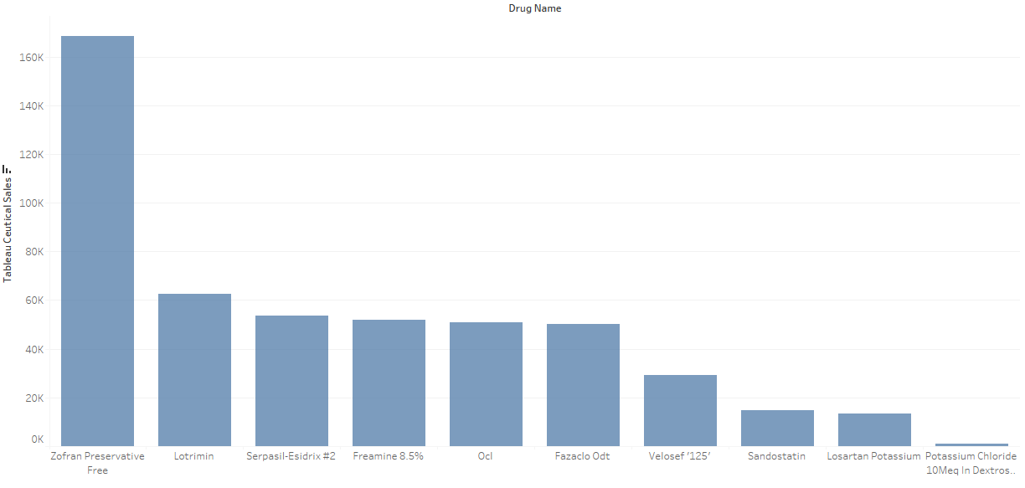
2. Bottom 10 Sales Producing Drugs from 2007-2010
Although these drugs are the bottom 10 profit producing drugs, we can see that there are sales being made.
Notes:
This graph was imported from Tableau during the EDA process.

Slide 11
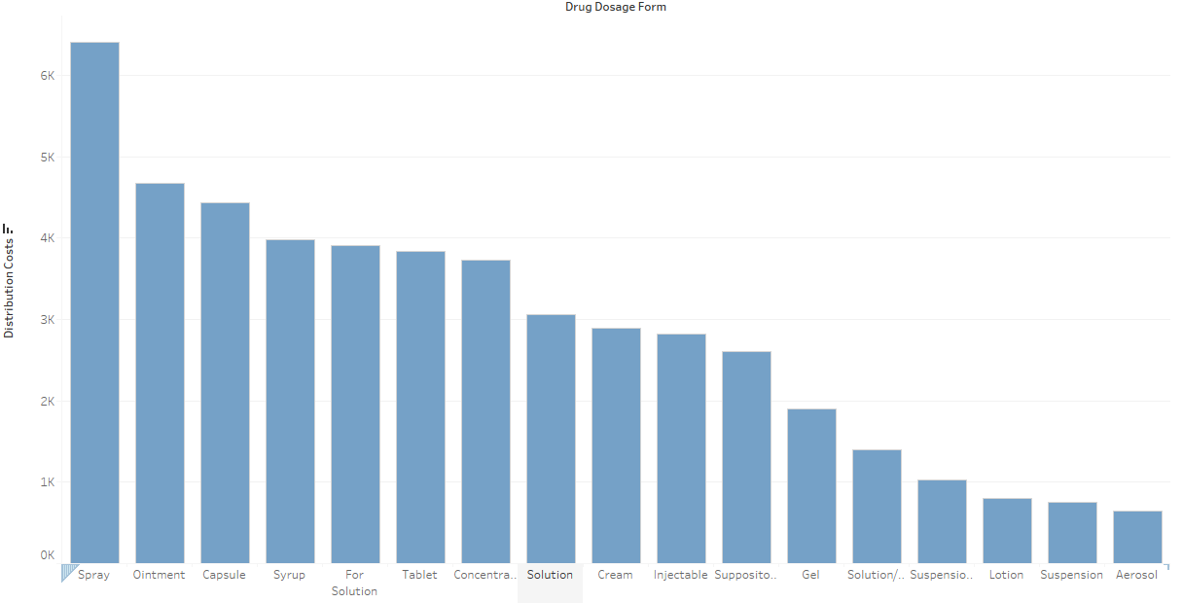
3. 2010 Distribution costs for Spray, Syrup, Injectable, and Aerosols
Distribution costs for Sprays are the highest.
Syrups and injectables are in the middle to higher end of distribution costs.
Aerosol has the lowest cost.
Notes:
This graph was imported from Tableau during the EDA process.

