Slide 1

Triscaler Discovery
ENDPOINT DATA PROTECTION
MACOS-FIRST PRODUCT BUILD
THREE DATA STATES
Sensitive data shows up
where teams least expect it.
AT REST
Files · databases · screenshots
IN MOTION
Find exposed passwords, keys, payment-card signals and selected identifiers across endpoints and supported browser workflows.
Supported browser forms · AI chats
IN USE
Recognized AI-tool connection metadata
Find · Validate · Understand · Respond
Product overview | November 2026
DISCOVER → CORRELATE → RESPOND
TRISCALER.COM · HELLO@TRISCALER.COM

Slide 2
Triscaler Discovery
ENDPOINT DATA PROTECTION
THE PROBLEM
Sensitive data spreads through ordinary work.
Teams need to know what was exposed, where it appeared, and who can take the next step.
01
02
03
Hidden across endpoints
Shared in the moment
Hard to investigate
Passwords, API/private keys and payment-card patterns can hide in files, databases, archives, screenshots, saved mail and Git history.
A paste or submit through a supported browser flow can send sensitive text to a website or AI chat before a person reviews it.
Copies across locations and tools create duplicate alerts. Without source and account context, teams lose time deciding what to do.
THE MISSING LINK
Sensitive data → its source → the responsible person → a recorded action
TRISCALER.COM
02 / 06

Slide 3
Triscaler Discovery
ENDPOINT DATA PROTECTION
HOW IT WORKS
AI has specific roles, not one vague promise.
Local detection, browser checks, AI-tool activity monitoring and future server analysis are separate capabilities.
01
On-device semantic model
02
Browser extension checks
A local ONNX embedding adds semantic context to other evidence. No per-scan cloud AI API call.
Supported paste, upload and submit flows are checked locally, not by a cloud LLM. Prompt text is not sent for model analysis.
03
AI-tool activity monitor
04
Server-side LLM (planned)
Recognized tool processes are linked to external connection metadata. Best effort only; no TLS content inspection or blocking.
Intended for user-behaviour insights on the server. It is not live and is not used by the endpoint scanner.
At-rest discovery → source/account context → local tray report and central console
TRISCALER.COM
03 / 06

Slide 4
Triscaler Discovery
ENDPOINT DATA PROTECTION
WHERE WE FIT
A focused complement to broad DLP platforms.
This is a positioning comparison, not a claim that established vendors cannot detect secrets or sensitive data.
ESTABLISHED DLP SUITES
TRISCALER'S FOCUSED LANE
Zscaler · Forcepoint · Microsoft Purview
Endpoint sensitive-data discovery
Designed for broad enterprise data protection and policy enforcement.
Focused findings
Passwords, API/private keys, payment-card signals and selected contextual identifiers.
Broad data categories
Regulated data, documents and other sensitive content.
Connected context
Source/account grouping and AI-transcript matches checked against source files.
Platform ecosystems
Endpoint, web, network and cloud scope varies by vendor and configuration.
Operator control
Signed hot-reload rules, local tray workflow and auditable analyst actions.
MATURE, WIDE-SCOPE CONTROL PLATFORMS
Our differentiator is the combination of endpoint evidence, source/account context and AI-workflow verification.
OFFICIAL SOURCES
Zscaler DLP
Forcepoint DLP
Microsoft Purview Endpoint DLP
Public pages checked 6 Nov 2026
TRISCALER.COM
04 / 06

Slide 5
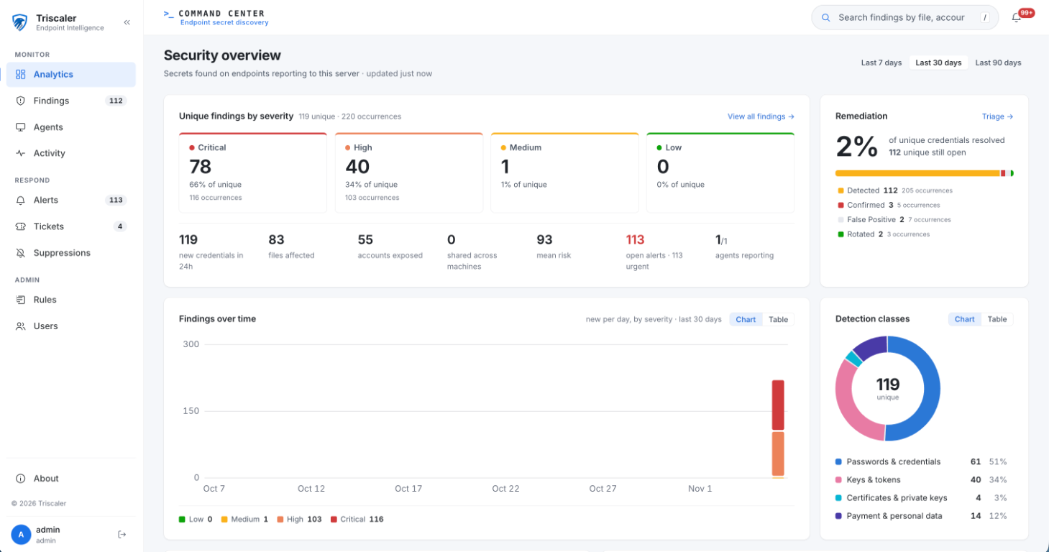
SERVER CONSOLE
A central view for findings, alerts and response.
The web console groups sensitive-data findings by risk and gives teams fleet and response context.
01
Severity at a glance
Unique findings and repeat sightings are separated by risk tier.
02
Response status
Triage, remediation and open alerts share one overview.
03
Fleet context
Agent status and detection classes help guide follow-up.
CAPTURED SERVER BUILD
Metrics are a point-in-time view.
TRISCALER.COM
05 / 06

Slide 6
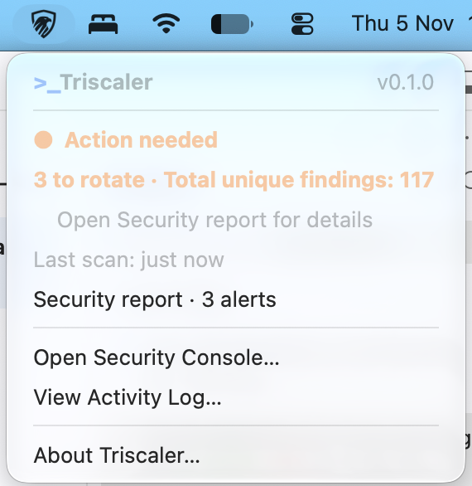
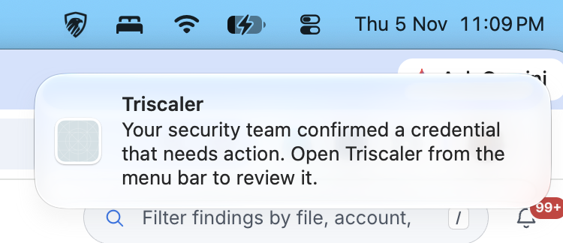
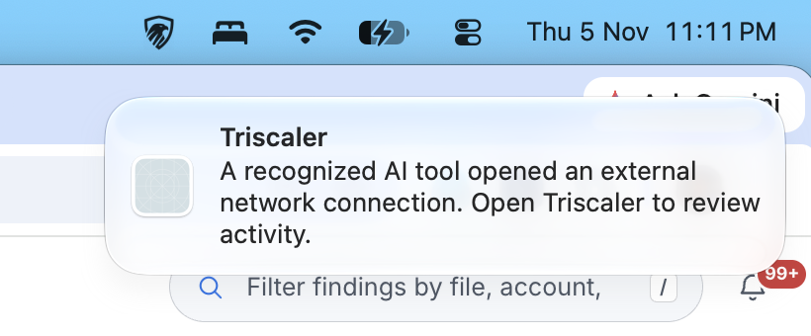
Triscaler Discovery
ENDPOINT DATA PROTECTION
PRODUCT IN ACTION
See the tray, the alert and the next step.
The endpoint menu keeps a local report close at hand. System notifications stay generic and avoid exposing sensitive details.
CONFIRMED-FINDING NOTIFICATION
AI-TOOL CONNECTION NOTIFICATION
The local report provides detail; the popups are intentionally privacy-safe.
TRAY MENU · SAMPLE TEST DATA
macOS-first · selected identifiers only · browser coverage is bounded · outbound monitoring is best-effort metadata, not content inspection or blocking
Looking for pilot partners, feedback and client or investor introductions.
hello@triscaler.com
triscaler.com
TRISCALER.COM
06 / 06

