Slide 1
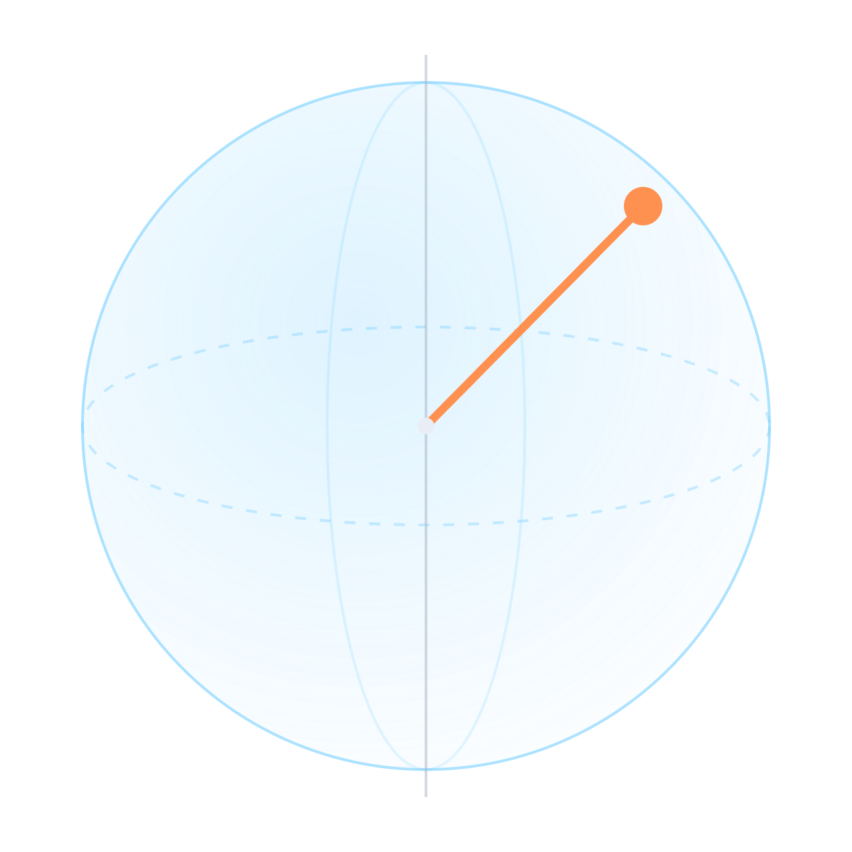
Quantum Green Wave
|0⟩ NS green
QISKIT HACKATHON · QUANTUM OPTIMIZATION FOR SMART CITIES
Ambulance signal preemption as a 96-qubit QUBO, solved by QAOA in 12-qubit windows and checked in a traffic simulator.
TEAM VOYAGER · Haadireza Premji and Trisha Prasad
|1⟩ EW green
Notes:
Open with the one-line idea: every traffic light is a qubit. One state means east–west green, the other north–south green. We choose the state of 16 lights over six 15-second slots, so 96 qubits, to give ambulances green without wrecking ordinary traffic. Then we prove each part works: the QUBO is tested against a direct cost function, QAOA reaches the proved optimum, and a traffic simulator checks the plans.

Slide 2
An ambulance at a red light waits like everyone else.
THE PROBLEM
Preemption today is local: one light reacts as the ambulance arrives, often behind a queue it never cleared. A city-wide plan has to decide three things at once.
01
02
03
Who goes where
Which lights, when
At what cost
Assign each ambulance to one incident, weighted by severity and congestion.
Set every signal on the route green for the slot the ambulance actually arrives.
Without starving the cross street or breaking the green wave for everyone else.
Quantum Green Wave · 02
Notes:
The three decisions are coupled: who goes where decides the routes, the routes decide which lights matter, and every light we flip for an ambulance costs ordinary drivers. Local preemption solves only the second, one light at a time.

Slide 3

Two coupled problems, two quantum encodings
THE IDEA
Dispatch · 16 qubits
Signals · 96 qubits
Constrained assignment
Unconstrained QUBO
4 ambulances × 4 incidents, one-hot rows. XY-mixer QAOA from a Dicke state keeps every ambulance on exactly one incident by construction.
routes become green requests
16 lights × 6 slots. Solved by QAOA, CVaR-QAOA and warm-start QAOA on 12-qubit windows inside a hybrid loop.
Quantum Green Wave · 03
Notes:
Dispatch is small but constrained, which is where a problem-aware mixer pays off. Signal timing is large but unconstrained, which is where decomposition is needed. The output of the first, the routes, feeds the second as preemption requests.

Slide 4
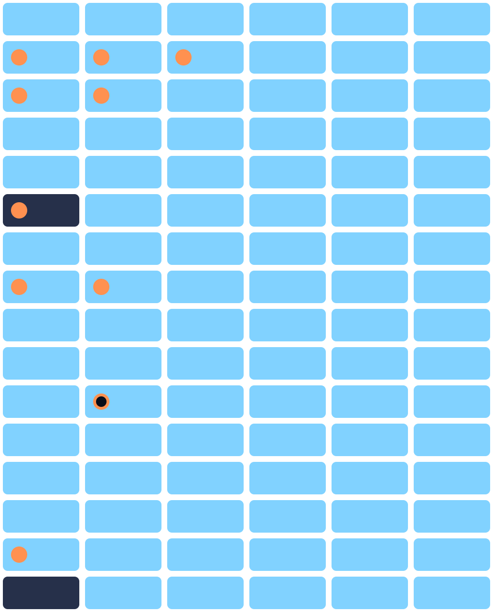
One qubit per light per 15-second slot
ENCODING
xₙ,ₜ = 1 → east–west green
xₙ,ₜ = 0 → north–south green
16 intersections × 6 slots = 96 binary variables, a 90-second horizon. Ambulances cross a 150 m block in about 9 s (measured in the simulator), so each crossing maps to one slot.
The proved-optimal plan for City 1: rows are intersections, columns are slots; orange dots are ambulance requests.
Quantum Green Wave · 04
Notes:
This grid is real output from the model: the exact optimum for the first city. Blue is east–west green; it dominates because this city has an east–west rush hour. The orange dots are the ambulance requests; filled dots are met by the plan.

Slide 5
Five terms, all at most quadratic: an unconstrained QUBO
THE COST HAMILTONIAN
Term | Form | What it encodes
Queue delay | q_ns · x + q_ew · (1 − x) | cars stuck on red
Platoon stops | f · xₙ,ₜ · (1 − xₘ,ₜ₊₁) | a released platoon hits red next block
Switching | s · (xₜ + xₜ₊₁ − 2xₜxₜ₊₁) | lost time when a light changes
Ambulance | W · sev · p(Δt) · [phase ≠ axis] | green requests, spread over ±1 slot
Fairness | μ · (Σₜ xₙ,ₜ − T/2)² | no axis starved over the horizon
x = (1 − Z)/2 → H = Σ hᵢ Zᵢ + Σ Jᵢⱼ ZᵢZⱼ → RZ and RZZ gates
Quantum Green Wave · 05
Notes:
Every term is linear or a product of two binaries, so the whole problem is one QUBO with no constraints and no penalty tuning. The ambulance term is an expectation over arrival uncertainty: weight 0.6 on the nominal slot, 0.2 on each neighbour. The standard substitution x = (1 − Z)/2 gives an Ising Hamiltonian, which compiles to RZ and RZZ rotations.

Slide 6
Built term by term, then proved
FROM THE MODEL
qgw/signals.py · to_qubo()
tests/test_core.py
# switching: s·(xa + xb − 2·xa·xb)
for n in range(c.N):
for t in range(T - 1):
a, b = c.var(n, t), c.var(n, t + 1)
lin[a] += s; lin[b] += s
add_pair(a, b, -2 * s)
# fairness: μ·(Σt xt − T/2)²
for n in range(c.N):
const += mu * T * T / 4
for t in range(T):
lin[c.var(n, t)] += mu * (1 - T)
for u in range(t + 1, T):
add_pair(.., .., 2 * mu)
for _ in range(30):
x = rng.integers(0, 2, q.n)
assert q.energy(x)[0] \
== approx(p.cost(x))
The algebra is never trusted: 150 random plans on 5 cities must give the same energy from the QUBO and from a plain cost function. The numpy QAOA is checked against Qiskit circuits the same way.
33 tests · all passing
Quantum Green Wave · 06
Notes:
Point at the fairness block: expanding μ(S − T/2)² with x² = x gives a linear coefficient μ(1 − T) and a 2μ coupling between every pair of slots at the same light. That is exactly what the code writes. The test on the right is the guarantee: the QUBO and a direct cost function agree on random plans, so any algebra slip would fail the suite.

Slide 7
The constraint becomes a symmetry of the mixer
DISPATCH · XY-MIXER QAOA
Start in a product of W/Dicke states, one excitation per ambulance row. The XY mixer exp(−iβ(XX+YY)/2) conserves Hamming weight in each row, so every ambulance serves exactly one incident at every depth. Only the column constraint is a penalty.
qgw/qalgos.py
def _apply_xy(psi, n, a, b, beta):
# rotates only |01⟩ ↔ |10⟩
i01, i10 = _xy_idx(n, a, b)
out = psi.copy()
c = np.cos(beta)
s = -1j * np.sin(beta)
out[i01] = c*psi[i01] + s*psi[i10]
out[i10] = c*psi[i10] + s*psi[i01]
return out
# |00⟩, |11⟩ untouched → weight kept
40%
4%
valid assignments, XY mixer
valid assignments, penalties only
16 qubits, p = 2, mean of 5 random cities. Only 24 of 65,536 basis states are valid.
Quantum Green Wave · 07
Notes:
This is the slide for a quantum audience. Instead of fighting the constraint with a penalty, we choose a mixer that commutes with the row-weight operator, so the evolution never leaves the subspace where each ambulance has exactly one incident. The gate is verified against Qiskit’s XXPlusYYGate in the tests. Result: about 9.5 times more valid assignments than penalty-only QAOA at the same depth (40.0% against 4.2%).

Slide 8

96 qubits do not fit a NISQ chip, so we solve them 12 at a time
THE HYBRID LOOP
1 · freeze
2 · evolve
3 · measure
4 · accept
Fix 84 variables at the current plan; the rest fold into an exact 12-qubit sub-QUBO.
QAOA, CVaR-QAOA or warm-start QAOA over 2¹² = 4096 plans.
Sample 256 shots and keep the cheapest plan seen.
Write it back only if the city-wide cost does not rise.
28 windows: every pair of neighbouring lights, plus windows that follow each ambulance route. Three sweeps in random order.
Monotone by construction: the plan cost can only fall, so a noisy quantum step can never make the city worse.
Quantum Green Wave · 08
Notes:
This is block-coordinate descent with a quantum block solver. Freezing the other variables is exact: their couplings become linear terms and a constant, so the 12-qubit sub-problem has exactly the energy of the full plan. The acceptance rule makes the loop safe to run on noisy hardware: a bad sample is simply rejected.

Slide 9
QAOA puts up to 40% of the amplitude on the best of 4096 plans
INSIDE ONE 12-QUBIT WINDOW
Blind guess
0.027% · ≈ 1 in 4096
QAOA p = 1
14% · ×500
QAOA p = 2
32% · ×1190
QAOA p = 3
40% · ×1500
Warm-start p = 2
41%*
CVaR-QAOA p = 3
14% · ×530
Ideal statevector, mean over 10 windows. Each depth starts from the previous depth’s angles (INTERP). *Warm-start begins at the rule-based plan, already in the top 1.2% of each window, so part of its lift is inherited. CVaR optimises the tail, not P(best).
Quantum Green Wave · 09
Notes:
The number to remember is about 1500 times a blind guess at p = 3: the circuit concentrates amplitude on the optimum. P(best) grows with depth because every depth is initialised from the interpolated angles of the one below, so p = 3 can never start worse than p = 2. We flag the warm-start result honestly: it starts from a good classical plan.

Slide 10
Every quantum variant reaches the proved optimum
CITY-WIDE RESULT
Method | Final cost
QAOA windows | 1593
CVaR-QAOA windows | 1593
Warm-start QAOA windows | 1593
Random best-of-256 windows | 1606–1627
Rule-based preemption | 1734
Queue-actuated | 1679
Fixed-time | 2423
1593
Exact optimum of the 96-variable QUBO, proved by HiGHS. Random sampling of the same windows stops short: the circuits, not luck, find it.
Quantum Green Wave · 10
Notes:
All quantum runs start from the same random plan of cost 2364, except warm-start, which starts from the rule-based plan. Three random-sampling runs of the same 28 windows end between 1606 and 1627, so the QAOA distribution is doing real work. HiGHS also proves 1593 in a fraction of a second: we say so on the claims slide.

Slide 11
The signal survives noise at p = 2
HARDWARE COST · IBM HEAVY-HEX
Depth | 2q gates, ideal line | 2q gates, Sherbrooke | Depth, Sherbrooke | Ideal P(best) | Noisy P(best)
p = 1 | 80 | 173 | 548 | 9.3% | 3.1%
p = 2 | 160 | 371 | 825 | 26.5% | 2.2%
p = 3 | 240 | 581 | 1011 | 38.4% | not run
≈ 90×
ready
a blind guess, with the noise model of a 127-qubit Eagle r3 calibration (FakeSherbrooke)
run_on_ibm.py sends the same window to a real backend through SamplerV2
Quantum Green Wave · 11
Notes:
Routing onto heavy-hex roughly doubles the two-qubit gate count because the window’s coupling graph is not native to the chip. Noise flattens the distribution: ideal 26.5% falls to 2.2% at p = 2, which is still about 90 times a blind guess of 1 in 4096. This is the honest NISQ picture: deeper is better in theory and worse on today’s noise, so shallow circuits plus the accept-if-better loop is the right design. The hardware script is written but untested, since it needs an IBM account.

Slide 12
The model is tested where it can fail: real vehicle dynamics
CLOSED-LOOP CHECK · SUMO TRAFFIC SIMULATOR
City | Ambulance, optimised | Ambulance, rule-based | Other cars, optimised | Other cars, rule-based
City 1 | 51.9 s | 41.7 s · faster | 34.8 s · less | 41.2 s
City 2 | 22.2 s · faster | 26.3 s | 39.1 s · less | 49.1 s
City 3 | 18.5 s · tie | 18.5 s · tie | 36.0 s · less | 39.1 s
Ambulances: 1 win, 1 tie, 1 loss. Severity-weighted mean trip time, 3 simulator seeds each.
Everyone else waits less in all three. Every plan simulated for the same 160 s window.
Quantum Green Wave · 12
Notes:
We report the loss instead of hiding it. In City 1 the optimised plan is slower for ambulances than simple rule-based preemption, because the QUBO models queues approximately: a lower model cost does not guarantee a lower simulated delay. What the optimised plan does consistently is protect ordinary traffic, which rule-based preemption sacrifices. Every plan is simulated for the same 160 seconds, with the same demand and seeds, after an audit fixed a measurement window bug.

Slide 13
Plan for the spread, not the point estimate
ARRIVAL UNCERTAINTY
1.35
0.58
−57%
missed greens, point plan
missed greens, ±1-slot plan
The request weight is an expectation over arrival slot t−1, t, t+1 (0.2 / 0.6 / 0.2). Severity-weighted missed greens, 6 cities × 1000 sampled arrivals, evaluated in the model.
Quantum Green Wave · 13
Notes:
Ambulances never arrive exactly on schedule. Folding the arrival distribution into the cost costs nothing in qubits: it only spreads each request’s weight over three slots. Sampling real delays shows the robust plan misses less than half as many greens. This is evaluated in the model, not in SUMO.

Slide 14
What this shows, and what it does not
CLAIMS
Shown
Not claimed
96-variable QUBO, tested vs direct cost
XY mixer: 9.5× more valid dispatches
Hybrid loop reaches the proved optimum
Gate counts and noise on an IBM layout
Simulator check, losses included
Quantum advantage: HiGHS takes < 1 s
Hardware runs: script written, not run
Real streets: the city is synthetic
Closed loop: one open-loop 90 s plan
The value is a formulation and a loop that scale with the hardware: the same code runs larger windows as qubit counts and fidelities grow.
Quantum Green Wave · 14
Notes:
Say this slide before a judge asks. A quantum audience will respect a precise boundary more than an inflated claim. Every number in this deck is regenerated by one command, python -m qgw.pipeline, and the whole suite of 33 tests passes.

Slide 15
Every light a qubit. Every ambulance a green wave.
NEXT
Run on IBM hardware
Rolling re-plan
Real streets
One 12-qubit window through SamplerV2, compared to the noisy simulation.
Re-solve every slot as ambulances report their position.
OpenStreetMap networks and measured traffic counts.
Team Voyager · Thank you
Notes:
Close on the one-line idea and invite questions. Good questions to be ready for: why QAOA if HiGHS is faster (method and scaling, no advantage claimed); why the XY mixer (constraint preserved by symmetry); why City 1 loses in SUMO (the QUBO approximates queues).

