Slide 1
Developing an Accurate Predictive Model for Diabetes Using Machine Learning

Slide 2
CONTENTS:
Introduction
Project objective
Dataset overview
Existing Challenges in Diabetes Prediction
Role of Machine Learning in Diabetes Prediction
Data visualizations
Algorithms
Results
Conclusion

Slide 3
Introduction:
Welcome to my presentation on ‘Developing an accurate predictive model for diabetes using machine learning’. Today, I will be sharing with you the key findings and insights from my project, highlighting the importance of early diabetes detection and the potential of machine learning in improving diabetes prediction and management.

Slide 4
Now, let's begin by understanding the significance of diabetes as a chronic disease affecting people of all ages.
Introduction to Diabetes:
Diabetes is a prevalent chronic condition characterized by high blood sugar levels, resulting from either inadequate insulin production or the body's inability to effectively use insulin. It poses significant health challenges worldwide, impacting millions of lives. Early detection of diabetes is crucial for effective prevention and management, enabling timely interventions and personalized treatment plans.

Slide 5
Project Objective:
The objective of my project was to develop an accurate predictive model for diabetes using machine learning algorithms. By leveraging data-driven techniques and advanced analytics, we aimed to improve the accuracy of diabetes prediction, allowing for proactive measures and personalized interventions.

Slide 6
Dataset Overview:
To accomplish our goal, we utilized a comprehensive dataset encompassing important medical features associated with diabetes. These features included age, body mass index (BMI), blood pressure, glucose levels, insulin levels, Diabetes Pedigree Function, Skin Thickness, and pregnancies. This dataset provided a rich foundation for building our predictive model.

Slide 7
Existing Challenges in Diabetes Prediction:
Before diving into our approach, let's briefly explore the existing challenges and methods in diabetes prediction. Traditional diagnostic criteria, risk assessment tools, and genetic/biomarker studies have been widely used. However, these methods have limitations in terms of accuracy, scalability, and interpretability.

Slide 8
Role of Machine Learning in Diabetes Prediction:
This is where machine learning comes into play. Machine learning algorithms, such as logistic regression, decision trees, and random forest, have shown promise in accurately predicting diabetes. These algorithms can leverage large datasets and complex patterns to improve prediction accuracy and provide valuable insights for healthcare professionals and individuals

Slide 9
Data Visualizations

Slide 10
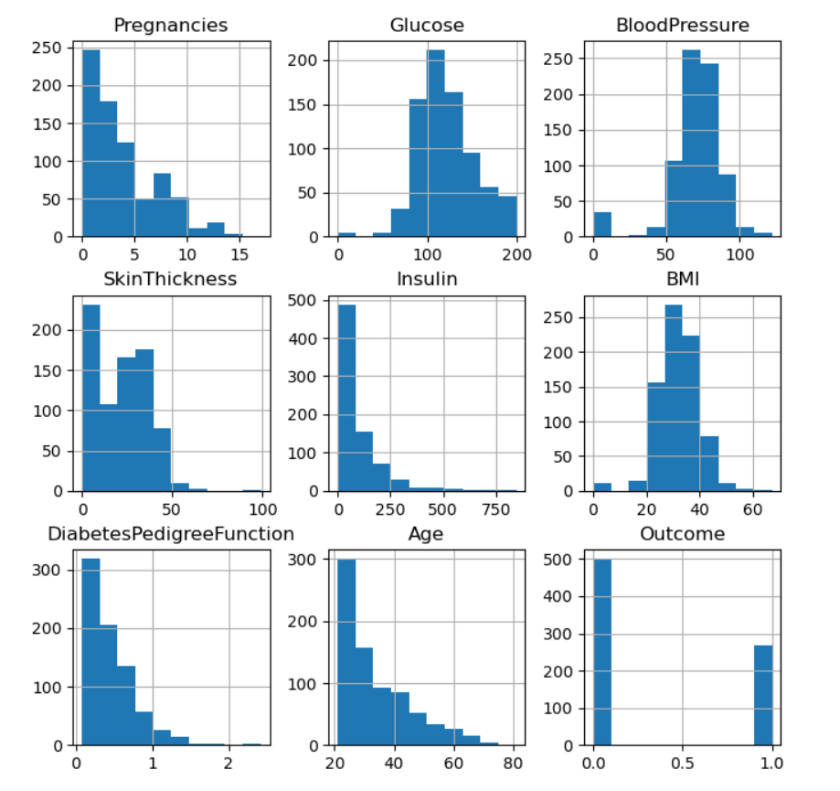
Data distribution plot before removing NULL values

Slide 11
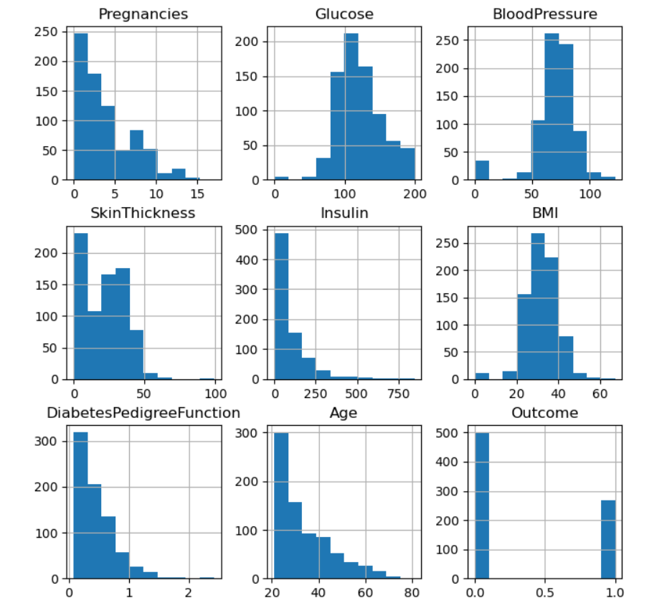
Data distribution plot after handling the missing values

Slide 12
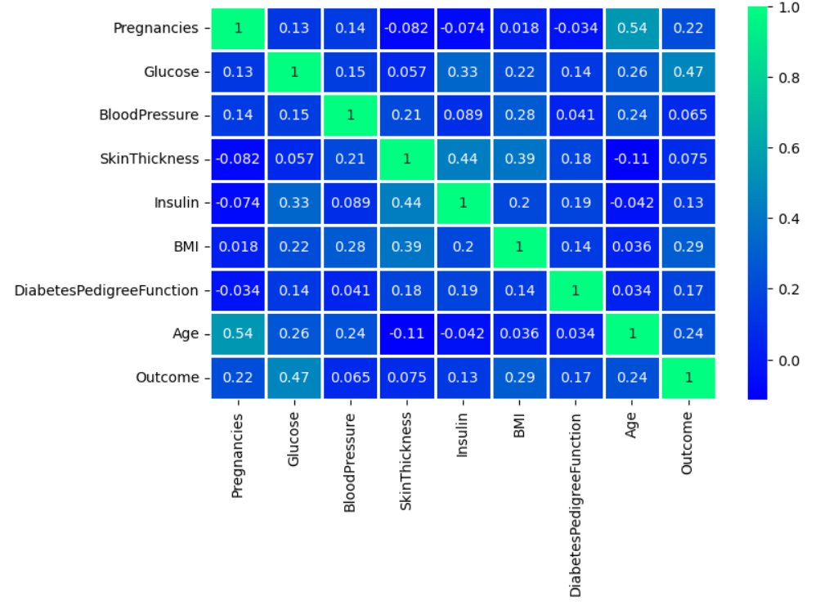
correlation between all the features in the dataset

Slide 13
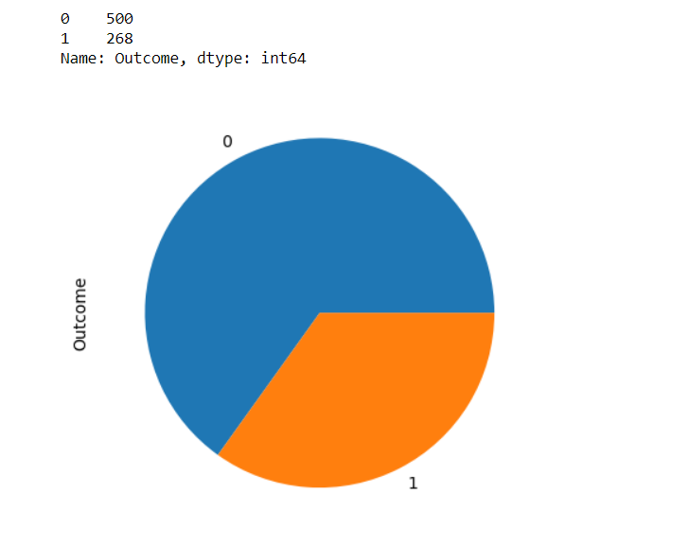
Data distribution of the outcome column

Slide 14
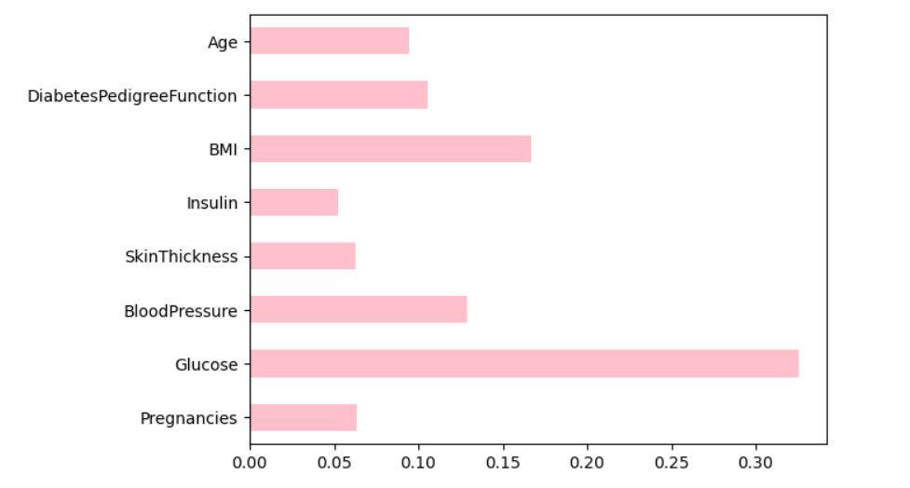
Visualization of the feature importance

Slide 15
Algorithms

Slide 16
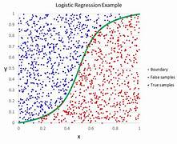
Logistic Regression:
Logistic regression is a widely used algorithm for binary classification tasks, making it suitable for predicting diabetes. It models the relationship between the input features and the probability of the outcome class. By fitting a logistic function to the training data, it estimates the probabilities and predicts the presence or absence of diabetes.

Slide 17
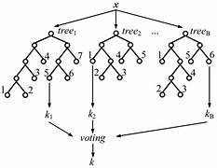
Random Forest:
Random forest is an ensemble learning algorithm that combines multiple decision trees to make predictions. It leverages the concept of bagging, where each tree is trained on a random subset of the data. By aggregating the predictions of the individual trees, random forest produces more robust and accurate predictions. It is known for its ability to handle high-dimensional datasets and reduce overfitting.

Slide 18
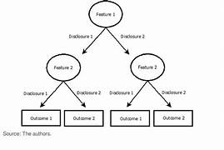
Decision Tree:
The decision tree algorithm is a powerful tool for predictive modeling. It builds a tree-like structure where each internal node represents a feature and each leaf node corresponds to a class label. By recursively splitting the data based on feature thresholds, it creates a set of rules for classifying instances. Decision trees can capture complex relationships between features and the target variable.

Slide 19
RESULTS

Slide 20
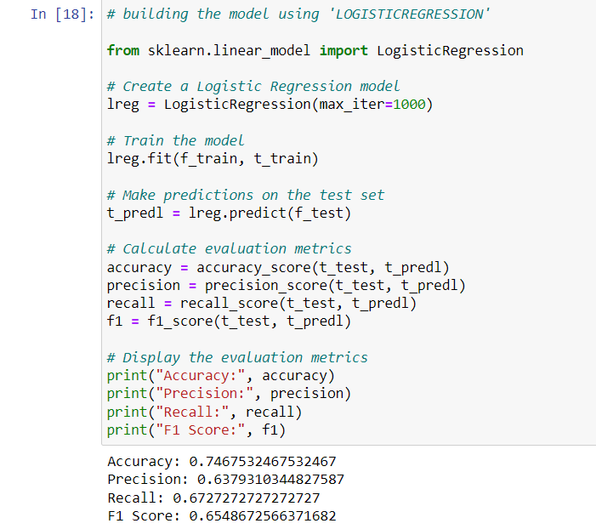
Logistic regression:

Slide 21
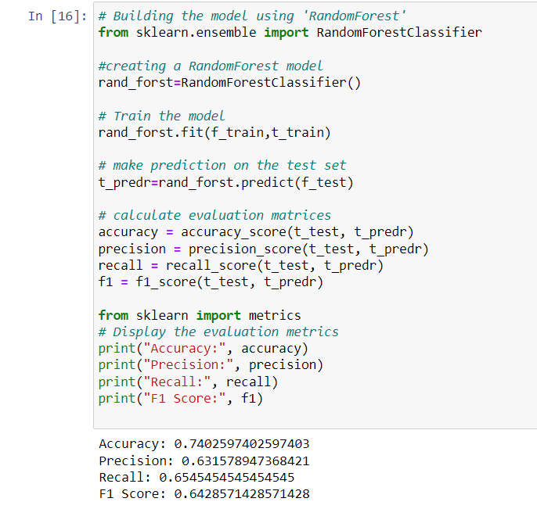
Random Forest

Slide 22
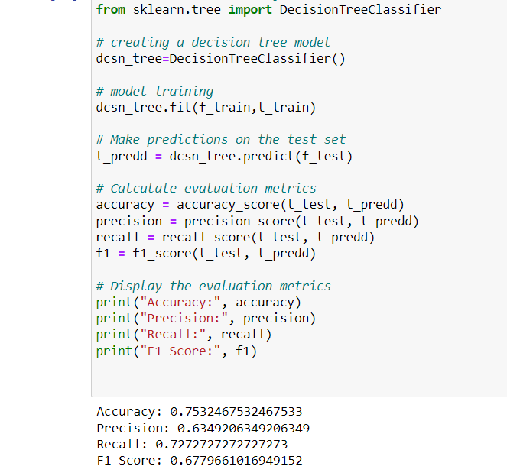
Decision Tree

Slide 23
Model Saving:
Decision Tree algorithm achieved the highest accuracy in predicting diabetes with an accuracy of 75%. So ultimately we saved decision tree as final predicting model.

Slide 24
Conclusion
To conclude I would like to say that our project successfully developed an accurate predictive model for diabetes using machine learning algorithms. Through the evaluation of various algorithms, the decision tree emerged as the top performer, demonstrating the highest accuracy in predicting diabetes within our research context. The developed model provides a valuable tool for healthcare professionals and individuals to assess diabetes risk and make informed decisions for disease prevention and management. The utilization of machine learning in diabetes prediction showcases its potential in enabling early detection and personalized interventions. Our project contributes to advancing healthcare outcomes and emphasizes the significance of data-driven approaches in improving diabetes prediction and proactive healthcare strategies.

Slide 25

ABOUT ME :
hello, I am Trisha Pal, 3rd year Computer Science and Engineering student in Neotia Institute of Technology Management and Science.I am a data science enthusiast , I’ve found this project really interesting and gained a lot of knowledge while implementing it. Thanks for giving me this opportunity.
-trishapal845@gmail.com

