Slide 1

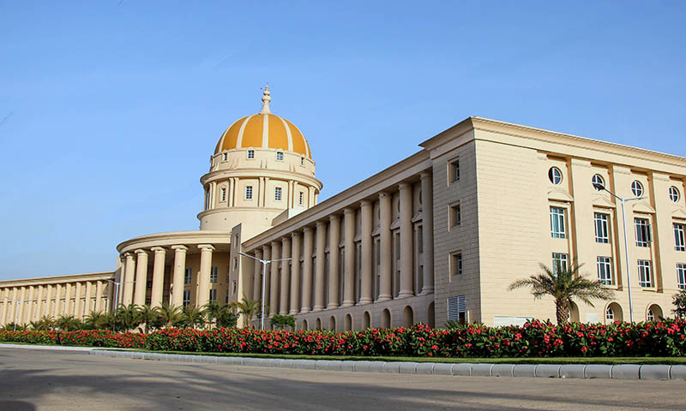
School of Computer Science and Engineering
Department of Computer Science and Engineering
SMART-DUSTBIN DISPOSAL WITH REWARD SYSTEM
Submitted By:
Trisha Chauhan
23FE10CSE00167
Supervised By:
Dr.Mayank Namdev

Slide 2
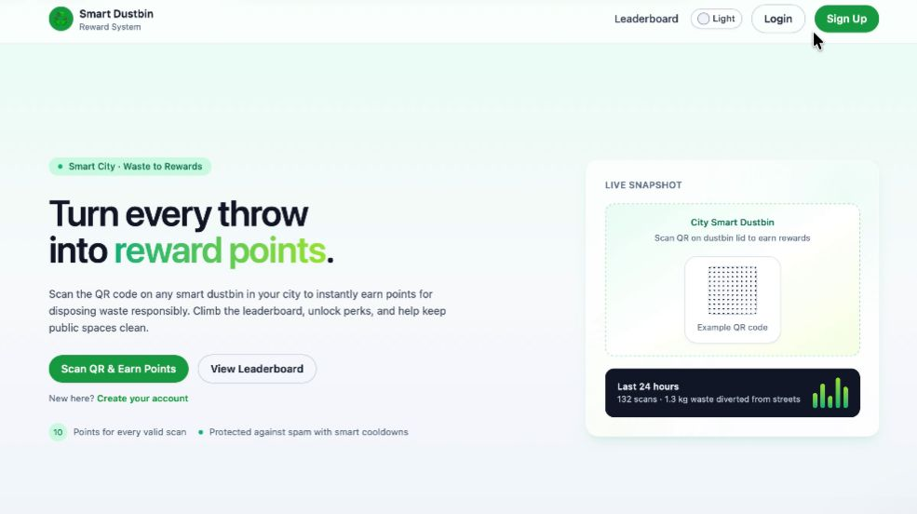
OUTLINE
Introduction
Literature Review
Problem Statement
Proposed Solution
Objectives
Results

Slide 3
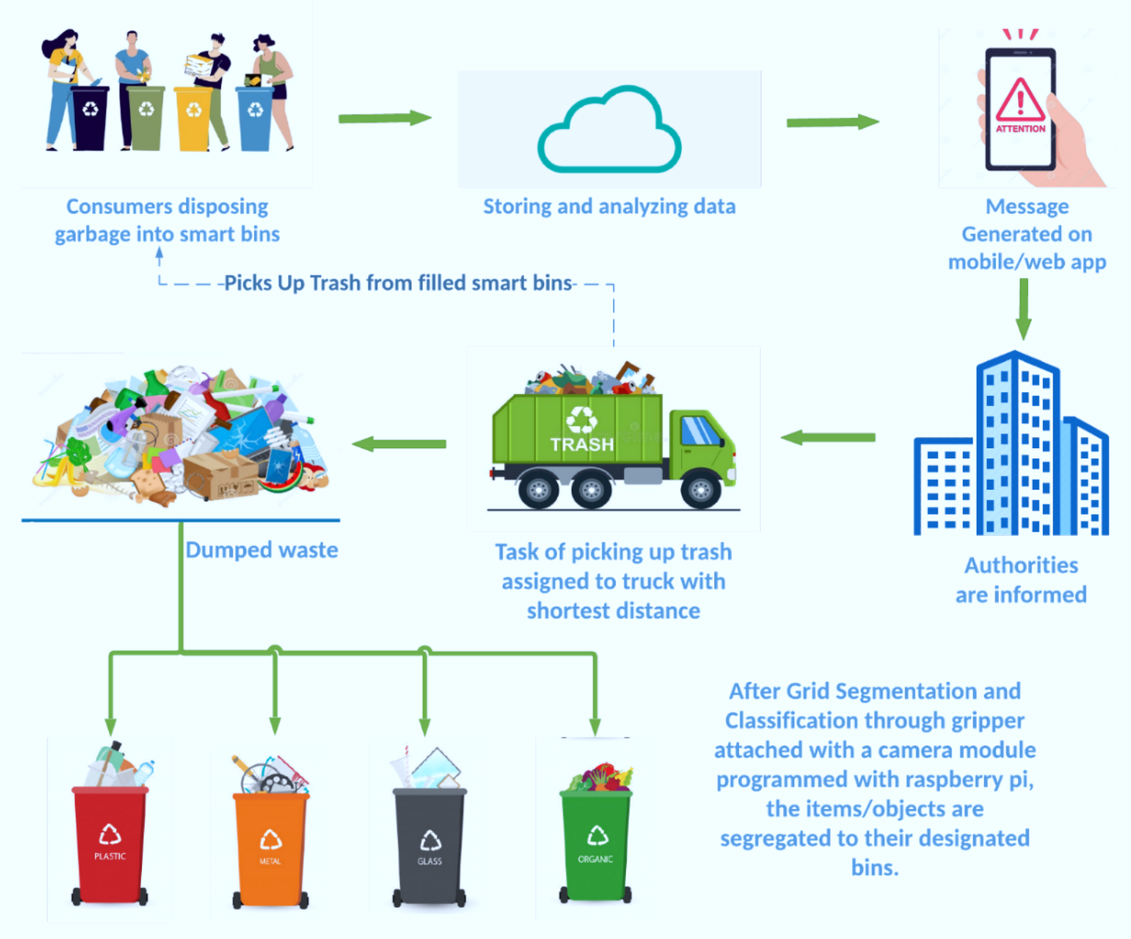
INTRODUCTION
GLOBAL CHALLENGE
Effective waste management is a critical challenge for modern society.Rapid urbanization has led to increased waste generation,polluted streets,and health hazard.
MOTIVATION GAP
A primary driver of this issue is the lack of public motivation.Current system rely on compliance rather than incentivization.This project proposes a solution that makes waste disposal rewarding.

Slide 4



LITERATURE REVIEW & BACKGROUND
ENFORCEMENT LIMITATIONS
GAMIFICATION GAP
CURRENT STATE
Traditional waste management is reactive.It relies on citizens’ instrinsic motivation,which often fails,leading to degradation.
Punitive measures and strict enforcement are difficult to scale and maintain.They do not create long-term behavorial change.
There is a lack of systems that utilize “Gamification” effectively-turning the chore of waste disposal into rewarding activity.
This Photo by Unknown Author is licensed uder CC BY-NC

Slide 5
PROBLEM STATEMENT
Traditional waste management fails due to a lack of citizen engagement.This project addresses the critical need for an incentivized system to motivate responsible waste segregation and disposal in urban environment.
Manual monitoring is inefficient and time-consuming.
No reward or ranking system for waste management performance.

Slide 6
PROJECT OBJECTIVES
Smart Identification:Design a high-tech system identifies and accurately measures desposited waste.
Website Interface:Develop a comprehensive website for user interaction and reward tracking.
Reward System:Implement a real-time mechanism that credits points to user upon verified waste disposal.
User Experience:Create a smooth and intuitive UI/UX to maximize user adoption and behavorial change.

Slide 7
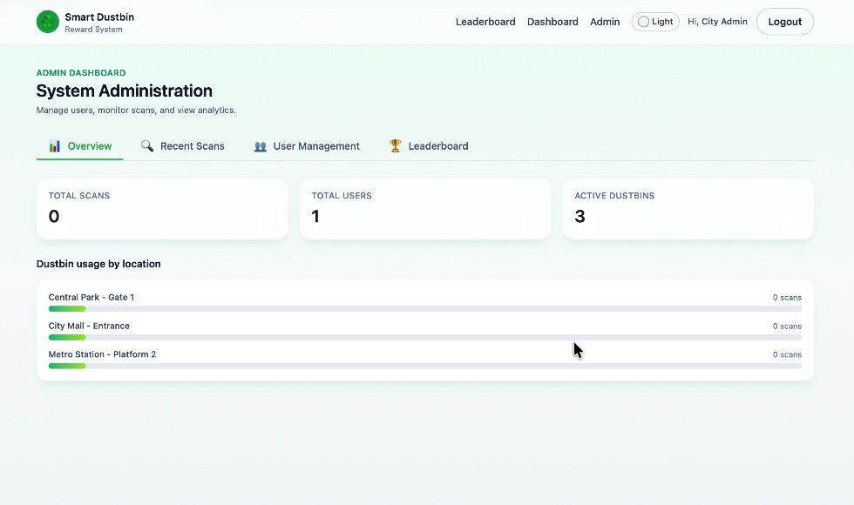
SYSTEM OVERVIEW
Web Application developed for waste management.
• Role-based login (Admin & Client).
• Dashboard for monitoring dustbin status.
• Leaderboard for ranking performance.
• Centralized data storage and management.

Slide 8
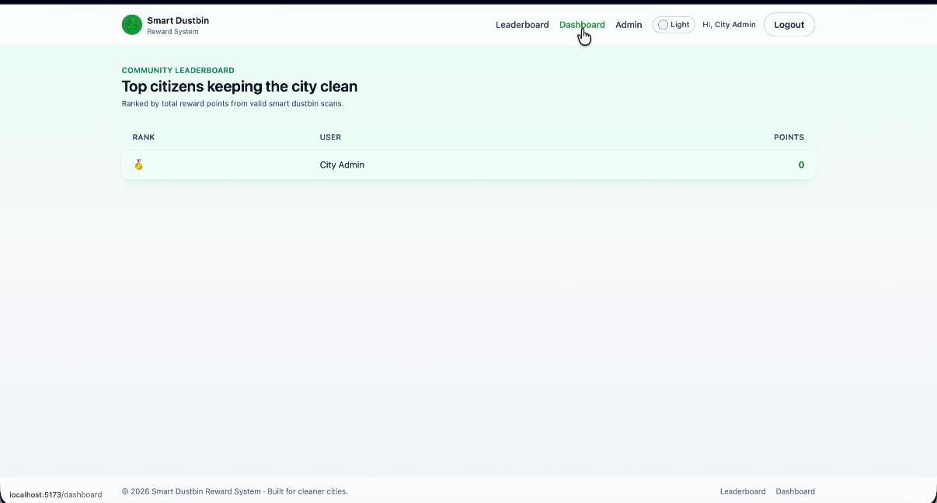
DASHBOARD
• View all registered clients.
• Monitor dustbin status and waste levels.
• Manage users and system data.
• Track overall performance statistics.
• Access leaderboard rankings.

Slide 9
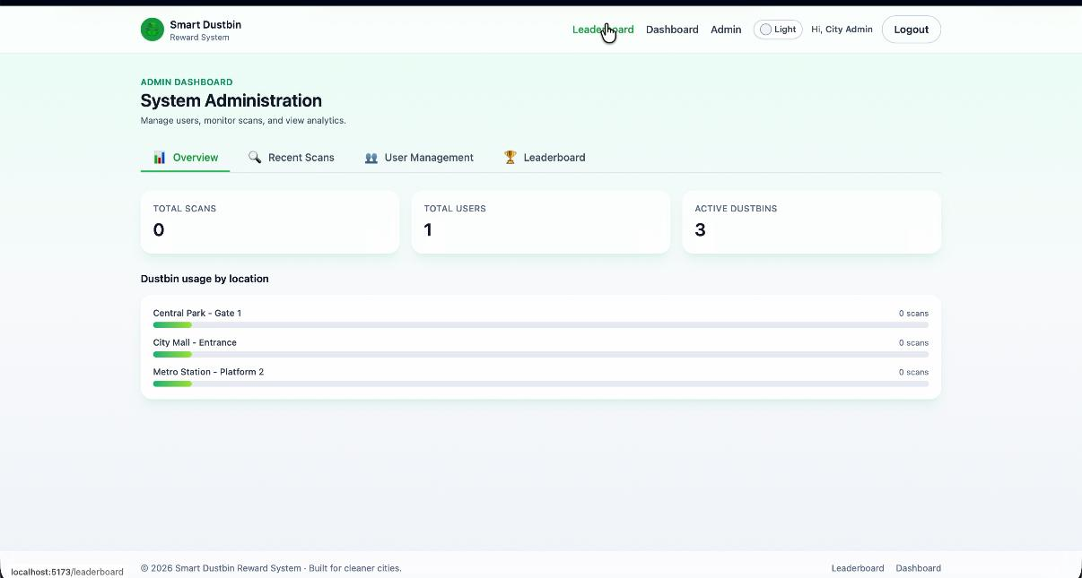
LEADERBOARD SYSTEM
• Ranks users based on performance metrics.
• Encourages healthy competition
• Improves accountability in waste collection.
• Displays top-performing clients.

Slide 10
WORKING PROCESS
1. User logs in (Admin/Client).
2. Dashboard displays real-time data.
3. Data updates when waste is collected.
4. System stores data in database.
5. Leaderboard updates automatically.

Slide 11
ADVANTAGES
• Reduces manual monitoring effort.
• Improves cleanliness and efficiency.
• Transparent performance tracking.
• Scalable for smart city implementation.

Slide 12
FUTURE ENHANCEMENT
• Integration with IoT sensors.
• Mobile application version.
• AI-based waste prediction system.
• GPS tracking for waste collection vehicles.

Slide 13
CONCLUSION
• Smart Dustbin Disposal System improves waste management.
• Website-based dashboards enhance monitoring and control.
• Leaderboard motivates better performance.
• Supports sustainable and smart city initiatives.

Slide 14
THANK YOU!

