Slide 1

CARPOOLING APP
By
Trisha Chakraborty
Aarthe Jayaprakash

Slide 2
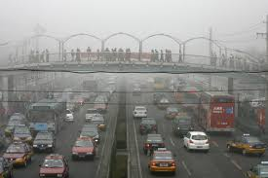
Background
The United States consumes 21 million barrels of
oil each day
Automobiles 9 million barrels
Some experts predict that oil consumption will
peak as soon as the year 2020

Slide 3
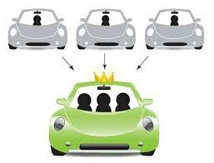
Why Carpool?
Save Money
Decreases the number of drivers on the road
Help the Environment
Convenient Option
Make New Friends
Increases productivity
Decreases the amount of parking needed
Increasing Gas Prices
Decreasing Supply
Worsening Pollution

Slide 4
What is carpooling?
Today it is important to promote initiatives to reduce car dependency and improve environmental quality. One such initiative is called shared path or carpooling. This term is applied to travel and work where public transport is limited.
Many people use their private transportation to do the same route. Why not add more people and use only one vehicle? Thus, it is possible to reduce the number of engines running on the road, with consequent benefits for the environment and the consumption of fossil fuels.

Slide 5
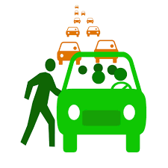
Aim
The proposed system is for Syracuse University ID card holders whose primary aim is to provide hassle free commute for commuters travelling in and around Syracuse University.
Primary Users:
Students
Faculty
Staff members

Slide 6
Process
The people who want to commute in and around Syracuse with a valid SUID set up their details in the carpooling app.
Riders
Drivers

Slide 7
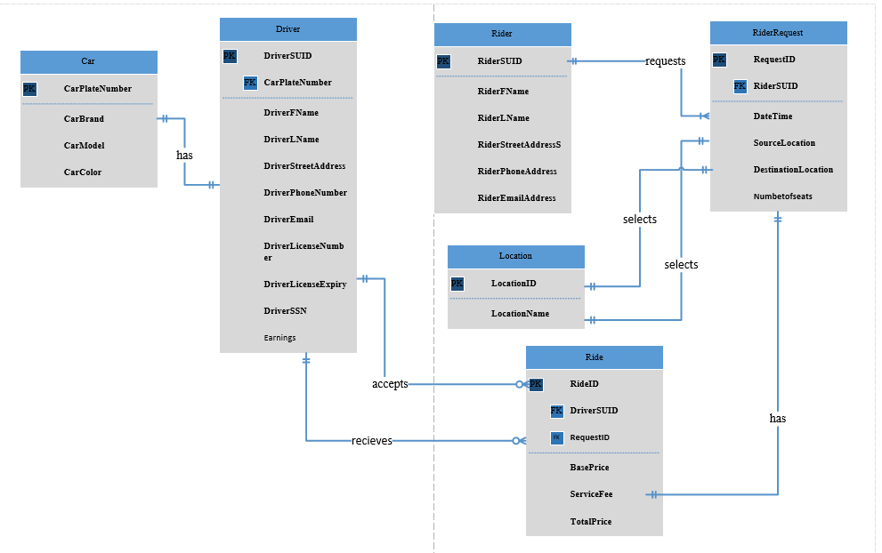
Entity Relationship Diagram

Slide 8
Major Business Questions Answered
How many customers use the app per week?
What are the peak hours for usage of the system?
What is the average number of riders in a car at a time?
How many times does each customer use the app in a month?
What are the popular areas of drop?
What are the popular areas of pickup?

Slide 9
DEMO

Slide 10
References
https://www.eia.gov/tools/faqs/faq.php?id=33&t=6
https://www.w3schools.com/
https://www.google.com/search?q=carpooling&source=lnms&tbm=isch&sa=X&ved=0ahUKEwjd0-27lPXeAhVlxFkKHQxkCJMQ_AUIDigB&biw=1280&bih=610

Slide 11
Thank You

