Slide 1
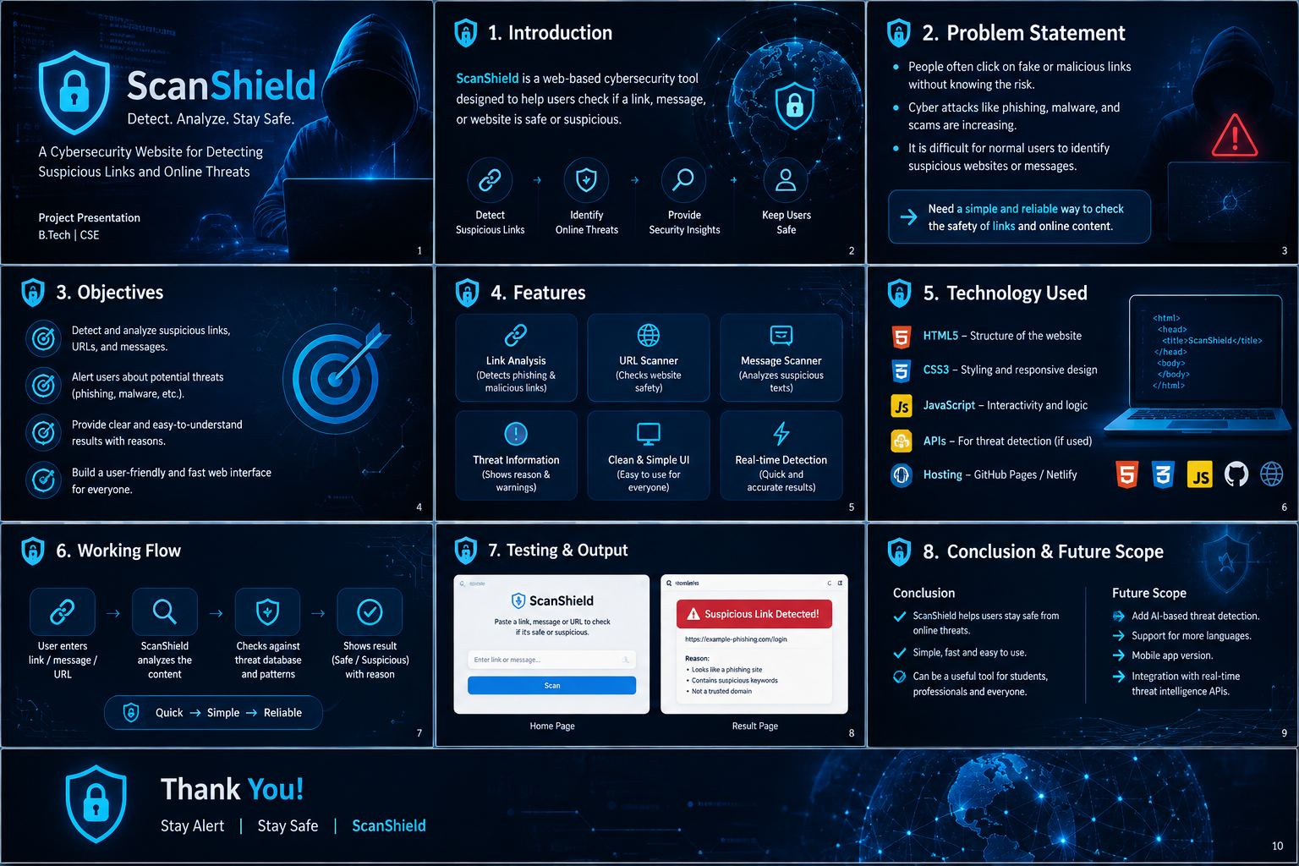
ScanShield
Cybersecurity Website for Detecting Suspicious Links & Online Threats
Internship Project Presentation
Presented by: Trisha Dubey

Slide 2
01 | INTRODUCTION
ScanShield is a web-based cybersecurity tool designed to help users check suspicious links, messages and online content.
✓ Simple and user-friendly interface
✓ Identifies potentially suspicious URLs/content
✓ Shows security warnings and reasons
✓ Focuses on cybersecurity awareness
02

Slide 3
02 | PROBLEM STATEMENT
Unknown links can expose users to phishing, fake websites and other online threats.
✓ Phishing and fake websites
✓ Malicious or misleading URLs
✓ Low awareness of warning signs
✓ Difficulty judging a link before opening it
03

Slide 4
03 | OBJECTIVES
The project focuses on making basic security checking easier for everyday users.
✓ Detect and analyze suspicious links/content
✓ Alert users about potential threats
✓ Provide clear results with understandable reasons
✓ Build a fast and user-friendly interface
04

Slide 5
04 | KEY FEATURES
Core capabilities of ScanShield.
✓ URL / suspicious-content input
✓ Security analysis and result display
✓ Suspicious / safer status indication
✓ Warning messages and reasons
✓ Responsive web interface
05

Slide 6
05 | TECHNOLOGY USED
Technologies used to build and manage the web project.
✓ HTML — page structure
✓ CSS — styling and responsive design
✓ JavaScript — interaction and analysis logic
✓ Visual Studio Code — development
✓ GitHub — source-code hosting
06

Slide 7
06 | WORKING FLOW
A simple user-to-result workflow.
✓ 1. User opens ScanShield
✓ 2. User enters a URL or suspicious content
✓ 3. JavaScript performs implemented checks
✓ 4. ScanShield evaluates available indicators
✓ 5. Result and warnings are displayed
07

Slide 8
07 | TESTING & OUTPUT
Testing should cover valid, suspicious and invalid inputs.
✓ Normal-looking URL
✓ Suspicious-looking URL
✓ Empty or invalid input
✓ Different browsers and screen sizes
✓ Add actual home/scan/result screenshots
08

Slide 9
08 | CONCLUSION & FUTURE SCOPE
ScanShield demonstrates a practical cybersecurity-awareness solution through a simple web interface.
✓ Simple and accessible for users
✓ Stronger URL reputation checks
✓ Threat-intelligence API integration
✓ Phishing-domain detection
✓ Scan history and reporting
09

Slide 10
THANK YOU
Stay Alert | Stay Safe | ScanShield
✓ Presented by: Trisha Dubey
10

