Slide 1
INTRODUCTION TO INFORMATION TECHNOLOGY
(Midterm Report)
喬伊 4100E219

Slide 2
AGENDA
Linux operating system
Linux Distribution
Kernel and Shell
Basic Linux Command
Pipeline and Redirection
Linux Network Command

Slide 3
LINUX OPERATING SYSTEMS
Linux is an open source operating system (OS). An operating system is the software that directly manages a system’s hardware and resources, like CPU, memory, and storage. The OS sits between applications and hardware and makes the connections between all of your software and the physical resources that do the work.

Slide 4
LINUX DISTRIBUTIONS
A Linux distribution (commonly abbreviated as distro) is created from a software assemblage, consisting of a Linux kernel and a package managing system. In simple words, the Linux distro combines the Linux kernel and available open-source software, to create a complete package.
We have commercially assisted distributions, such as Fedora, Ubuntu, and openSUSE, and also utterly community-driven distributions, such as Debian, Gentoo, Slackware, and Arch Linux.

Slide 5
CENTO
CentOS is an open-source Linux distribution. Many refer to it as a replica of the Red Hat Enterprise Linux (RHEL), which is considered to be the most widely used in the corporate IT world. CentOS is an enterprise class operating system supported by the community and released back in 2004.

Slide 6
UBUNTU
Ubuntu is well-known and is amongst the leading Linux distributions. For using Ubuntu, we do not need to be technically sound, which is why it is extremely popular and also, the perfect place to begin experimenting with Linux.
Ubuntu offers an easy installation procedure, with the installer speaking in any major language required. We have the option of demoing Ubuntu, before installing it.

Slide 7
RED HAT ENTERPRISE SERVER
Red Hat Enterprise Linux supports and powers software and technologies for automation, cloud, containers, middleware, storage, application development, microservices, virtualization, management, and more. Linux plays a major role as the core of many of Red Hat's offerings.

Slide 8
KALIX
CentOS is an open-source Linux distribution. Many refer to it as a replica of the Red Hat Enterprise Linux (RHEL), which is considered to be the most widely used in the corporate IT world. CentOS is an enterprise class operating system supported by the community and released back in 2004.

Slide 9
REMUX LINUX
REMnux® is a Linux toolkit for reverse-engineering and analyzing malicious software. REMnux provides a curated collection of free tools created by the community. Analysts can use it to investigate malware without having to find, install, and configure the tools.

Slide 10
SECURITY ONION LINUX
Security Onion is a free and open Linux distribution for threat hunting, enterprise security monitoring, and log management. It includes TheHive, Playbook, Fleet, osquery, CyberChef, Elasticsearch, Logstash, Kibana, Suricata, Zeek, Wazuh, and many other security tools. Security Onion has been downloaded over 2 million times and is being used by security teams around the world to monitor and defend their enterprises. Our easy-to-use Setup wizard allows you to build an army of distributed sensors for your enterprise in minutes!

Slide 11
KERNEL

Slide 12
The kernel is the heart of the operating system.
The term kernel often refers to the operating system. The critical code of the kernel is stored in a special memory area to protect it from other programs. It is a vital component as it is the basis for the proper functioning of the entire system.
The kernel performs a variety of tasks including process management, managing hardware devices and handling interrupts.

Slide 13
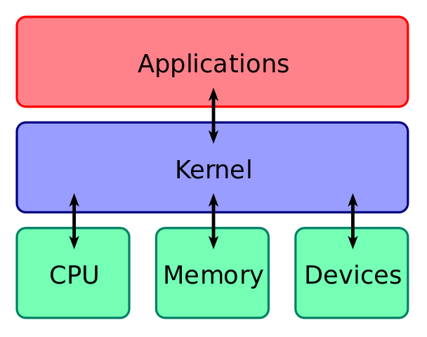

Slide 14
Furthermore, it performs memory management, file handling, and task scheduling. A system call is a request by a process to the kernel. The kernel manages these system calls and other resources.

Slide 15
SHELLS

Slide 16
Shell is the interface between user and kernel. It is a command-line interpreter and is the interface between the user and the kernel.
The user can enter commands to the shell. Then it interprets the commands to perform the required task. Furthermore, it executes programs and shell scripts. A shell script is a set of commands. The user should follow the standard syntax to write commands to the shell.

Slide 17
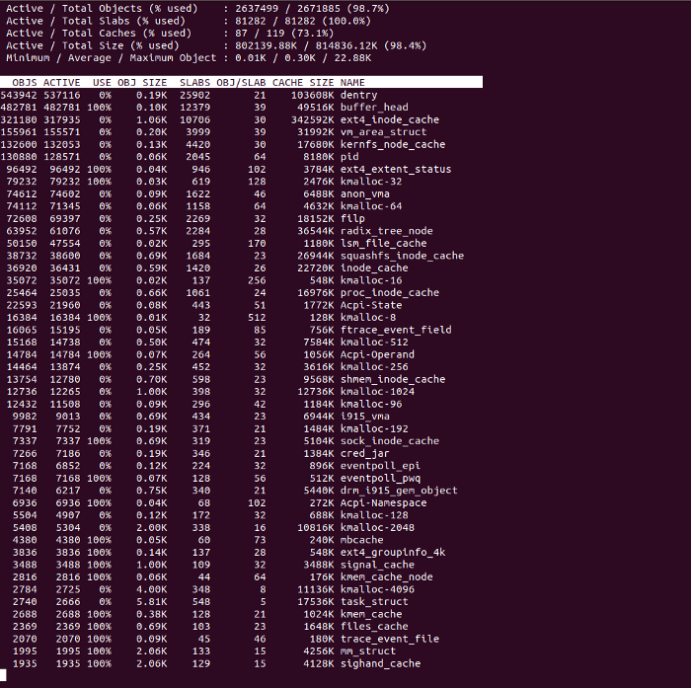

Slide 18
Types of Shells
There are various types of shells. The Bourne shell (sh) is the most popular Unix shell. The default prompt of Bourne shell is $. The Korn shell (ksh) is backward compatible with the Bourne shell and includes many features of C shell. Bourne Again Shell (bash) is a free shell replacement for the Bourne shell. The Korn and Bourne Again Shell are supersets of Bourne shell.

Slide 19
Type of Shells
Furthermore, the C shell (csh) provides a few advantages over the Bourne shell. It provides history features and aliasing of commands. The default prompt of the C shell is %.

Slide 20
BASIC LINUX COMMAND

Slide 21
LINUX BASIC COMMANDS
The Linux command is a utility of the Linux operating system. All basic and advanced tasks can be done by executing commands. The commands are executed on the Linux terminal. The terminal is a command-line interface to interact with the system, which is similar to the command prompt in the Windows OS. Commands in Linux are case-sensitive.

Slide 22
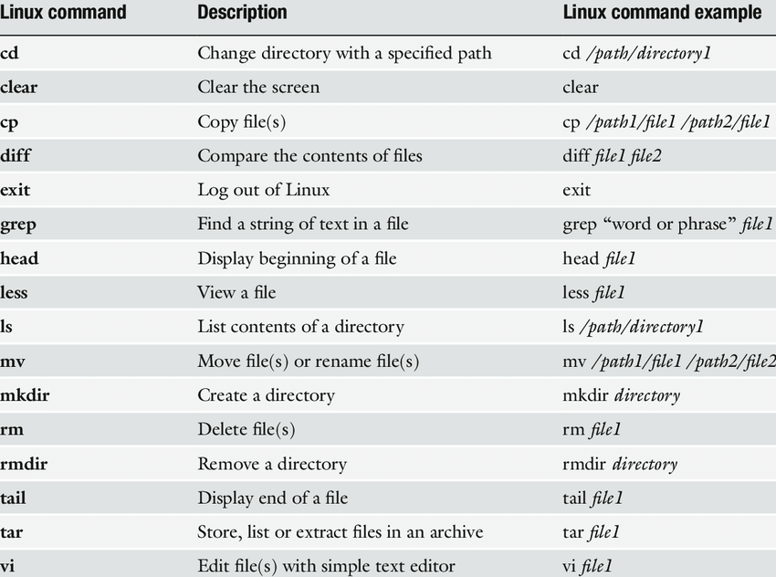

Slide 23
LINUX REDIRECTION AND PIPELINE

Slide 24
REDIRECTION
used to redirect the stdout/stdin/stderr
ls > log.txt.

Slide 25
PIPES
Pipes are used to give the output of a command as input to another command.
ls | grep file.txt.

Slide 26
LINUX NETWORKING
COMMAND

Slide 27
LINUX NETWORKING COMMAND
Every computer is connected to some other computer through a network whether internally or externally to exchange some information. This network can be small as some computers connected in your home or office, or can be large or complicated as in large University or the entire Internet.

Slide 28
Here is a list of Networking and Troubleshooting commands:
ifconfig | Display and manipulate route and network interfaces.
ip | It is a replacement of ifconfig command.
traceroute | Network troubleshooting utility.
tracepath | Similar to traceroute but doesn't require root privileges.
ping | To check connectivity between two nodes.
netstat | Display connection information.

Slide 29
Here is a list of Networking and Troubleshooting commands:
ss | It is a replacement of netstat.
dig | Query DNS related information.
nslookup | Find DNS related query.
route | Shows and manipulate IP routing table.
host | Performs DNS lookups.
arp | View or add contents of the kernel's ARP table.

Slide 30
Here is a list of Networking and Troubleshooting commands:
iwconfig | Used to configure wireless network interface.
hostname | To identify a network name.
curl or wget | To download a file from internet.
mtr | Combines ping and tracepath into a single command.
whois | Will tell you about the website's whois.
ifplugstatus | Tells whether a cable is plugged in or not.

