Slide 1
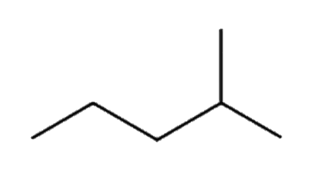
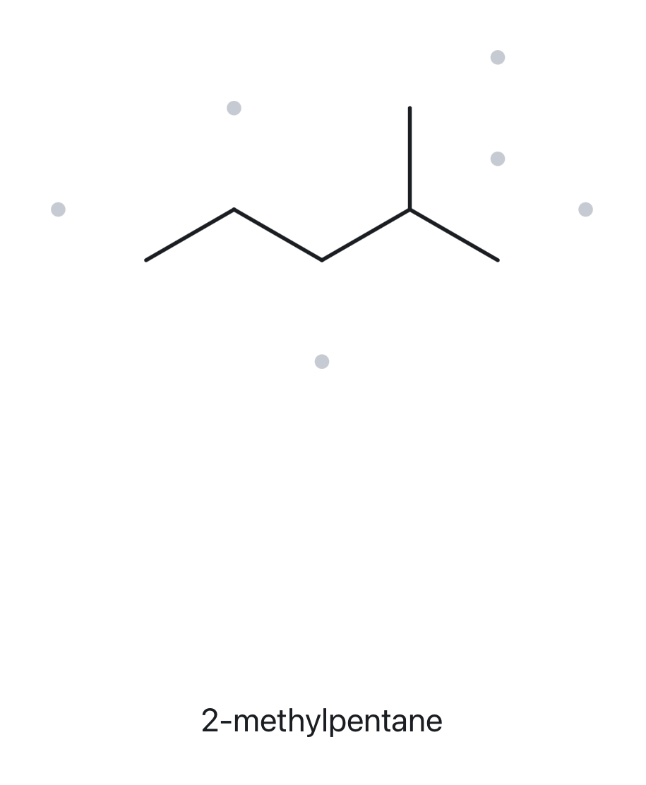
A01
FOUNDATION
C₆H₁₄
1 · NUMBERED PARENT
2 · NAMING TRAIL
Parent: longest chain = 5 C → pentane
Numbering: L→R gives 4; R→L gives 2. First point of difference: 2 < 4, so the number from the right
Substituents: (A→Z): methyl on C2
4
2
5
3
1
Parent (5 C) highlighted; carbons numbered from the right-hand end
3 · MY NAME (WRITTEN FIRST)
4 · THE ALKANE CHECK
Returned Name: 2-methylpentane
Verdict: ✓ Match
2-methylpentane
✓ ✓ ✓ ✓ ✓
☐ longest chain/ring ☐ lowest locants ☐ alphabetical order ☐ punctuation ☐ formula counted

Slide 2
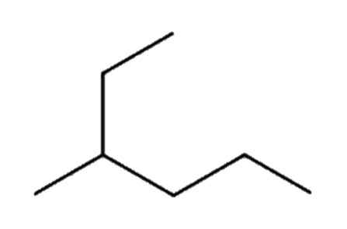
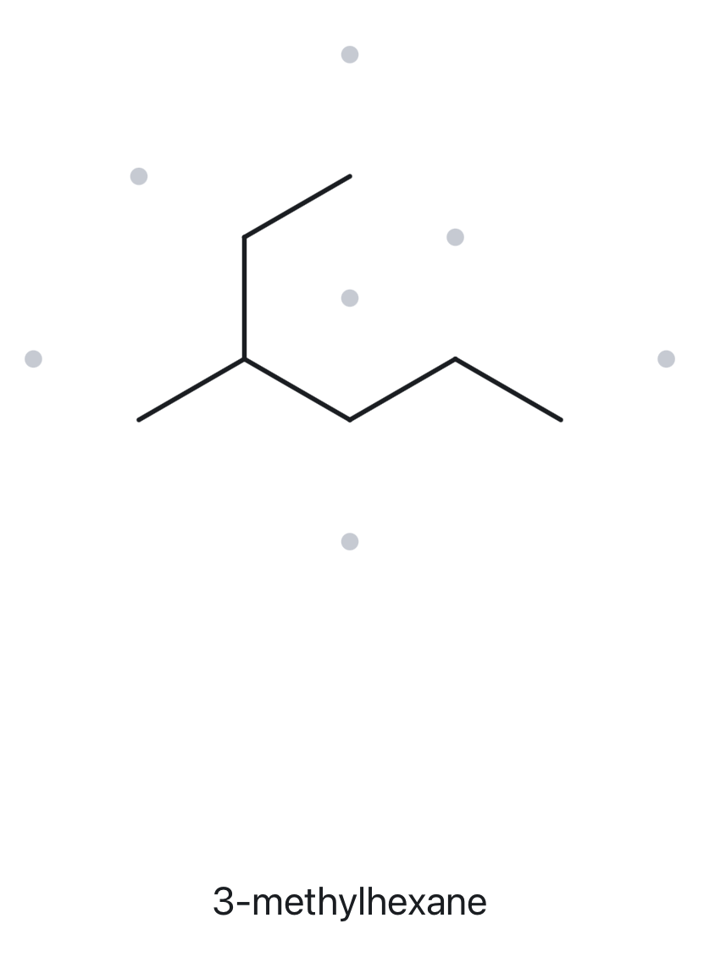
A02
FOUNDATION
C₇H₁₆
1 · NUMBERED PARENT
2 · NAMING TRAIL
1
2
Parent: longest chain = 6 C → hexane
Numbering: T→ Right End gives 3; Right End → T gives 4. First point of difference: 3 < 4, so the number from the top
Substituents: (A→Z): methyl on C3
3
5
4
6
Parent (6 C) highlighted; carbons numbered from the top to right end
3 · MY NAME (WRITTEN FIRST)
4 · THE ALKANE CHECK
Returned Name: 3-methylhexane
Verdict: ✓ Match
3-methylhexane
✓ ✓ ✓ ✓ ✓
☐ longest chain/ring ☐ lowest locants ☐ alphabetical order ☐ punctuation ☐ formula counted

Slide 3
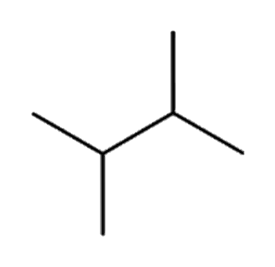
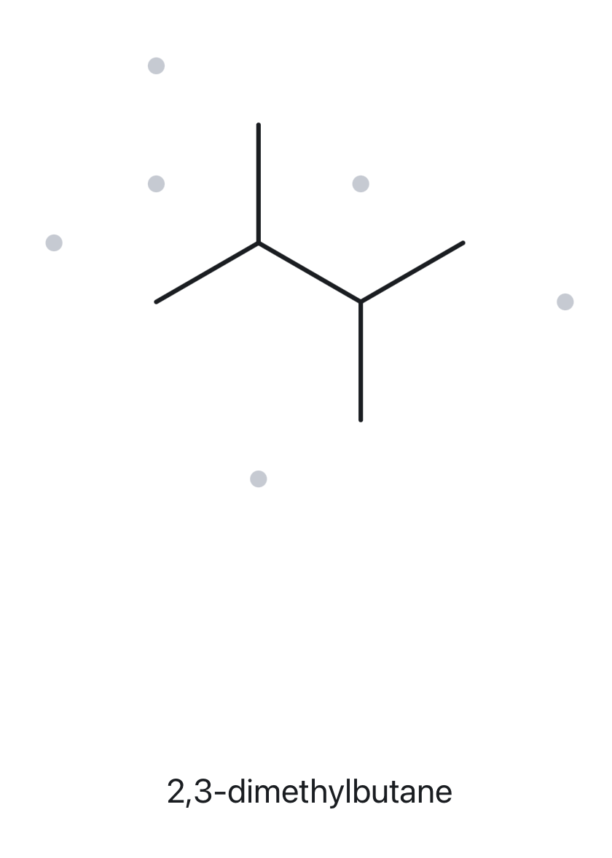
A03
FOUNDATION
C₆H₁₄
1 · NUMBERED PARENT
2 · NAMING TRAIL
Parent: longest chain = 4 C → butane
Numbering: L→R gives 2,3; R→L gives 2,3. Both directions give the same set, so either works. Number from right to left
Substituents: (A→Z): methyl on C2; methyl on C3
3
4
2
1
Parent (4 C) highlighted; carbons numbered from the right to left end
3 · MY NAME (WRITTEN FIRST)
4 · THE ALKANE CHECK
Returned Name: 2,3-dimethylbutane
Verdict: ✓ Match
2,3-dimethylbutane
✓ ✓ ✓ ✓ ✓
☐ longest chain/ring ☐ lowest locants ☐ alphabetical order ☐ punctuation ☐ formula counted

Slide 4
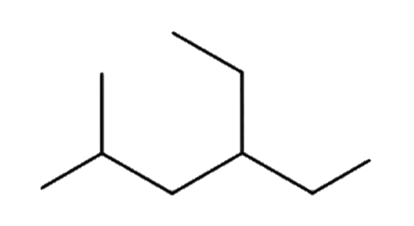
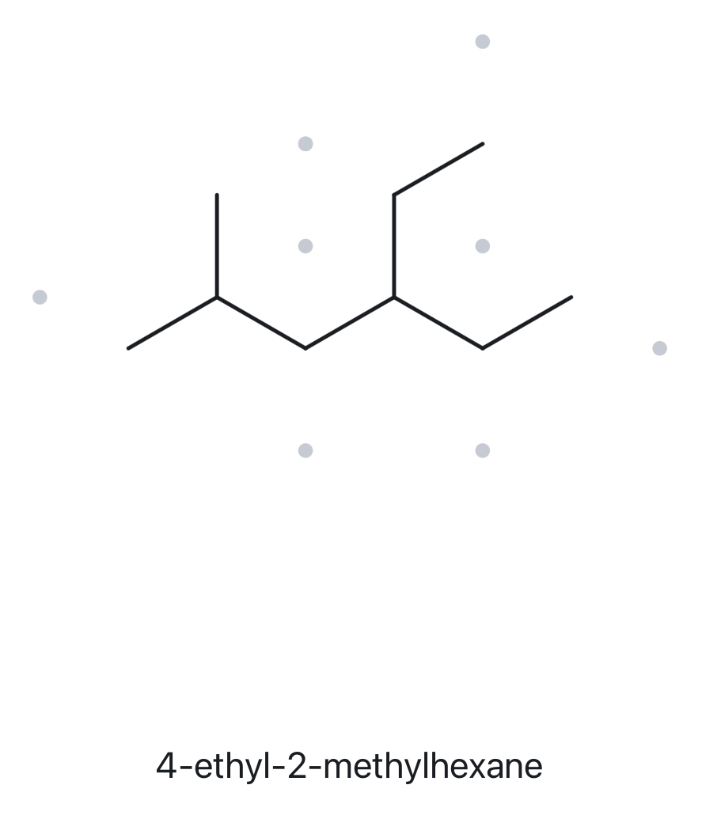
A04
DEVELOPING
C₉H₂₀
1 · NUMBERED PARENT
2 · NAMING TRAIL
6
5
Parent: longest chain = 6 C → hexane
Numbering: Left End → Top gives {2,4}; Top → Left End gives {3,5}. First point of difference: 2 < 3, so number from the left end
Substituents: (A→Z): ethyl on C4; methyl on C2
3
4
2
1
Parent (6 C) highlighted; carbons numbered from the left end to the top end
3 · MY NAME (WRITTEN FIRST)
4 · THE ALKANE CHECK
Returned Name: 4-ethyl-2-methylhexane
Verdict: ✓ Match
4-ethyl-2-methylhexane
✓ ✓ ✓ ✓ ✓
☐ longest chain/ring ☐ lowest locants ☐ alphabetical order ☐ punctuation ☐ formula counted

Slide 5
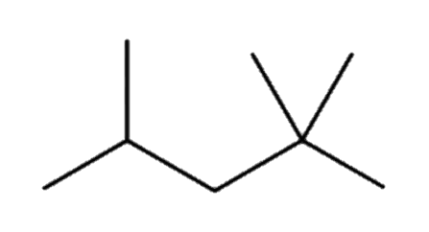
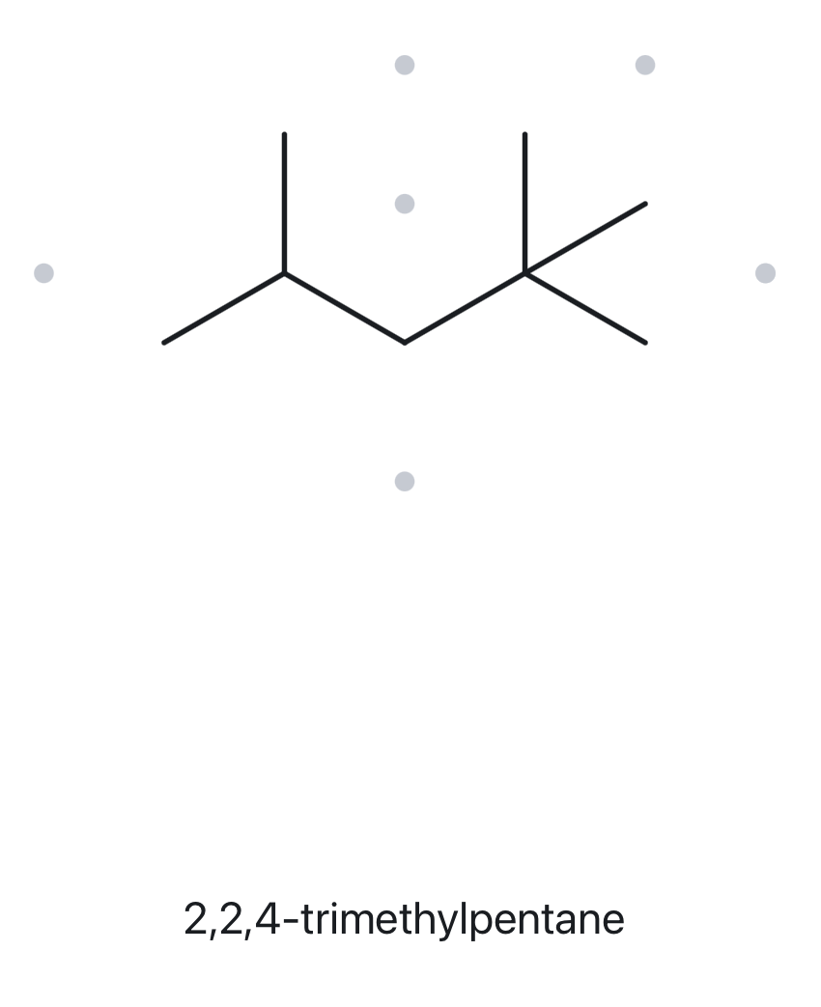
A05
DEVELOPING
C₈H₁₈
1 · NUMBERED PARENT
2 · NAMING TRAIL
Parent: longest chain = 5 C → pentane
Numbering: L→R gives {2,4,4}; R→L gives {2,2,4}. First point of difference: 2 < 4 (second locant), so number from right to left
Substituents: methyl on C2; methyl on C2; methyl on C4
4
2
5
3
1
Parent (5 C) highlighted; carbons numbered from the right to left end
3 · MY NAME (WRITTEN FIRST)
4 · THE ALKANE CHECK
Returned Name: 2,2,4-trimethylpentane
Verdict: ✓ Match
2,2,4-trimethylpentane
✓ ✓ ✓ ✓ ✓
☐ longest chain/ring ☐ lowest locants ☐ alphabetical order ☐ punctuation ☐ formula counted

Slide 6
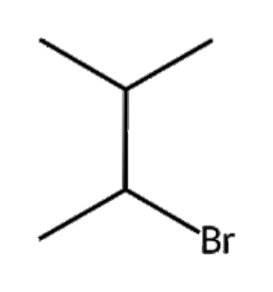
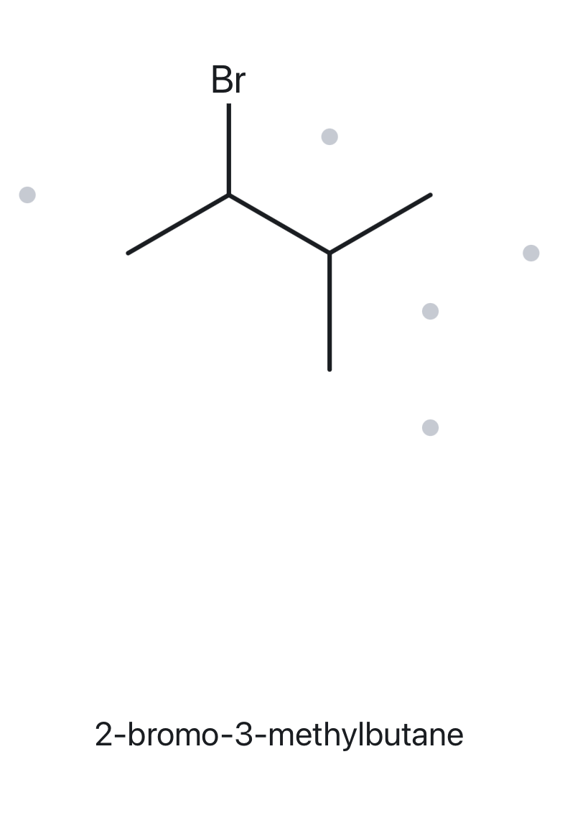
A06
DEVELOPING
C₅H₁₁Br
1 · NUMBERED PARENT
2 · NAMING TRAIL
4
Parent: longest chain = 4 C → butane
Numbering: Lower-left → upper-left gives 2,3; upper-left → lower-left gives 2,3. Tie-breaker: bromo (alphabetically first) gets the lower number, so number from lower-left to upper-left
Substituents: (A→Z): bromo on C2; methyl on C3
3
2
1
Parent (4 C) highlighted; carbons numbered from the lower-left end to the upper-left end
3 · MY NAME (WRITTEN FIRST)
4 · THE ALKANE CHECK
Returned Name: 2-bromo-3-methylbutane
Verdict: ✓ Match
2-bromo-3-methylbutane
✓ ✓ ✓ ✓ ✓
☐ longest chain/ring ☐ lowest locants ☐ alphabetical order ☐ punctuation ☐ formula counted

Slide 7
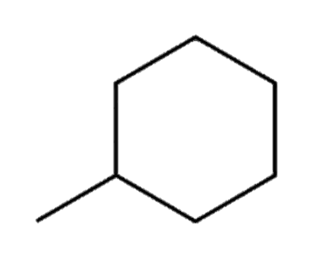
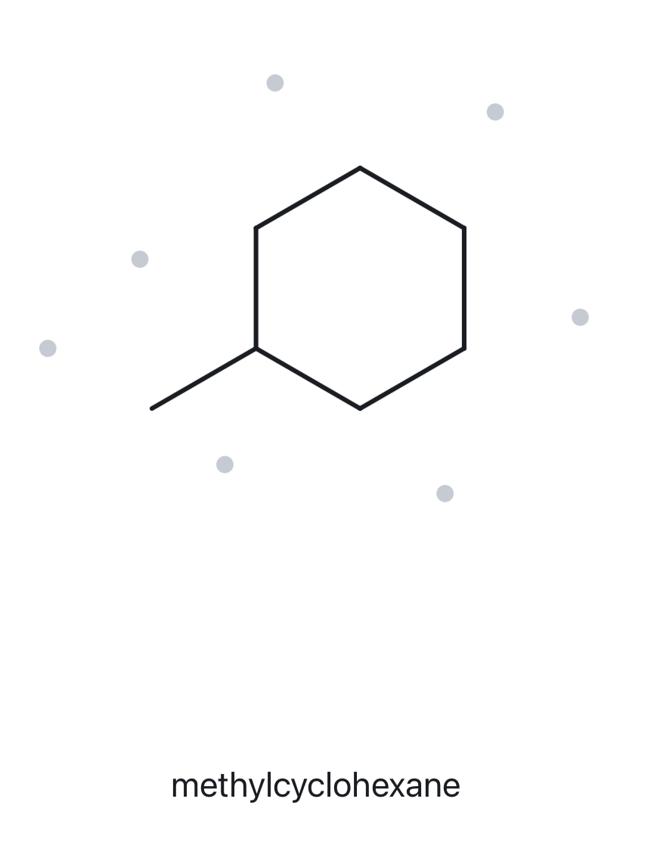
A07
DEVELOPING
C₇H₁₄
1 · NUMBERED PARENT
2 · NAMING TRAIL
3
2
4
Parent: ring = 6 C → cyclohexane
Numbering: L→R gives 1; R→L gives 1. Only one substituent, so the ring carbon bearing the methyl group is C1, and either direction gives the same locant.
Substituents: (A→Z): methyl on C1
5
1
6
Parent (6 C) highlighted; cyclohexane ring numbered starting from the carbon attached to the methyl group (C1), proceeding clockwise
3 · MY NAME (WRITTEN FIRST)
4 · THE ALKANE CHECK
Returned Name: methylcyclohexane
Verdict: ✓ Match
methylcyclohexane
✓ ✓ ✓ ✓ ✓
☐ longest chain/ring ☐ lowest locants ☐ alphabetical order ☐ punctuation ☐ formula counted

Slide 8
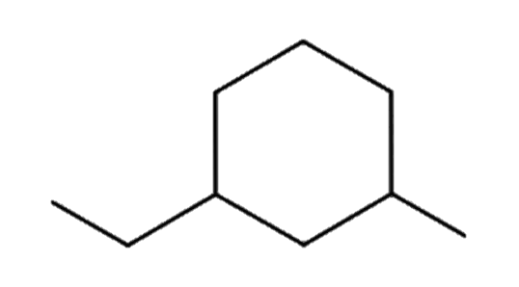
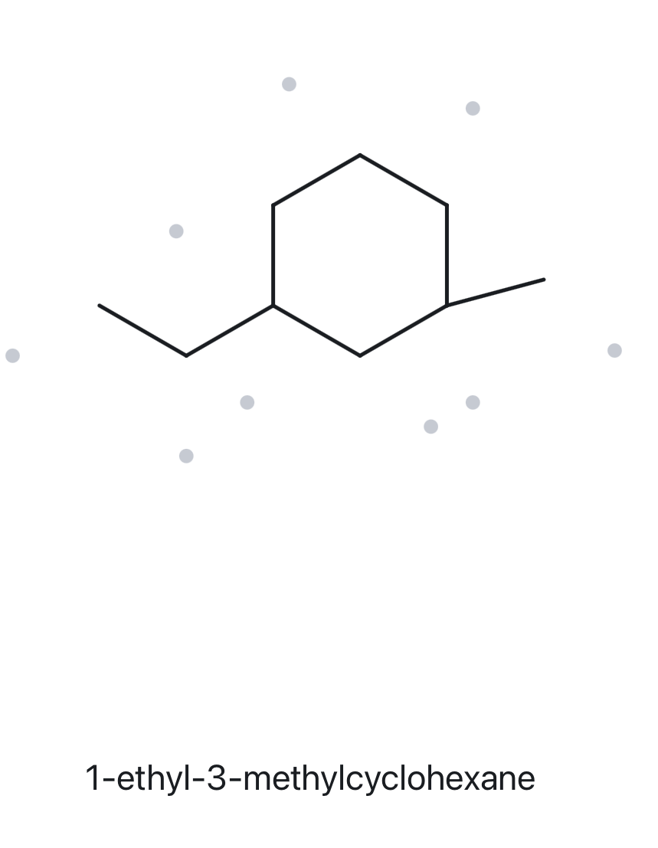
A08
CHALLENGE
C₉H₁₈
1 · NUMBERED PARENT
2 · NAMING TRAIL
5
6
4
Parent: ring = 6 C → cyclohexane
Numbering: L→R gives 1,3; R→L gives 1,3. The locant sets tie, so ethyl (alphabetically first) takes the lower number: C1 is the ethyl carbon, so number from left to right.
Substituents: (A→Z): ethyl on C1; methyl on C3
1
3
2
Parent (6 C) highlighted; cyclohexane ring numbered starting from the carbon attached to the ethyl group (C1), proceeding counterclockwise
3 · MY NAME (WRITTEN FIRST)
4 · THE ALKANE CHECK
Returned Name: 1-ethyl-3-methylcyclohexane
Verdict: ✓ Match
1-ethyl-3-methylcyclohexane
✓ ✓ ✓ ✓ ✓
☐ longest chain/ring ☐ lowest locants ☐ alphabetical order ☐ punctuation ☐ formula counted

Slide 9
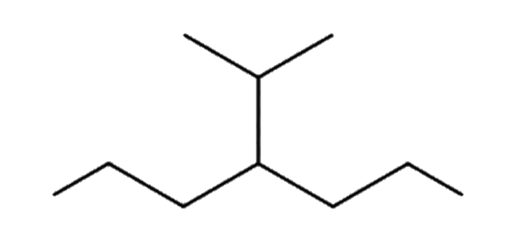
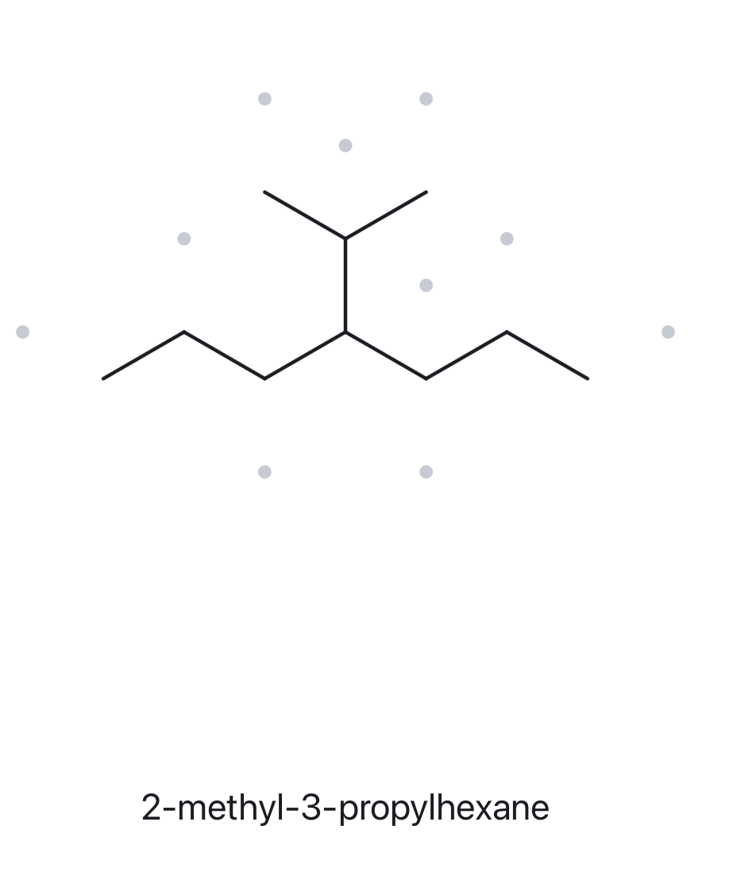
A09
CHALLENGE
C₁₀H₂₂
1 · NUMBERED PARENT
2 · NAMING TRAIL
Parent: longest chain = 7 C → heptane
Numbering: L→R gives 4; R→L gives 4. Both directions give the same locant, so number from left to right.
Substituents: (A→Z): isopropyl on C4
2
5
4
6
1
7
3
Parent (7 C) highlighted; carbons numbered from the left end to the right end
3 · MY NAME (WRITTEN FIRST)
4 · THE ALKANE CHECK
Returned Name: 2-methyl-3-propylhexane
Verdict: X Mismatch
Correct Name: 4-isopropylheptane (same compound as 4-(1-methylethyl)heptane)
Rule: The parent must be the longest continuous chain. The horizontal chain has 7 C, but the tool used a 6-C parent through the isopropyl group.
4-isopropylheptane
✓ ✓ ✓ ✓ ✓
☐ longest chain/ring ☐ lowest locants ☐ alphabetical order ☐ punctuation ☐ formula counted

Slide 10
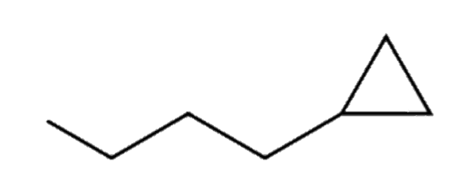
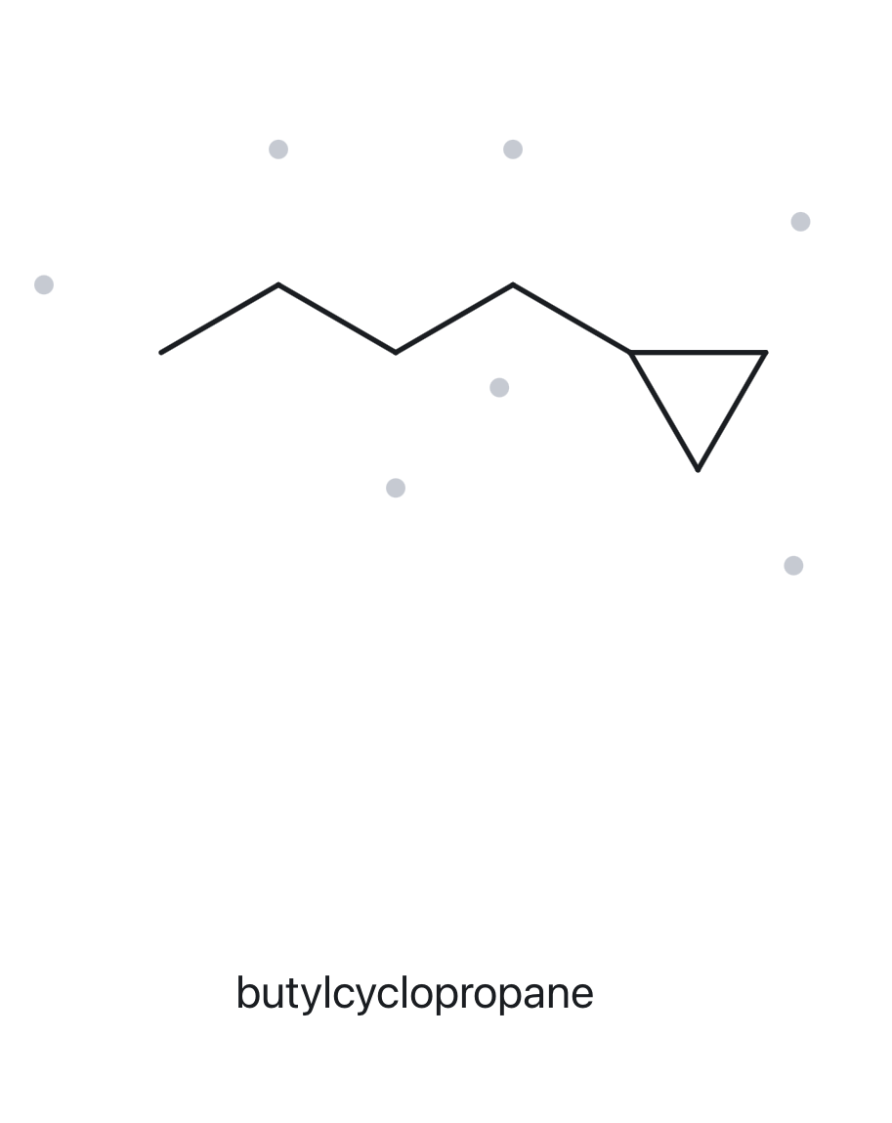
A10
CHALLENGE
C₇H₁₄
1 · NUMBERED PARENT
2 · NAMING TRAIL
3
Parent: ring = 3 C → cyclopropane
Numbering: Only one substituent, so the ring carbon bearing the butyl group is C1. Either direction around the ring gives the same locant, so no locant is needed in the name
Substituents: (A→Z): butyl on C1
1
2
Parent (ring of 3 C) highlighted; C1 is the ring carbon bearing the butyl group
3 · MY NAME (WRITTEN FIRST)
4 · THE ALKANE CHECK
Returned Name: butylcyclopropane
Verdict: ✓ Match
butylcyclopropane
✓ ✓ ✓ ✓ ✓
☐ longest chain/ring ☐ lowest locants ☐ alphabetical order ☐ punctuation ☐ formula counted

Slide 11
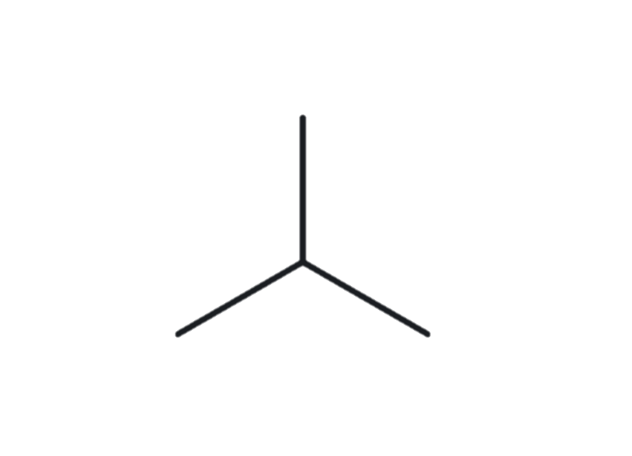
B01
FOUNDATION
2-methylpropane
1 · NAME DECODED
2 · BOND-LINE STRUCTURE (THE ALKANE)
Parent: propane → a 3-carbon chain
Substituents: methyl on C2
Expected Formula: 3 + 1 = 4 C; open chain → C₄H₁₀
3 · FORMULA CHECK
4 · BACK-CHECK
Counted from the Drawing: C₄H₁₀
Open Chain: CₙH₂ₙ₊₂ = 2(4) + 2 = C₄H₁₀ ✓
Returned by The Alkane: 2-methylpropane
✓ Same as the Given Name
✓ ✓ ✓ ✓
☐ parent length ☐ substituent positions ☐ formula agrees ☐ back-check recorded

Slide 12
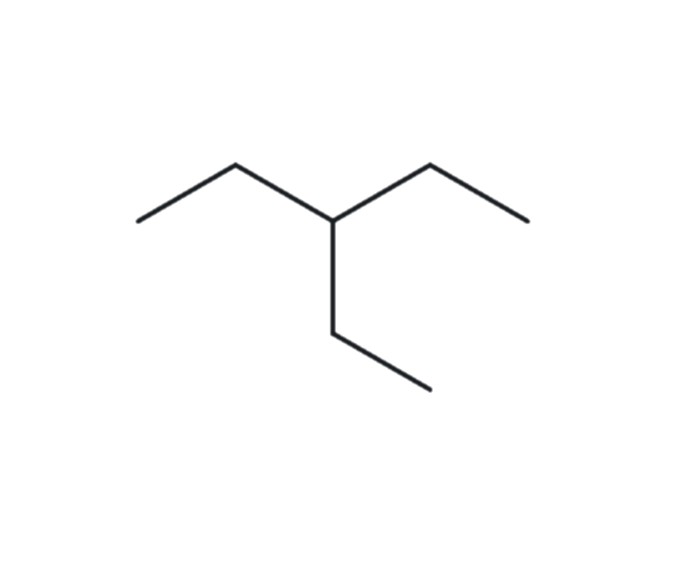
B02
FOUNDATION
3-ethylpentane
1 · NAME DECODED
2 · BOND-LINE STRUCTURE (THE ALKANE)
Parent: pentane → a 5-carbon chain
Substituents: ethyl on C3
Expected Formula: 5 + 2 = 7 C; open chain → C₇H₁₆
3 · FORMULA CHECK
4 · BACK-CHECK
Counted from the Drawing: C₇H₁₆
Open Chain: CₙH₂ₙ₊₂ = 2(7) + 2 = C₇H₁₆ ✓
Returned by The Alkane: 3-ethylpentane
✓ Same as the Given Name
✓ ✓ ✓ ✓
☐ parent length ☐ substituent positions ☐ formula agrees ☐ back-check recorded

Slide 13
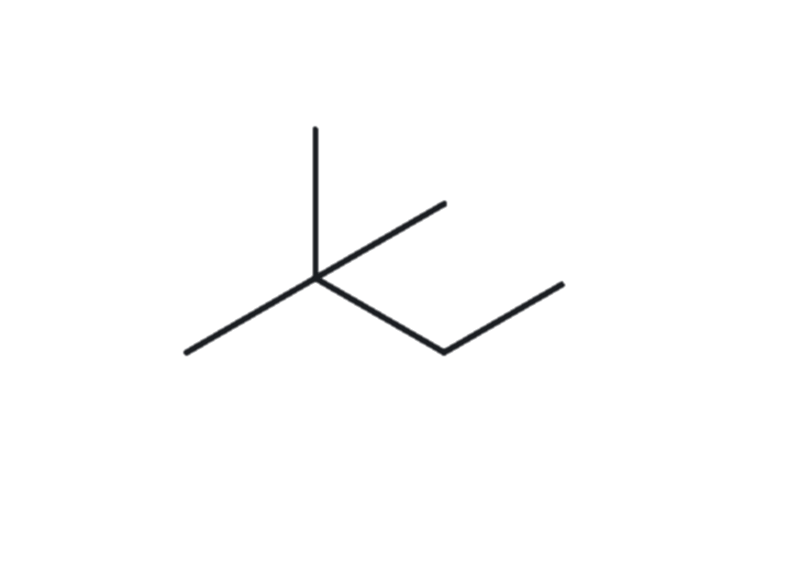
B03
FOUNDATION
2,2-dimethylbutane
1 · NAME DECODED
2 · BOND-LINE STRUCTURE (THE ALKANE)
Parent: butane → a 4-carbon chain
Substituents: methyl on C2; methyl on C2 (two methyl groups on the same carbon)
Expected Formula: 4 + 2 = 6 C; open chain → C₆H₁₄
3 · FORMULA CHECK
4 · BACK-CHECK
Counted from the Drawing: C₆H₁₄
Open Chain: CₙH₂ₙ₊₂ = 2(6) + 2 = C₆H₁₄ ✓
Returned by The Alkane: 2,2-dimethylbutane
✓ Same as the Given Name
✓ ✓ ✓ ✓
☐ parent length ☐ substituent positions ☐ formula agrees ☐ back-check recorded

Slide 14
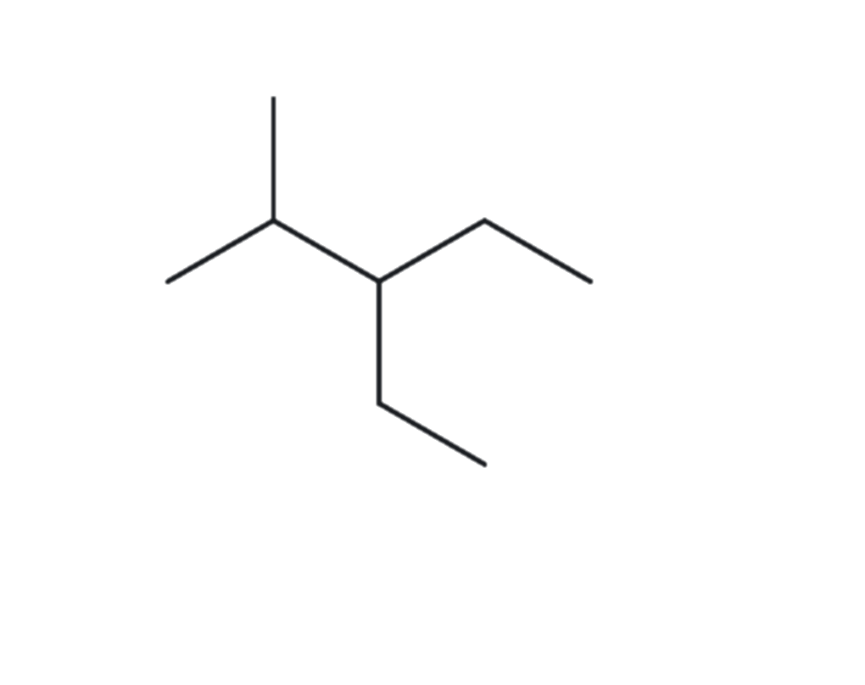
B04
DEVELOPING
3-ethyl-2-methylpentane
1 · NAME DECODED
2 · BOND-LINE STRUCTURE (THE ALKANE)
Parent: pentane → a 5-carbon chain
Substituents: ethyl on C3; methyl on C2
Expected Formula: 5 + 2 + 1 = 8 C; open chain → C₈H₁₈
3 · FORMULA CHECK
4 · BACK-CHECK
Counted from the Drawing: C₈H₁₈
Open Chain: CₙH₂ₙ₊₂ = 2(8) + 2 = C₈H₁₈ ✓
Returned by The Alkane: 3-ethyl-2-methylpentane
✓ Same as the Given Name
✓ ✓ ✓ ✓
☐ parent length ☐ substituent positions ☐ formula agrees ☐ back-check recorded

Slide 15
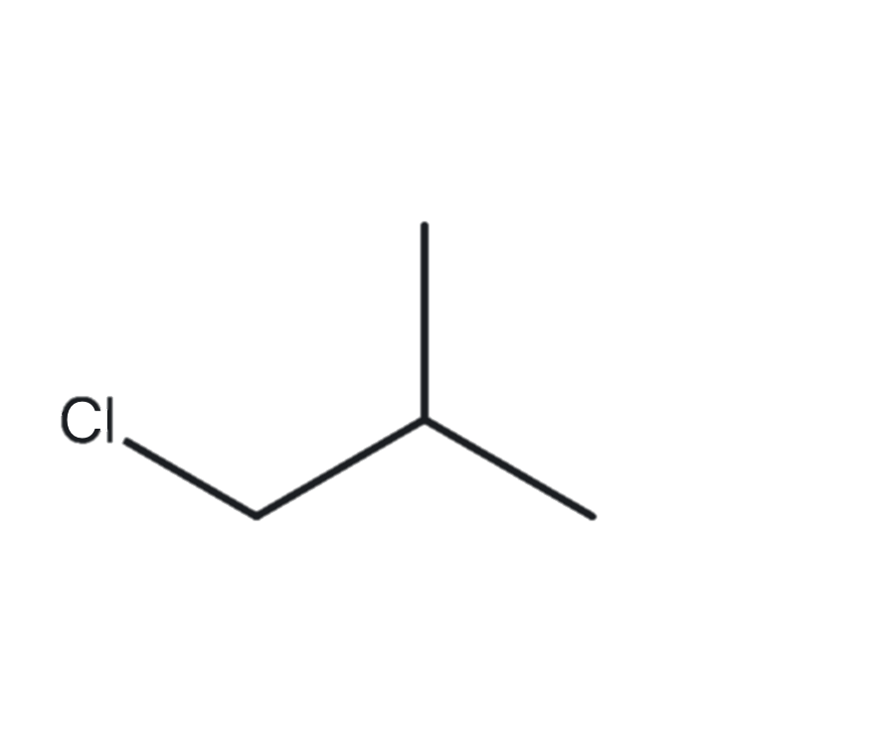
B05
DEVELOPING
1-chloro-2-methylpropane
1 · NAME DECODED
2 · BOND-LINE STRUCTURE (THE ALKANE)
Parent: propane → a 3-carbon chain
Substituents: chloro on C1; methyl on C2
Expected Formula: 3 + 1 = 4 C; open chain → C₄H₁₀; Cl replaces one H → C₄H₉Cl
3 · FORMULA CHECK
4 · BACK-CHECK
Counted from the Drawing: C₄H₉Cl
Open Chain: CₙH₂ₙ₊₂ = 2(4) + 2 = C₄H₁₀; minus one H for Cl = C₄H₉Cl ✓
Returned by The Alkane: 1-chloro-2-methylpropane
✓ Same as the Given Name
✓ ✓ ✓ ✓
☐ parent length ☐ substituent positions ☐ formula agrees ☐ back-check recorded

Slide 16
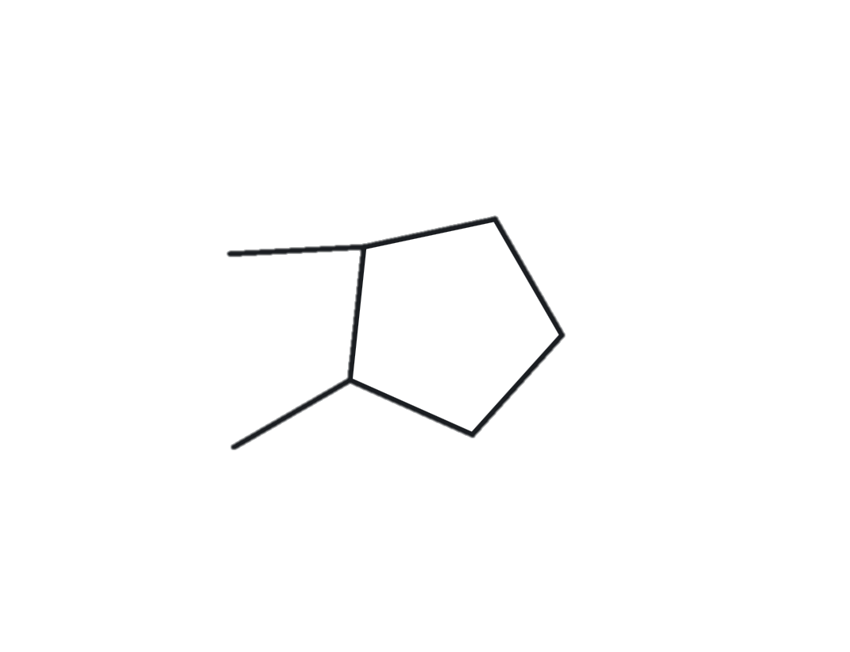
B06
DEVELOPING
1,2-dimethylcyclopentane
1 · NAME DECODED
2 · BOND-LINE STRUCTURE (THE ALKANE)
Parent: cyclopentane → a 5-carbon ring
Substituents: methyl on C1; methyl on C2
Expected Formula: 5 + 2 = 7 C; one ring → C₇H₁₄
3 · FORMULA CHECK
4 · BACK-CHECK
Counted from the Drawing: C₇H₁₄
One Ring: CₙH₂ₙ = C₇H₁₄ ✓
Returned by The Alkane: 1,2-dimethylcyclopentane
✓ Same as the Given Name
✓ ✓ ✓ ✓
☐ parent length ☐ substituent positions ☐ formula agrees ☐ back-check recorded

Slide 17
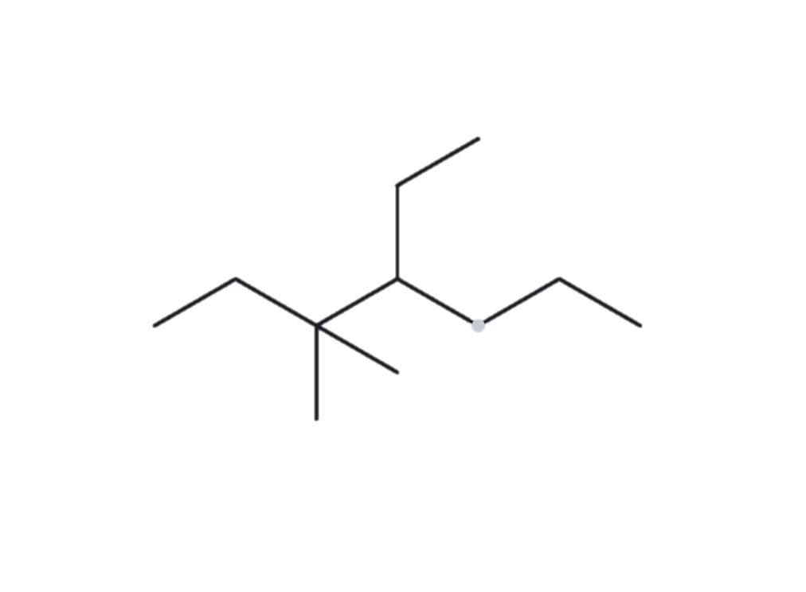
B07
DEVELOPING
4-ethyl-3,3-dimethylheptane
1 · NAME DECODED
2 · BOND-LINE STRUCTURE (THE ALKANE)
Parent: heptane → a 7-carbon chain
Substituents: ethyl on C4; methyl on C3; methyl on C3 (two methyl groups on the same carbon)
Expected Formula: 7 + 2 + 1 + 1 = 11 C; open chain → C₁₁H₂₄
3 · FORMULA CHECK
4 · BACK-CHECK
Counted from the Drawing: C₁₁H₂₄
Open Chain: CₙH₂ₙ₊₂ = 2(11) + 2 = C₁₁H₂₄ ✓
Returned by The Alkane: 4-ethyl-3,3-dimethylheptane
✓ Same as the Given Name
✓ ✓ ✓ ✓
☐ parent length ☐ substituent positions ☐ formula agrees ☐ back-check recorded

Slide 18
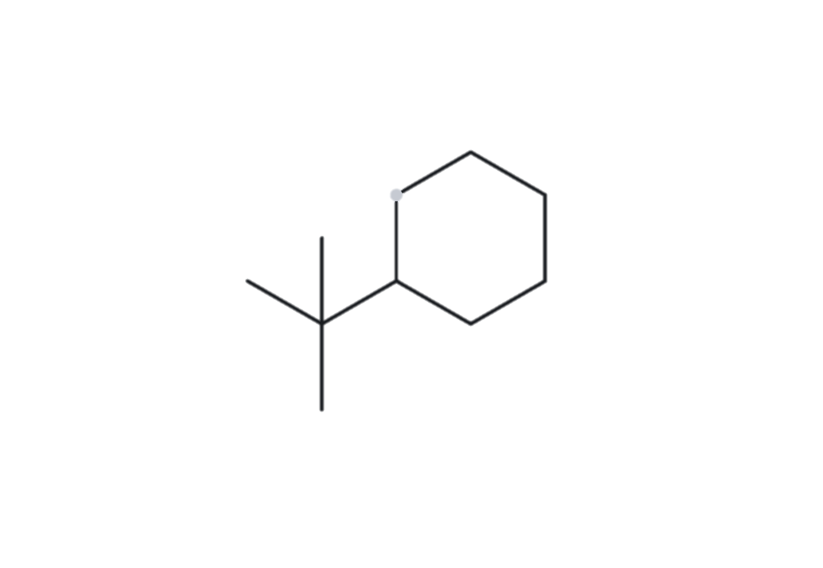
B08
CHALLENGE
tert-butylcyclohexane
1 · NAME DECODED
2 · BOND-LINE STRUCTURE (THE ALKANE)
Parent: cyclohexane → a 6-carbon ring
Substituents: tert-butyl on C1 (a single substituent on a ring needs no locant). tert-Butyl is a carbon carrying three methyl groups, (CH₃)₃C–, 4 carbons in all
Expected Formula: 6 + 4 = 10 C; one ring → C₁₀H₂₀
3 · FORMULA CHECK
4 · BACK-CHECK
Returned by The Alkane: (1,1-dimethylethyl)cyclohexane
✓ Same as the Given Name (1,1-dimethylethyl) is the systematic form of tert-butyl (Appendix B.3), so the names differ only in how the substituent is written
Counted from the Drawing: C₁₀H₂₀
One Ring: CₙH₂ₙ = C₁₀H₂₀ ✓
✓ ✓ ✓ ✓
☐ parent length ☐ substituent positions ☐ formula agrees ☐ back-check recorded

Slide 19
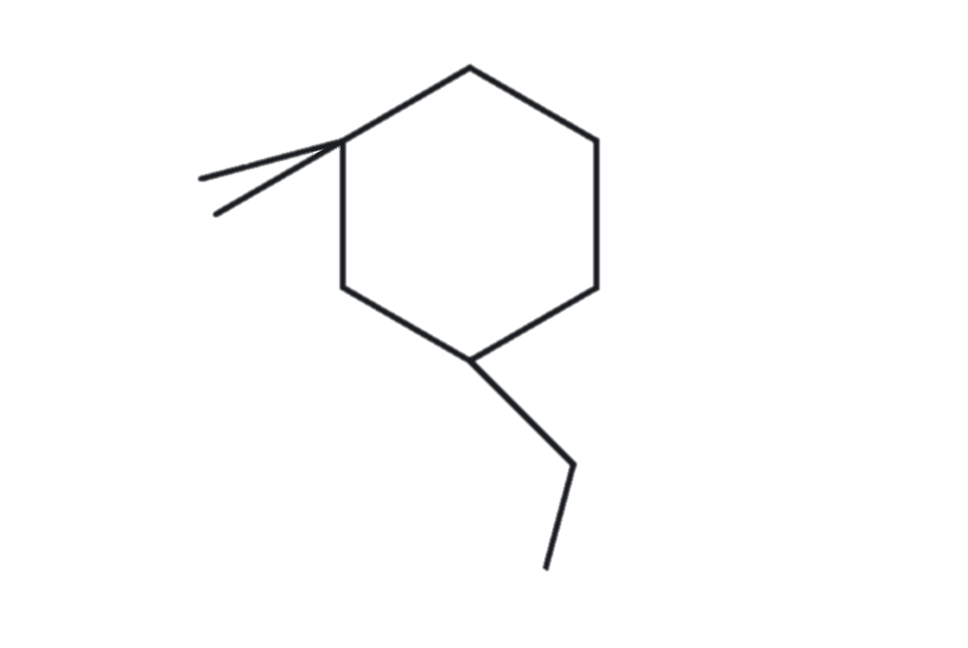
B09
CHALLENGE
3-ethyl-1,1-dimethylcyclohexane
1 · NAME DECODED
2 · BOND-LINE STRUCTURE (THE ALKANE)
Parent: cyclohexane → a 6-carbon ring
Substituents: ethyl on C3; methyl on C1; methyl on C1 (two methyl groups on the same carbon)
Expected Formula: 6 + 2 + 1 + 1 = 10 C; one ring → CₙH₂ₙ = C₁₀H₂₀
3 · FORMULA CHECK
4 · BACK-CHECK
Counted from the Drawing: C₁₀H₂₀
One Ring: CₙH₂ₙ = C₁₀H₂₀ ✓
Returned by The Alkane: 3-ethyl-1,1-dimethylcyclohexane
✓ Same as the Given Name
✓ ✓ ✓ ✓
☐ parent length ☐ substituent positions ☐ formula agrees ☐ back-check recorded

Slide 20
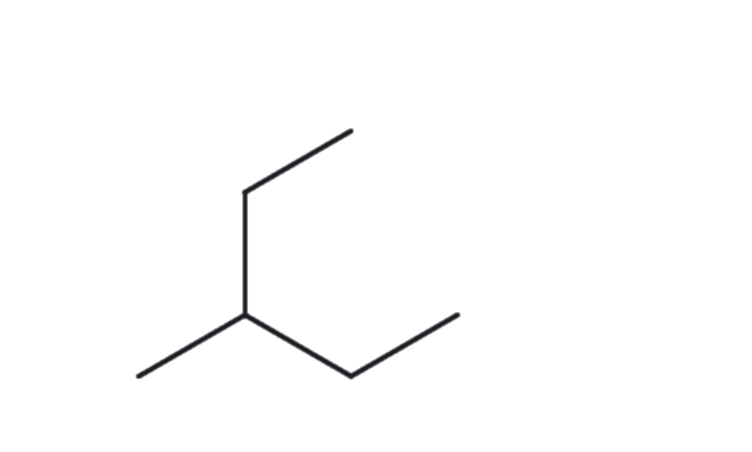
B10
CHALLENGE
2-ethylbutane
1 · NAME DECODED
2 · BOND-LINE STRUCTURE (THE ALKANE)
Parent: butane → a 4-carbon chain
Substituents: ethyl on C2
Expected Formula: 4 + 2 = 6 C; open chain → C₆H₁₄
3 · FORMULA CHECK
4 · BACK-CHECK
Returned by The Alkane: 3-methylpentane
✗ Differs from the given name
Correct Name: 3-methylpentane. The given name 2-ethylbutane breaks the longest-chain rule: the ethyl group on C2 extends the chain, so the longest continuous chain in the drawing is 5 carbons (pentane), not 4. The leftover single carbon is a methyl on C3.
Counted from the Drawing: C₆H₁₄
Open Chain: CₙH₂ₙ₊₂ = 2(6) + 2 = C₆H₁₄ ✓
✓ ✓ ✓ ✓
☐ parent length ☐ substituent positions ☐ formula agrees ☐ back-check recorded

