Slide 1
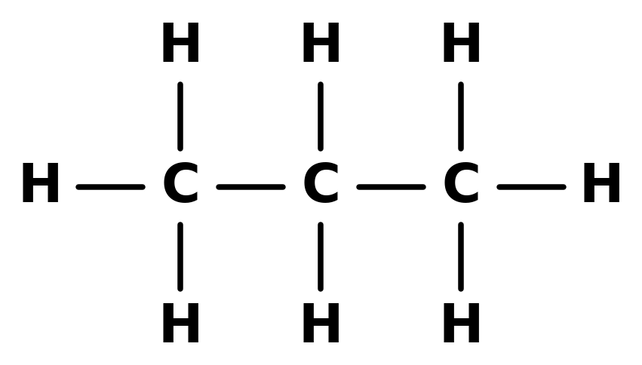
CARD 01 — PROPANE
Molecular Formula: C₃H₈
C₃H₈
Propane
11 atoms (3 C, 8 H)
CH₃CH₂CH₃
Notes:
Card 01: Propane, C3H8. Insert 001_propane_lastname.png in panel 4 and confirm all four panels show the same connectivity.

Slide 2
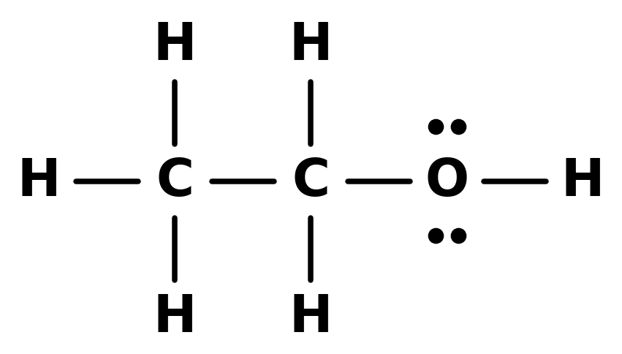

CARD 02 — ETHANOL
Molecular Formula: C₂H₆O
C₂H₆O
Ethanol
9 atoms (2 C, 6 H, 1 O)
CH₃CH₂OH
Notes:
Card 02: Ethanol, C2H6O. Insert 002_ethanol_lastname.png in panel 4 and confirm all four panels show the same connectivity.

Slide 3
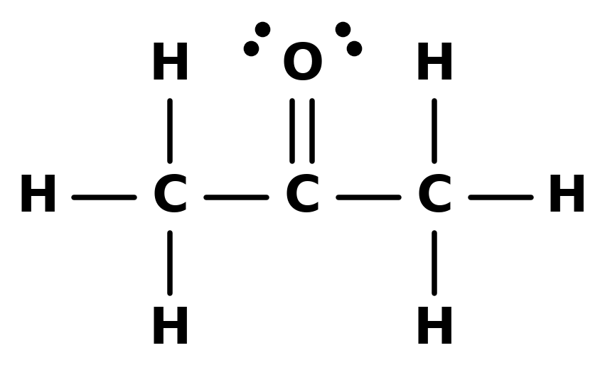

CARD 03 — ACETONE
Molecular Formula: C₃H₆O
C₃H₆O
Acetone (propan-2-one)
10 atoms (3 C, 6 H, 1 O)
CH₃COCH₃
also written (CH₃)₂C=O
Notes:
Card 03: Acetone (propan-2-one), C3H6O. Insert 003_acetone_lastname.png in panel 4 and confirm all four panels show the same connectivity.

Slide 4
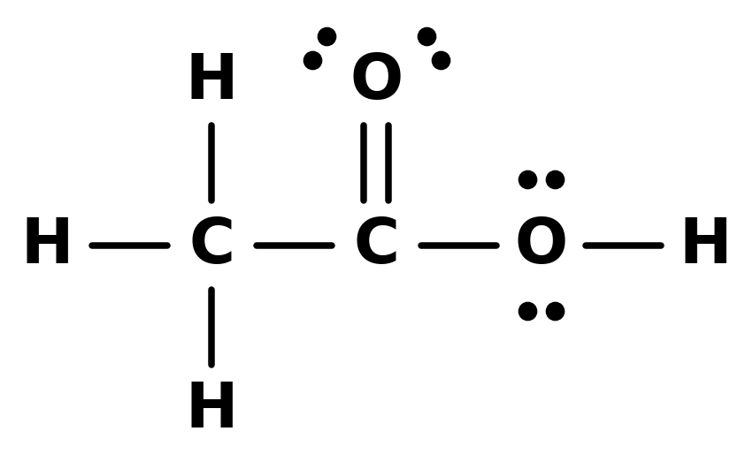

CARD 04 — ACETIC ACID
Molecular Formula: C₂H₄O₂
C₂H₄O₂
Acetic acid (ethanoic acid)
8 atoms (2 C, 4 H, 2 O)
CH₃COOH
Notes:
Card 04: Acetic acid (ethanoic acid), C2H4O2. Insert 004_acetic_acid_lastname.png in panel 4 and confirm all four panels show the same connectivity.

Slide 5
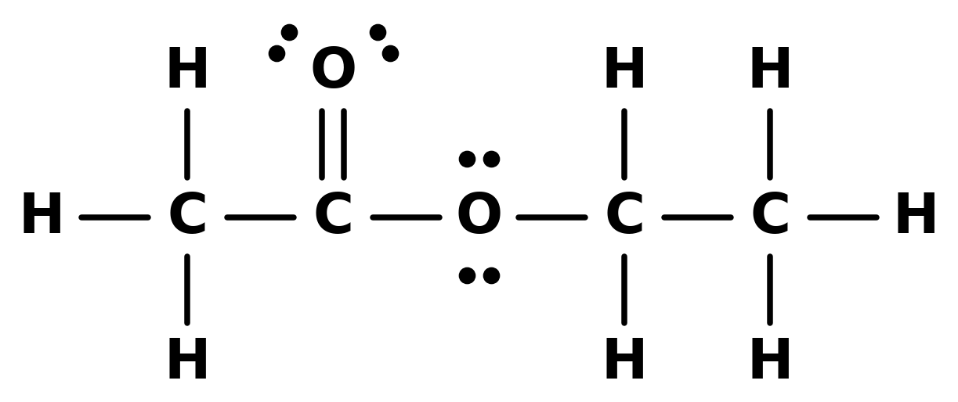

CARD 05 — ETHYL ACETATE
Molecular Formula: C₄H₈O₂
C₄H₈O₂
Ethyl acetate (ethyl ethanoate)
14 atoms (4 C, 8 H, 2 O)
CH₃COOCH₂CH₃
Notes:
Card 05: Ethyl acetate (ethyl ethanoate), C4H8O2. Insert 005_ethyl_acetate_lastname.png in panel 4 and confirm all four panels show the same connectivity.

Slide 6
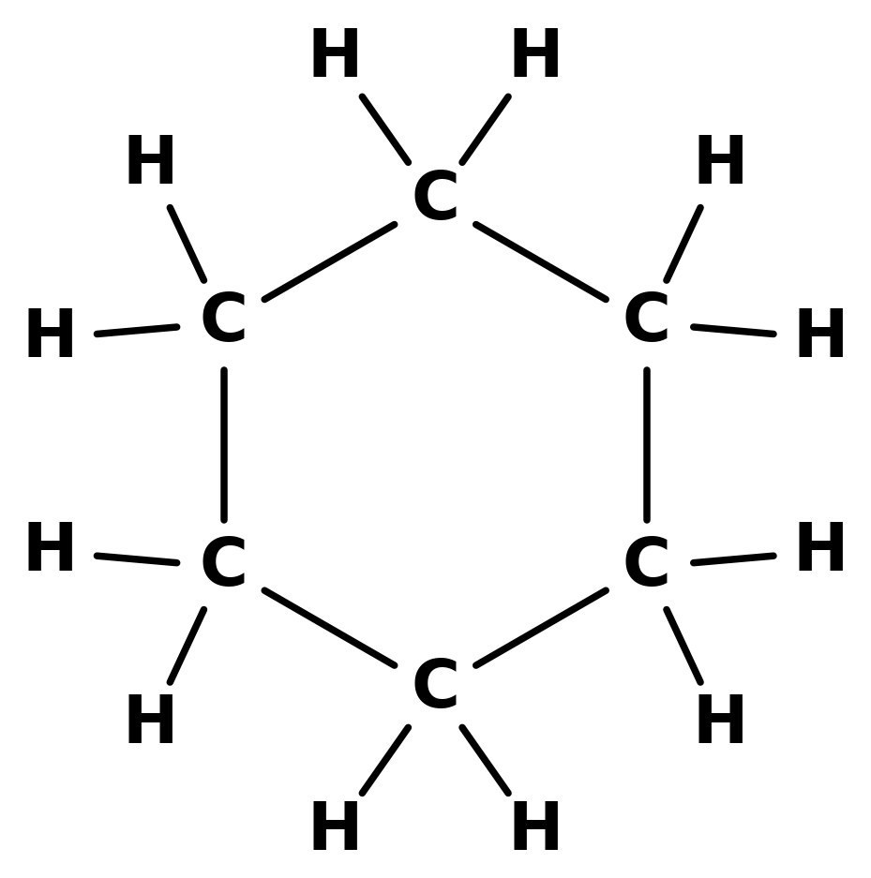

CARD 06 — CYCLOHEXANE
Molecular Formula: C₆H₁₂
C₆H₁₂
Cyclohexane
18 atoms (6 C, 12 H)
(CH₂)₆
ring of six CH₂ groups
Notes:
Card 06: Cyclohexane, C6H12. Insert 006_cyclohexane_lastname.png in panel 4 and confirm all four panels show the same connectivity.

Slide 7
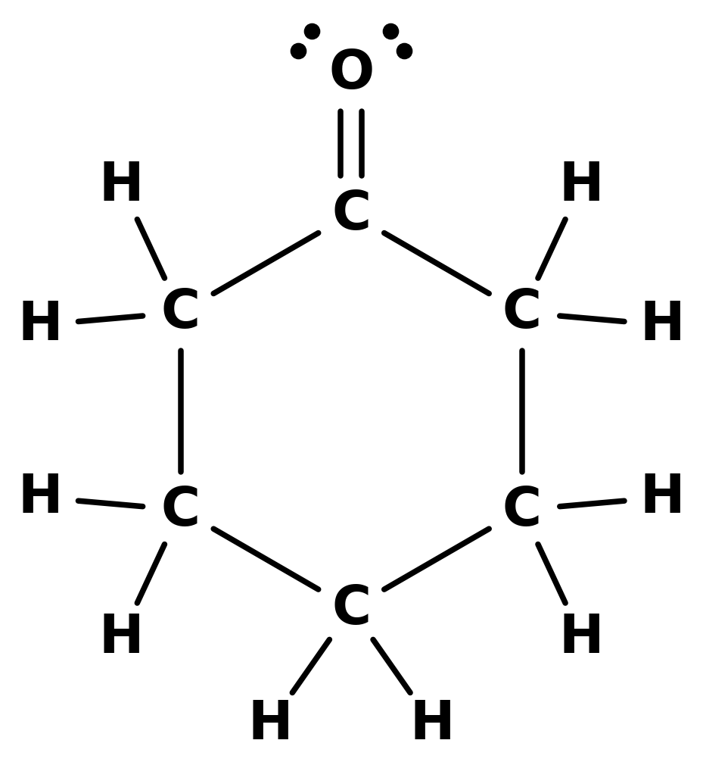

CARD 07 — CYCLOHEXANONE
Molecular Formula: C₆H₁₀O
C₆H₁₀O
Cyclohexanone
17 atoms (6 C, 10 H, 1 O)
(CH₂)₅C=O
ring of five CH₂ groups and one C=O
Notes:
Card 07: Cyclohexanone, C6H10O. Insert 007_cyclohexanone_lastname.png in panel 4 and confirm all four panels show the same connectivity.

Slide 8
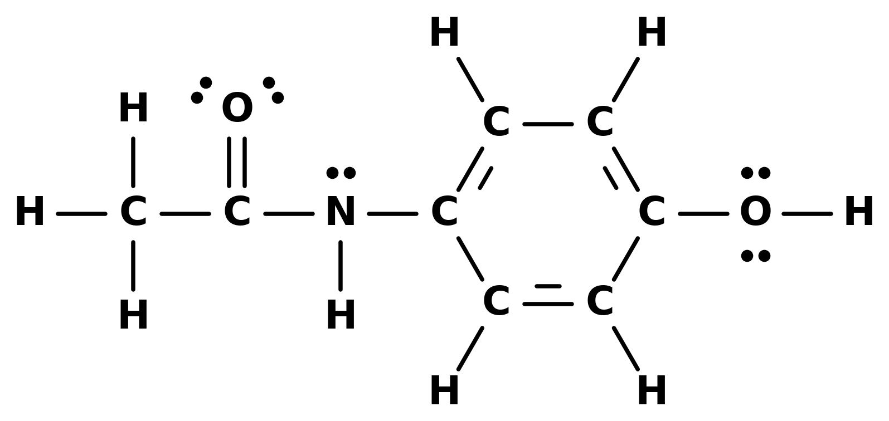
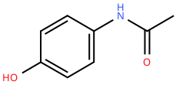
CARD 08 — ACETAMINOPHEN
Molecular Formula: C₈H₉NO₂
C₈H₉NO₂
Acetaminophen (paracetamol)
20 atoms (8 C, 9 H, 1 N, 2 O)
CH₃CONH–C₆H₄–OH
para (1,4) substitution on the ring
Notes:
Card 08: Acetaminophen (paracetamol), C8H9NO2. Insert 008_acetaminophen_lastname.png in panel 4 and confirm all four panels show the same connectivity.

Slide 9
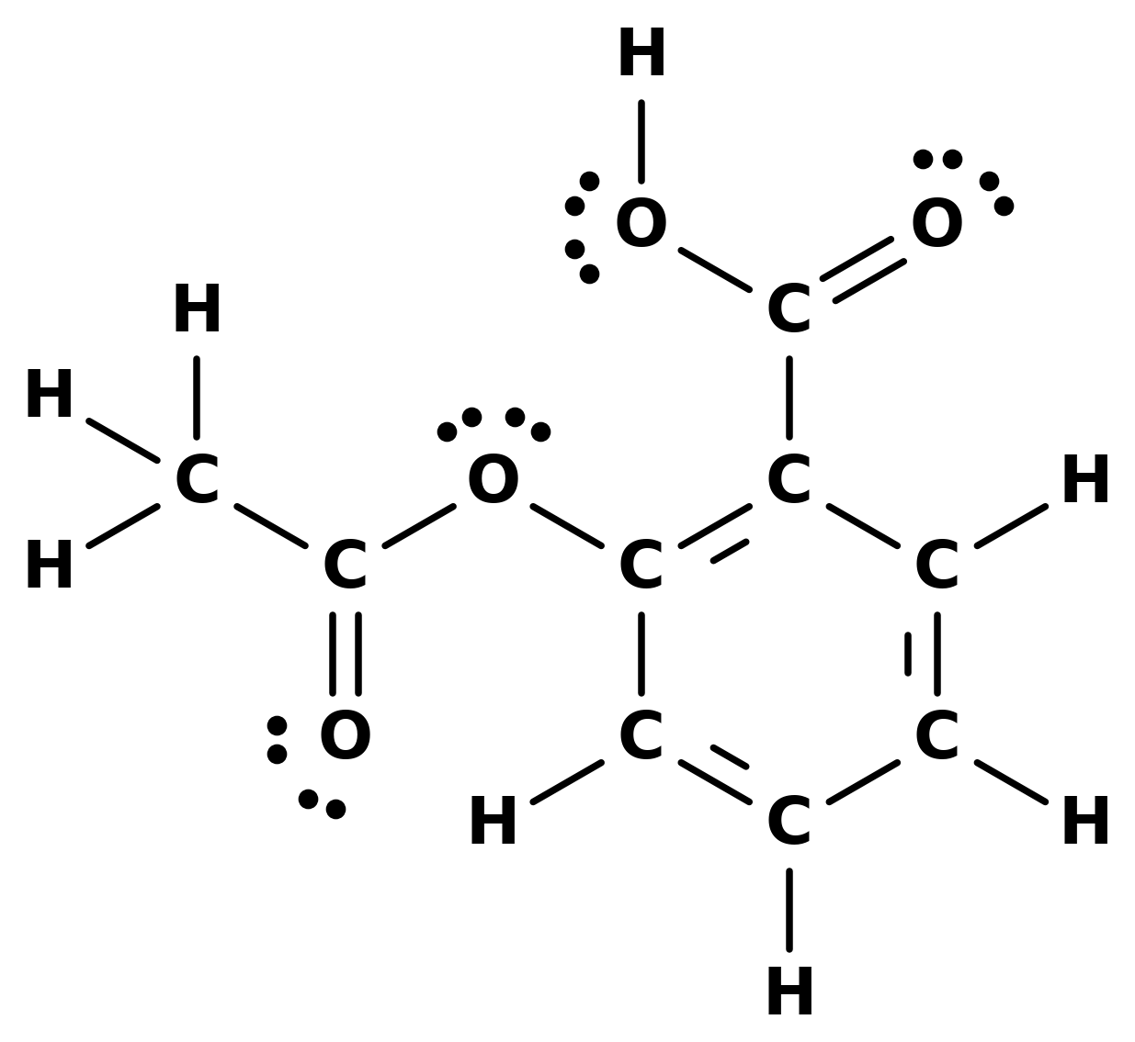
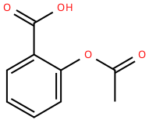
CARD 09 — ASPIRIN
Molecular Formula: C₉H₈O₄
C₉H₈O₄
Aspirin (acetylsalicylic acid)
21 atoms (9 C, 8 H, 4 O)
CH₃COO–C₆H₄–COOH
ortho (1,2) substitution on the ring
Notes:
Card 09: Aspirin (acetylsalicylic acid), C9H8O4. Insert 009_aspirin_lastname.png in panel 4 and confirm all four panels show the same connectivity.

Slide 10
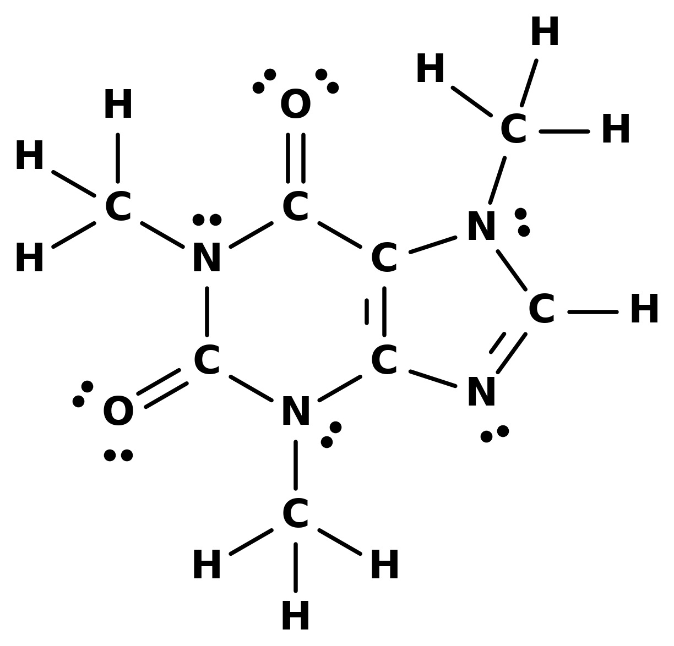
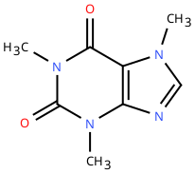
CARD 10 — CAFFEINE
Molecular Formula: C₈H₁₀N₄O₂
C₈H₁₀N₄O₂
Caffeine (1,3,7-trimethylxanthine)
24 atoms (8 C, 10 H, 4 N, 2 O)
N1(CH₃)–C2(=O)–N3(CH₃)–C4=C5–C6(=O)–N1
C4–N9=C8(H)–N7(CH₃)–C5
written with ring labels: six-membered ring on the first line, five-membered ring closed on the second
Notes:
Card 10: Caffeine (1,3,7-trimethylxanthine), C8H10N4O2. Insert 010_caffeine_lastname.png in panel 4 and confirm all four panels show the same connectivity.

