Slide 1
Network Traffic Classification & Attack Detection
Current model: BENIGN vs DDoS
Multi-attack-ready extension
Leakage-aware evaluation

Slide 2
Problem Statement
Network flows need to be classified by traffic type. The bundled benchmark is currently BENIGN vs DDoS.
Goal: automate traffic classification using measurable flow-level predictors.
The supplied raw file is the DDoS-specific CICIDS2017 capture slice. Other CICIDS2017 attack families require additional capture files and retraining.

Slide 3
Dataset
225,745 rows × 79 columns initially
After exact duplicate removal: 223,112 rows
DDoS: 128,016 (57.38%)
BENIGN: 95,096 (42.62%)
Target: Label | Current labels: BENIGN, DDoS | Multi-attack extension: combine the full CICIDS2017 attack files

Slide 4
Data Cleaning
Trim column names
Convert numeric fields safely
Replace ±infinity with missing values
Remove exact duplicate rows
Remove 10 constant numeric features
Median imputation inside model pipeline

Slide 5
EDA & Feature Selection
Class distribution
Packet and byte behavior
Timing/IAT behavior
TCP flag analysis
Correlation and redundancy
Mutual information ranking
Top 30 features selected using training data only

Slide 6
Models Evaluated
Decision Tree
Random Forest
Extra Trees
XGBoost
Soft Voting Ensemble
Metrics: Accuracy, Precision, Recall, F1, ROC-AUC

Slide 7
Leakage / Generalization Audit
Random row splits can overstate performance when identical flows/features cross train/test.
A StratifiedGroupKFold evaluation grouped identical cleaned numeric feature vectors.
Feature selection was fitted only on the training portion.
The supplied data lacks an explicit timestamp/session/flow-ID field, limiting stronger temporal validation.

Slide 8
Final Evaluation
Tuned XGBoost
Internal holdout accuracy: 99.9955%
Precision: 100.0000%
Recall: 99.9922%
F1: 99.9961%
ROC-AUC: 99.9980%
44,622 holdout flows

Slide 9
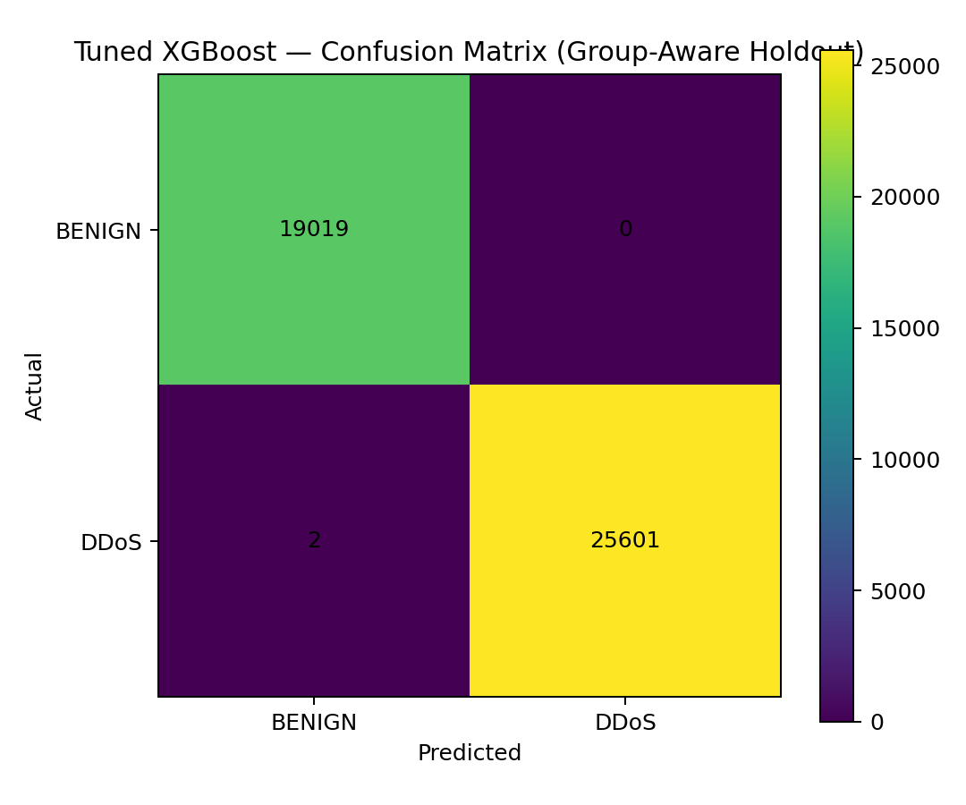
Confusion Matrix

Slide 10
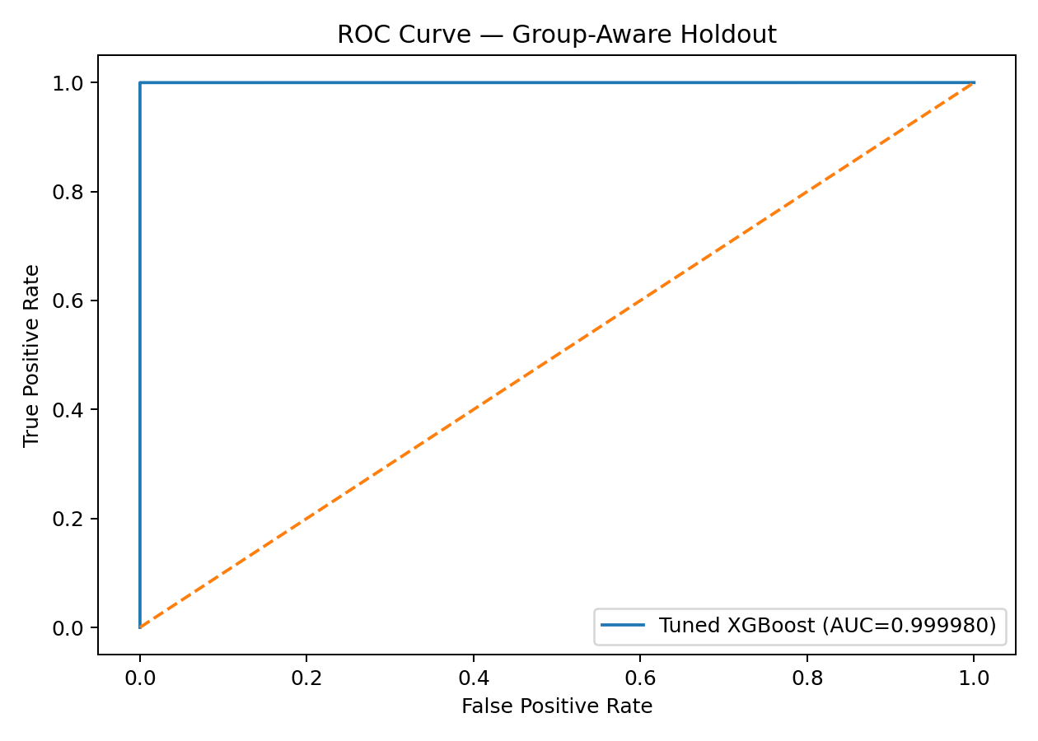
ROC Curve

Slide 11
Deployment
Final binary XGBoost model saved as ddos_xgboost_final.joblib
Streamlit app supports single-flow and CSV batch prediction
Application reports DDoS probability and predicted class for the bundled binary model
Next production step: external validation plus multi-attack retraining

Slide 12
Conclusion & Future Work
Use the model as a research prototype, not as guaranteed production accuracy.
Validate on independent contemporary traffic.
Add time/session identifiers when available.
Monitor drift and recalibrate thresholds.
Expand to true multi-attack classification using the combined CICIDS2017 attack files.

Slide 13
Why 99.99% should be read carefully
The reported accuracy is arithmetically correct: (19,019 TN + 25,601 TP) / 44,622 holdout flows = 99.995518%.
What this number is: an internal group-aware holdout benchmark from the supplied capture family.
What it is not: proof of production accuracy on a different network, date, or attack campaign.
The source package does not provide a timestamp/session/flow-ID field, so a true time-based or session-based external split cannot be reconstructed from the supplied materials.
For the next stage, report independent contemporary-capture results and per-attack metrics.

Slide 14
Why do two features dominate?
The model uses 30 selected features, not two.
The current XGBoost native importance assigns 98.67% of total importance to the top two features; the remaining features share 1.33%.
The bundled sample shows redundant CICFlowMeter feature pairs such as Subflow Fwd Bytes = Total Length of Fwd Packets and Avg Fwd Segment Size = Fwd Packet Length Mean.
A tree model can repeatedly split on one member of a redundant pair, making its native importance look much larger than the duplicate.
Reviewer interpretation: the top two are dominant for this dataset, while the other traffic, timing, port, packet-length and TCP-window features still provide supporting signal.

Slide 15
Multi-attack classification: what changes?
Current bundled model: BENIGN vs DDoS because the supplied raw file is the DDoS-specific CICIDS2017 slice.
True multi-class extension: merge the other CICIDS2017 capture files while preserving original labels.
Attack families available in the full dataset include FTP-Patator, SSH-Patator, DoS variants, Web attacks, Infiltration, Bot, PortScan and DDoS.
Modeling change: train a multi-class classifier and report macro-F1, per-class recall, confusion matrix, and class-wise support.
Deployment change: return attack type plus confidence instead of only DDoS probability.

