Slide 1
Network Traffic Classification
BENIGN vs DDoS
Machine Learning + Leakage-Aware Evaluation
Final project

Slide 2
Problem Statement
Network flows need to be classified as BENIGN or DDoS.
Goal: automate traffic classification using measurable flow-level predictors.
The supplied dataset contains packet, byte, timing, TCP flag, subflow and active/idle statistics.

Slide 3
Dataset
225,745 rows × 79 columns initially
After exact duplicate removal: 223,112 rows
DDoS: 128,016 (57.38%)
BENIGN: 95,096 (42.62%)
Target: Label

Slide 4
Data Cleaning
Trim column names
Convert numeric fields safely
Replace ±infinity with missing values
Remove exact duplicate rows
Remove 10 constant numeric features
Median imputation inside model pipeline

Slide 5
EDA & Feature Selection
Class distribution
Packet and byte behavior
Timing/IAT behavior
TCP flag analysis
Correlation and redundancy
Mutual information ranking
Top 30 features selected using training data only

Slide 6
Models Evaluated
Decision Tree
Random Forest
Extra Trees
XGBoost
Soft Voting Ensemble
Metrics: Accuracy, Precision, Recall, F1, ROC-AUC

Slide 7
Leakage / Generalization Audit
Random row splits can overstate performance when identical flows/features cross train/test.
A StratifiedGroupKFold evaluation grouped identical cleaned numeric feature vectors.
Feature selection was fitted only on the training portion.
The supplied data lacks an explicit timestamp/session/flow-ID field, limiting stronger temporal validation.

Slide 8
Final Evaluation
Tuned XGBoost
Accuracy: 99.9955%
Precision: 100.0000%
Recall: 99.9922%
F1: 99.9961%
ROC-AUC: 99.9980%

Slide 9
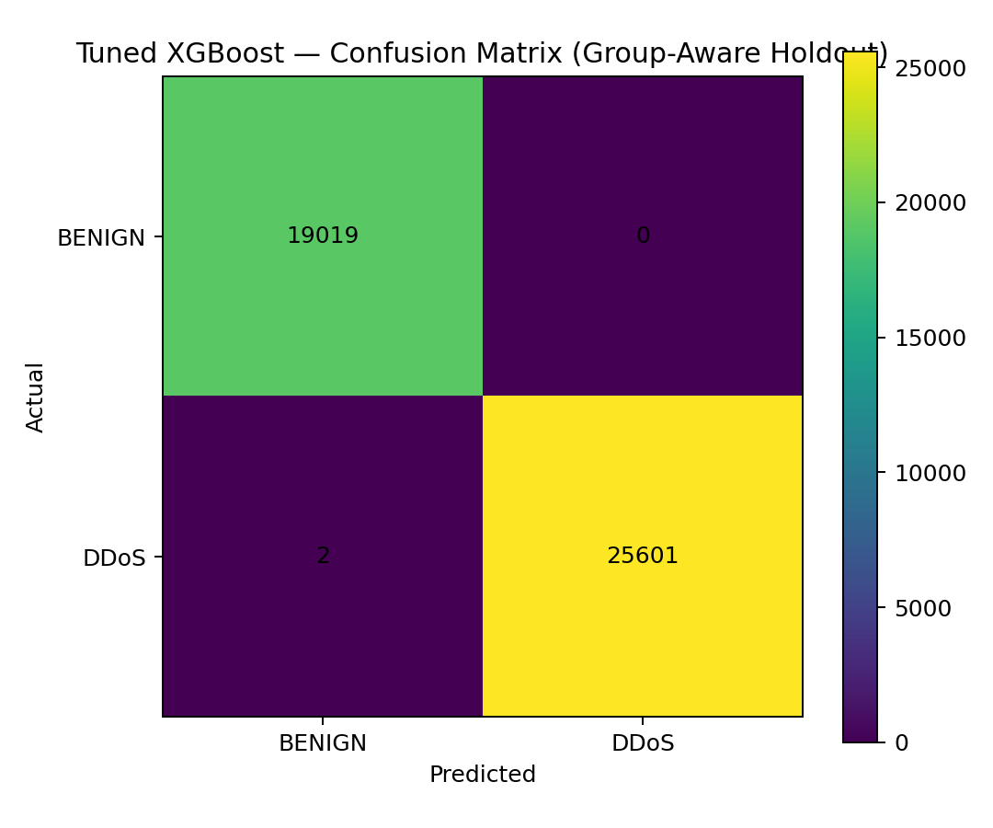
Confusion Matrix

Slide 10
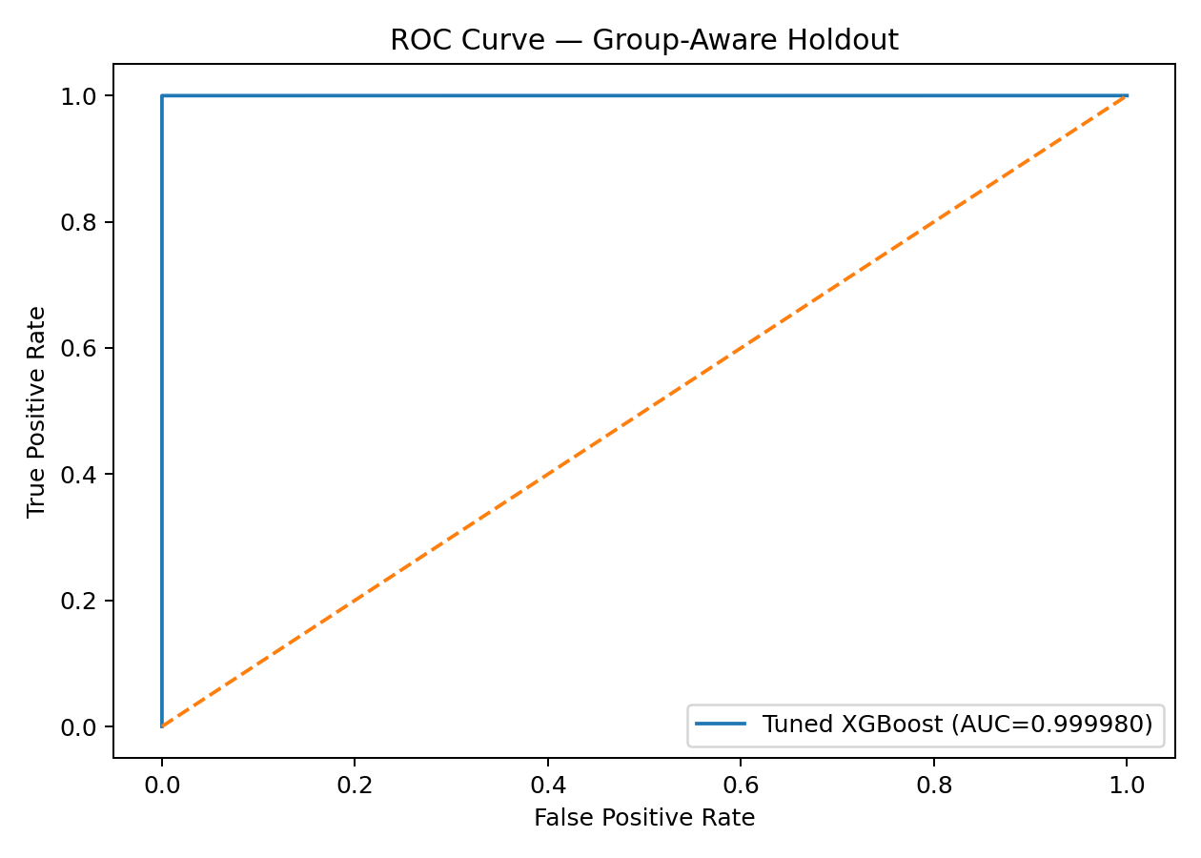
ROC Curve

Slide 11
Deployment
Final XGBoost model saved as ddos_xgboost_final.joblib
Streamlit app supports single-flow and CSV batch prediction
Application reports DDoS probability and predicted class
Next production step: validate on an independent contemporary capture

Slide 12
Conclusion & Future Work
Use the model as a research prototype, not as a guaranteed production detector.
Validate across different networks and attack campaigns.
Add time/session identifiers when available.
Monitor drift and recalibrate thresholds.
Expand to multiclass attack detection and real-time telemetry.

