Slide 1
PIP CSE7301 - INTERNSHIP Review-0 Presentation INTERNSHIP MANAGEMENT SYSTEM
Student Details
Name | TRISHANYA
Roll No | 20211CSE0361
Section | 8CSE04
Batch No. | CSE-37
Under the Supervision of,
Ms. Rakheeba Taseen
Assistant Professor
School of Computer Science and Engineering
Presidency University
Name of the Program: BTech
Name of the HoD: Dr. Asif Mohammad
Name of the School Internship: Mr. Md Ziaur Rahman /Dr. Sampath A K

Slide 2
Content
About Company or Organization
Working domain or the technology
About your team and reporting Manager
Challenges Faced in Internship
Objectives of the work
Internship Roadmap
Github Link

Slide 3
About Company or Organization
The Rail Wheel Factory (RWF) in Yelahanka, Bangalore, is a government-owned company under
the Ministry of Railways, India. It plays a crucial role in manufacturing high-quality railway wheels and axles.
RWF is an integral part of the Indian Railways' supply chain, ensuring the production of wheels and axles
used in trains across the country.
Established: 1984
Location: Yelahanka, Bangalore, Karnataka, India
Ownership: Indian Railways
Parent Company: Rail Coach Factory, Kapurthala (for certain products)

Slide 4
Clients:
Primary Client: Indian Railways, which is the largest customer, utilizing RWF’s products for its extensive rail network.
Exports: The factory also exports products to various countries, contributing to the global railway industry.
Other Sectors: The factory may supply to other clients in sectors like defense, metro systems, and other rail operators.

Slide 5
Working domain or the technology
During Full Stack internship at RWF, I am working with Dapper to perform CRUD operations (Create, Read, Update, Delete) on the database. Dapper is a lightweight ORM for .NET that helps execute SQL queries efficiently while mapping results to C# objects
Notes:
It's fast, flexible, and ideal for high-performance applications, making it perfect for handling real-time production data, inventory, and maintenance records. By using Dapper, you can easily interact with relational databases, optimizing data access and improving performance. Your work helps streamline processes such as tracking production, managing inventory, and ensuring smooth maintenance operations in the factory.

Slide 6
About your team and reporting Manager
Reporting Manager: Prasad Rao Sir , MI center

Slide 7
Challenges Faced in Internship
One of the biggest challenges was identifying a suitable internship. With limited openings and high competition, it required extensive research and effort.
I had to explore multiple job portals, reach out for referrals, and tailor my resume and cover letters to suit each specific role.
I had to quickly adapt to the team’s communication style, tools, and collaboration methods. This experience significantly improved my professional and interpersonal skills.

Slide 8
Objectives of the work
To automate the creation of internship batches using college name, course, and period.
To enable easy addition, editing, and deletion of student records under each batch.
To track and manage attendance for each student effectively.
To generate and download student offer letter in PDF format.

Slide 9
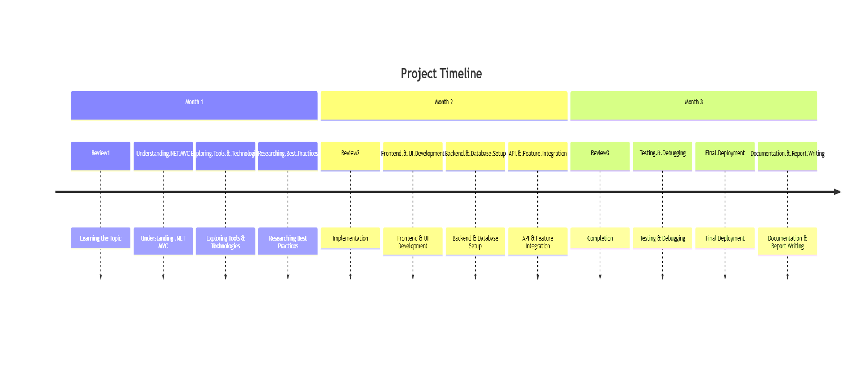
Internship Road Map

Slide 10
Github Link
https://github.com/trishanya921/internship-management-system

Slide 11
Q&A

Slide 12
Thank you !!

