Slide 1
PIP CSE7301 - INTERNSHIP
Review-2 Presentation
INTERNSHIP MANAGEMENT SYSTEM
Student Details
Name | TRISHANYA
Roll No | 20211CSE0361
Section | 8CSE04
Batch No. | CSE-37
Under the Supervision of,
Ms. Rakheeba Taseen
Assistant Professor
School of Computer Science and Engineering
Presidency University
Name of the Program: BTech
Name of the HoD: Dr. Asif Mohammad
Name of the School Internship: Mr. Md Ziaur Rahman /Dr. Sampath A K

Slide 2
Content
Title
Abstract
Review of literature
Objectives
Problem identification, and formulation of problem statement.
Road map, impact and advantages of the proposed work. (Time Line by GanttChart).
References

Slide 3
Title
INTERNSHIP MANAGEMENT SYSTEM

Slide 4
Abstract
The Internship Management System is a web-based application designed to simplify and automate the management of student internships. It enables the creation of internship batches, management of student records, attendance tracking, and PDF report generation. Built using ASP.NET Core MVC, Dapper, and SQL Server, the system ensures accuracy, efficiency, and ease of use for coordinators and administrators.

Slide 5
Review of Literature
Traditional monolithic web development faces challenges in scalability and maintenance.
MVC is widely adopted due to its structured approach and testability.
Studies highlight that .NET MVC offers better security features, performance optimization, and third-party integrations .
Case studies from Microsoft and other enterprises showcase successful implementation in large-scale projects.

Slide 6
Objectives of the work
To automate the creation of internship batches using college name, course, and period.
To enable easy addition, editing, and deletion of student records under each batch.
To track and manage attendance for each student effectively.
To generate and download student offer letter in PDF format.

Slide 7
Problem Identification and Formulation
Challenges in Traditional Web Development
  Lack of scalability in large applications.
  Security vulnerabilities in data handling.
  Complexity in managing code and UI updates.
Problem Statement
"How can .NET MVC be leveraged to build secure, scalable, and maintainable websites with enhanced performance?"

Slide 8
Roadmap and Proposed Work
Technology Stack
  Framework: .NET MVC
  Programming Language: C#
  Database: Firebase , MySQL
  Frontend: Bootstrap, HTML, CSS, JavaScript
  Tools: Visual Studio, Visual Studio Community, Sql Server management studio

Slide 9
Development Phases
  Requirement Gathering & System Design
  Frontend & UI Design
  Backend Development (Models, Controllers, Database)
  Testing & Debugging
  Deployment & Maintenance

Slide 10
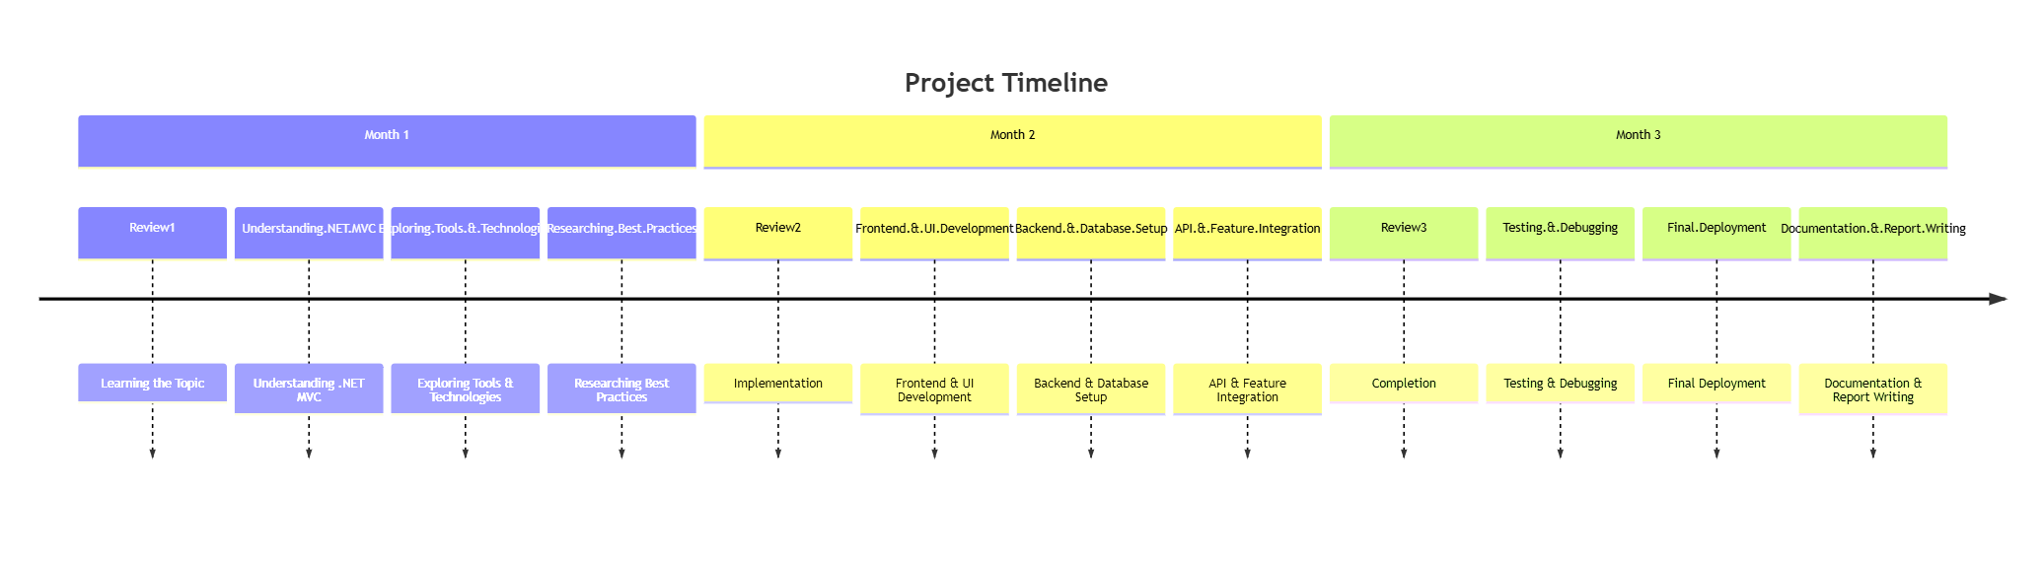
Timeline Gantt Chart

Slide 11
Impact and Advantages of Proposed Work
Impact
  Provides a structured development approach for future applications.
  Ensures better security and performance in web applications.
Advantages of Using .NET MVC
  Separation of concerns: Easier to maintain and scale.
  Built-in security: Protects against SQL injection & cross-site scripting (XSS).
  Faster development: Code reusability speeds up project completion.
  Integration with databases & third-party APIs.

Slide 12
References
Microsoft Documentation: https://learn.microsoft.com/en-us/aspnet/mvc/overview/
.NET Official Site: https://dotnet.microsoft.com/
Research Paper on MVC Frameworks in Web Development

Slide 13

Q&A

Slide 14
Thank you !!

